Slide 1
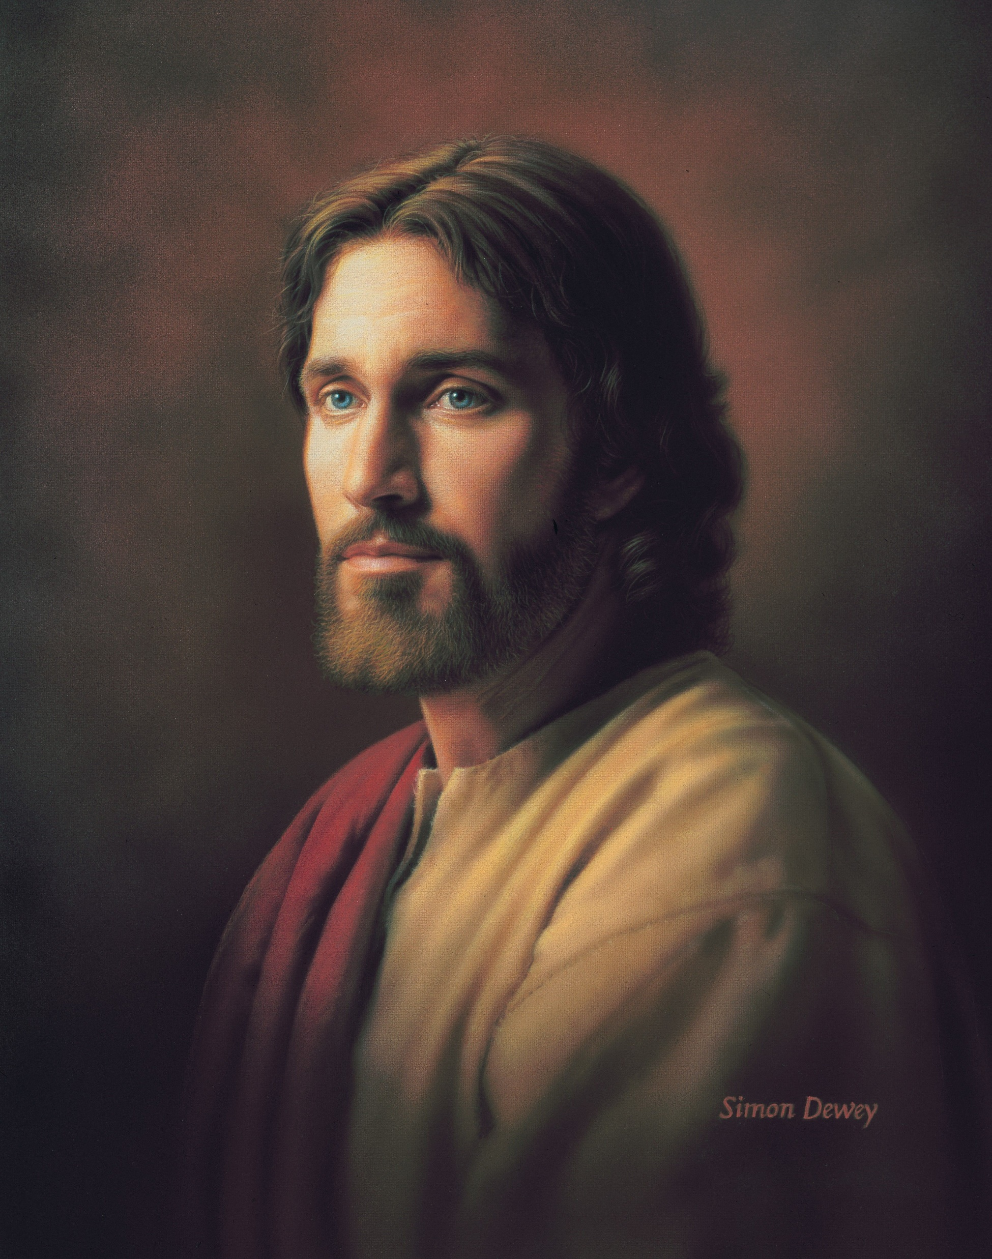
Behold, the Great Redeemer Die Hymn #191, Verse 1 Text: Eliza R. Snow Music: George Careless Flipchart compiled by Cherice Montgomery

Slide 2
Behold, the great Redeemer die,
Notes:
Dewey, Simon. (n.d.). Divine Redeemer, by Simon Dewey. The Church of Jesus Christ of Latter-Day Saints Media Library. Retrieved Jun. 23, 2023 from https://pacific.churchofjesuschrist.org/8-things-about-jesus-christs-atoning-sacrifice

Slide 3
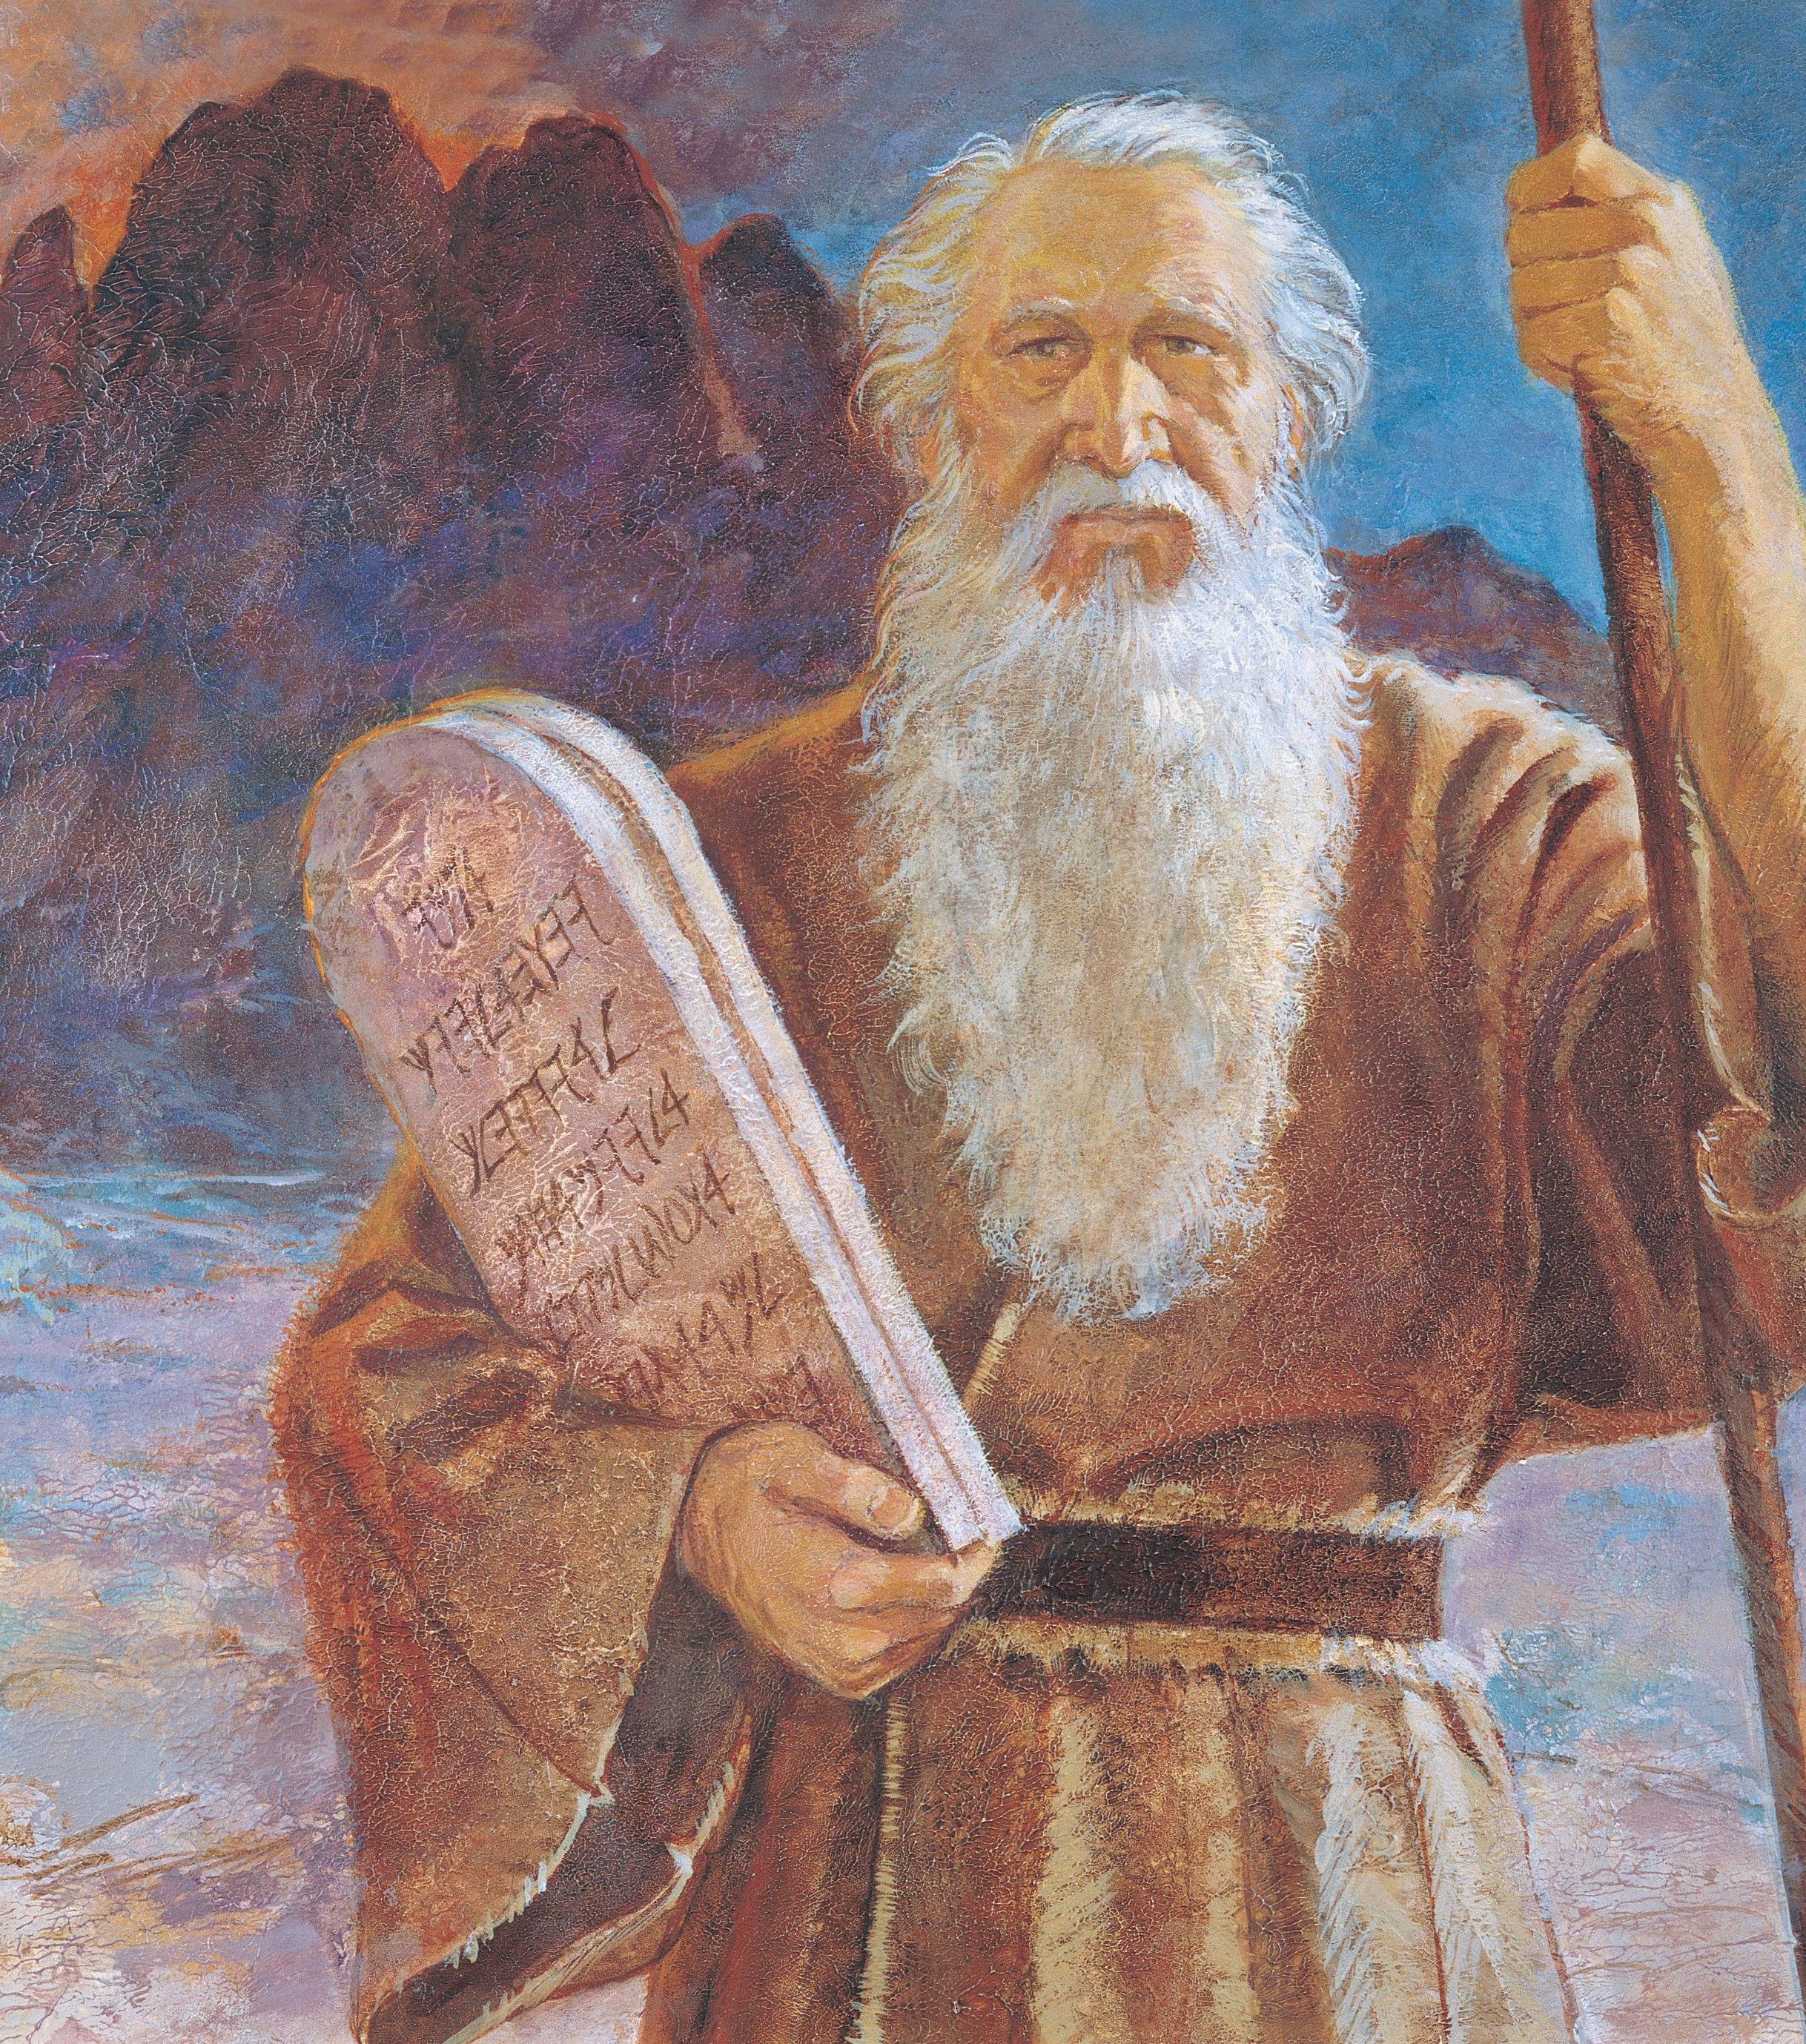
A broken law to satisfy.
Notes:
Harston, Jerry. (n.d.). Moses and the Tablets, by Jerry Harston; GAB 14; Primary manual 6-24; Exodus 19–20. The Church of Jesus Christ of Latter-Day Saints Media Library. Retrieved Jun. 23, 2023 from https://www.churchofjesuschrist.org/media/image/moses-ten-commandments-1717b4a?lang=eng&collectionId=65a92c1051e01cb5bea39a2451a9310ba63e01a2

Slide 4
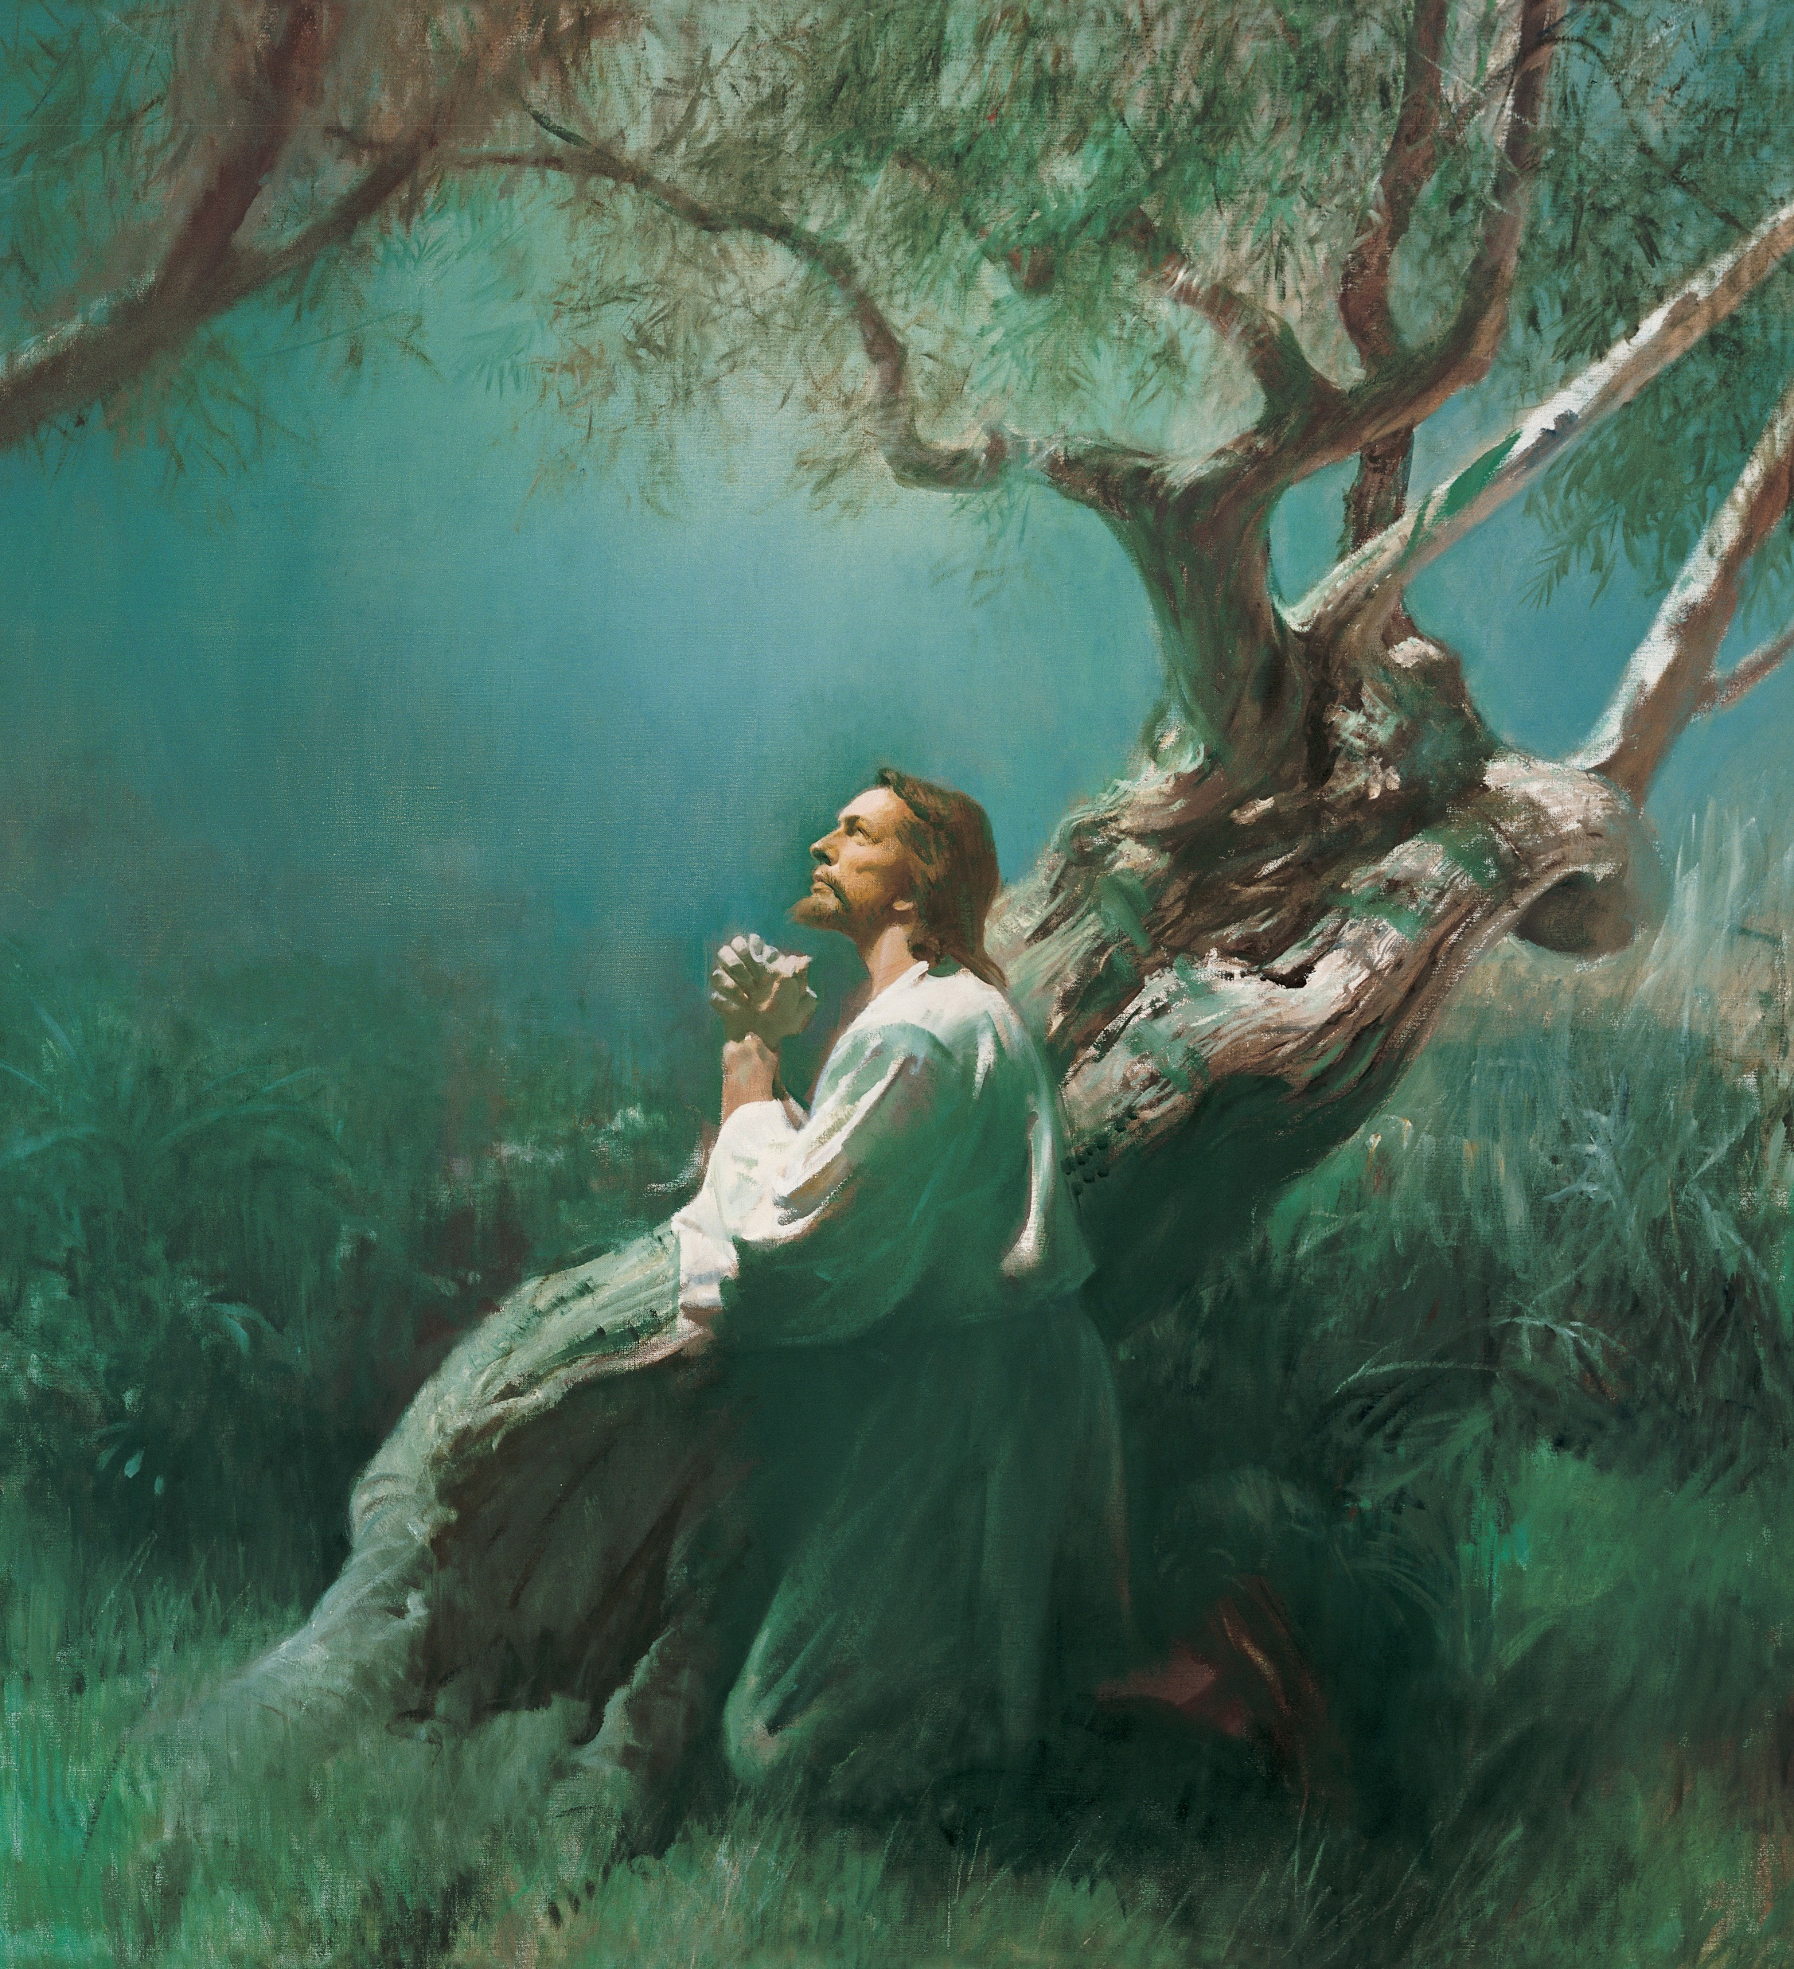
He dies a sacrifice for sin,
Notes:
Anderson, Harry. (n.d.). Jesus Praying in Gethsemane (Christ in Gethsemane), by Harry Anderson (62175); GAB 56; GAK 227; Primary manual 1-72; Primary manual 2-52; Primary manual 3-46; Primary manual 6-47; Primary manual 7-30; Matthew 26:36–45; Luke 22:39–46; Alma 7:11–13. The Church of Jesus Christ of Latter-day Saints Media Library. Retrieved Jun. 23, 2023 from https://www.churchofjesuschrist.org/media/image/jesus-praying-in-gethsemane-e32f582?lang=eng&collectionId=e1e5a0ca39f8cd49eddffddcb9e294a689d12b88

Slide 5
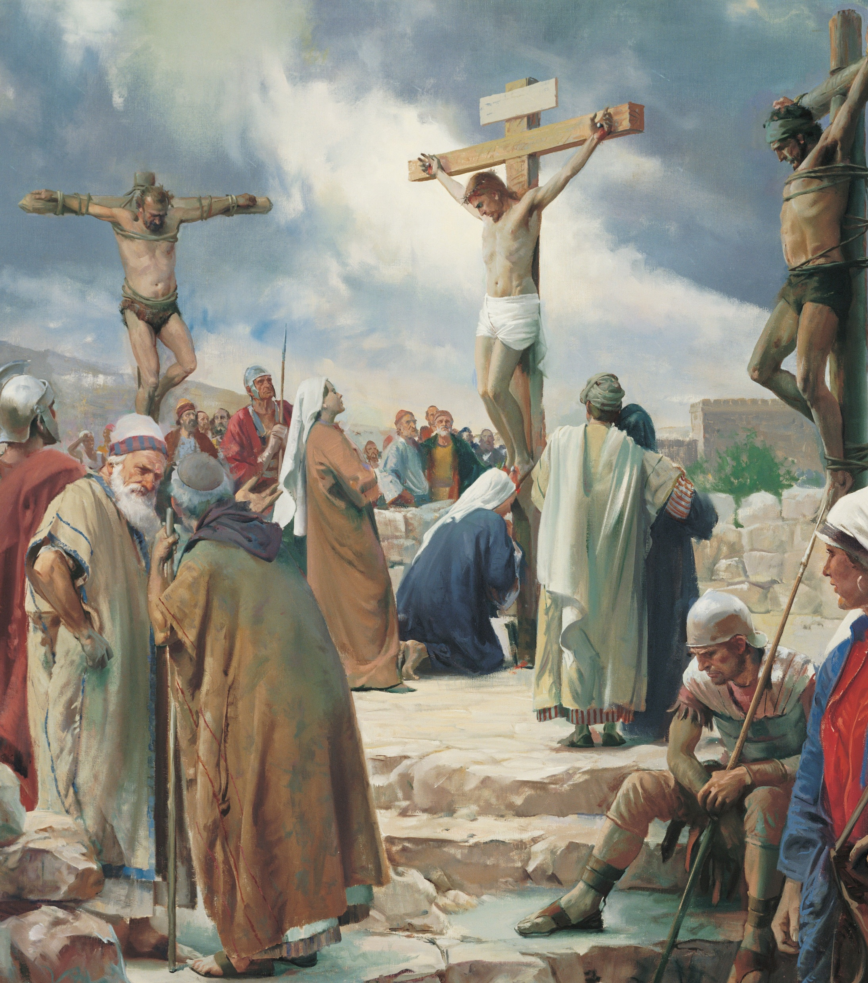
He dies a sacrifice for sin,
Notes:
Anderson, Harry. (n.d.). The Crucifixion, by Harry Anderson (62505); GAK 230; GAB 57; Primary manual 1-59; Primary manual 2-61; Primary manual 3-71; Primary manual 4-11; Primary manual 6-27; Primary manual 7-33; Psalm 22:16; Matthew 27:31–50; Mark 15:20–37; Luke 23:33–46; John 19:16–37; 1 Nephi 19:10; 2 Nephi 5; 6:9; 10:3; 25:13; Mosiah 3:9; 15:7. The Church of Jesus Christ of Latter-day Saints Media Library. Retrieved Jun. 23, 2023 from https://www.churchofjesuschrist.org/media/image/crucifixion-christ-anderson-43dad9f?lang=eng&collectionId=e1e5a0ca39f8cd49eddffddcb9e294a689d12b88

Slide 6
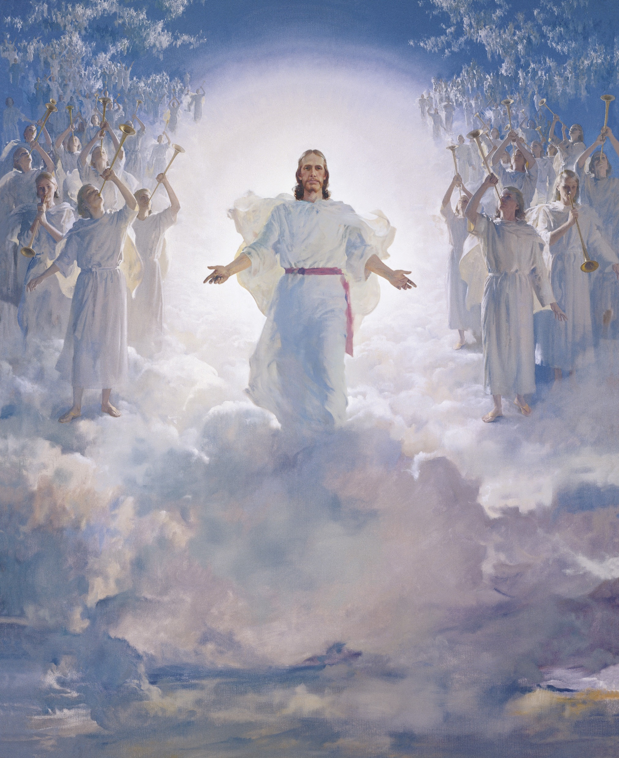
That man may live and glory win.
Notes:
Anderson, Harry. (n.d.). The Second Coming, by Harry Anderson (62562); GAK 238; GAB 66; Primary manual 5-28; Primary manual 6-28; Primary manual 7-25; Matthew 16:27; 24:30–31; 25:31. The Church of Jesus Christ of Latter-day Saints. Retrieved Jun. 23, 2023 from https://www.churchofjesuschrist.org/media/image/the-second-coming-a824e2d?lang=eng&collectionId=e1e5a0ca39f8cd49eddffddcb9e294a689d12b88

Slide 7
Image Credits:
Anderson, Harry. (n.d.). The Crucifixion, by Harry Anderson (62505); GAK 230; GAB 57; Primary manual 1-59; Primary manual 2-61; Primary manual 3-71; Primary manual 4-11; Primary manual 6-27; Primary manual 7-33; Psalm 22:16; Matthew 27:31–50; Mark 15:20–37; Luke 23:33–46; John 19:16–37; 1 Nephi 19:10; 2 Nephi 5; 6:9; 10:3; 25:13; Mosiah 3:9; 15:7. The Church of Jesus Christ of Latter-day Saints Media Library. Retrieved Jun. 23, 2023 from https://www.churchofjesuschrist.org/media/image/crucifixion-christ-anderson-43dad9f?lang=eng&collectionId=e1e5a0ca39f8cd49eddffddcb9e294a689d12b88
Anderson, Harry. (n.d.). Jesus Praying in Gethsemane (Christ in Gethsemane), by Harry Anderson (62175); GAB 56; GAK 227; Primary manual 1-72; Primary manual 2-52; Primary manual 3-46; Primary manual 6-47; Primary manual 7-30; Matthew 26:36–45; Luke 22:39–46; Alma 7:11–13. The Church of Jesus Christ of Latter-day Saints Media Library. Retrieved Jun. 23, 2023 from https://www.churchofjesuschrist.org/media/image/jesus-praying-in-gethsemane-e32f582?lang=eng&collectionId=e1e5a0ca39f8cd49eddffddcb9e294a689d12b88
Anderson, Harry. (n.d.). The Second Coming, by Harry Anderson (62562); GAK 238; GAB 66; Primary manual 5-28; Primary manual 6-28; Primary manual 7-25; Matthew 16:27; 24:30–31; 25:31. The Church of Jesus Christ of Latter-day Saints. Retrieved Jun. 23, 2023 from https://www.churchofjesuschrist.org/media/image/the-second-coming-a824e2d?lang=eng&collectionId=e1e5a0ca39f8cd49eddffddcb9e294a689d12b88
Dewey, Simon. (n.d.). Divine Redeemer, by Simon Dewey. The Church of Jesus Christ of Latter-Day Saints Media Library. Retrieved Jun. 23, 2023 from https://pacific.churchofjesuschrist.org/8-things-about-jesus-christs-atoning-sacrifice
Harston, Jerry. (n.d.). Moses and the Tablets, by Jerry Harston; GAB 14; Primary manual 6-24; Exodus 19–20. The Church of Jesus Christ of Latter-Day Saints Media Library. Retrieved Jun. 23, 2023 from https://www.churchofjesuschrist.org/media/image/moses-ten-commandments-1717b4a?lang=eng&collectionId=65a92c1051e01cb5bea39a2451a9310ba63e01a2
The Church of Jesus Christ of Latter-day Saints. (2021, Jul. 6). President Dallin H. Oaks: ‘Inspired and unique constitution.’ Newsroom. Retrieved Jun. 23, 2023 from https://newsroom.churchofjesuschrist.org/article/president-dallin-h-oaks-inspired-and-unique-constitution
The Church of Jesus Christ of Latter-day Saints. (n.d.). Eight things to remember about Jesus’s atoning sacrifice. The Church of Jesus Christ of Latter-day Saints: Pacific. Retrieved Jun. 23, 2023 from https://pacific.churchofjesuschrist.org/8-things-about-jesus-christs-atoning-sacrifice

