Slide 1
Dance Move Signs

Slide 2
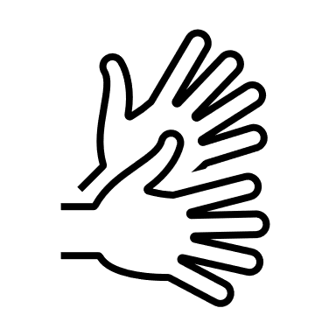
Brush

Slide 3
Clap

Slide 4
Grapevine

Slide 5
Left

Slide 6
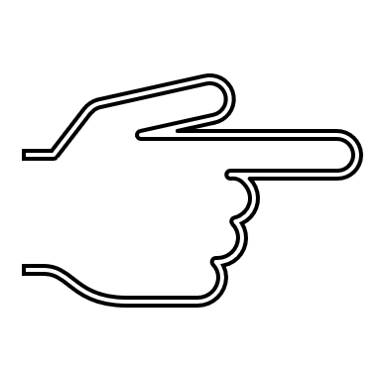
Point

Slide 7
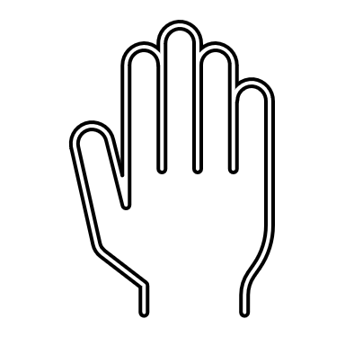
Pat

Slide 8
Right

Slide 9
Spin

Slide 10
Thumbs up

Slide 11
Turn

Slide 12
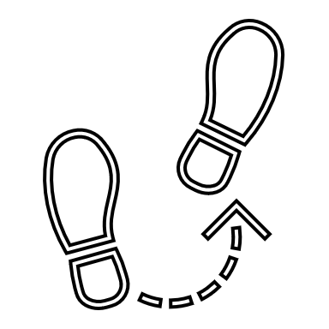
Step

Slide 13
Tap

Slide 14
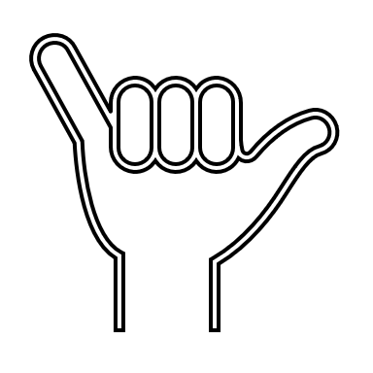
Wag

Slide 15
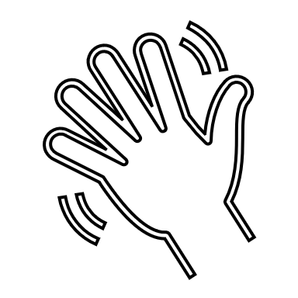
Wave

Slide 16
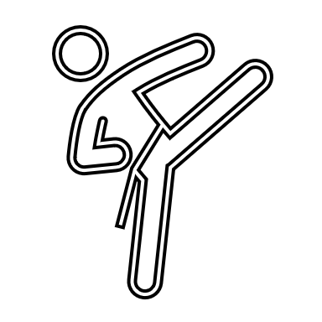
Kick

Slide 17
Dance Freestyle

