Slide 1
Dare to Do Right Children’s Songbook, p. 158
Words: George L. Taylor Music: William B. Bradbury Flipchart: Cherice Montgomery
Notes:
The Church of Jesus Christ of Latter-Day Saints. (n.d). Tithing: A person puts tithing in a tithing envelope. The Church of Jesus Christ of Latter-Day Saints Media Library. Retrieved Jun. 23, 2023 from https://www.churchofjesuschrist.org/media/image/tithes-offerings-illustration-fdfbb38?lang=eng&collectionId=408040e2e846420e8df818f3169c9543

Slide 2
Dare to do right!
Notes:
The Church of Jesus Christ of Latter-Day Saints. (n.d). Obedience: Choose the right: An illustration of the CTR symbol. The Church of Jesus Christ of Latter-Day Saints Media Library. Retrieved Jun. 23, 2023 from https://www.churchofjesuschrist.org/media/image/ctr-logo-62da351?lang=eng&collectionId=28d3f141a27f495281ed04d6ae40d8b4

Slide 3
Dare to be true,
Notes:
The Church of Jesus Christ of Latter-Day Saints. (n.d). Faith in Jesus Christ: An illustration of a boy looking at a portrait of Jesus. The Church of Jesus Christ of Latter-Day Saints Media Library. Retrieved Jun. 23, 2023 from https://www.churchofjesuschrist.org/media/image/boy-portrait-jesus-8a8dead?lang=eng&collectionId=28d3f141a27f495281ed04d6ae40d8b4

Slide 4
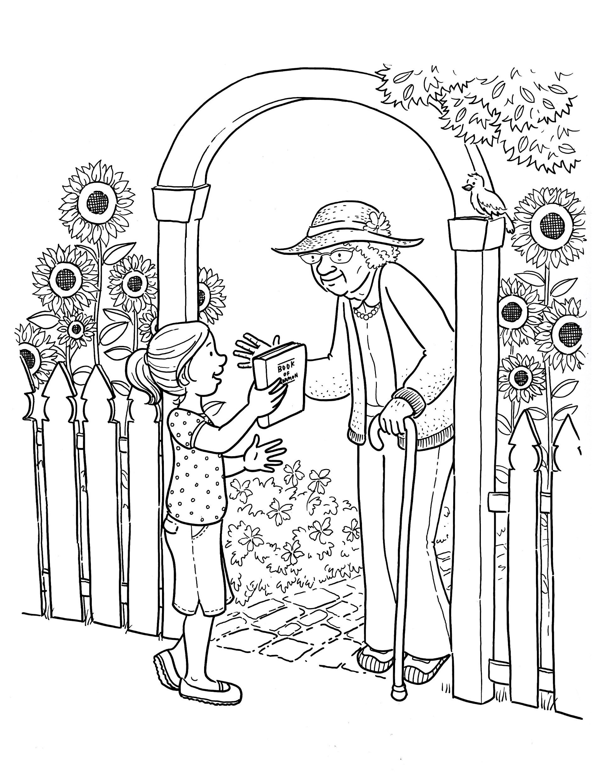
You have a work that no other can do;
Notes:
The Church of Jesus Christ of Latter-Day Saints. (n.d). Sharing the Book of Mormon: A girl gives an elderly woman a copy of the Book of Mormon. The Church of Jesus Christ of Latter-Day Saints Media Library. Retrieved Jun. 23, 2023 from https://www.churchofjesuschrist.org/media/image/girl-man-coloring-page-stott-5831133?lang=eng&collectionId=6819ec5df2c64c63bf29fdbba3c60125

Slide 5
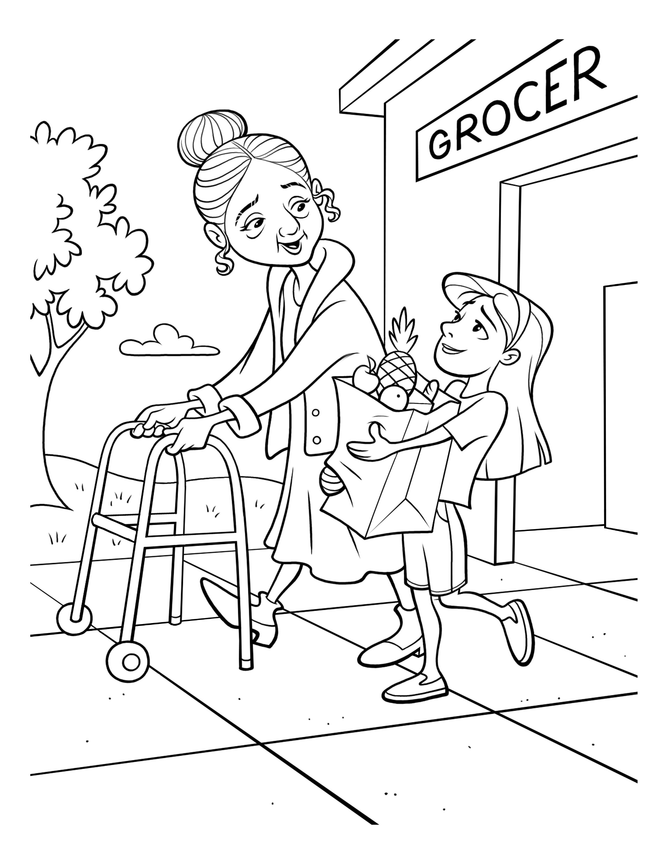
Do it so bravely, so kindly, so well,
Notes:
The Church of Jesus Christ of Latter-Day Saints. (n.d). Service: A little girl helps an elderly woman carry her groceries out of the store. The Church of Jesus Christ of Latter-Day Saints Media Library. Retrieved Jun. 23, 2023 from https://www.churchofjesuschrist.org/media/image/girl-elderly-woman-groceries-helping-4208cbc?lang=eng&collectionId=6819ec5df2c64c63bf29fdbba3c60125

Slide 6
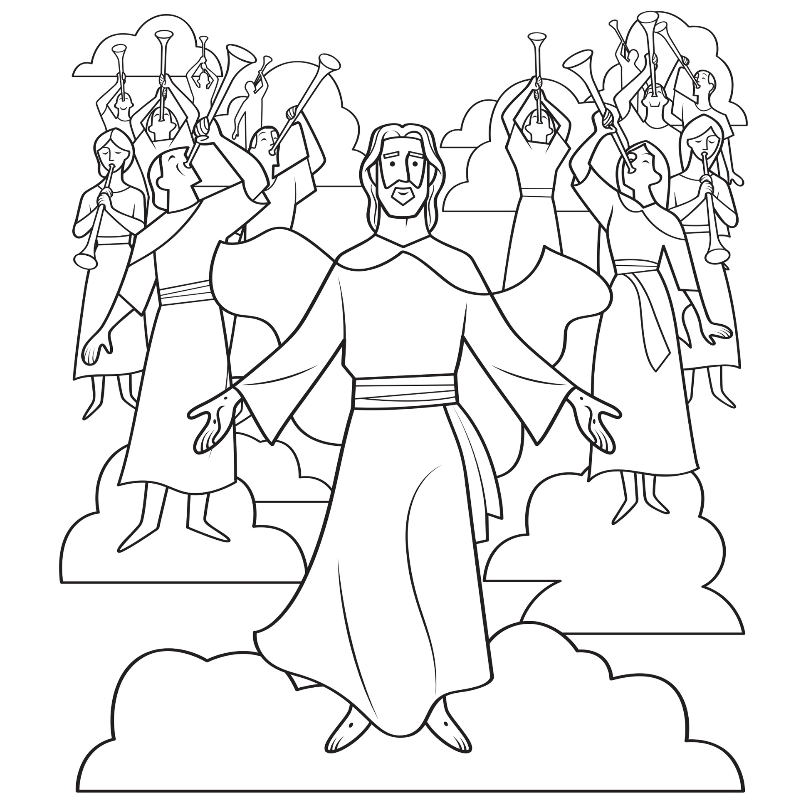
Angels will hasten the story to tell.
Notes:
The Church of Jesus Christ of Latter-Day Saints. (n.d). The second coming of Jesus: While He lived on earth, Jesus promised His disciples that He would come again. Color the image of Jesus’s Second Coming. Location in the Scriptures: Joseph Smith—Matthew 1. Search the Scriptures: How should we prepare to be saved at Jesus's Second Coming? The Church of Jesus Christ of Latter-Day Saints Media Library. Retrieved Jun. 23, 2023 from https://www.churchofjesuschrist.org/media/image/pearl-great-price-coloring-book-d073ec4?lang=eng&collectionId=7aaa7e150fda4072889c75f4d2933b91

Slide 7
Dare, dare, dare to do right;
Notes:
The Church of Jesus Christ of Latter-Day Saints. (n.d). Obedience: Choose the right: An illustration of the CTR symbol. The Church of Jesus Christ of Latter-Day Saints Media Library. Retrieved Jun. 23, 2023 from https://www.churchofjesuschrist.org/media/image/ctr-logo-62da351?lang=eng&collectionId=28d3f141a27f495281ed04d6ae40d8b4

Slide 8
Dare, dare, dare to be true,
Notes:
The Church of Jesus Christ of Latter-Day Saints. (n.d). Faith in Jesus Christ: An illustration of a boy looking at a portrait of Jesus. The Church of Jesus Christ of Latter-Day Saints Media Library. Retrieved Jun. 23, 2023 from https://www.churchofjesuschrist.org/media/image/boy-portrait-jesus-8a8dead?lang=eng&collectionId=28d3f141a27f495281ed04d6ae40d8b4

Slide 9
Dare to be true,
Notes:
The Church of Jesus Christ of Latter-Day Saints. (n.d). Faith in Jesus Christ: An illustration of a boy looking at a portrait of Jesus. The Church of Jesus Christ of Latter-Day Saints Media Library. Retrieved Jun. 23, 2023 from https://www.churchofjesuschrist.org/media/image/boy-portrait-jesus-8a8dead?lang=eng&collectionId=28d3f141a27f495281ed04d6ae40d8b4

Slide 10
Dare to be true.
Notes:
The Church of Jesus Christ of Latter-Day Saints. (n.d). Faith in Jesus Christ: An illustration of a boy looking at a portrait of Jesus. The Church of Jesus Christ of Latter-Day Saints Media Library. Retrieved Jun. 23, 2023 from https://www.churchofjesuschrist.org/media/image/boy-portrait-jesus-8a8dead?lang=eng&collectionId=28d3f141a27f495281ed04d6ae40d8b4

Slide 11
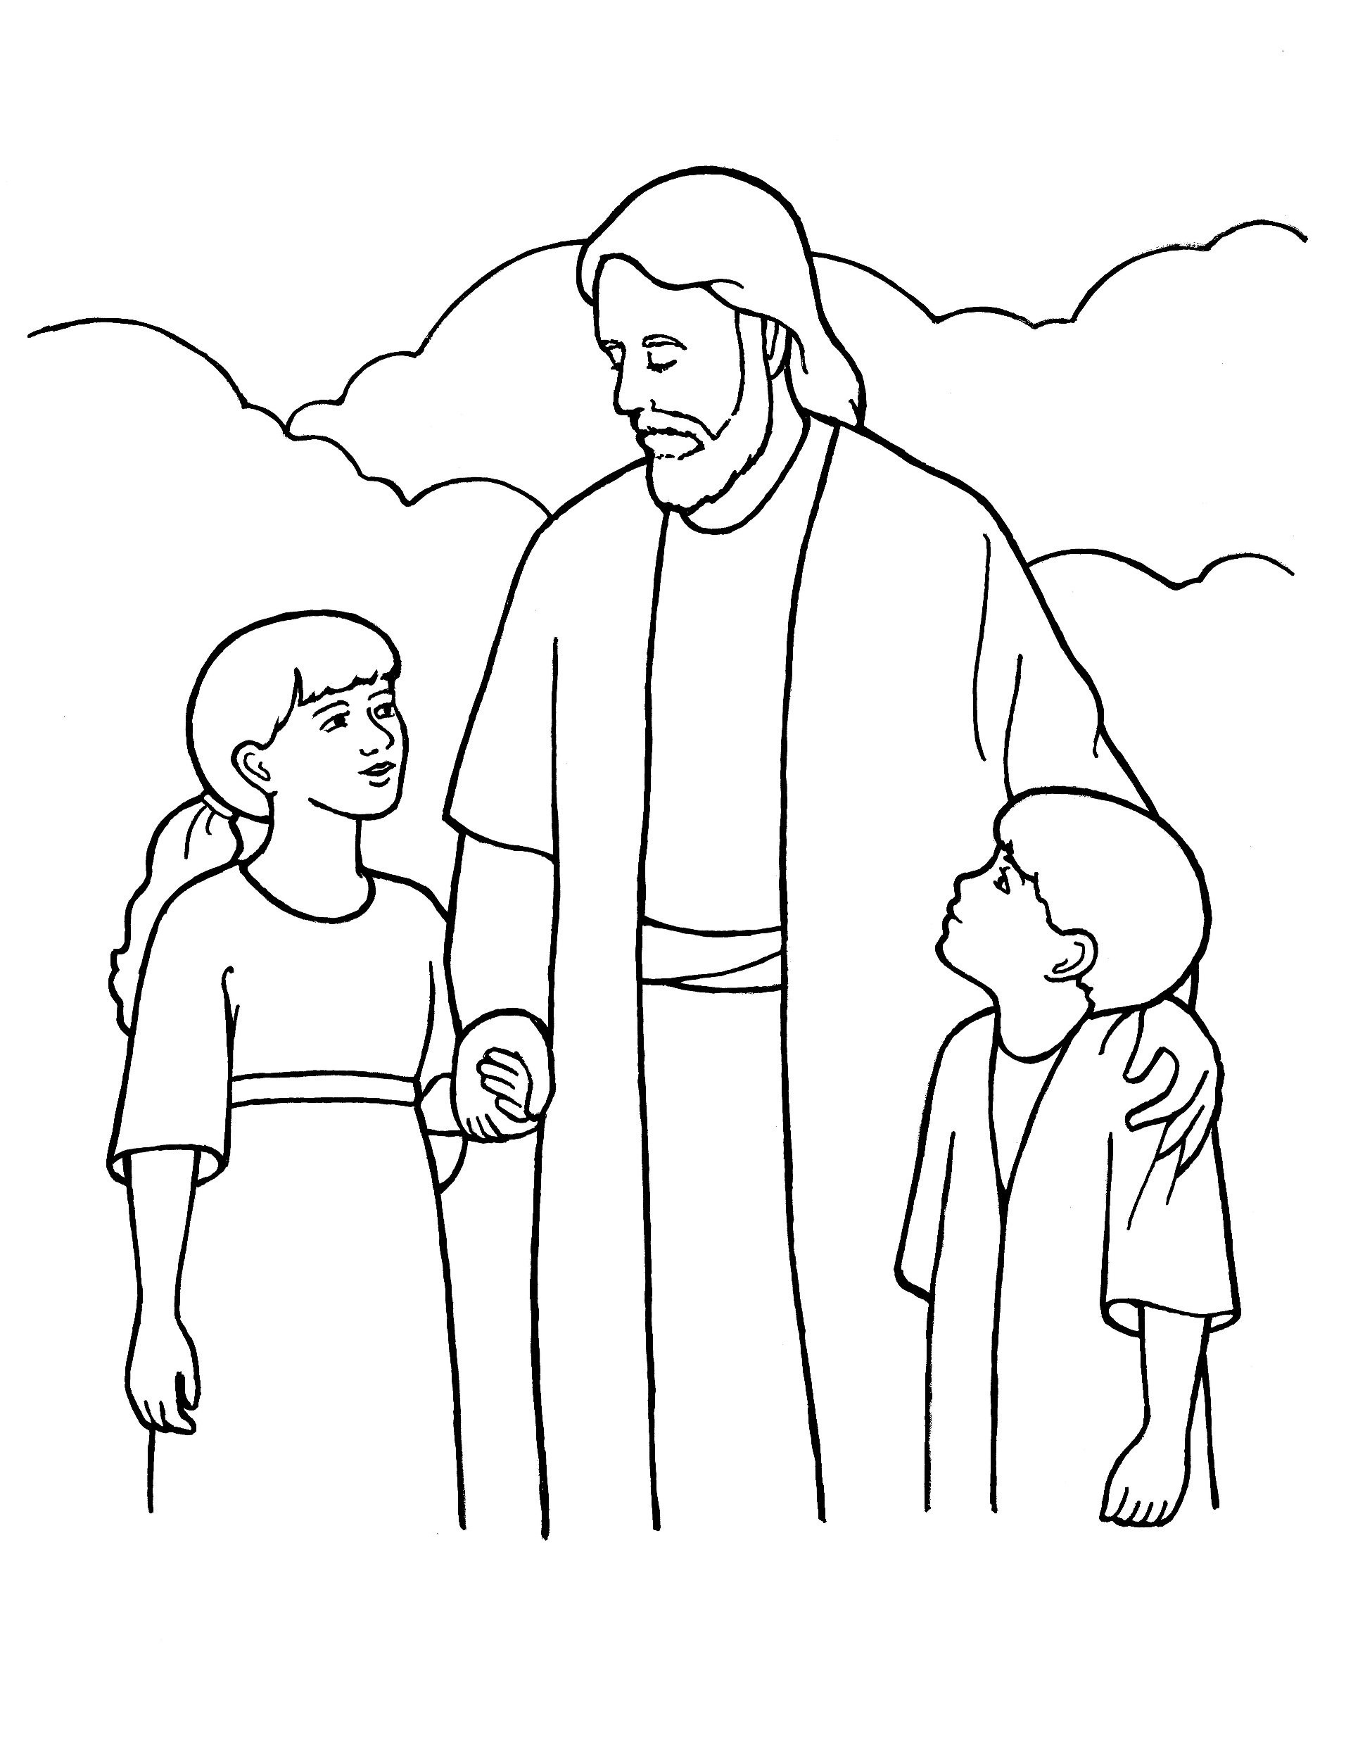
Dare to be true,
Notes:
The Church of Jesus Christ of Latter-Day Saints. (n.d). Eternal life: An illustration of Christ with two children, from the nursery manual Behold Your Little Ones (2008), page 15. The Church of Jesus Christ of Latter-Day Saints Media Library. Retrieved Jun. 23, 2023 from https://www.churchofjesuschrist.org/media/image/jesus-with-children-whittaker-71b0a64?lang=eng&collectionId=cfba124a283645fda1da4f9361fe4afc

Slide 12
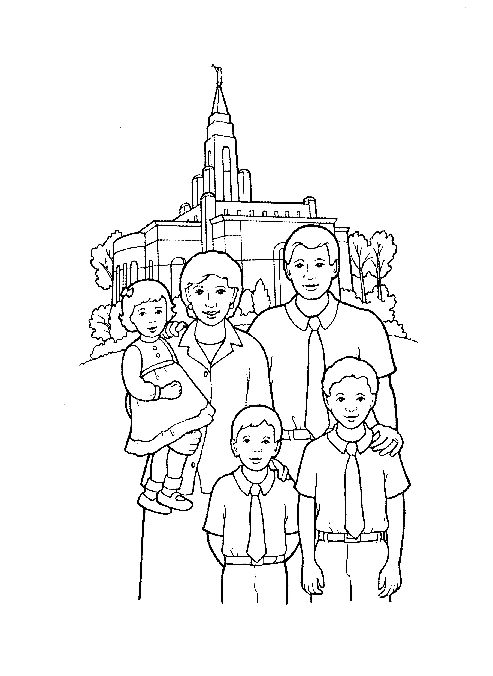
Dare to be true,
Notes:
The Church of Jesus Christ of Latter-Day Saints. (n.d). Temple sealing: An illustration of a family standing in front of a temple. The Church of Jesus Christ of Latter-Day Saints Media Library. Retrieved Jun. 23, 2023 from https://www.churchofjesuschrist.org/media/image/family-temple-b4bc12b?lang=eng&collectionId=d032668ad7d9496daef639526bd0a37d

Slide 13
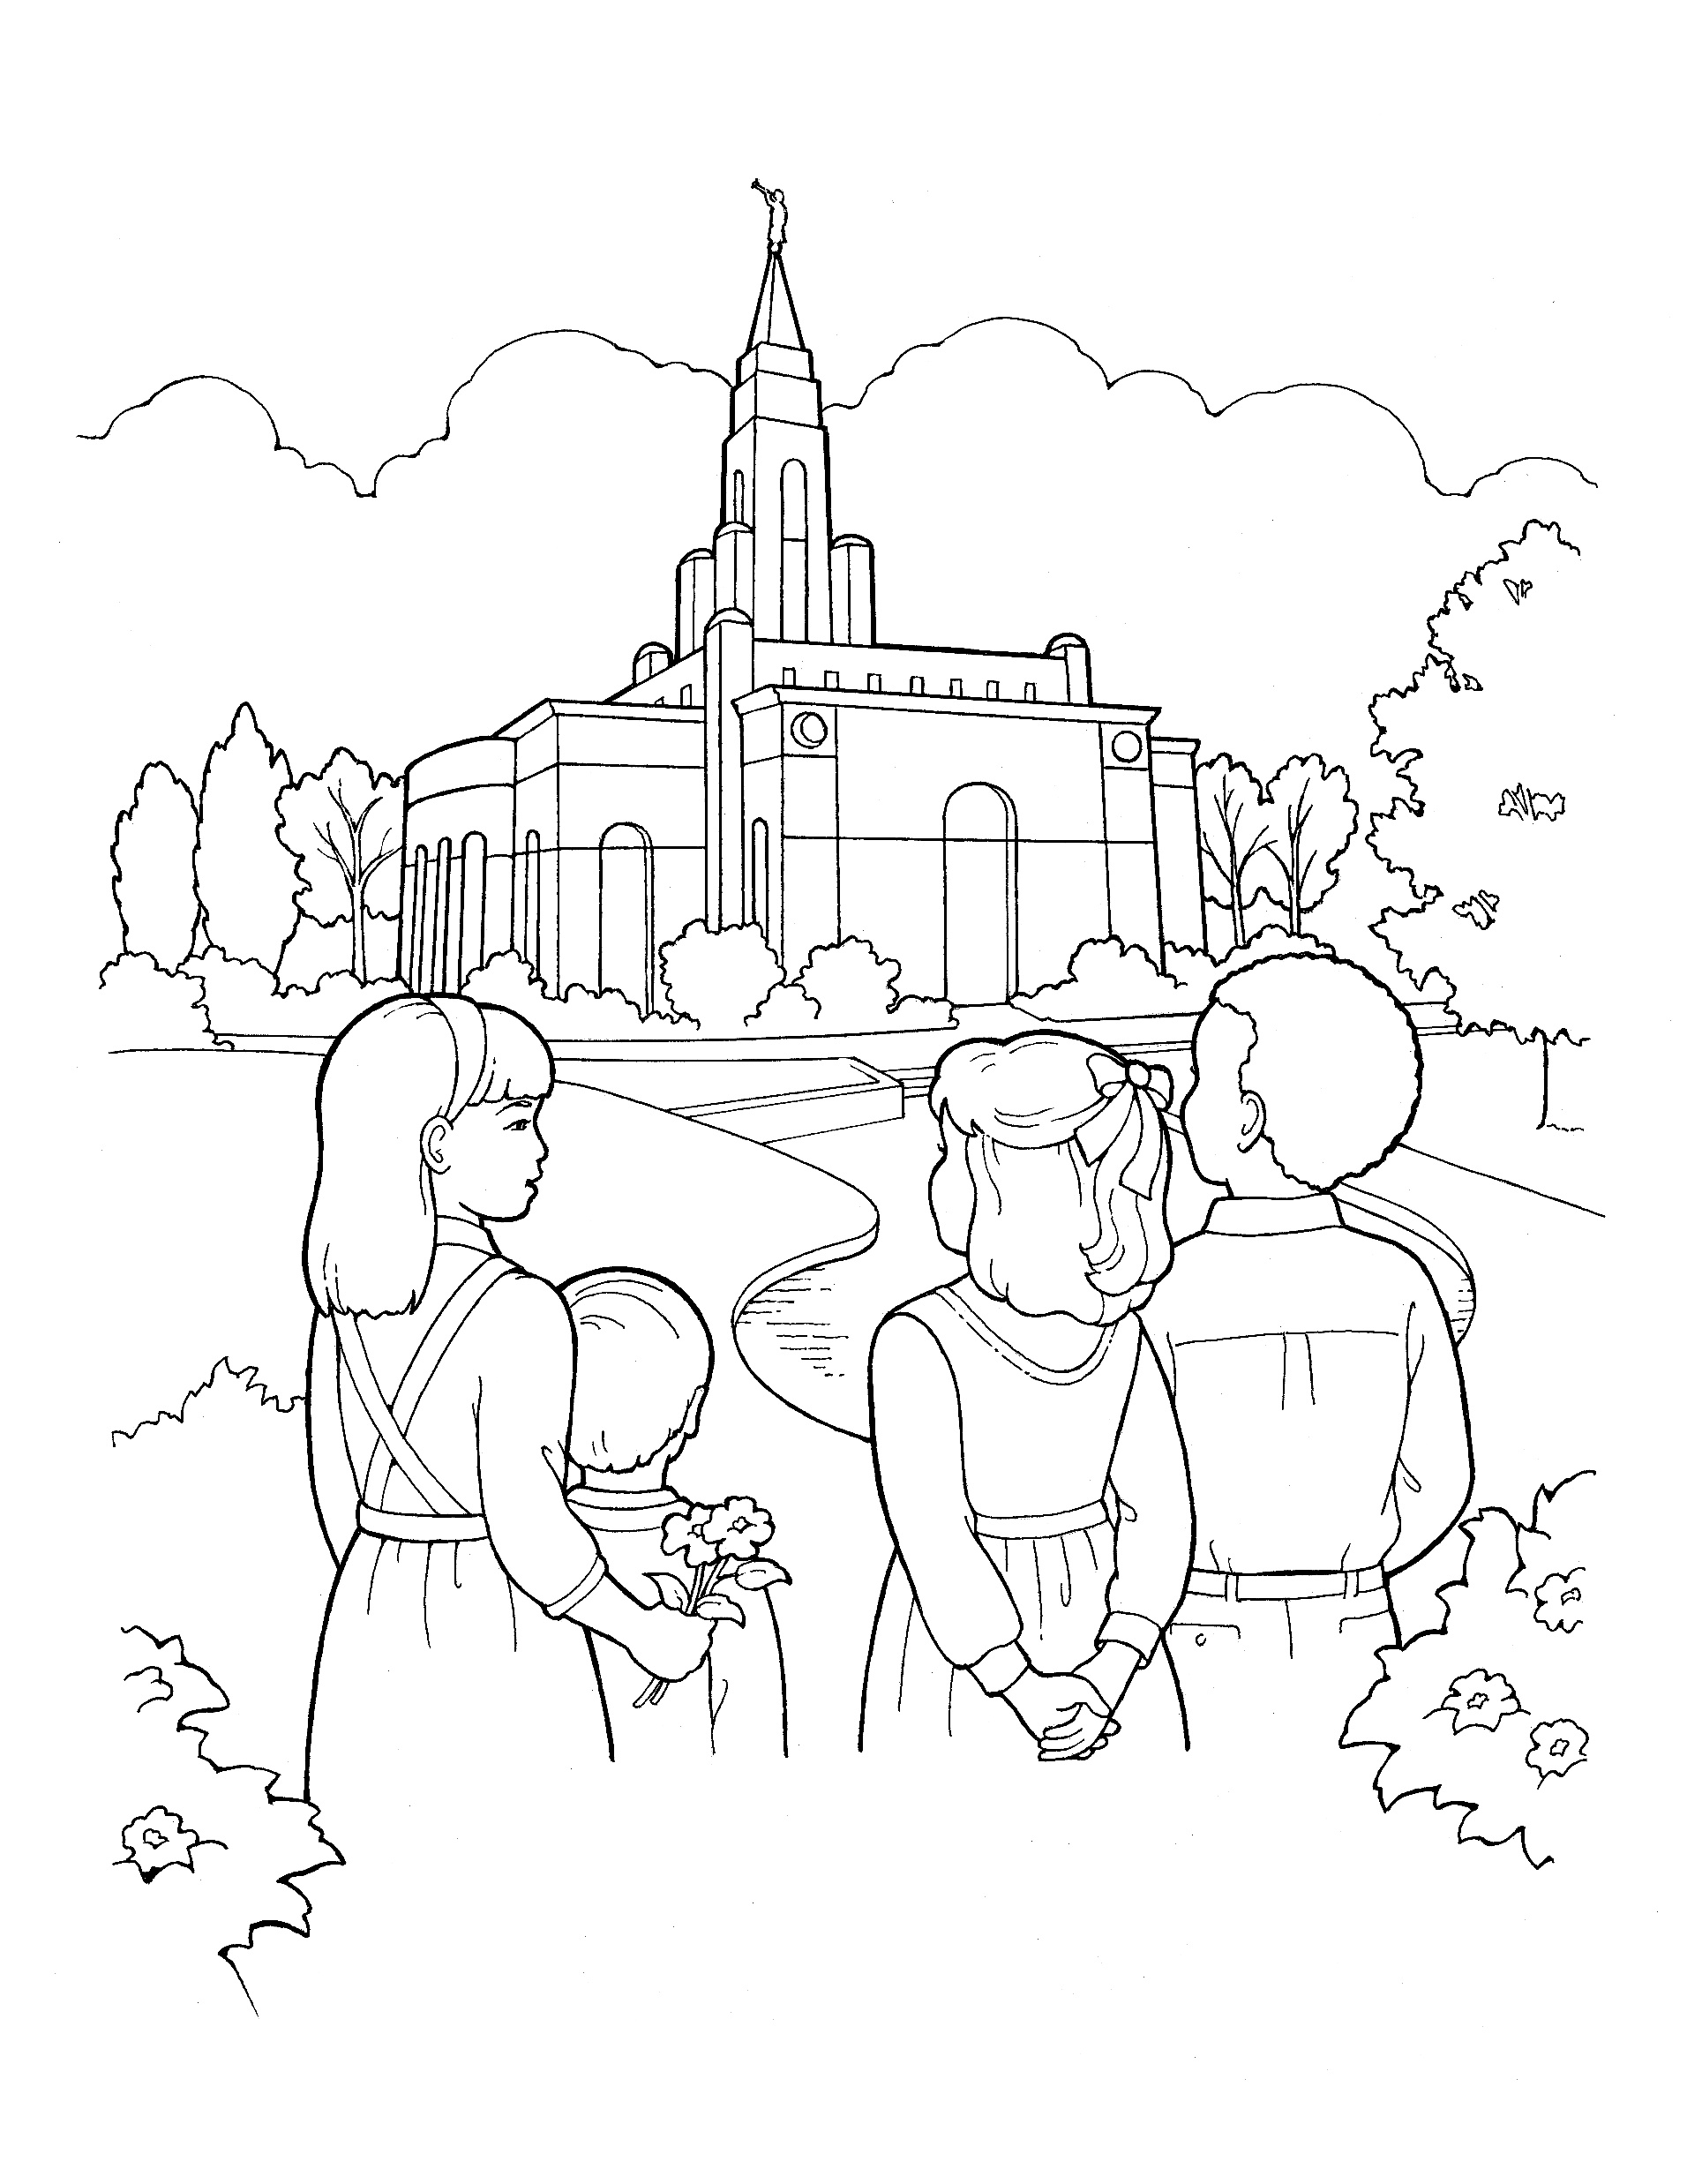
You have a work that no other can do;
Notes:
The Church of Jesus Christ of Latter-Day Saints. (n.d). Children gazing at the temple: An image of children gazing at a beautiful LDS temple. The Church of Jesus Christ of Latter-Day Saints Media Library. Retrieved Jun. 23, 2023 from https://www.churchofjesuschrist.org/media/image/line-art-children-temple-b2f7d77?lang=eng&collectionId=c7c087efe31d4825809e8599cf30c117

Slide 14
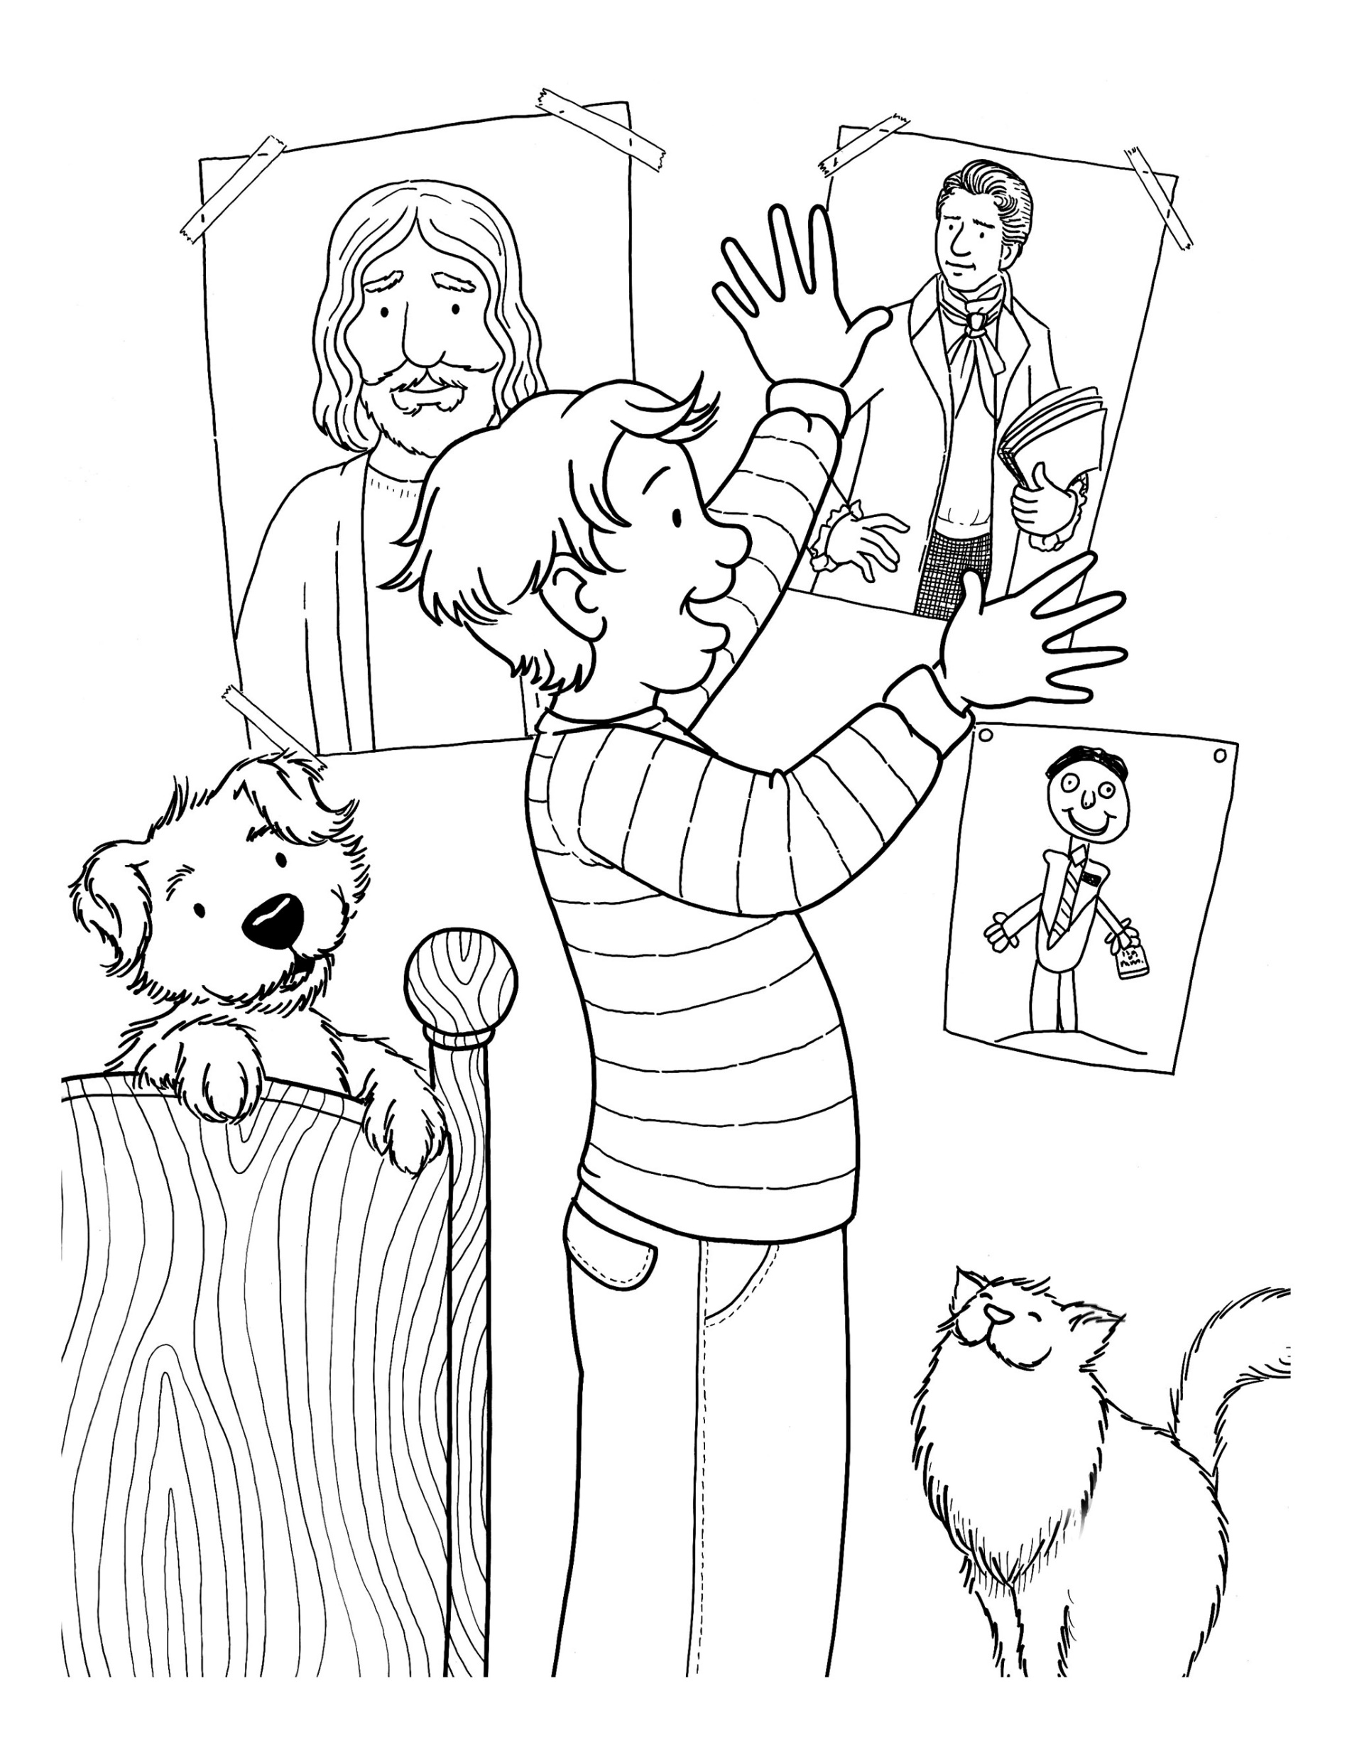
You have a work that no other can do;
Notes:
The Church of Jesus Christ of Latter-Day Saints. (n.d). Posters of prophets: A boy tapes a poster of Joseph Smith to his bedroom wall next to a poster of Jesus Christ. The Church of Jesus Christ of Latter-Day Saints Media Library. Retrieved Jun. 23, 2023 from https://www.churchofjesuschrist.org/media/image/boy-hanging-posters-02e6f28?lang=eng&collectionId=6819ec5df2c64c63bf29fdbba3c60125

Slide 15
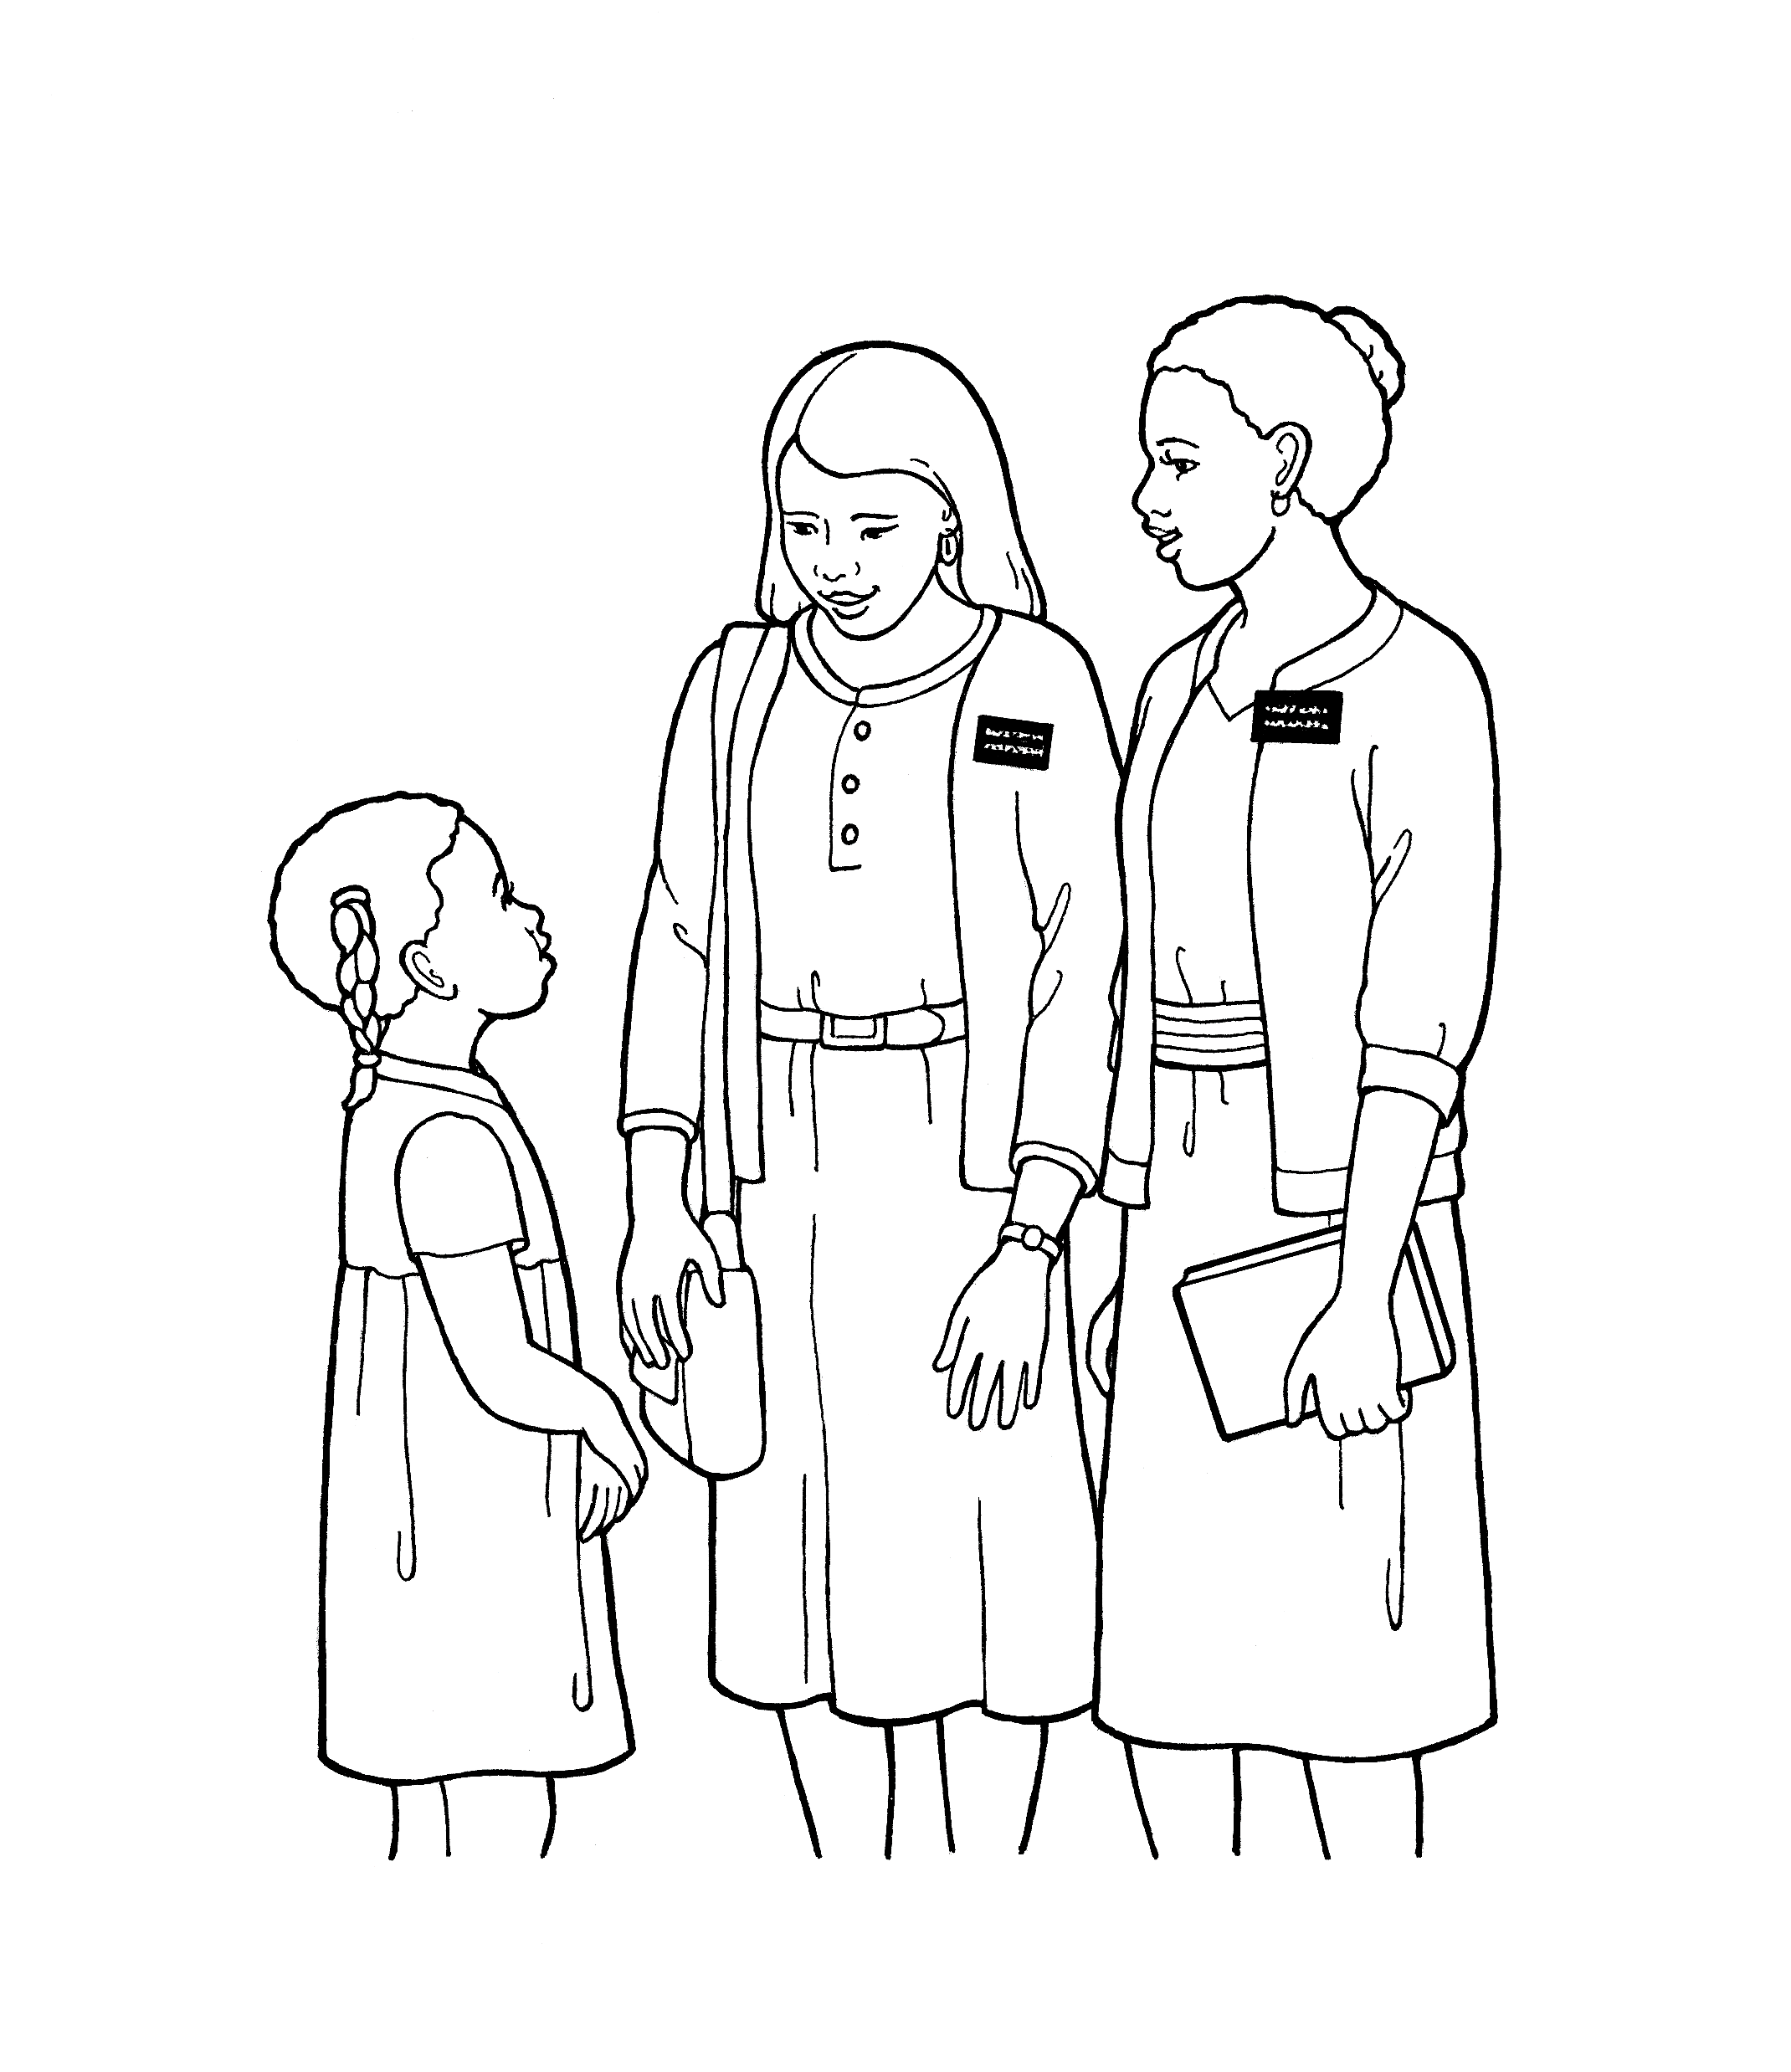
You have a work that no other can do;
Notes:
The Church of Jesus Christ of Latter-Day Saints. (n.d). Sister missionaries: An illustration of two sister missionaries talking to a young girl. The Church of Jesus Christ of Latter-Day Saints Media Library. Retrieved Jun. 23, 2023 from https://www.churchofjesuschrist.org/media/image/lds-missionaries-sisters-20a3d36?lang=eng&collectionId=28d3f141a27f495281ed04d6ae40d8b4

Slide 16
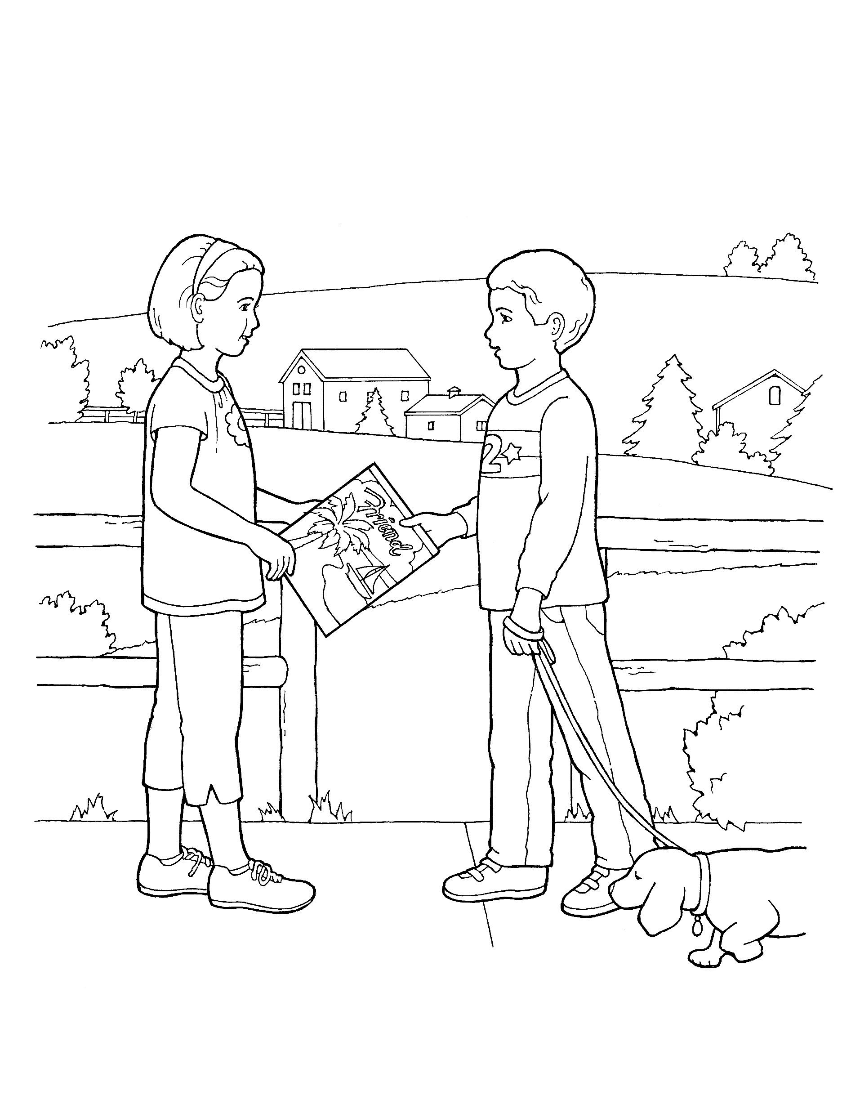
You have a work that no other can do;
Notes:
The Church of Jesus Christ of Latter-Day Saints. (n.d). Children with the Friend: An image of children holding a Friend magazine while walking a dog. The Church of Jesus Christ of Latter-Day Saints Media Library. Retrieved Jun. 23, 2023 from https://www.churchofjesuschrist.org/media/image/boy-girl-magazine-de4817c?lang=eng&collectionId=c7c087efe31d4825809e8599cf30c117

Slide 17
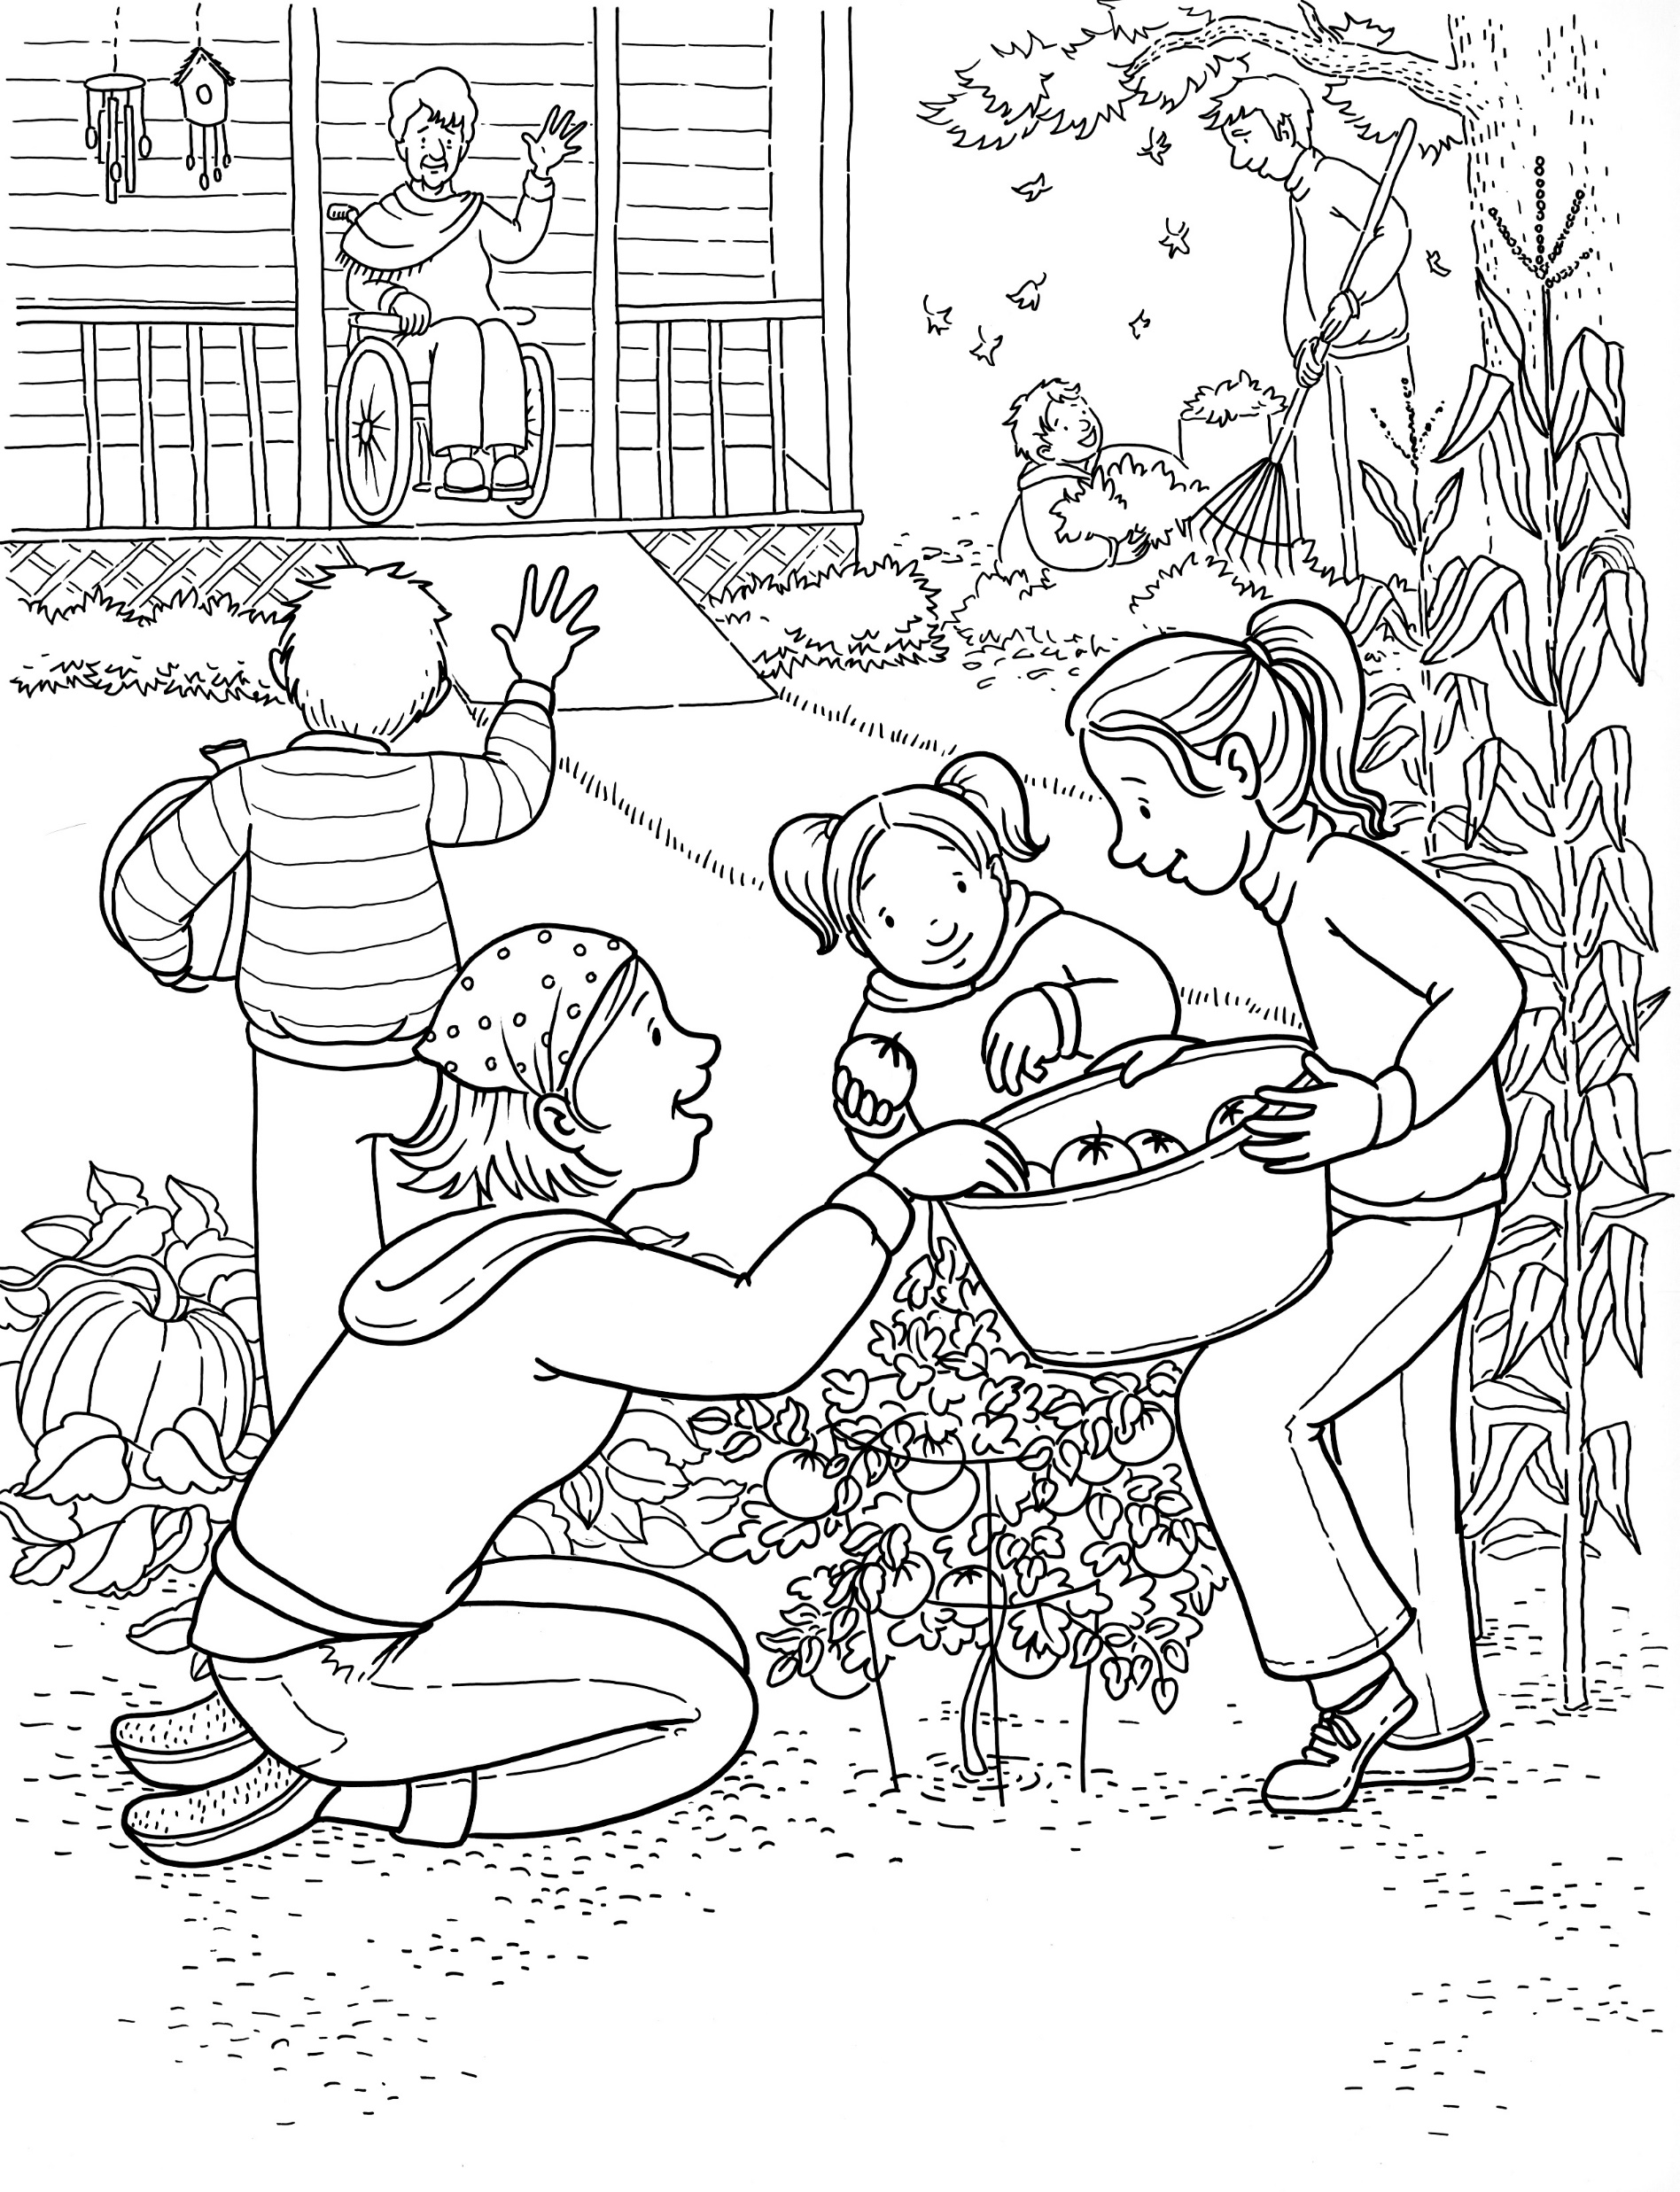
You have a work that no other can do;
Notes:
The Church of Jesus Christ of Latter-Day Saints. (n.d). Gardening: A family does service for an elderly woman by working in her garden. The Church of Jesus Christ of Latter-Day Saints Media Library. Retrieved Jun. 23, 2023 from https://www.churchofjesuschrist.org/media/image/garden-family-service-wheelchair-man-7353398?lang=eng&collectionId=6819ec5df2c64c63bf29fdbba3c60125

Slide 18
You have a work that no other can do;
Notes:
The Church of Jesus Christ of Latter-Day Saints. (n.d). Helping one another: Two children helping another child who has dropped her belongings. The Church of Jesus Christ of Latter-Day Saints Media Library. Retrieved Jun. 23, 2023 from https://www.churchofjesuschrist.org/media/image/children-helping-playing-3d63704?lang=eng&collectionId=6819ec5df2c64c63bf29fdbba3c60125

Slide 19
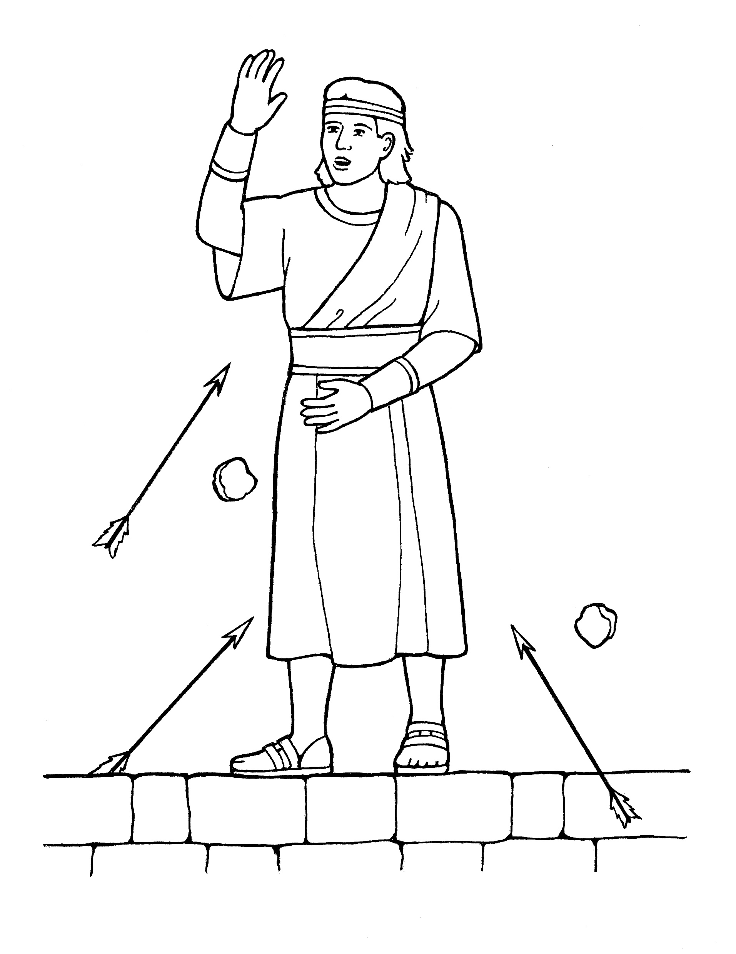
Do it so bravely, so kindly, so well,
Notes:
The Church of Jesus Christ of Latter-Day Saints. (n.d). Samuel the Lamanite: An illustration of Samuel the Lamanite from the nursery manual Behold Your Little Ones (2008), page 103. The Church of Jesus Christ of Latter-Day Saints Media Library. Retrieved Jun. 23, 2023 from https://www.churchofjesuschrist.org/media/image/nursery-manual-illustration-2229998?lang=eng&collectionId=cfba124a283645fda1da4f9361fe4afc

Slide 20
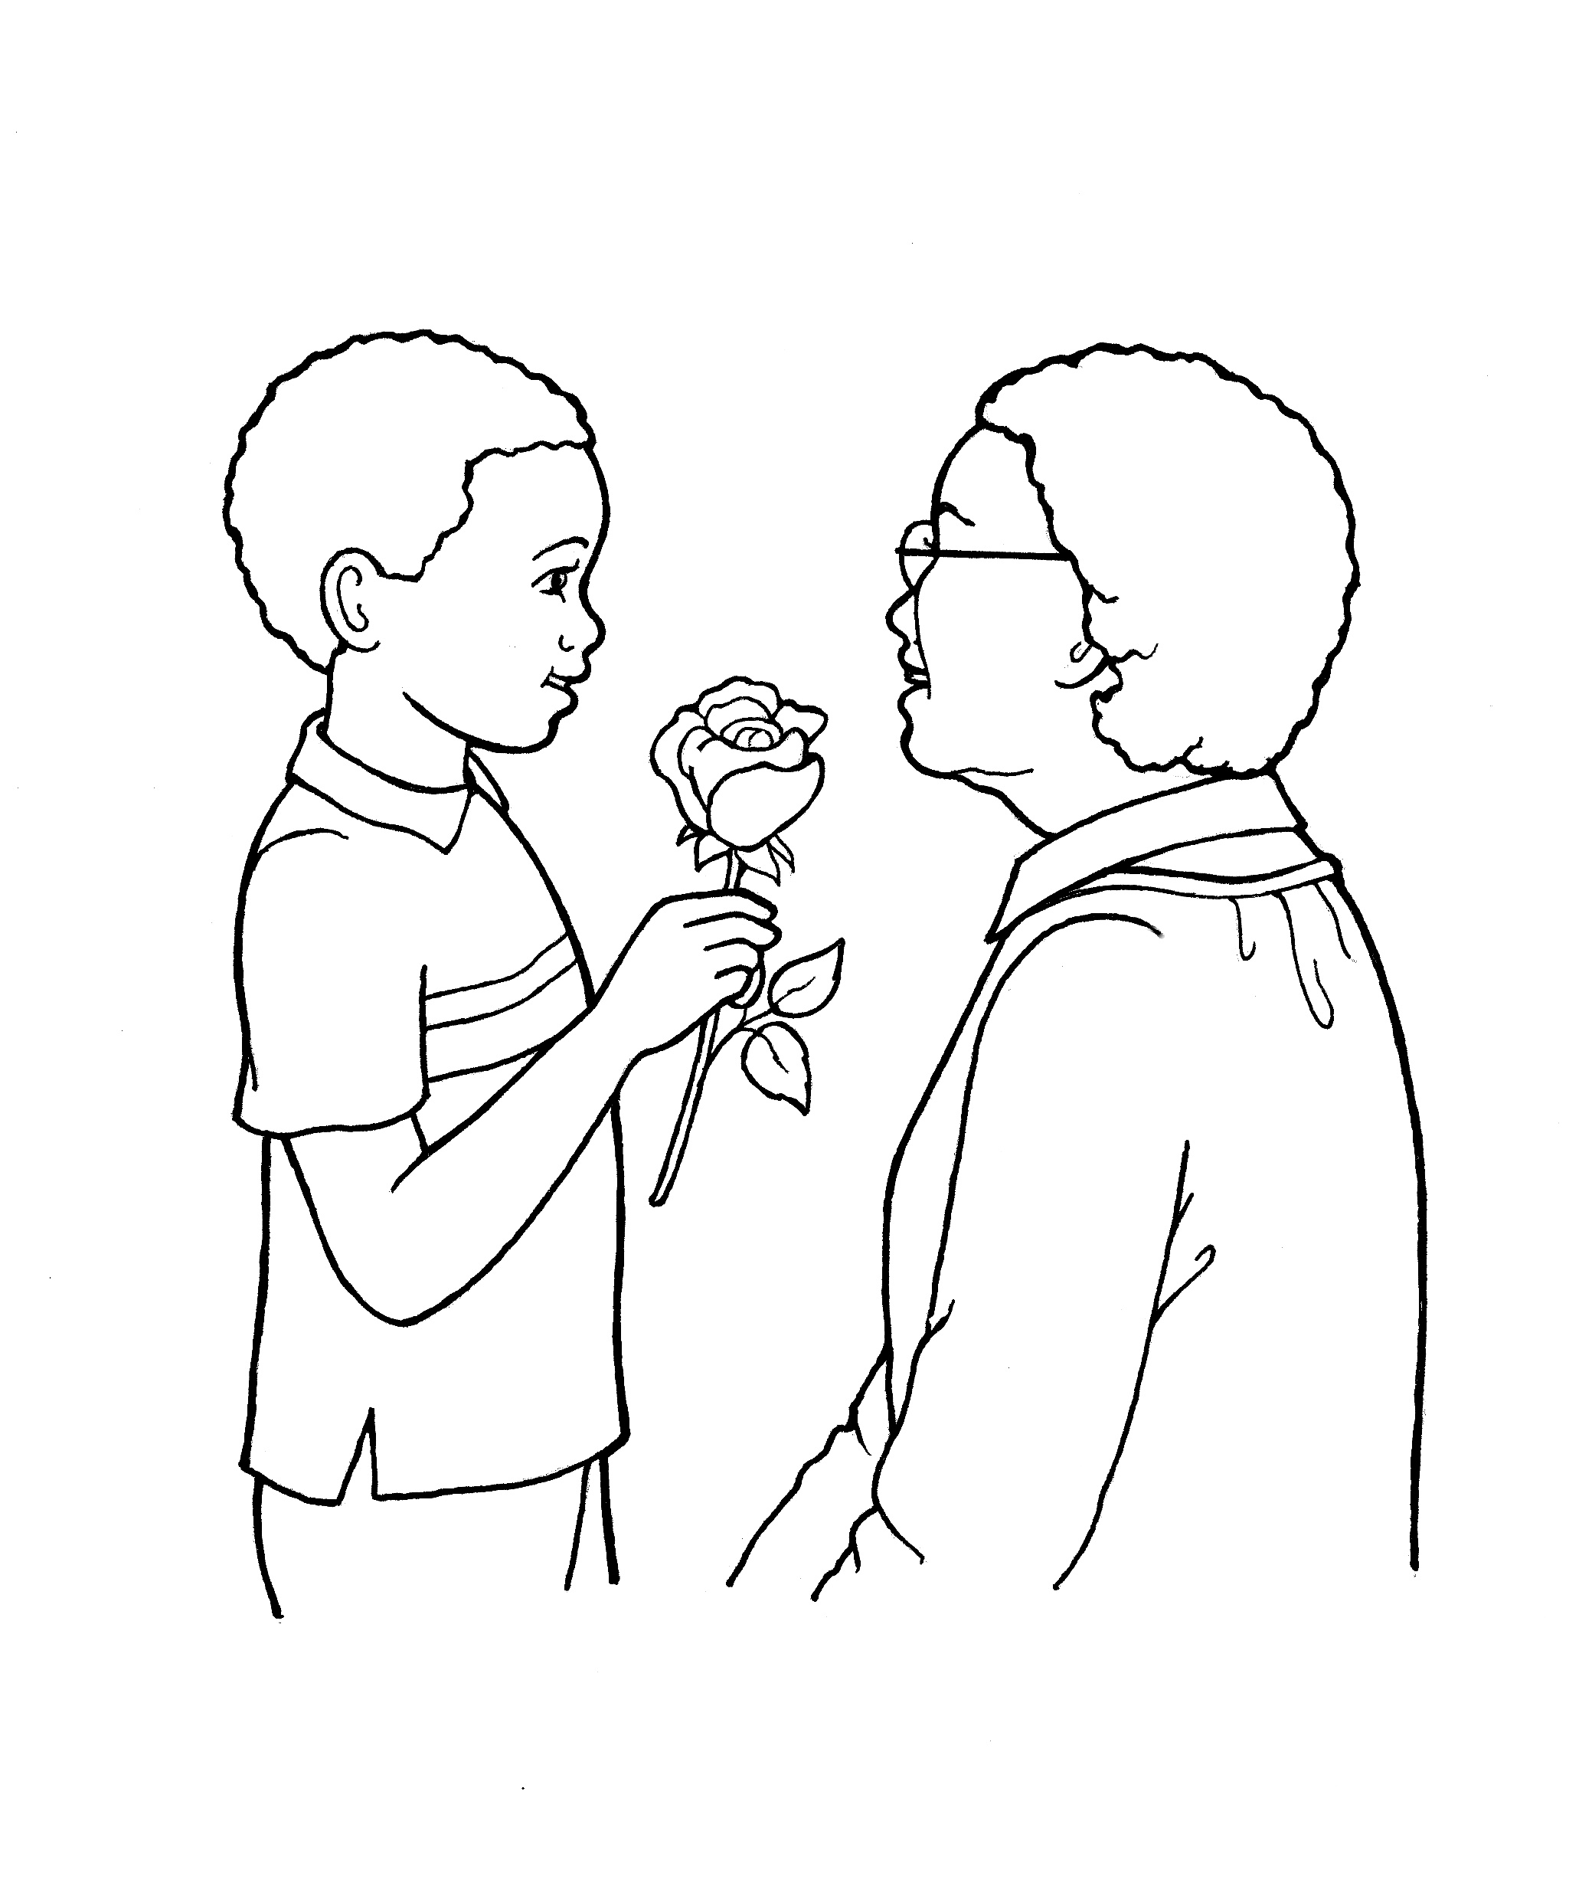
Do it so bravely, so kindly, so well,
Notes:
The Church of Jesus Christ of Latter-Day Saints. (n.d). Boy giving flowers to an older woman: An illustration of a boy giving a rose to an older woman. The Church of Jesus Christ of Latter-Day Saints Media Library. Retrieved Jun. 23, 2023 from https://www.churchofjesuschrist.org/media/image/boy-rose-gift-bac8bf9?lang=eng&collectionId=c7c087efe31d4825809e8599cf30c117

Slide 21
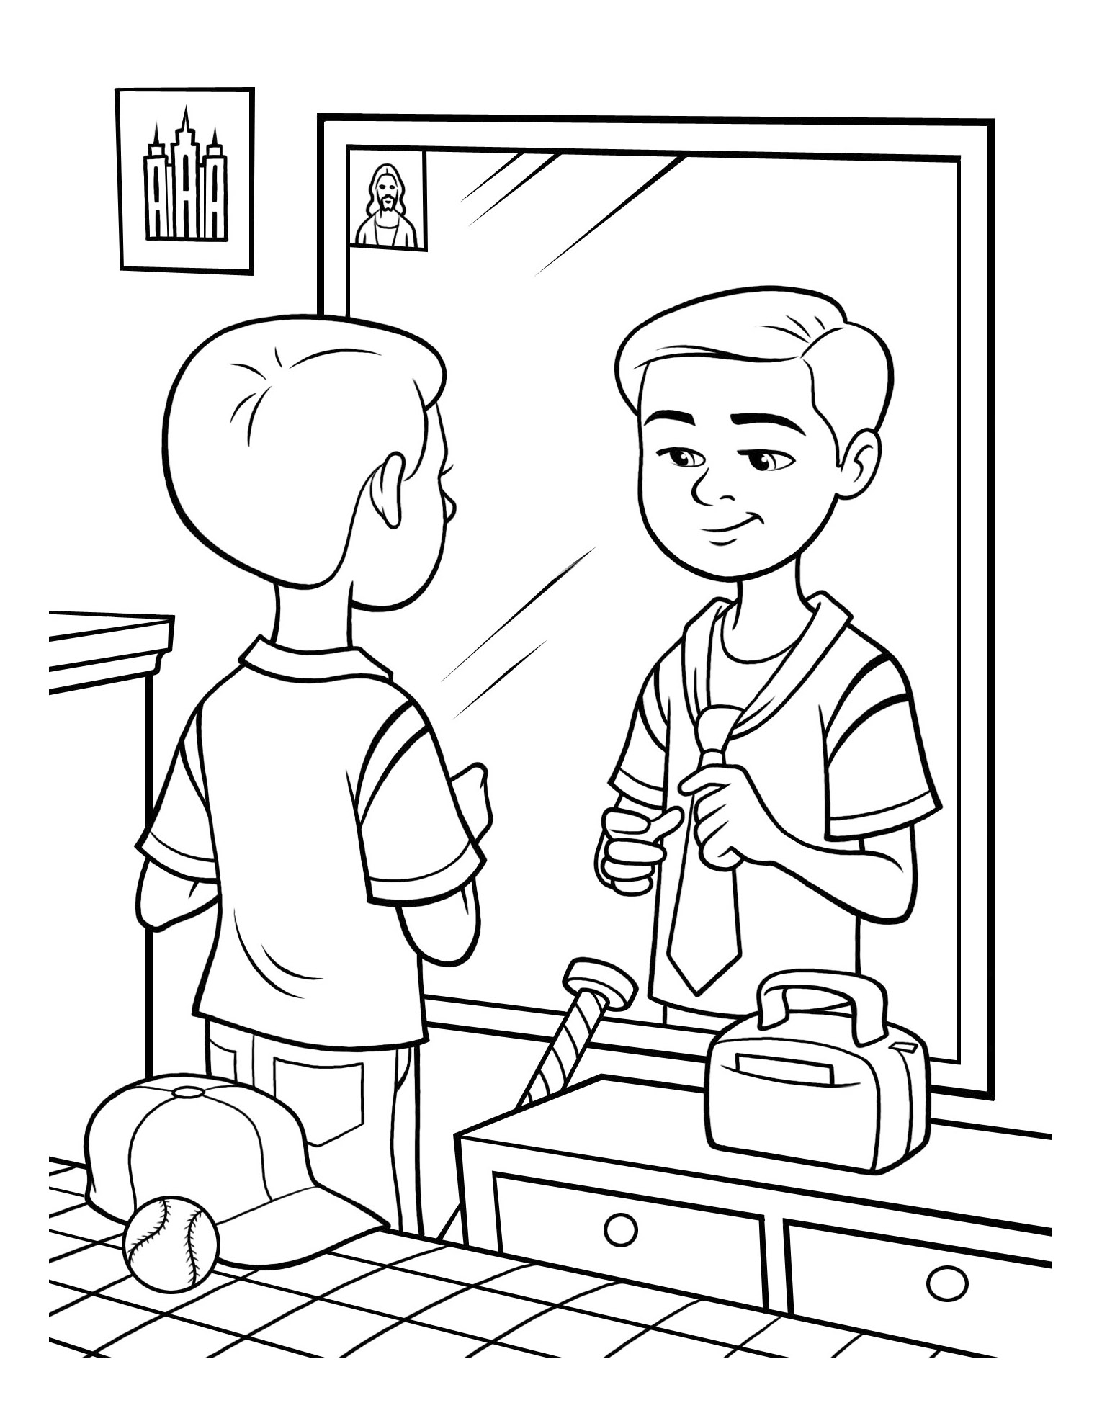
Do it so bravely,
Notes:
The Church of Jesus Christ of Latter-Day Saints. (n.d). Tying a tie: A boy stands in front of his mirror and practices tying a tie. The Church of Jesus Christ of Latter-Day Saints Media Library. Retrieved Jun. 23, 2023 from https://www.churchofjesuschrist.org/media/image/boy-mirror-tying-tie-9ed09b1?lang=eng&collectionId=6819ec5df2c64c63bf29fdbba3c60125

Slide 22
so kindly,
Notes:
The Church of Jesus Christ of Latter-Day Saints. (n.d). Boy giving flowers to an older woman: An illustration of a boy giving a rose to an older woman. The Church of Jesus Christ of Latter-Day Saints Media Library. Retrieved Jun. 23, 2023 from https://www.churchofjesuschrist.org/media/image/boy-rose-gift-bac8bf9?lang=eng&collectionId=c7c087efe31d4825809e8599cf30c117

Slide 23
so well,
Notes:
The Church of Jesus Christ of Latter-Day Saints. (n.d). Service: A little girl helps an elderly woman carry her groceries out of the store. The Church of Jesus Christ of Latter-Day Saints Media Library. Retrieved Jun. 23, 2023 from https://www.churchofjesuschrist.org/media/image/girl-elderly-woman-groceries-helping-4208cbc?lang=eng&collectionId=6819ec5df2c64c63bf29fdbba3c60125

Slide 24
Image Credits:
The Church of Jesus Christ of Latter-Day Saints. (n.d). Faith in Jesus Christ: An illustration of a boy looking at a portrait of Jesus. The Church of Jesus Christ of Latter-Day Saints Media Library. Retrieved Jun. 23, 2023 from https://www.churchofjesuschrist.org/media/image/boy-portrait-jesus-8a8dead?lang=eng&collectionId=28d3f141a27f495281ed04d6ae40d8b4
The Church of Jesus Christ of Latter-Day Saints. (n.d). Obedience: Choose the right: An illustration of the CTR symbol. The Church of Jesus Christ of Latter-Day Saints Media Library. Retrieved Jun. 23, 2023 from https://www.churchofjesuschrist.org/media/image/ctr-logo-62da351?lang=eng&collectionId=28d3f141a27f495281ed04d6ae40d8b4
The Church of Jesus Christ of Latter-Day Saints. (n.d). Service: A little girl helps an elderly woman carry her groceries out of the store. The Church of Jesus Christ of Latter-Day Saints Media Library. Retrieved Jun. 23, 2023 from https://www.churchofjesuschrist.org/media/image/girl-elderly-woman-groceries-helping-4208cbc?lang=eng&collectionId=6819ec5df2c64c63bf29fdbba3c60125
The Church of Jesus Christ of Latter-Day Saints. (n.d). Sharing the Book of Mormon: A girl gives an elderly woman a copy of the Book of Mormon. The Church of Jesus Christ of Latter-Day Saints Media Library. Retrieved Jun. 23, 2023 from https://www.churchofjesuschrist.org/media/image/girl-man-coloring-page-stott-5831133?lang=eng&collectionId=6819ec5df2c64c63bf29fdbba3c60125
The Church of Jesus Christ of Latter-Day Saints. (n.d). The second coming of Jesus: While He lived on earth, Jesus promised His disciples that He would come again. Color the image of Jesus’s Second Coming. Location in the Scriptures: Joseph Smith—Matthew 1. Search the Scriptures: How should we prepare to be saved at Jesus's Second Coming? The Church of Jesus Christ of Latter-Day Saints Media Library. Retrieved Jun. 23, 2023 from https://www.churchofjesuschrist.org/media/image/pearl-great-price-coloring-book-d073ec4?lang=eng&collectionId=7aaa7e150fda4072889c75f4d2933b91
Alternate image credits:
The Church of Jesus Christ of Latter-Day Saints. (n.d). Boy giving flowers to an older woman: An illustration of a boy giving a rose to an older woman. The Church of Jesus Christ of Latter-Day Saints Media Library. Retrieved Jun. 23, 2023 from https://www.churchofjesuschrist.org/media/image/boy-rose-gift-bac8bf9?lang=eng&collectionId=c7c087efe31d4825809e8599cf30c117
The Church of Jesus Christ of Latter-Day Saints. (n.d). Children gazing at the temple: An image of children gazing at a beautiful LDS temple. The Church of Jesus Christ of Latter-Day Saints Media Library. Retrieved Jun. 23, 2023 from https://www.churchofjesuschrist.org/media/image/line-art-children-temple-b2f7d77?lang=eng&collectionId=c7c087efe31d4825809e8599cf30c117
The Church of Jesus Christ of Latter-Day Saints. (n.d). Children with the Friend: An image of children holding a Friend magazine while walking a dog. The Church of Jesus Christ of Latter-Day Saints Media Library. Retrieved Jun. 23, 2023 from https://www.churchofjesuschrist.org/media/image/boy-girl-magazine-de4817c?lang=eng&collectionId=c7c087efe31d4825809e8599cf30c117
The Church of Jesus Christ of Latter-Day Saints. (n.d). Eternal life: An illustration of Christ with two children, from the nursery manual Behold Your Little Ones (2008), page 15. The Church of Jesus Christ of Latter-Day Saints Media Library. Retrieved Jun. 23, 2023 from https://www.churchofjesuschrist.org/media/image/jesus-with-children-whittaker-71b0a64?lang=eng&collectionId=cfba124a283645fda1da4f9361fe4afc
The Church of Jesus Christ of Latter-Day Saints. (n.d). Gardening: A family does service for an elderly woman by working in her garden. The Church of Jesus Christ of Latter-Day Saints Media Library. Retrieved Jun. 23, 2023 from https://www.churchofjesuschrist.org/media/image/garden-family-service-wheelchair-man-7353398?lang=eng&collectionId=6819ec5df2c64c63bf29fdbba3c60125
The Church of Jesus Christ of Latter-Day Saints. (n.d). Helping one another: Two children helping another child who has dropped her belongings. The Church of Jesus Christ of Latter-Day Saints Media Library. Retrieved Jun. 23, 2023 from https://www.churchofjesuschrist.org/media/image/children-helping-playing-3d63704?lang=eng&collectionId=6819ec5df2c64c63bf29fdbba3c60125
The Church of Jesus Christ of Latter-Day Saints. (n.d). Posters of prophets: A boy tapes a poster of Joseph Smith to his bedroom wall next to a poster of Jesus Christ. The Church of Jesus Christ of Latter-Day Saints Media Library. Retrieved Jun. 23, 2023 from https://www.churchofjesuschrist.org/media/image/boy-hanging-posters-02e6f28?lang=eng&collectionId=6819ec5df2c64c63bf29fdbba3c60125
The Church of Jesus Christ of Latter-Day Saints. (n.d). Samuel the Lamanite: An illustration of Samuel the Lamanite from the nursery manual Behold Your Little Ones (2008), page 103. The Church of Jesus Christ of Latter-Day Saints Media Library. Retrieved Jun. 23, 2023 from https://www.churchofjesuschrist.org/media/image/nursery-manual-illustration-2229998?lang=eng&collectionId=cfba124a283645fda1da4f9361fe4afc
The Church of Jesus Christ of Latter-Day Saints. (n.d). Sister missionaries: An illustration of two sister missionaries talking to a young girl. The Church of Jesus Christ of Latter-Day Saints Media Library. Retrieved Jun. 23, 2023 from https://www.churchofjesuschrist.org/media/image/lds-missionaries-sisters-20a3d36?lang=eng&collectionId=28d3f141a27f495281ed04d6ae40d8b4
The Church of Jesus Christ of Latter-Day Saints. (n.d). Temple sealing: An illustration of a family standing in front of a temple. The Church of Jesus Christ of Latter-Day Saints Media Library. Retrieved Jun. 23, 2023 from https://www.churchofjesuschrist.org/media/image/family-temple-b4bc12b?lang=eng&collectionId=d032668ad7d9496daef639526bd0a37d
The Church of Jesus Christ of Latter-Day Saints. (n.d). Tying a tie: A boy stands in front of his mirror and practices tying a tie. The Church of Jesus Christ of Latter-Day Saints Media Library. Retrieved Jun. 23, 2023 from https://www.churchofjesuschrist.org/media/image/boy-mirror-tying-tie-9ed09b1?lang=eng&collectionId=6819ec5df2c64c63bf29fdbba3c60125

