Slide 1
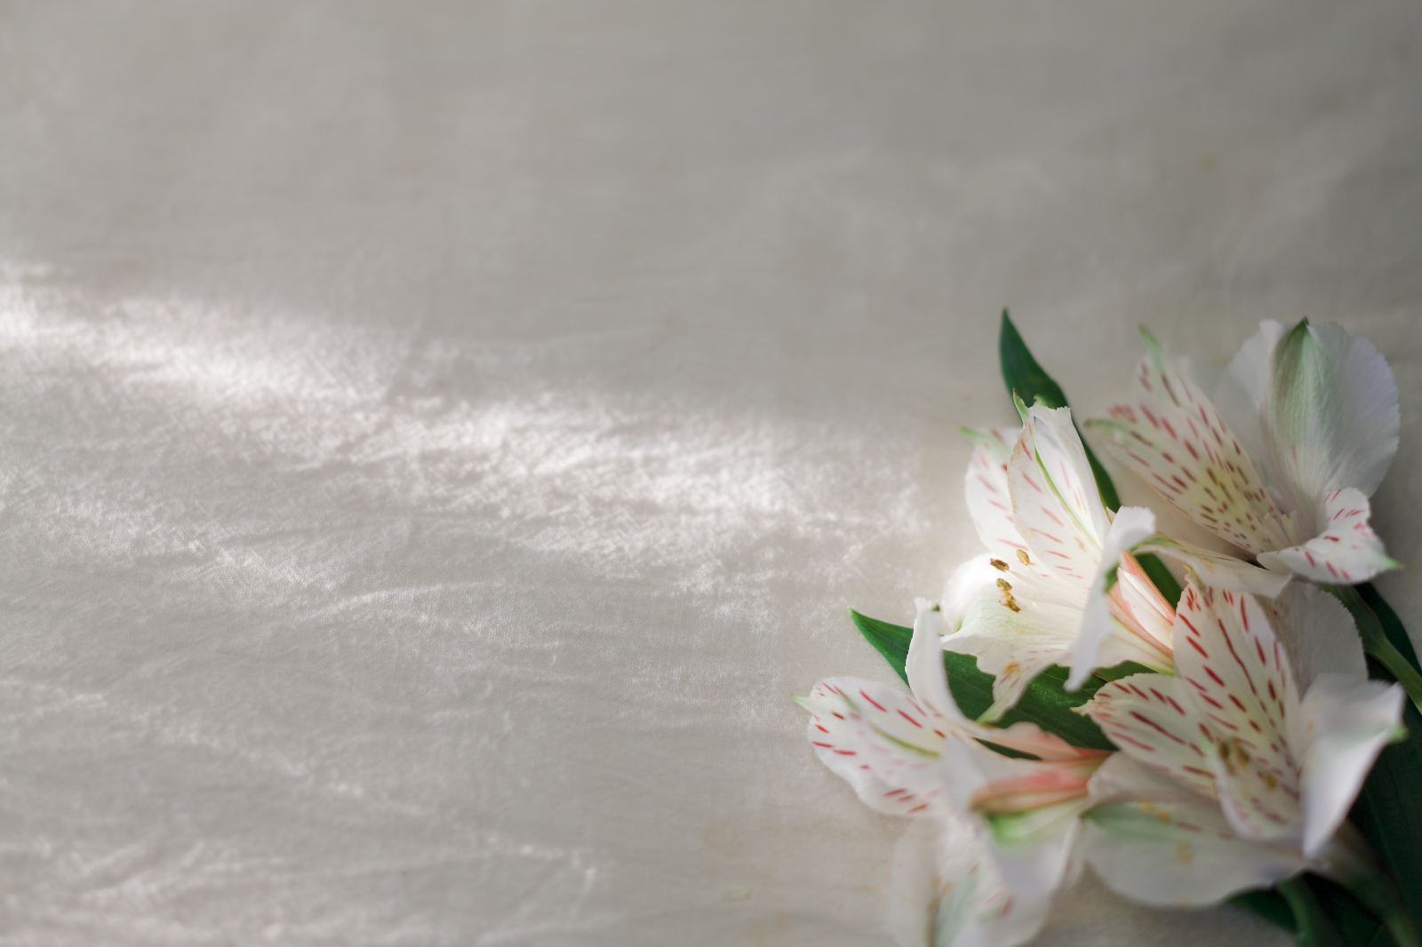
Singing Time
with Sister Montgomery
Image: The Church of Jesus Christ
Notes:
The Church of Jesus Christ. (2020). White and Pink Lilies. A bunch of white and pink lilies lying on a piece of linen. Gospel Media. Retrieved April 10, 2020, from https://www.churchofjesuschrist.org/media-library/images/jesus-christ-lilies-827206?lang=eng

Slide 2
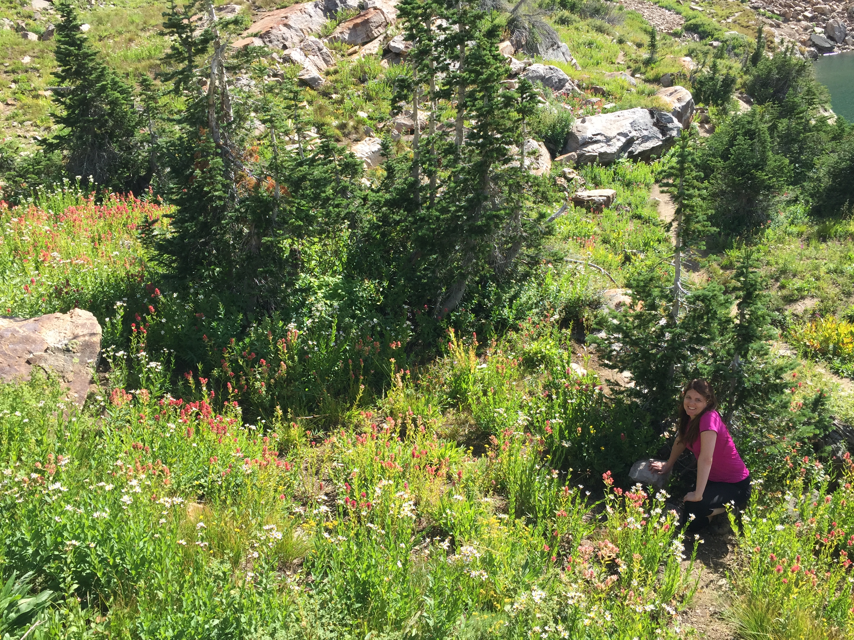
Spring is here!
Image: Bryce Purcella
Notes:
Purcella, Bryce. (2015). Cherice Montgomery at Cecret Lake in Alta, Utah.

Slide 3
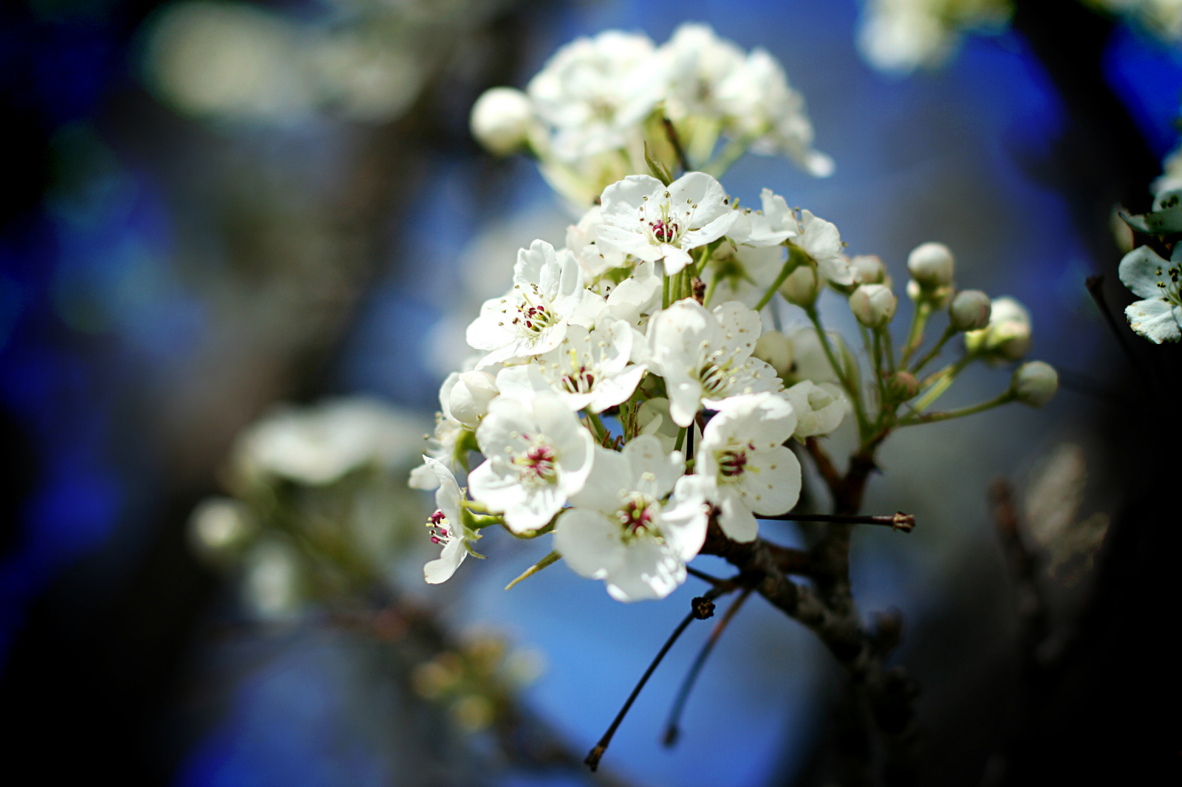
1: 
Popcorn Popping, p. 242
Image: The Church of Jesus Christ
Notes:
The Church of Jesus Christ of Latter-day Saints. (2020). White Blossoms. White blossoms on a tree. Gospel Media Library. Retrieved April 11, 2020, from https://www.churchofjesuschrist.org/media-library/images/flowers-tree-837633?lang=eng

Slide 4
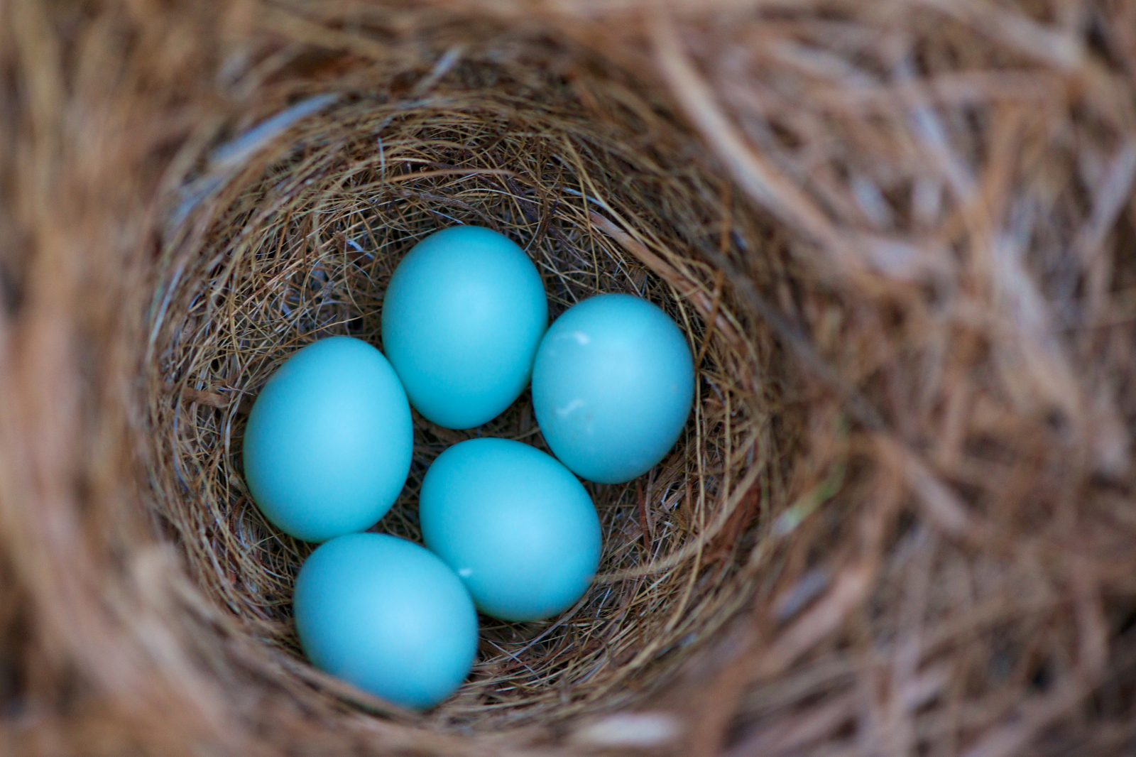
Birds in the Tree, p. 241a
1:
2:
Image: The Church of Jesus Christ
Notes:
The Church of Jesus Christ of Latter-day Saints. (2020). Bird’s Nest. A bird’s nest with five blue eggs. Gospel Media. Retrieved April 1, 2020, from https://www.churchofjesuschrist.org/media-library/images/blue-bird-eggs-1169160?lang=eng&_r=1

Slide 5
?
Image: The Church of Jesus Christ
Notes:
The Church of Jesus Christ of Latter-day Saints. (2020). Dyeing Easter Eggs. Several cups of Easter egg dye near a carton of newly colored eggs. Gospel Media Library. Retrieved April 10, 2020, from https://www.churchofjesuschrist.org/media-library/images/eater-eggs-903729?lang=eng

Slide 6
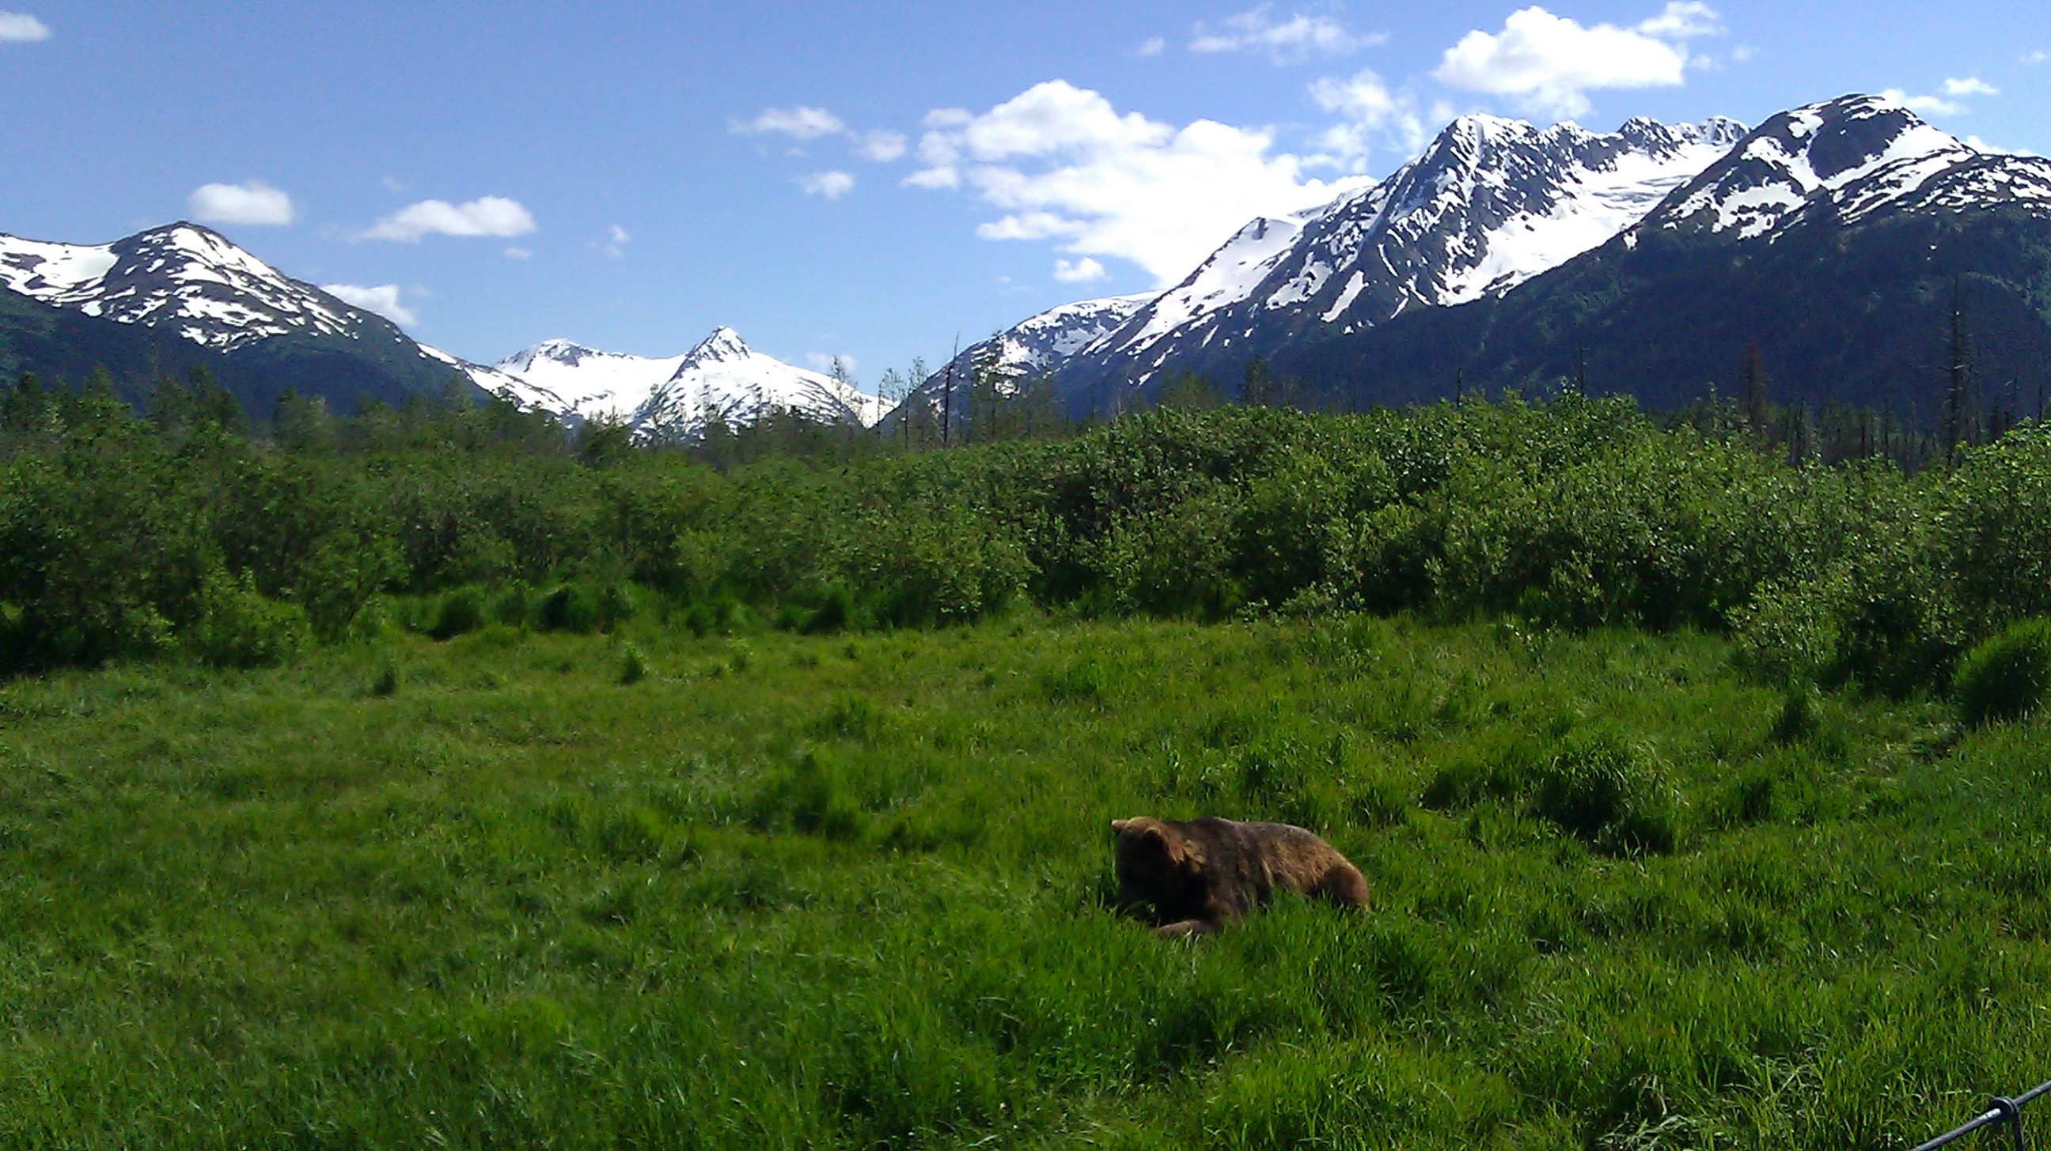
The World is So Big, p. 235
1:
Image: Cherice Montgomery
Notes:
Montgomery, Cherice. (2015). Alaska Wildlife Conservation Center in Portage, Alaska.

Slide 7
grow
body
learn
Image: The Church of Jesus Christ
Notes:
The Church of Jesus Christ of Latter-day Saints. (2020). Newborn baby. A newborn baby sleeping. Gospel Media. Retrieved April 11, 2020, from https://www.churchofjesuschrist.org/media-library/images/newborn-baby-1234674?lang=eng&_r=1

Slide 8
☒
☹

mistakes
sick
die
Image: Microsoft
Notes:
Images: Microsoft Symbols.

Slide 9
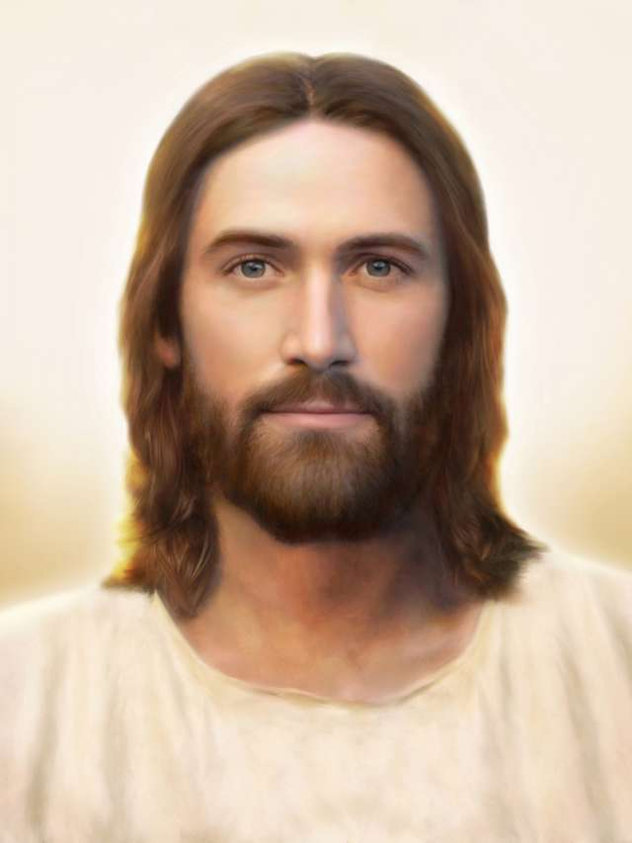
He Sent His Son, p. 34
1:☺
Image: Brent Borup
Notes:
Borup, Brent. (2020). Light of the World. Light of the World, by Brent Borup. Gospel Media Library. Retrieved April 11, 2020, from https://www.churchofjesuschrist.org/media-library/images/light-of-the-world-jesus-christ-1301483?lang=eng

Slide 10
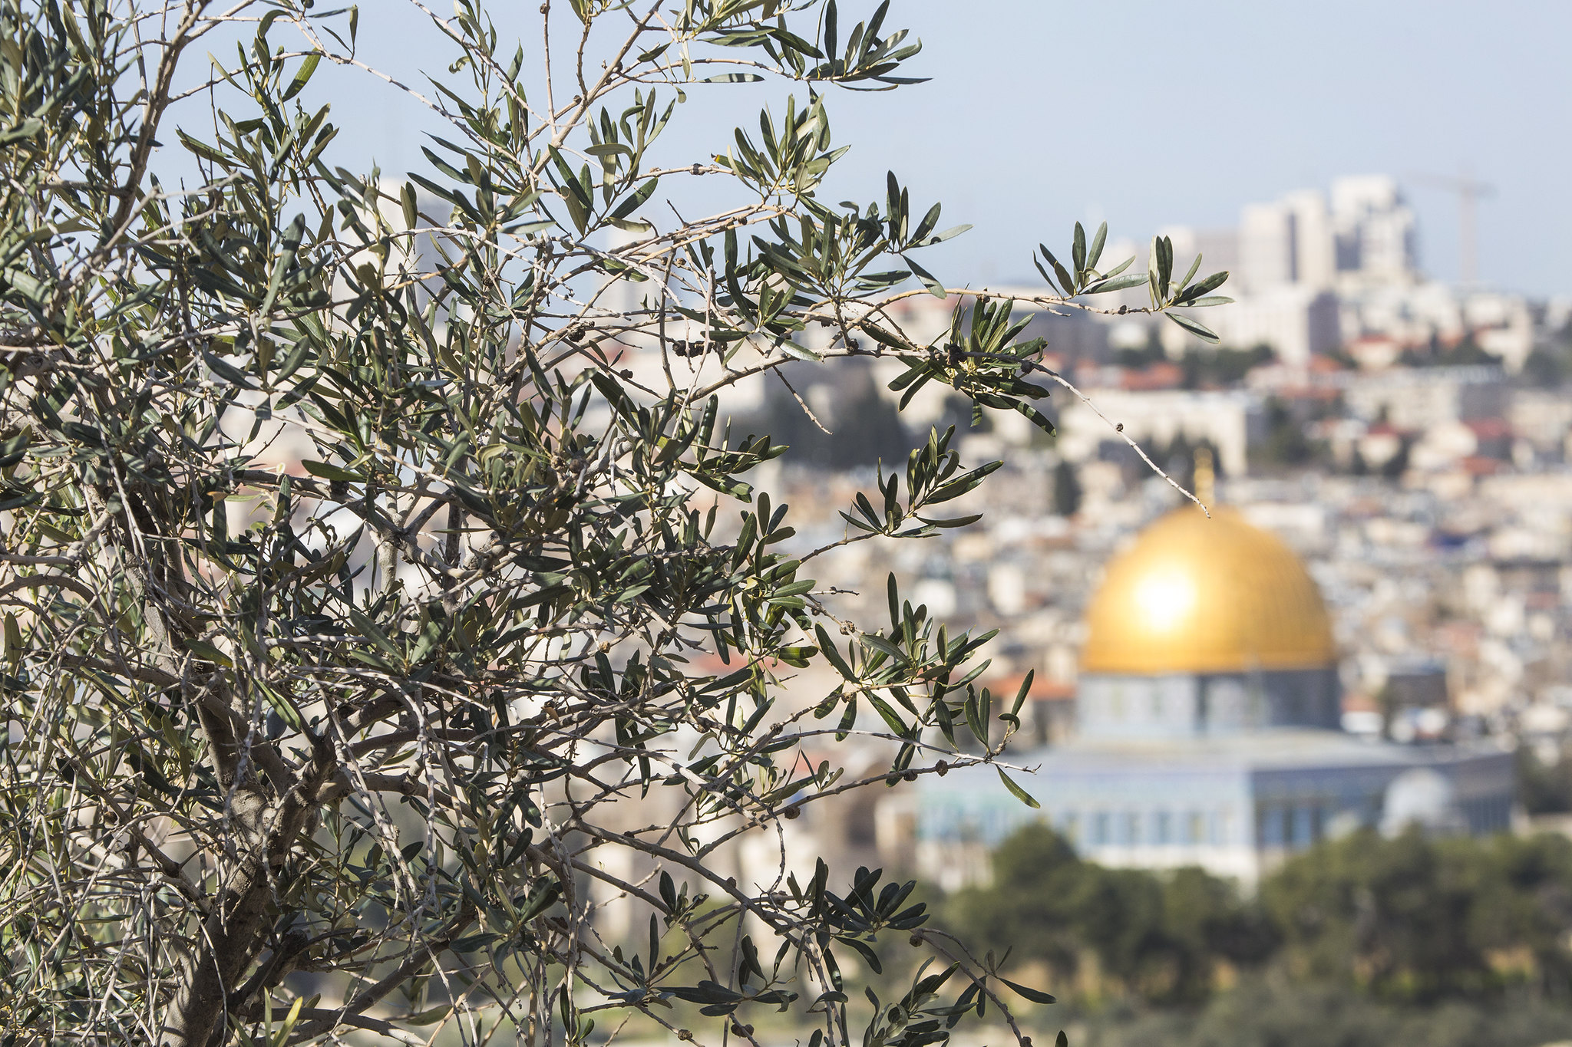
Jesus lived in Jerusalem.
Image: Steve Evans
Notes:
Evans, Steve. (2016, Feb. 5). Olive tree, Jerusalem: Overlooking the old city of Jerusalem, this was taken form the Mount of Olives. Flickr. Retrieved March 8, 2020, from https://www.flickr.com/photos/babasteve/26319511901/ Used under a Creative Commons Attribution Non-commercial License.

Slide 11
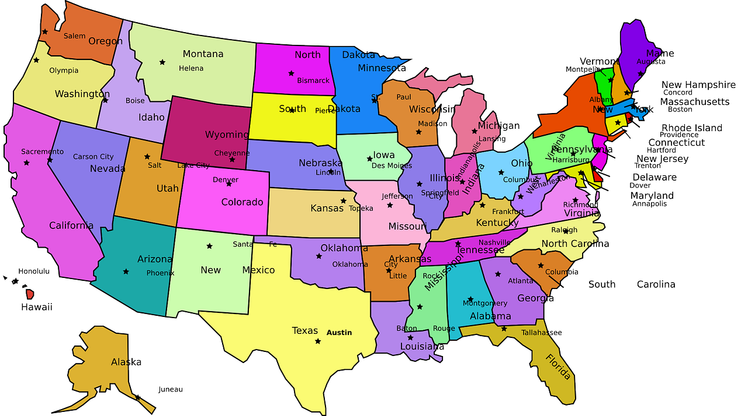
Image: Open Clipart Vectors
Notes:
Open-Clipart-Vectors. (2013, Oct. 21). PIxabay. Retrieved April 11, 2020, from https://pixabay.com/vectors/usa-capitals-map-united-states-155594/ Used under a Pixabay License. Free for commercial use. No attribution required.

Slide 12
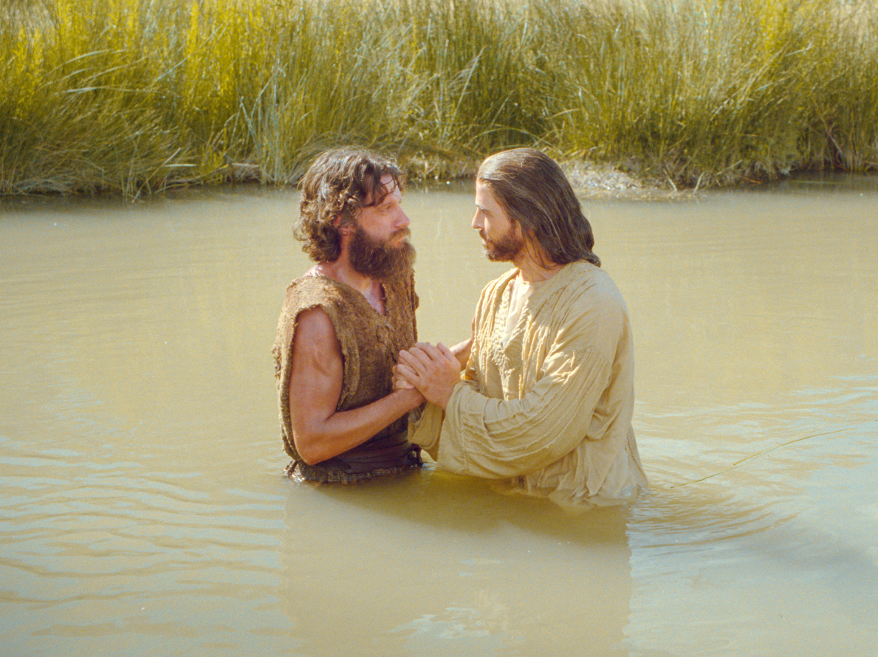
Jesus promised to help us.
We promise to follow Jesus.
Image: The Church of Jesus Christ
Notes:
The Church of Jesus Christ. (2020). I Have Need to Be Baptized of Thee. As Jesus enters the water to be baptized, John declares that he must be baptized by Jesus. Jesus responds that He must be baptized to fulfill all righteousness. Gospel Media Library. Retrieved April 12, 2020, from https://www.churchofjesuschrist.org/media-library/images/jesus-christ-baptism-1402597?lang=eng

Slide 13
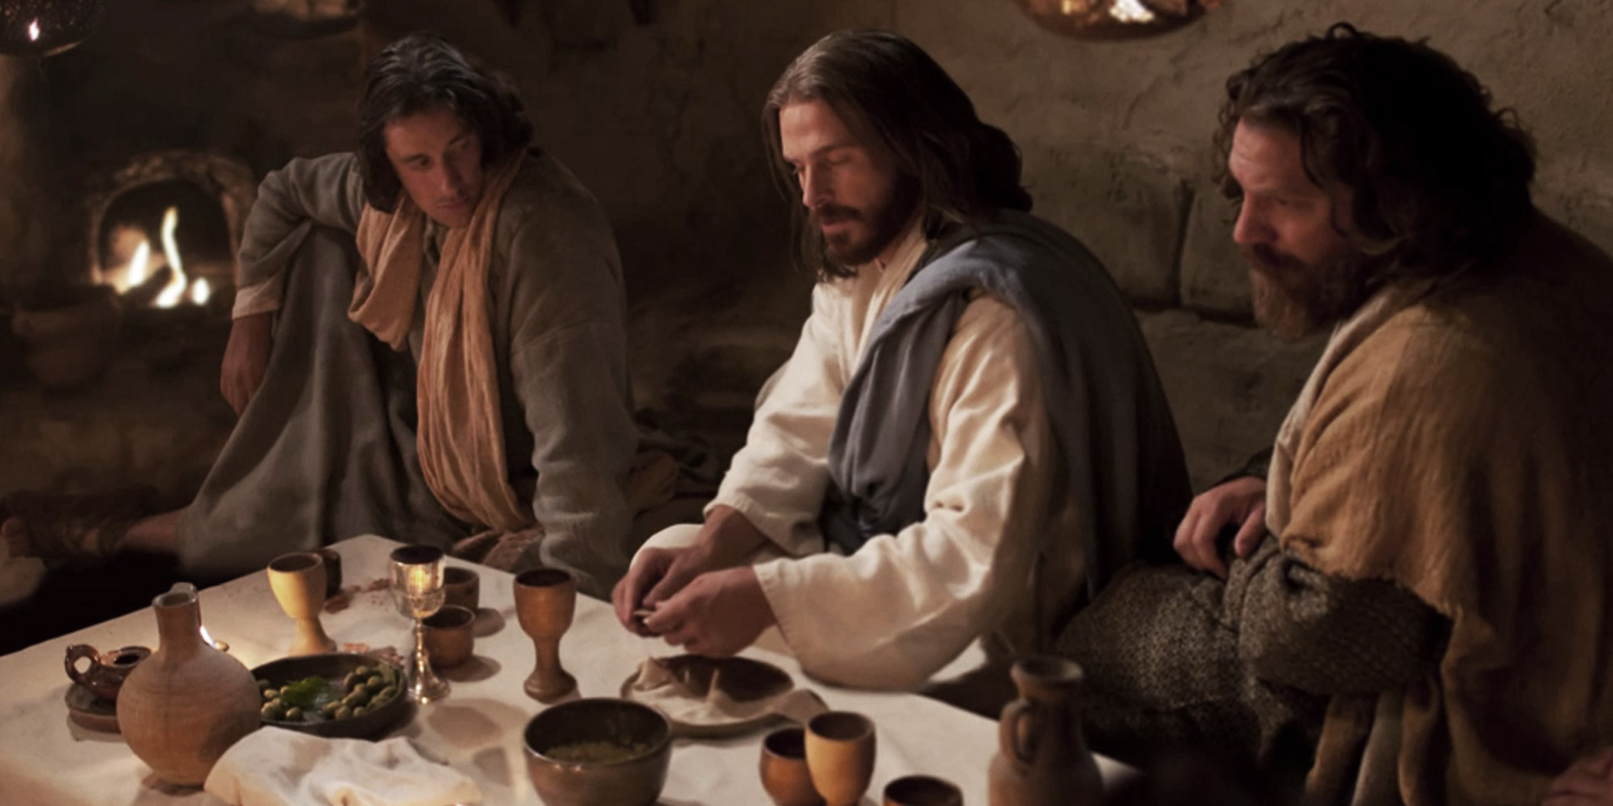
Image: The Church of Jesus Christ
Notes:
The Church of Jesus Christ. (2020). The resurrected Jesus appears and shows Himself to the Apostles. Gospel Media Library. Retrieved April 11, 2020, from https://www.churchofjesuschrist.org/media-library/images/resurrection-jesus-appears-apostles-1103199?lang=eng&clang=ase

Slide 14
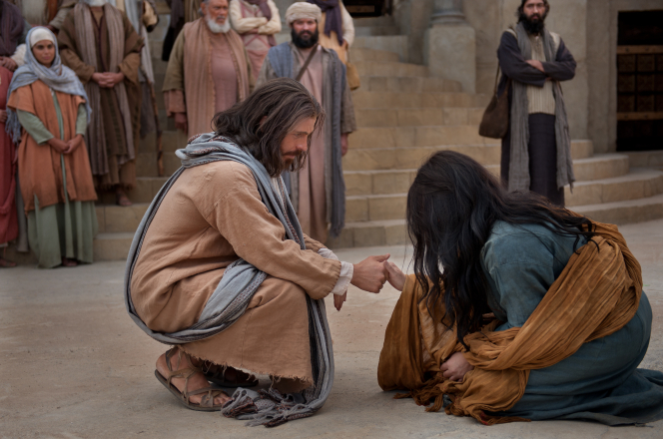
help
promise
Image: The Church of Jesus Christ
Notes:
The Church of Jesus Christ. (2020). Christ Reaching to Help Woman. Jesus reaches out to help the woman taken in adultery. Gospel Media Library. Retrieved April 11, 2020, from https://www.churchofjesuschrist.org/media-library/images/jesus-woman-taken-in-adultery-948852?lang=eng

Slide 15
The Miracle by Shawna Edwards
Image: 321beckarama
Notes:
321beckarama. (2019, Jun. 22). The Miracle by Shawna Edwards (with lyrics). YouTube. Retrieved April 10, 2020, from https://www.youtube.com/watch?v=ES4_29QwKpI

Slide 16
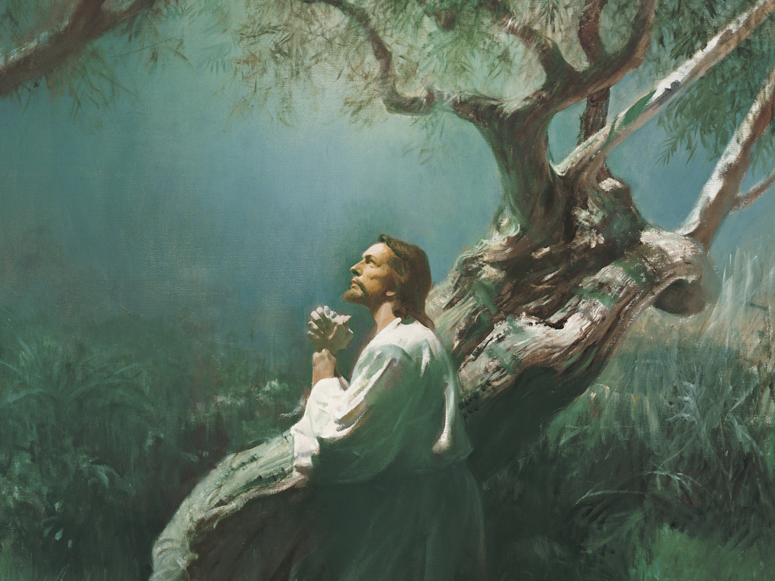
To keep His promise to us, Jesus had to feel “all that was sad, wicked, or bad, all the pain we would ever know.”
Image: Harry Anderson
Notes:
The Church of Jesus Christ. (2020). Jesus Praying in Gethsemane (Christ in Gethsemane). Jesus Praying in Gethsemane (Christ in Gethsemane), by Harry Anderson (62175); GAB 56; GAK 227; Primary manual 1-72; Primary manual 2-52; Primary manual 3-46; Primary manual 6-47; Primary manual 7-30; Matthew 26:36–45; Luke 22:39–46; Alma 7:11–13. Gospel Media. Retrieved April 11, 2020, from https://www.churchofjesuschrist.org/media-library/images/jesus-praying-in-gethsemane-39591?lang=eng&_r=1

Slide 17
Gethsemane by Roger & Melanie Hoffman
Video: cate0424
Notes:
Cate0424. (2015, Sept. 28). Gethsemane song with lyrcis. YouTube. Retrieved April 12, 2020, from https://www.youtube.com/watch?v=SnPANvcX6B0

Slide 18
Satan made sure people didn’t understand why Jesus was important.
Image: The Church of Jesus Christ
Notes:
The Church of Jesus Christ. (2020). Christ in Captivity. Jesus Christ standing with His hands tied. Gospel Media. Retrieved April 11, 2020, from https://www.churchofjesuschrist.org/media-library/images/jesus-easter-821713?lang=eng

Slide 19
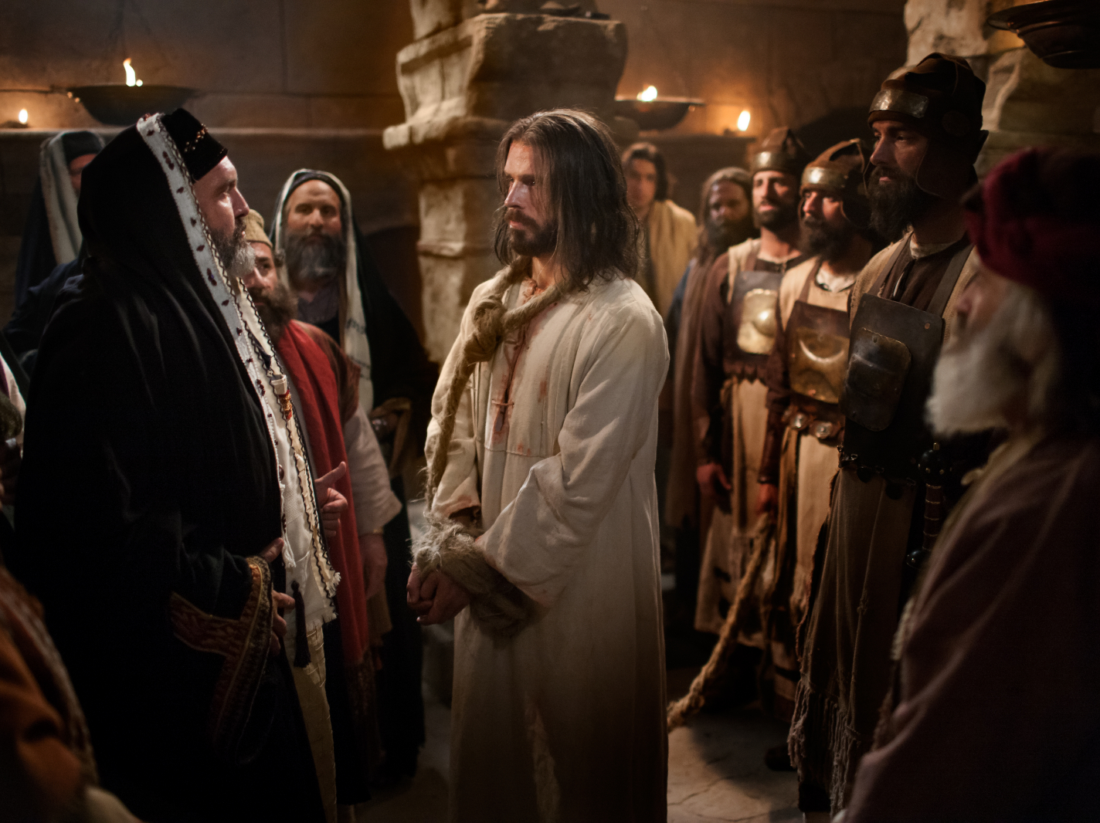
The people decided to kill him.
Image: The Church of Jesus Christ
Notes:
The Church of Jesus Christ. (2020). Jesus Christ before Caiaphas. Jesus standing bound before Caiaphas and the Sanhedrin. Gospel Media. Retrieved April 11, 2020, from https://www.churchofjesuschrist.org/media-library/images/pictures-of-jesus-trial-999236?lang=eng

Slide 20
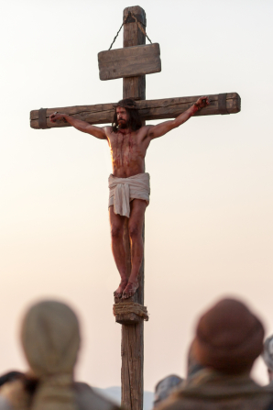
Jesus knew the second part of his promise was to die for us.
Image: The Church of Jesus Christ
Notes:
The Church of Jesus Christ. (n.d.). Detail of Christ on the cross. A detail of Jesus Christ on the cross at the time of His death.. Gospel Media. Retrieved April 6, 2020, from https://www.churchofjesuschrist.org/media-library/images/easter-pictures-jesus-cross-1127727?lang=eng&_r=1

Slide 21
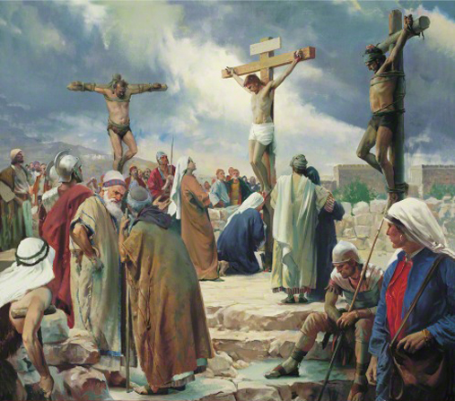
But he asked Heavenly Father to forgive the people who killed him because he loved them so much!
Image: Harry Anderson
Notes:
The Church of Jesus Christ. (2020). The Crucifixion. The Crucifixion, by Harry Anderson (62505); GAK 230; GAB 57; Primary manual 1-59; Primary manual 2-61; Primary manual 3-71; Primary manual 4-11; Primary manual 6-27; Primary manual 7-33; Psalm 22:16; Matthew 27:31–50; Mark 15:20–37; Luke 23:33–46; John 19:16–37; 1 Nephi 19:10; 2 Nephi 5; 6:9; 10:3; 25:13; Mosiah 3:9; 15:7. Gospel Media. Retrieved April 10, 2020, from https://www.churchofjesuschrist.org/media-library/images/crucifixion-christ-anderson-39598?lang=eng&_r=1

Slide 22
To Think About Jesus – p. 71
1:
Image: Phyllis Luch
Notes:
Luch, Phyllis. (2020). Children with Christ. Jesus hugging four children. From the Children’s Songbook, page 82, “When He Comes Again”; watercolor illustration by Phyllis Luch. Gospel Media Library. Retrieved April 11, 2020, from https://www.churchofjesuschrist.org/media-library/images/jesus-holding-children-phyllis-luch-358169?lang=eng&clang=ase

Slide 23
Image: Richard Hull
Notes:
Hull, Richard. (2020). Children Rolling Their Hands. Three children rolling their hands while singing a song. From the Children’s Songbook, page 274, “Roll Your Hands”; watercolor illustration by Richard Hull. Gospel Media Library. Retrieved April 11, 2020, from https://www.churchofjesuschrist.org/media-library/images/childrens-songbook-lds-358201?lang=eng

Slide 24
Image: Phyllis Luch
Notes:
Luch, Phyllis. (2020). Girl Sitting with a Hat. A young girl holding a hat and sitting atop a hill. From the Children’s Songbook, page 2, “I Am a Child of God”; watercolor illustration by Phyllis Luch. Gospel Media Library. Retrieved April 11, 2020, from https://www.churchofjesuschrist.org/media-library/images/children-songbook-art-153031?lang=eng

Slide 25
Image: Beth Whittaker
Notes:
Whittaker, Beth. (The Atonement). Christ praying in the Garden of Gethsemane. From the Children’s Songbook, page 123, “The Third Article of Faith”; watercolor illustration by Beth Whittaker. Gospel Media Library. Retrieved April 11, 2020, from https://www.churchofjesuschrist.org/media-library/images/children-songbook-art-153009?lang=eng&clang=ase

Slide 26
Image: Phyllis Luch
Notes:
Luch, Phyllis. (2020). Girl Holding Scriptures. A girl holding her scriptures. From the Children’s Songbook, page 71, “To Think about Jesus”; watercolor illustration by Phyllis Luch. Gospel Media Library. Retrieved April 11, 2020, from https://www.churchofjesuschrist.org/media-library/images/children-songbook-art-153093?lang=eng

Slide 27
Image: Phyllis Luch
Notes:
Luch, Phyllis. (2020). Small Girl with a Book. A small girl looking at a book. From the title page of the Children’s Songbook; watercolor illustration by Phyllis Luch. Gospel Media Library. Retrieved April 11, 2020, from https://www.churchofjesuschrist.org/media-library/images/children-songbook-153103?lang=eng&_r=1

Slide 28
Image: Beth Whittaker
Notes:
Whittaker, Beth. (2020). Looking at a Portrait of Christ. A boy standing and looking at a portrait of Christ. From the Children’s Songbook, page 160, “Choose the Right Way”; watercolor illustration by Beth Whittaker. Gospel Media Library. Retrieved April 11, 2020, from https://www.churchofjesuschrist.org/media-library/images/children-songbook-art-153019?lang=eng&_r=1

Slide 29
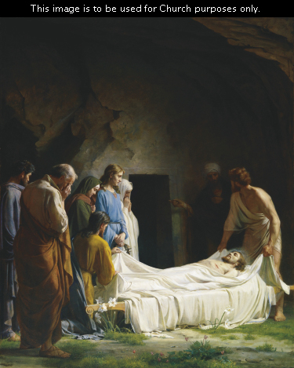
Image: Carl Heinrich Bloch
Notes:
The Church of Jesus Christ. (2020). Burial of Jesus (The Burial of Christ). Burial of Jesus (The Burial of Christ), by Carl Heinrich Bloch (62180); GAK 231; GAB 58; Primary manual 1-73; Primary manual 3-74; Primary manual 7-34; Isaiah 53:9; Matthew 27:57–61; John 19:38–42. This image is to be used for Church purposes only. Gospel Media. Retrieved April 10, 2020, from https://www.churchofjesuschrist.org/media-library/images/jesus-burial-tomb-1083559?lang=eng&_r=1

Slide 30
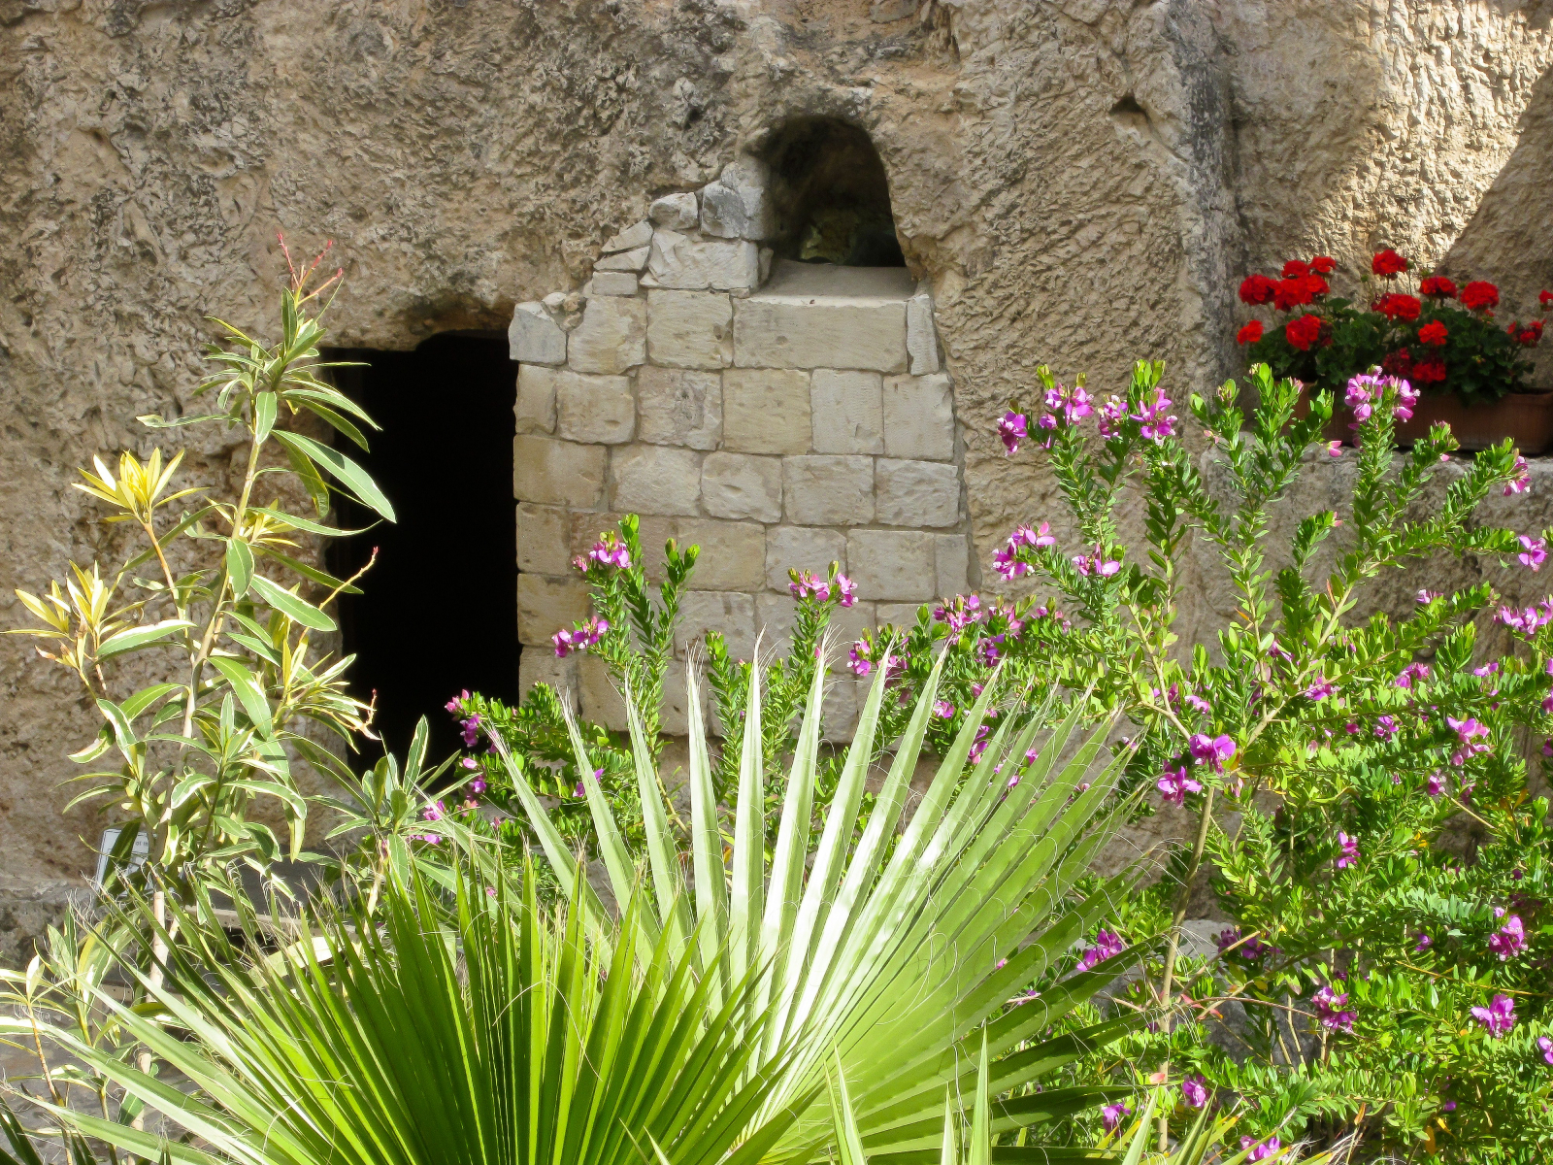
3 days
Image: The Church of Jesus Christ
Notes:
The Church of Jesus Christ. (2020). Entrance to the Garden Tomb. The entrance to the Garden Tomb amid native plants and flowers. Gospel Media. Retrieved April 10, 2020, from https://www.churchofjesuschrist.org/media-library/images/garden-tomb-929388?lang=eng&_r=1

Slide 31
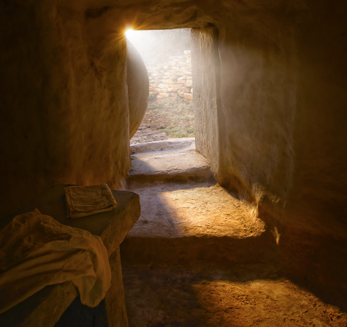
1: 2:
Faith, p. 96
Image: The Church of Jesus Christ
Notes:
The Church of Jesus Christ. (n.d.). Garden tomb. A portrayal of Christ’s empty tomb after his resurrection.. Gospel Media. Retrieved April 6, 2020, from https://www.churchofjesuschrist.org/media-library/images/jesus-christ-empty-tomb-goshen-utah-1574218?lang=eng

Slide 32
Image: The Church of Jesus Christ
Notes:
The Church of Jesus Christ of Latter-day Saints. (2020). Peter and John Look for Christ. Peter and John enter Christ's tomb to find that He is gone. Gospel Media Library. Retrieved April 10, 2020, from https://www.churchofjesuschrist.org/media-library/images/bible-videos-empty-tomb-peter-1426755?lang=eng

Slide 33
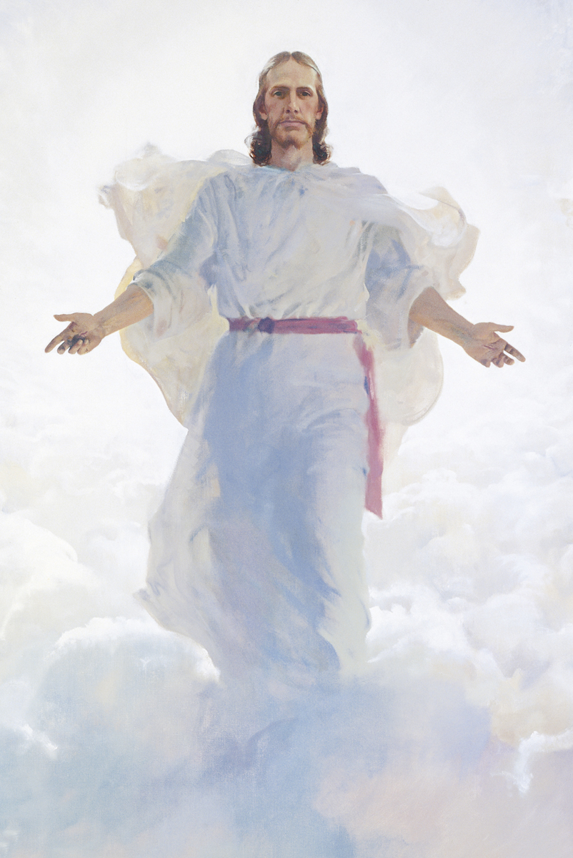
resurrected
Image: Harry Anderson
Notes:
Anderson, Harry. (2020). The Resurrected Jesus Christ. The Resurrected Jesus Christ, by Harry Anderson (62187); GAK 239; Primary manual 2-65; Primary manual 3-15; Primary manual 4-49; Primary manual 6-48; Primary manual 7-37; Primary manual 7-25; Matthew 16:27; 24:30–31; 25:31. Gospel Media Library. Retrieved April 12, 2020, from https://www.churchofjesuschrist.org/media-library/images/the-second-coming-39621?lang=eng&_r=1

Slide 34
Image: The Church of Jesus Christ
Notes:
The Church of Jesus Christ of Latter-day Saints. (2020). Mary Magdalene Weeps. Mary Magdalene weeps after seeing that Christ's body is gone. Gospel Media Library. Retrieved April 10, 2020, from https://www.churchofjesuschrist.org/media-library/images/bible-videos-empty-tomb-mary-1426754?lang=eng

Slide 35
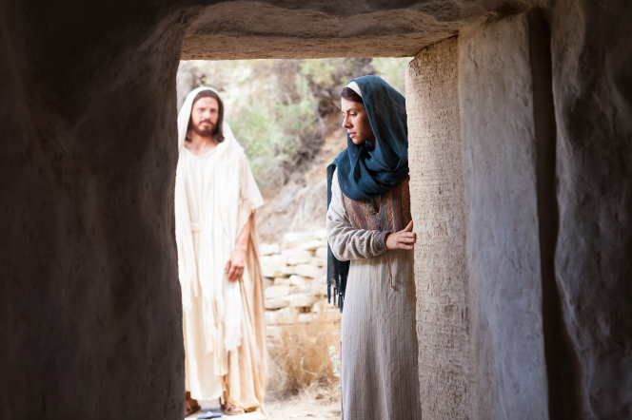
Image: The Church of Jesus Christ
Notes:
The Church of Jesus Christ. (n.d.). Mary Encounters Christ at the Tomb. Mary weeps outside the tomb while Christ approaches to speak with her. Gospel Media. Retrieved April 6, 2020, from https://www.churchofjesuschrist.org/media-library/images/easter-pictures-mary-magdalene-tomb-1104071?lang=eng&_r=1

Slide 36
Image: The Church of Jesus Christ
Notes:
The Church of Jesus Christ of Latter-day Saints. (2020). Mary Speaks with the Resurrected Christ. Mary Magdalene speaks with Christ after His Resurrection. Gospel Media Library. Retrieved April 10, 2020, from https://www.churchofjesuschrist.org/media-library/images/easter-pictures-resurrection-mary-magdalene-1242543?lang=eng

Slide 37
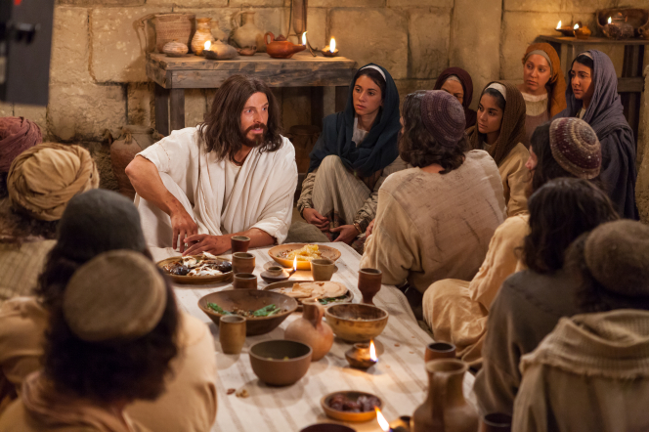
Did Jesus Really Live Again?, p. 64
1:
2: 
Image: The Church of Jesus Christ
Notes:
The Church of Jesus Christ. (2020). Christ Appears to the Apostles. The resurrected Jesus appears and shows Himself to the Apostles. Gospel Media. Retrieved April 10, 2020, from https://www.churchofjesuschrist.org/media-library/images/resurrection-jesus-appears-apostles-1103199?lang=eng&_r=1

Slide 38
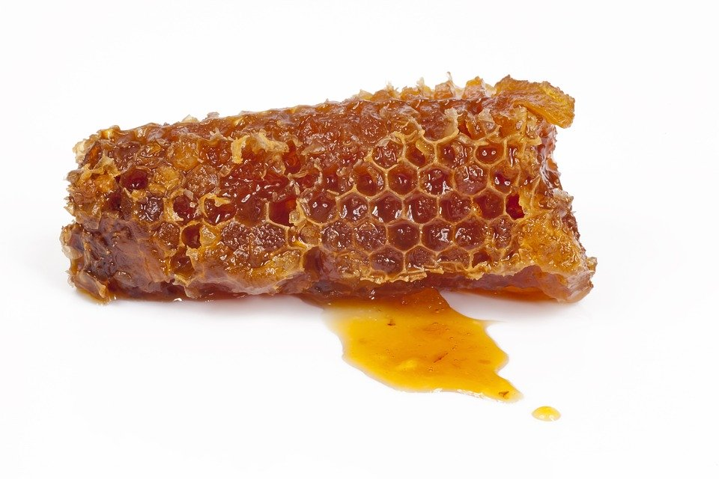
honeycomb
Image: Mel_gama
Notes:
Mel_gama. (2017, Mar. 5). Pixabay. Retrieved April 5, 2020, from https://pixabay.com/photos/honeycomb-honey-bee-nature-2113867/ Used under a Pixabay License. Free for commercial use. No attribution required.

Slide 39
Because Jesus died, everyone with a body will live again.
Image: The Church of Jesus Christ
Notes:
The Church of Jesus Christ of Latter-day Saints. (n.d.). Reenactment of Christ with Children. A reenactment showing Christ sitting with a group of children. Gospel Media Library. Retrieved April 10, 2020, from https://www.churchofjesuschrist.org/media-library/images/jesus-with-children-craig-dimond-82779?lang=eng

Slide 40
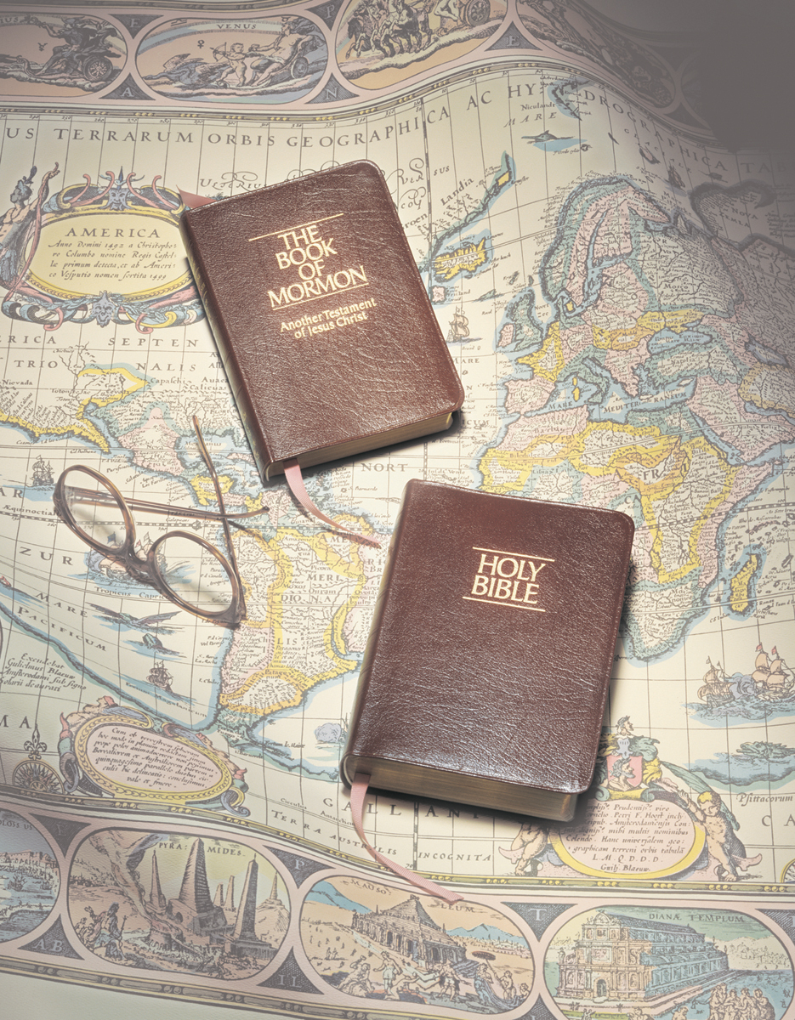
The rest of the story
Image: Grant Heaton
Notes:
Heaton, Grant. (n.d.). Scriptures, by Grant Heaton. Gospel Media Library. Retrieved March 31, 2020, from https://www.churchofjesuschrist.org/media-library/images/bible-and-book-of-mormon-261218?lang=eng

Slide 41
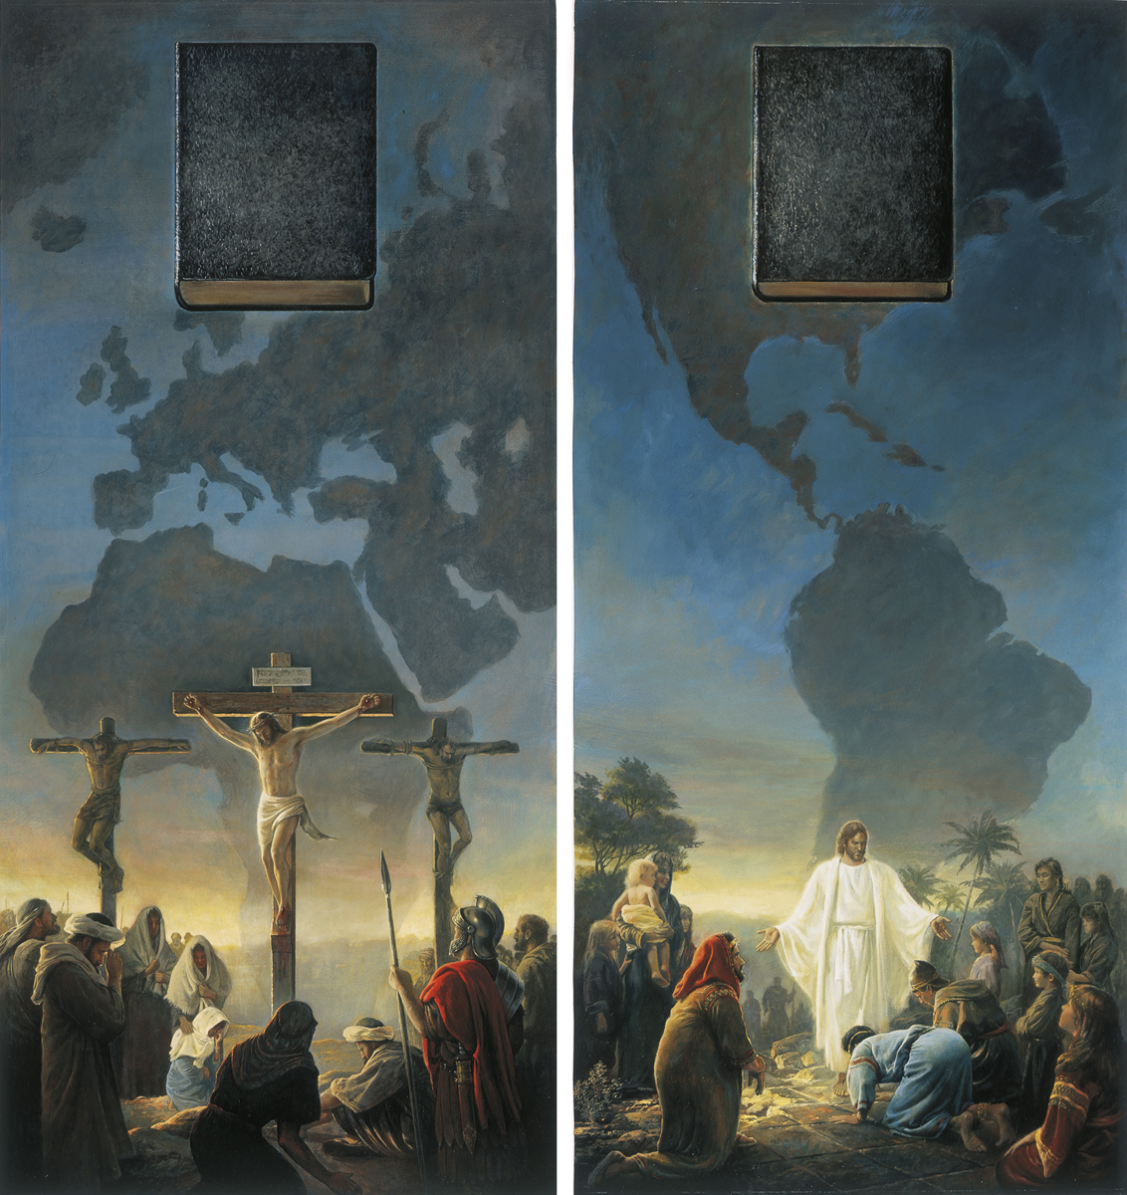
Image: Greg K. Olsen
Notes:
The Church of Jesus Christ. (2020). The Bible and the Book of Mormon Testify of Christ (The Bible and Book of Mormon: Two Witnesses). The Bible and the Book of Mormon Testify of Christ (The Bible and Book of Mormon: Two Witnesses), by Greg K. Olsen; GAK 326; Ezekiel 37:16–19; 1 Nephi 13:23–25, 38–41; 2 Nephi 3:12; Doctrine and Covenants 21:1; 27:5. Gospel Media. Retrieved April 10, 2020, from https://www.churchofjesuschrist.org/media-library/images/bible-book-of-mormon-39683?lang=eng

Slide 42
Image: John Scott
Notes:
The Church of Jesus Christ of Latter-day Saints. (2020). Detail from Jesus Christ Visits the Americas. A detail from Jesus Christ Visits the Americas, by John Scott. Gospel Media Library. Retrieved April 10, 2020, from https://www.churchofjesuschrist.org/media-library/images/jesus-nephites-859163?lang=eng

Slide 43
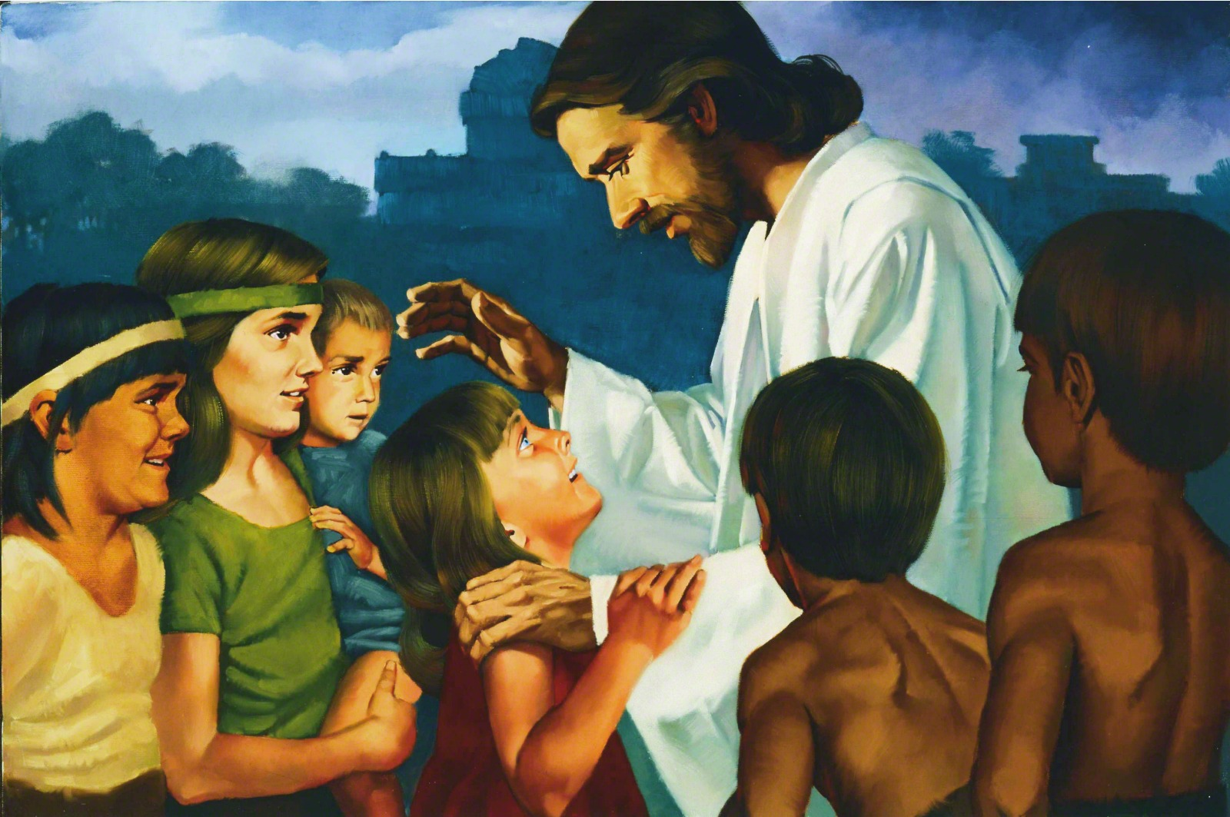
Image: Ted Henniger
Notes:
Henniger, Ted. (2020). Christ Blessing the Nephite Children (Jesus Christ Blessing the Nephite Children). Christ Blessing the Nephite Children (Jesus Christ Blessing the Nephite Children), by Ted Henninger; Primary manual 1-20; Primary manual 3-57. Gospel Media Library. Retrieved April 12, 2020, from https://www.churchofjesuschrist.org/media-library/images/christ-blessing-nephite-children-451708?lang=eng

Slide 44
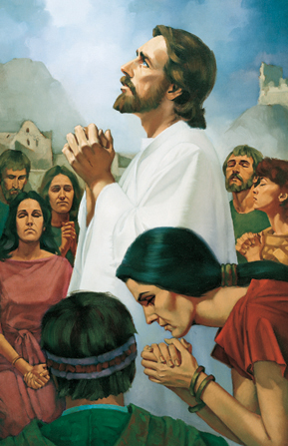
Image: Ted Henniger
Notes:
Henniger, Ted. (2020). Christ Praying with the Nephites. Christ Praying with the Nephites, by Ted Henninger. Gospel Media Library. Retrieved April 10, 2020, from https://www.churchofjesuschrist.org/media-library/images/christ-praying-nephites-henninger-art-37745?lang=eng

Slide 45
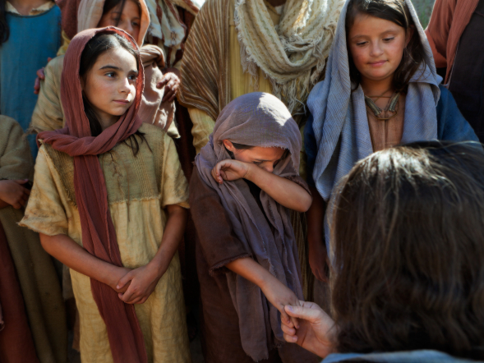
1: ASL
Love One Another, p. 136
Image: The Church of Jesus Christ
Notes:
Barrett, Robert T. (2020). Christ Speaking with Children. Christ talks with a group of children, one of whom is crying. Gospel Media Library. Retrieved April 10, 2020, from https://www.churchofjesuschrist.org/media-library/images/pictures-of-jesus-with-children-958511?lang=eng&_r=1

Slide 46
Image: Jennifer Harward
Notes:
Harward, Jennifer. (n.d.). Sign language for “love one another.” A series of sign language illustrations to help children learn the signs for “Love One Another.” From the Children’s Songbook, page 137, “Love One Another”; illustration by Jennifer Harward. Gospel Media. Retrieved April 1, 2020, from https://www.churchofjesuschrist.org/media-library/images/sign-language-love-one-another-1416354?lang=eng&clang=ase

Slide 47
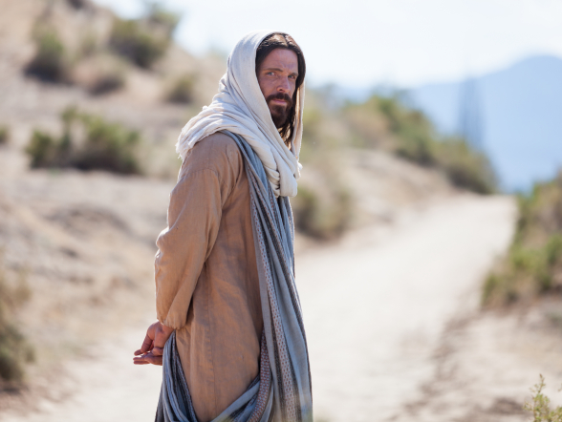
“Come, follow me”
(Luke 18:22)
Image: The Church of Jesus Christ
Notes:
Barrett, Robert T. (2020). Portrait of Christ Looking Back. Portrait of Christ facing away, looking back over His shoulder. Gospel Media Library. Retrieved April 10, 2020, from https://www.churchofjesuschrist.org/media-library/images/pictures-of-jesus-1128833?lang=eng&_r=1

Slide 48
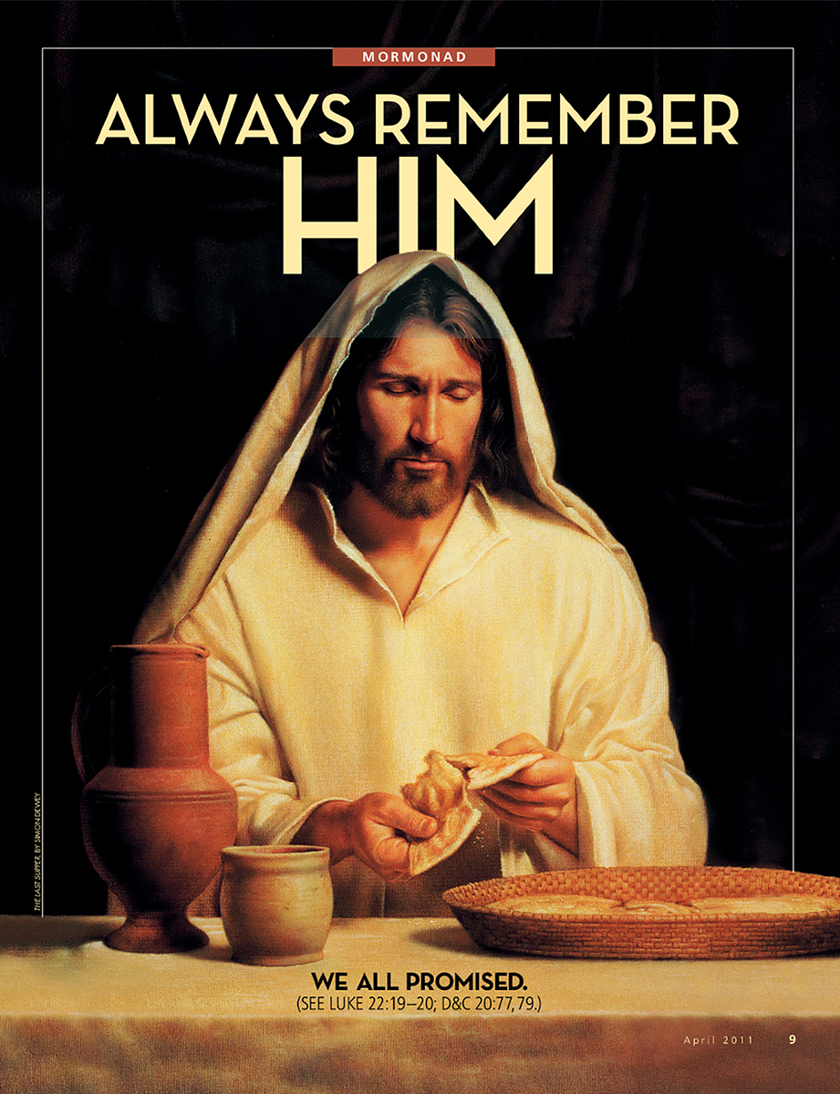
Image: The Church of Jesus Christ
Notes:
The Church of Jesus Christ of Latter-day Saints. (2020). Always Remember Him. Always Remember Him. We all promised. (See Luke 22:19–20; D&C 20:77,79.) Apr. 2011. Gospel Media Library. Retrieved April 11, 2020, from https://www.churchofjesuschrist.org/media-library/images/mormonad-always-remember-him-1118439?lang=eng&clang=ase

Slide 49
Peace in Christ
Image: Cacie Waite
Notes:
Waite, Cacie. (2018, Jul. 15). Peace in Christ. YouTube. Retrieved April 10, 2020, from https://www.youtube.com/watch?v=KMCCJWaS4Ac

Slide 50
Peace in Christ in 21 Languages
Image: Andrew Wang
Notes:
Wang, Andrew. (2020, Mar. 27). Peace in Christ (sung by missionaries in 21 languages) 2020. YouTube. Retrieved April 10, 2020, from https://www.youtube.com/watch?v=x0kki9l02KM

Slide 51
37
?
Image: The Church of Jesus Christ
Notes:
The Church of Jesus Christ of Latter-day Saints. (2020). Easter Eggs in the Grass. Several plastic Easter eggs lying in green grass. Gospel Media Library. Retrieved April 10, 2020, from https://www.churchofjesuschrist.org/media-library/images/plastic-easter-eggs-461679?lang=eng&_r=1

Slide 52
Happy Easter!
Image: The Church of Jesus Christ
Notes:
The Church of Jesus Christ of Latter-day Saints. (2020). Easter Lily. A white lily on a plain background. Gospel Media Library. Retrieved April 10, 2020, from https://www.churchofjesuschrist.org/media-library/images/easter-lily-809062?lang=eng

Slide 53
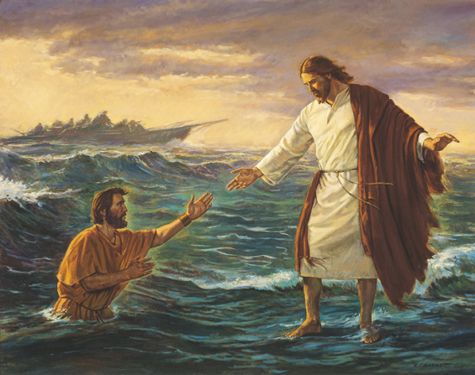
Image: Robert T. Barrett
Notes:
Barrett, Robert T. (2020). Christ Walking on the Water. Christ Walking on the Water, by Robert T. Barrett; GAK 243; Primary manual 7-17; Matthew 14:22–33; Mark 6:45-51
Gospel Media Library. Retrieved April 10, 2020, from https://www.churchofjesuschrist.org/media-library/images/jesus-walking-on-water-129516?lang=eng&_r=1

Slide 54
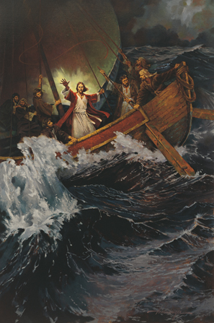
Image: Ted Henninger
Notes:
Henninger, Ted. (2020). Stilling the Storm. Stilling the Storm, by Ted Henninger (62139); GAK 214; Primary manual 2-28; Primary manual 7-15; Matthew 8:23–27; Mark 4:36–41; Luke 8:22–25.
Gospel Media Library. Retrieved April 12, 2020, from https://www.churchofjesuschrist.org/media-library/images/jesus-calms-the-storm-39557?lang=eng&_r=1

Slide 55
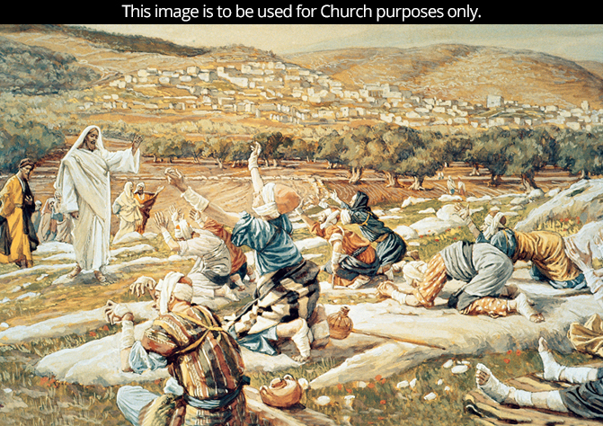
Image: The Church of Jesus Christ
Notes:
The Church of Jesus Christ of Latter-day Saints. (2020). Ten Lepers (The Healing of the Ten Lepers). Ten Lepers (The Healing of the Ten Lepers), by James Tissot; Primary manual 2-45; Primary manual 7-23. This image is to be used for Church purposes only. Gospel Media Library. Retrieved April 12, 2020, from https://www.churchofjesuschrist.org/media-library/images/ten-lepers-christ-healed-tissot-39577?lang=eng

Slide 56
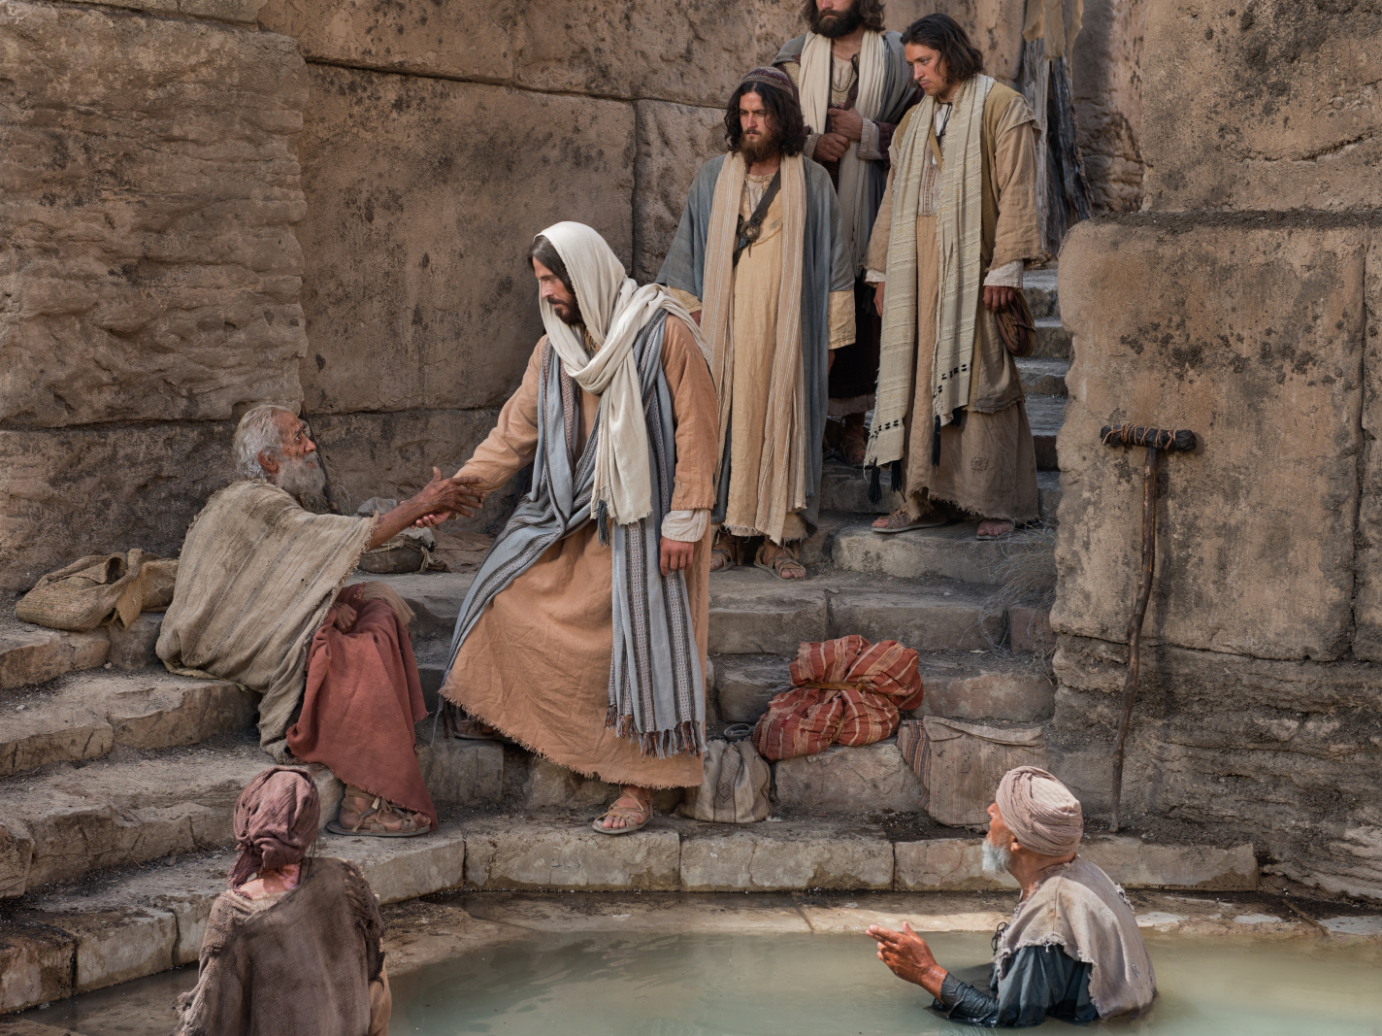
Image: The Church of Jesus Christ
Notes:
The Church of Jesus Christ of Latter-day Saints. (2020). Christ Healing at Bethesda. Christ at the pool of Bethesda, reaching toward the man waiting there. Gospel Media Library. Retrieved April 12, 2020, from https://www.churchofjesuschrist.org/media-library/images/bible-pictures-pool-of-bethesda-1138571?lang=eng&_r=1

Slide 57
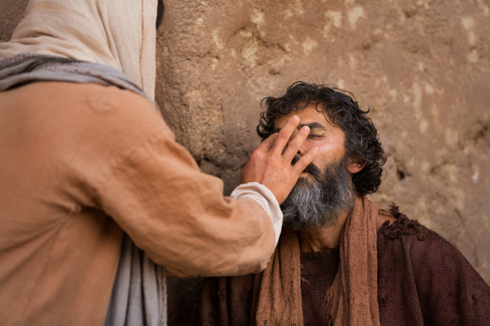
Image: The Church of Jesus Christ
Notes:
The Church of Jesus Christ of Latter-day Saints. (2020). Christ Heals a Blind Man. Christ heals the blind man by putting clay on his eyes. Gospel Media Library. Retrieved April 12, 2020, from https://www.churchofjesuschrist.org/media-library/images/miracles-of-jesus-healing-blind-man-1138534?lang=eng&_r=1

Slide 58
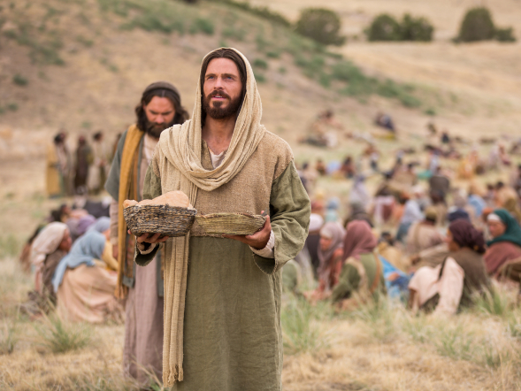
Image: The Church of Jesus Christ
Notes:
The Church of Jesus Christ of Latter-day Saints. (2020). Jesus Feeds the 5,000. Jesus blesses the bread and fish to feed the people gathered to hear His teachings. Gospel Media Library. Retrieved April 12, 2020, from https://www.churchofjesuschrist.org/media-library/images/miracles-of-jesus-feeding-5000-1433376?lang=eng&_r=1

Slide 59
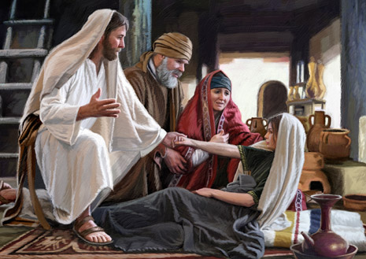
Image: Dan Burr
Notes:
Burr, Dan. (2013, Sept.). Jesus performed numerous miracles for people during times of need. He healed a leper, calmed the sea, and raised Jairus’s daughter from the dead. Illustration by Dan Burr. Christ-like mercy. Ensign.
Retrieved April 12, 2020, from https://www.churchofjesuschrist.org/bc/content/shared/content/images/magazines/ensign/2013/09/en13sep33-jarius-daughter.jpg

Slide 60
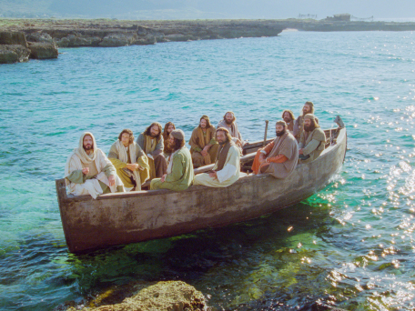
Image: The Church of Jesus Christ
Notes:
The Church of Jesus Christ of Latter-day Saints. (2020). Jesus Teaches His Disciples. Jesus declares the parables of the wheat and the tares, mustard seed, and leaven to His disciples.
. Gospel Media Library. Retrieved April 12, 2020, https://www.churchofjesuschrist.org/media-library/images/jesus-christ-preaching-1402873?lang=eng&_r=1

Slide 61
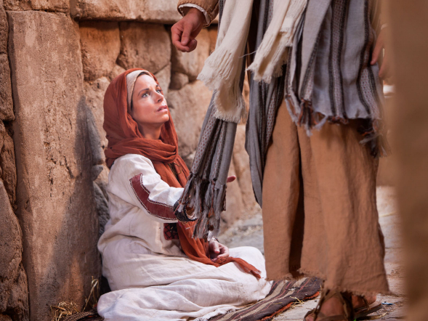
Image: The Church of Jesus Christ
Notes:
The Church of Jesus Christ of Latter-day Saints. (2020). Woman Touches Clothes of Jesus. A woman with an issue of blood touches the clothes of Jesus. Gospel Media Library. Retrieved April 12, 2020, from https://www.churchofjesuschrist.org/media-library/images/bible-video-jesus-miracles-woman-1400924?lang=eng&_r=1

Slide 62
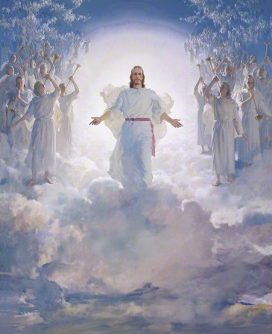
Image: Harry Anderson
Notes:
Anderson, Harry. (2020). The Second Coming. The Second Coming, by Harry Anderson (62562); GAK 238; GAB 66; Primary manual 5-28; Primary manual 6-28; Primary manual 7-25; Matthew 16:27; 24:30–31; 25:31. Gospel Media Library. Retrieved April 12, 2020, from https://www.churchofjesuschrist.org/media-library/images/the-second-coming-39618?lang=eng&_r=1

