Slide 1
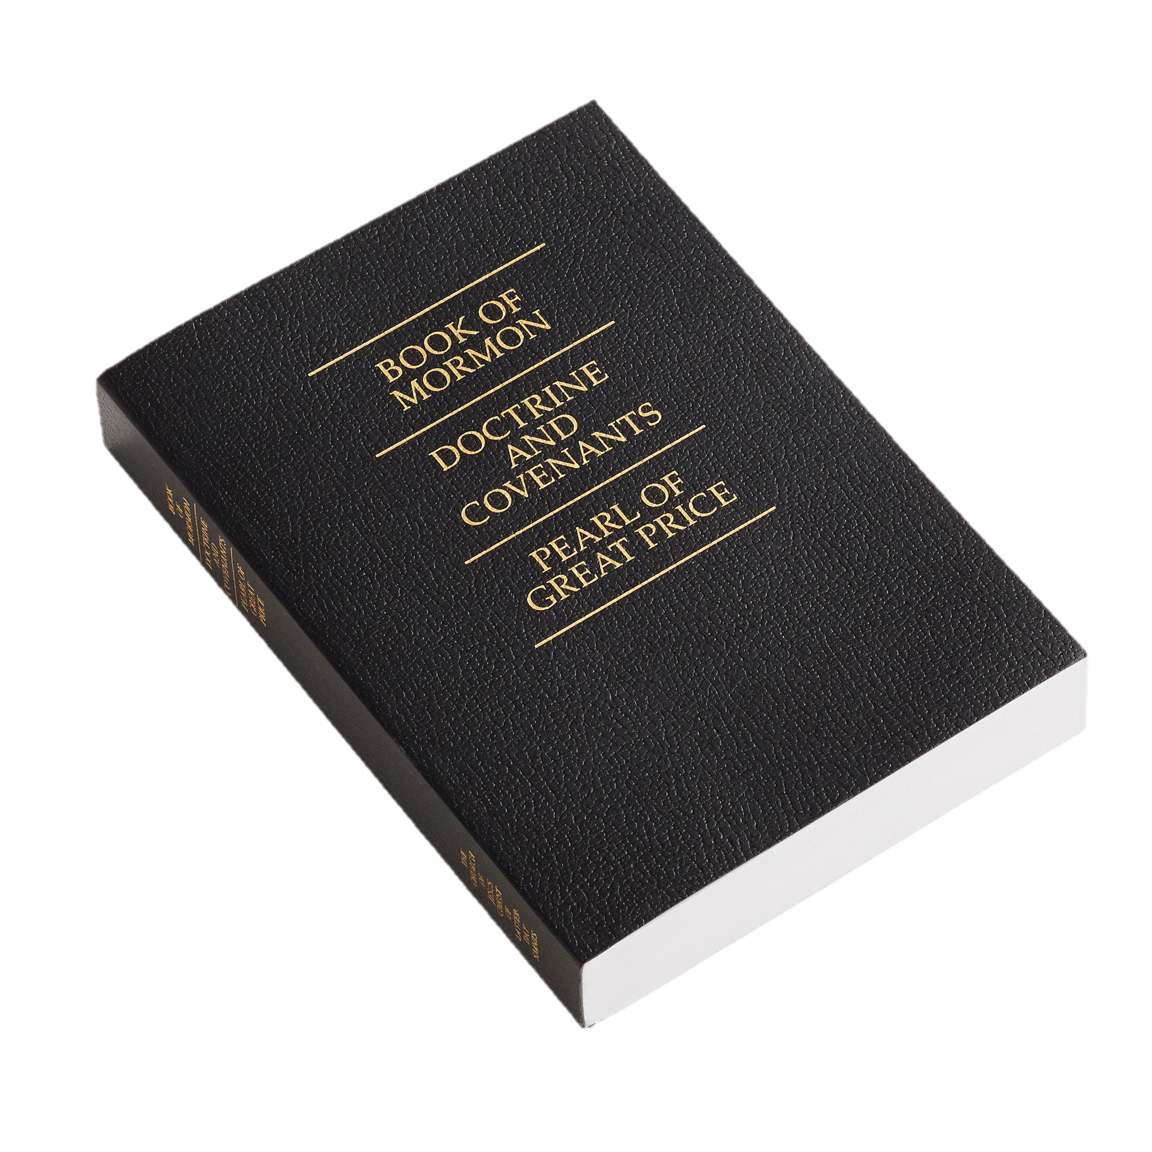
The Fourth Article of Faith Children’s Songbook, p. 124
Words: Joseph Smith Music: Vanja Y. Watkins Flipchart: Cherice Montgomery
Notes:
The Church of Jesus Christ of Latter-Day Saints. (n.d). Triple combination: A softcover triple combination with gold text. The Church of Jesus Christ of Latter-Day Saints Media Library. Retrieved Jun. 23, 2023 from https://www.churchofjesuschrist.org/media/image/triple-combination-scripture-cover-bae554c?lang=eng&collectionId=4c1997b4f9eb0ee0945ec3cc819168f32a2aeda9

Slide 2
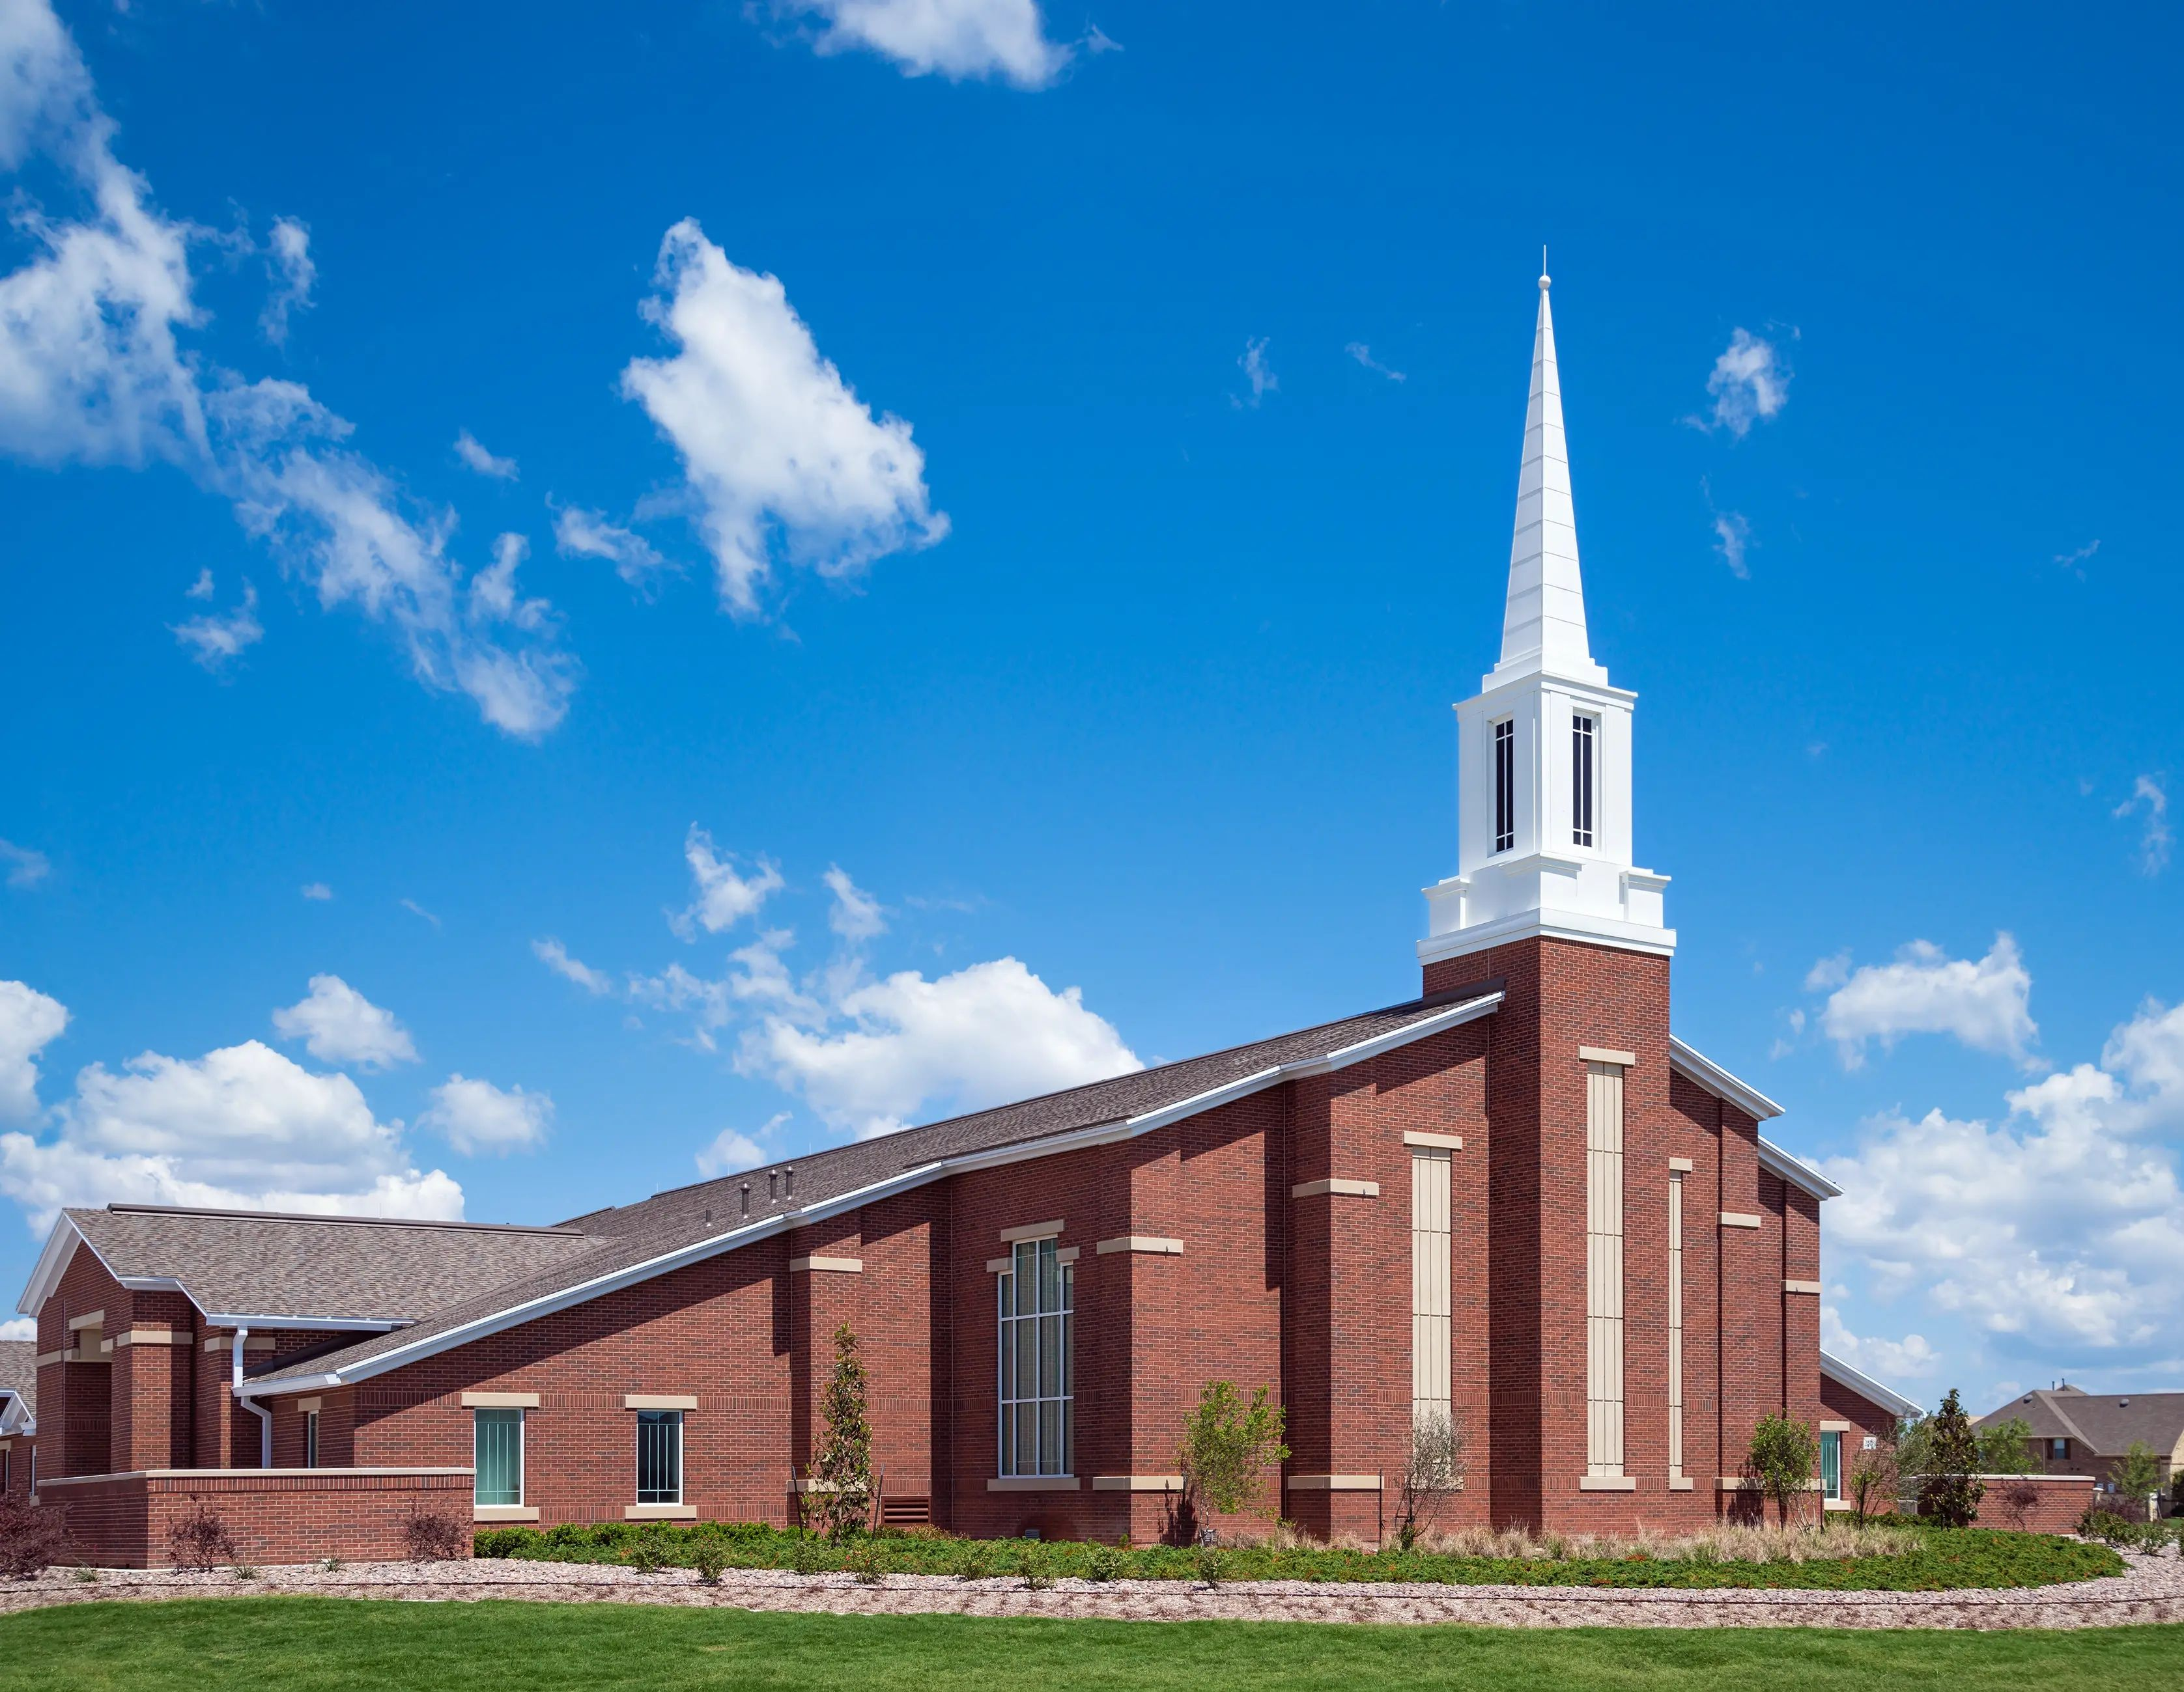
We believe that the first principles and ordinances of the gospel are:
Notes:
The Church of Jesus Christ of Latter-Day Saints. (n.d). Meetinghouse: A brick meetinghouse with a white steeple. The Church of Jesus Christ of Latter-Day Saints Media Library. Retrieved Jun. 23, 2023 from https://www.churchofjesuschrist.org/media/image/meetinghouse-brick-4cbfaca?lang=eng

Slide 3
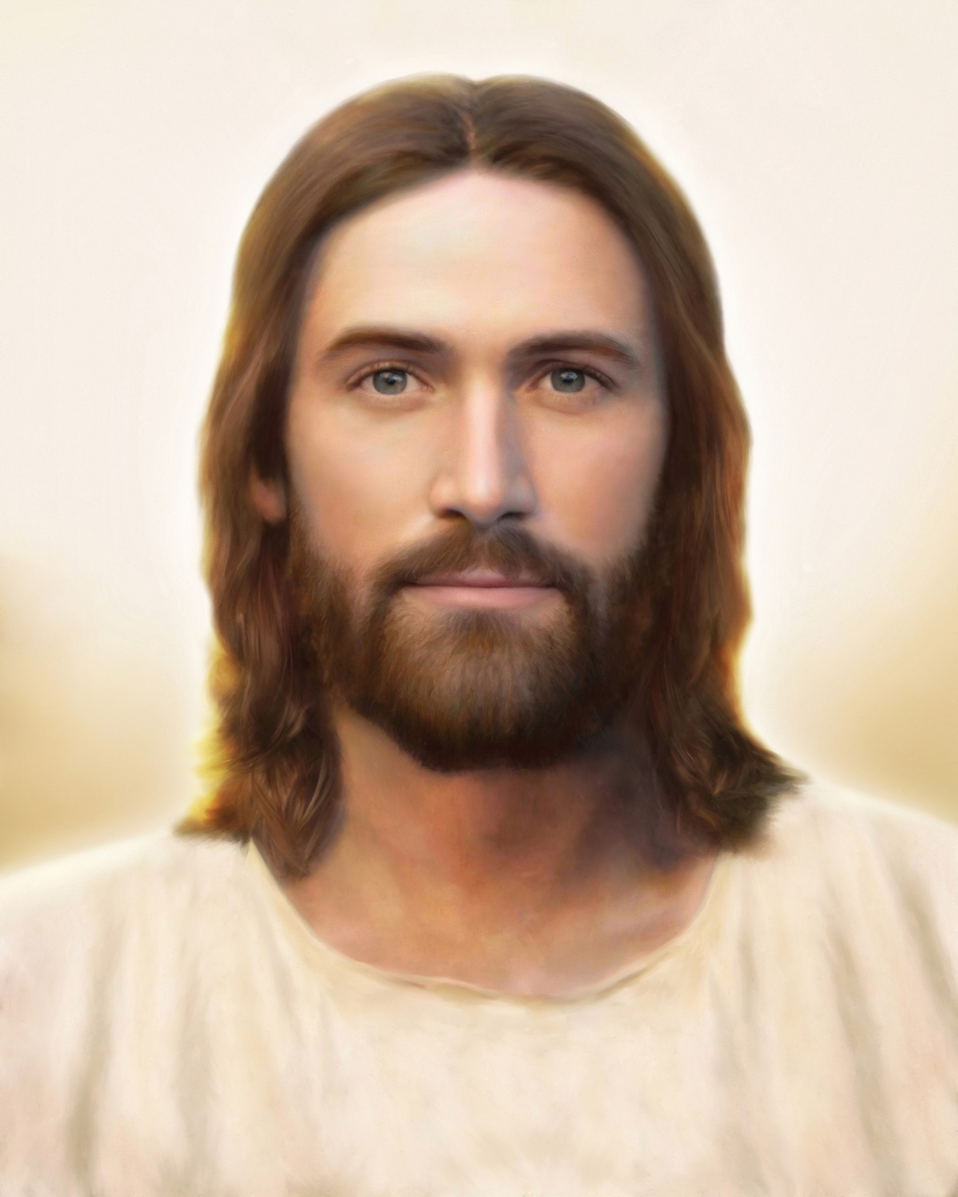
First, Faith in the Lord Jesus Christ;
Notes:
Borup, Brent. (n.d). Light of the World: Light of the World, by Brent Borup. The Church of Jesus Christ of Latter-Day Saints Media Library. Retrieved Jun. 23, 2023 from https://www.churchofjesuschrist.org/media/image/light-of-the-world-jesus-christ-3cf7b89?lang=eng&collectionId=3cbf78e787498a07417814a31656063f9227b4c6

Slide 4
second, Repentance;
Notes:
The Church of Jesus Christ of Latter-Day Saints. (n.d). Taking the sacrament: Giving and receiving the sacrament. The Church of Jesus Christ of Latter-Day Saints Media Library. Retrieved Jun. 23, 2023 from https://www.churchofjesuschrist.org/media/image/sacrament-bread-hands-8ccb5e2?lang=eng&collectionId=1d5d569ab33dea67f63cbcdcc87bc8756d679194

Slide 5
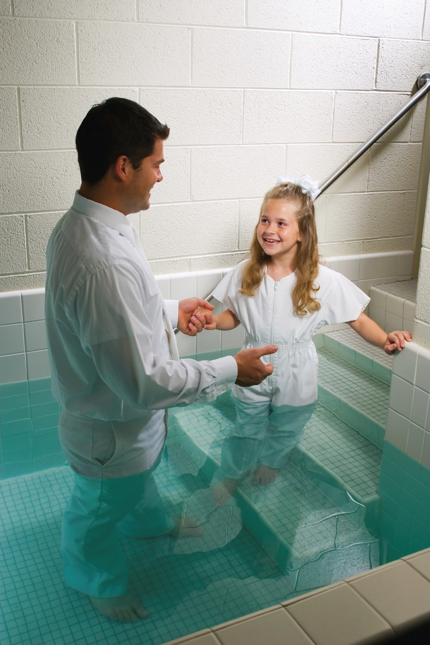
third, baptism by immersion for the remission of sins;
Notes:
The Church of Jesus Christ of Latter-Day Saints. (n.d). Entering the baptismal font: A father leads his young daughter into the baptismal font. The Church of Jesus Christ of Latter-Day Saints Media Library. Retrieved Jun. 23, 2023 from https://www.churchofjesuschrist.org/media/image/girl-baptism-64aa5ef?lang=eng&collectionId=1d5d569ab33dea67f63cbcdcc87bc8756d679194

Slide 6
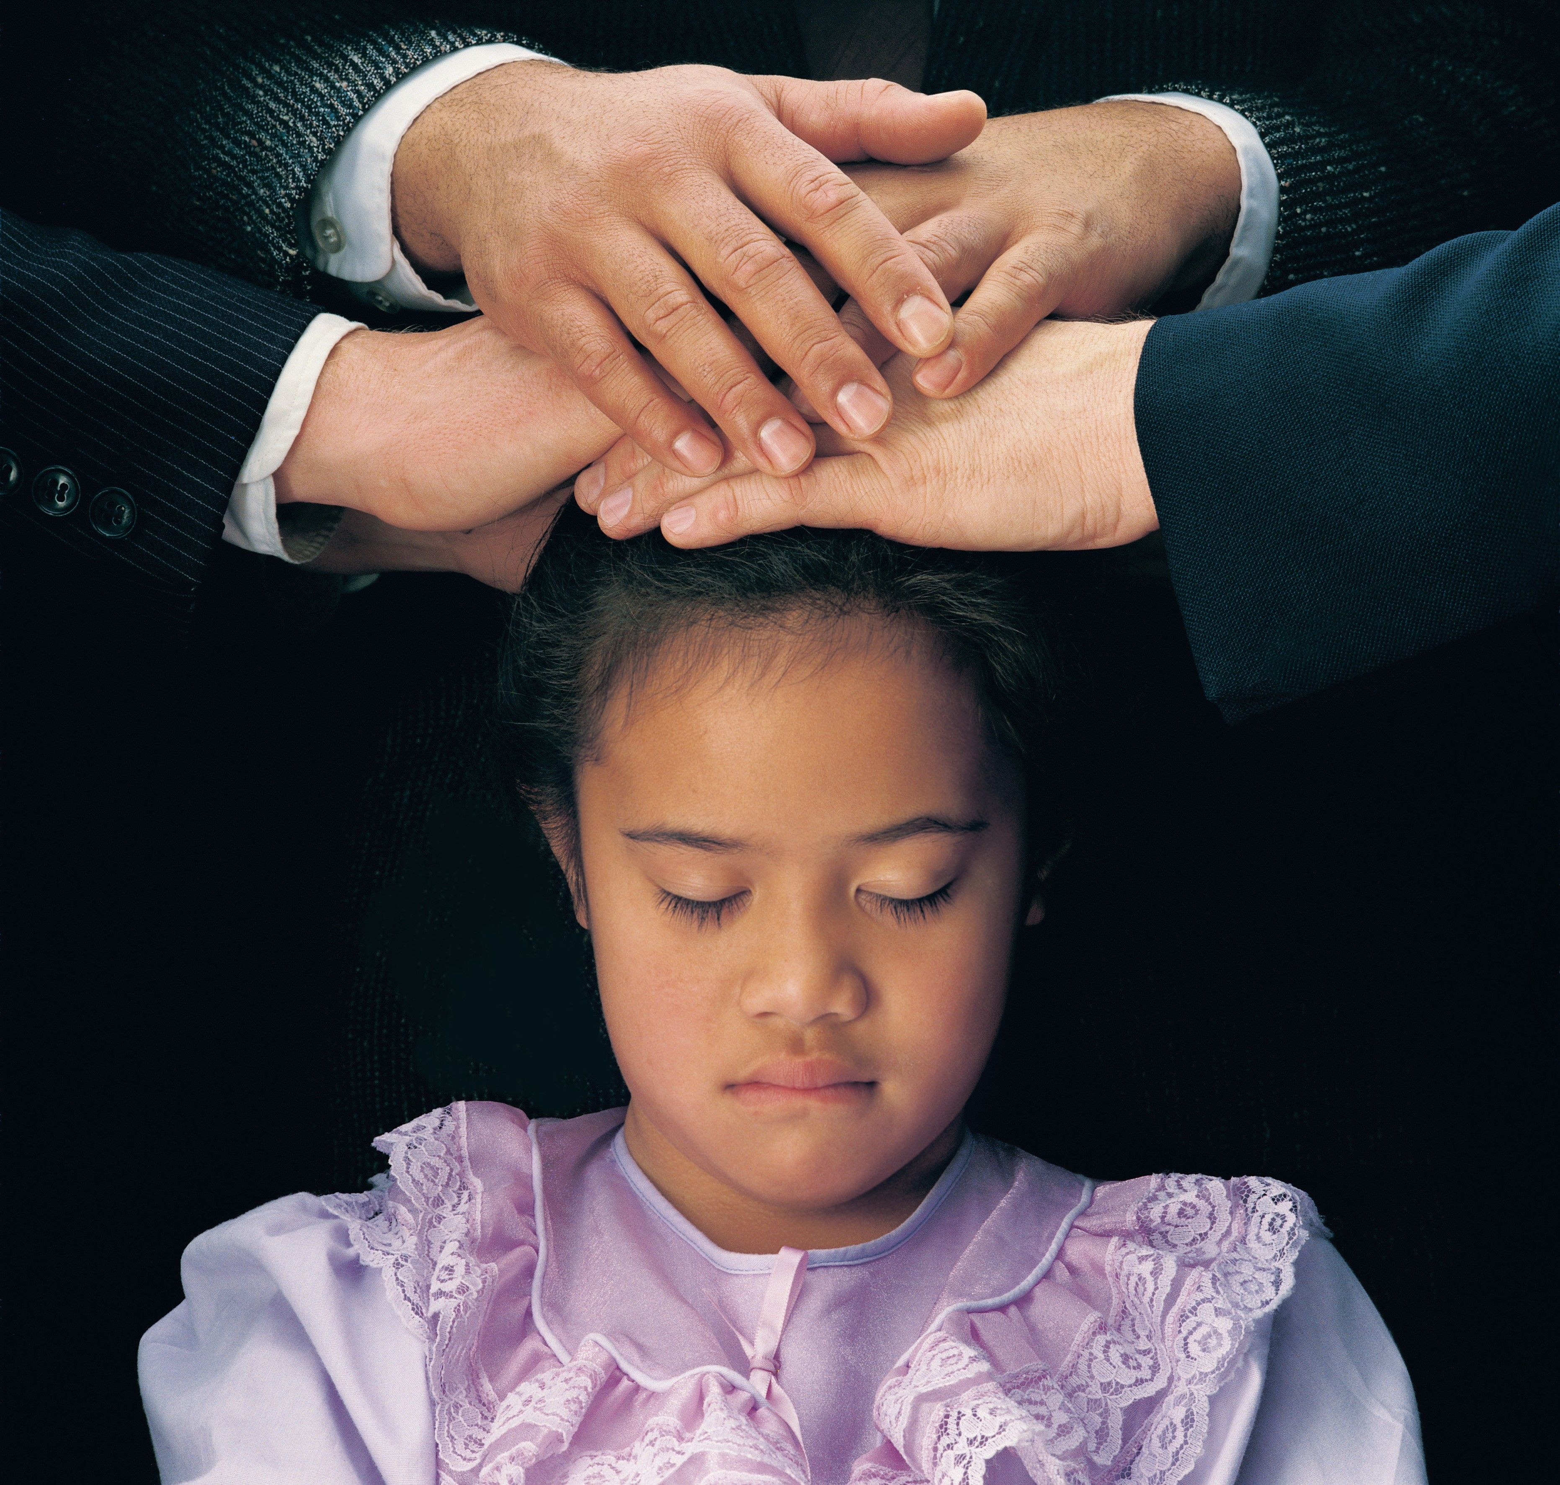
fourth, Laying on of hands for the gift of the Holy Ghost.
Notes:
The Church of Jesus Christ of Latter-Day Saints. (n.d). The gift of the Holy Ghost: The Gift of the Holy Ghost; GAK 602; Primary manual 2-30; Primary manual 3-14; Acts 2:38; 1 Corinthians 12:3; 2 Nephi 32:5; Doctrine and Covenants 130:22. The Church of Jesus Christ of Latter-Day Saints Media Library. Retrieved Jun. 23, 2023 from https://www.churchofjesuschrist.org/media/image/priesthood-blessing-0be2109?lang=eng&collectionId=1d5d569ab33dea67f63cbcdcc87bc8756d679194

Slide 7
Image Credits:
Borup, Brent. (n.d). Light of the World: Light of the World, by Brent Borup. The Church of Jesus Christ of Latter-Day Saints Media Library. Retrieved Jun. 23, 2023 from https://www.churchofjesuschrist.org/media/image/light-of-the-world-jesus-christ-3cf7b89?lang=eng&collectionId=3cbf78e787498a07417814a31656063f9227b4c6
The Church of Jesus Christ of Latter-Day Saints. (n.d). Entering the baptismal font: A father leads his young daughter into the baptismal font. The Church of Jesus Christ of Latter-Day Saints Media Library. Retrieved Jun. 23, 2023 from https://www.churchofjesuschrist.org/media/image/girl-baptism-64aa5ef?lang=eng&collectionId=1d5d569ab33dea67f63cbcdcc87bc8756d679194
The Church of Jesus Christ of Latter-Day Saints. (n.d). Meetinghouse: A brick meetinghouse with a white steeple. The Church of Jesus Christ of Latter-Day Saints Media Library. Retrieved Jun. 23, 2023 from https://www.churchofjesuschrist.org/media/image/meetinghouse-brick-4cbfaca?lang=eng
The Church of Jesus Christ of Latter-Day Saints. (n.d). Taking the sacrament: Giving and receiving the sacrament. The Church of Jesus Christ of Latter-Day Saints Media Library. Retrieved Jun. 23, 2023 from https://www.churchofjesuschrist.org/media/image/sacrament-bread-hands-8ccb5e2?lang=eng&collectionId=1d5d569ab33dea67f63cbcdcc87bc8756d679194
The Church of Jesus Christ of Latter-Day Saints. (n.d). The gift of the Holy Ghost: The Gift of the Holy Ghost; GAK 602; Primary manual 2-30; Primary manual 3-14; Acts 2:38; 1 Corinthians 12:3; 2 Nephi 32:5; Doctrine and Covenants 130:22. The Church of Jesus Christ of Latter-Day Saints Media Library. Retrieved Jun. 23, 2023 from https://www.churchofjesuschrist.org/media/image/priesthood-blessing-0be2109?lang=eng&collectionId=1d5d569ab33dea67f63cbcdcc87bc8756d679194
The Church of Jesus Christ of Latter-Day Saints. (n.d). Triple combination: A softcover triple combination with gold text. The Church of Jesus Christ of Latter-Day Saints Media Library. Retrieved Jun. 23, 2023 from https://www.churchofjesuschrist.org/media/image/triple-combination-scripture-cover-bae554c?lang=eng&collectionId=4c1997b4f9eb0ee0945ec3cc819168f32a2aeda9
Nika_Akin. (2019, Oct. 22). Pixabay. Retrieved Jun. 23, 2023 from https://pixabay.com/illustrations/gift-christmas-celebrate-4567561/ Used under a Pixabay License. Free for use or download. No attribution required.
Quimono. (2016, Dec. 8). Pixabay. Retrieved Jun. 23, 2023 from https://pixabay.com/photos/present-package-gift-celebration-1893639/ Used under a Pixabay License. Free for use or download. No attribution required.

Slide 8
1st principles and ordinances
Notes:
The Church of Jesus Christ of Latter-Day Saints. (n.d). Meetinghouse: A brick meetinghouse with a white steeple. The Church of Jesus Christ of Latter-Day Saints Media Library. Retrieved Jun. 23, 2023 from https://www.churchofjesuschrist.org/media/image/meetinghouse-brick-4cbfaca?lang=eng

Slide 9
Gospel
Notes:
The Church of Jesus Christ of Latter-Day Saints. (n.d). Triple combination: A softcover triple combination with gold text. The Church of Jesus Christ of Latter-Day Saints Media Library. Retrieved Jun. 23, 2023 from https://www.churchofjesuschrist.org/media/image/triple-combination-scripture-cover-bae554c?lang=eng&collectionId=4c1997b4f9eb0ee0945ec3cc819168f32a2aeda9

Slide 10
1st Faith
Notes:
Borup, Brent. (n.d). Light of the World: Light of the World, by Brent Borup. The Church of Jesus Christ of Latter-Day Saints Media Library. Retrieved Jun. 23, 2023 from https://www.churchofjesuschrist.org/media/image/light-of-the-world-jesus-christ-3cf7b89?lang=eng&collectionId=3cbf78e787498a07417814a31656063f9227b4c6

Slide 11
2nd Repentance
Notes:
The Church of Jesus Christ of Latter-Day Saints. (n.d). Taking the sacrament: Giving and receiving the sacrament. The Church of Jesus Christ of Latter-Day Saints Media Library. Retrieved Jun. 23, 2023 from https://www.churchofjesuschrist.org/media/image/sacrament-bread-hands-8ccb5e2?lang=eng&collectionId=1d5d569ab33dea67f63cbcdcc87bc8756d679194

Slide 12
3rd Baptism
Notes:
The Church of Jesus Christ of Latter-Day Saints. (n.d). Entering the baptismal font: A father leads his young daughter into the baptismal font. The Church of Jesus Christ of Latter-Day Saints Media Library. Retrieved Jun. 23, 2023 from https://www.churchofjesuschrist.org/media/image/girl-baptism-64aa5ef?lang=eng&collectionId=1d5d569ab33dea67f63cbcdcc87bc8756d679194

Slide 13
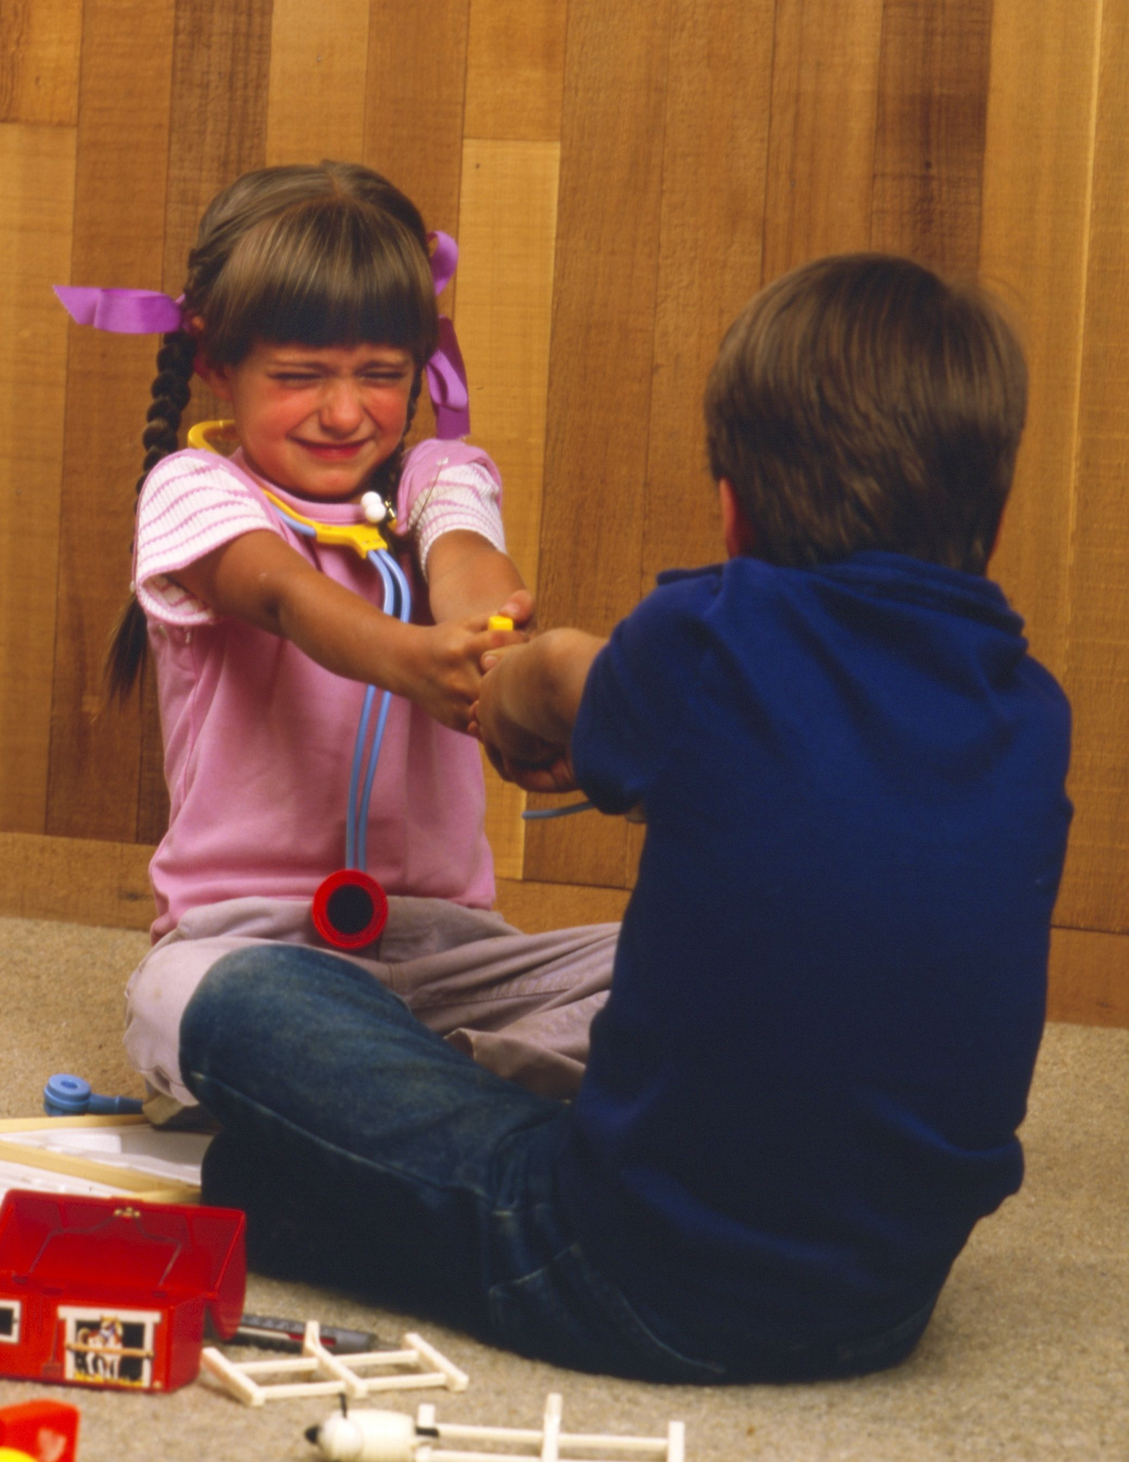
for the remission of sins
Notes:
The Church of Jesus Christ of Latter-Day Saints. (n.d). Childhood: A little boy and a little girl fighting over a toy. The Church of Jesus Christ of Latter-Day Saints Media Library. Retrieved Jun. 23, 2023 from https://www.churchofjesuschrist.org/media/image/children-childhood-fighting-toys-8911272?lang=eng

Slide 14
4th Laying on of Hands
Notes:
The Church of Jesus Christ of Latter-Day Saints. (n.d). The gift of the Holy Ghost: The Gift of the Holy Ghost; GAK 602; Primary manual 2-30; Primary manual 3-14; Acts 2:38; 1 Corinthians 12:3; 2 Nephi 32:5; Doctrine and Covenants 130:22. The Church of Jesus Christ of Latter-Day Saints Media Library. Retrieved Jun. 23, 2023 from https://www.churchofjesuschrist.org/media/image/priesthood-blessing-0be2109?lang=eng&collectionId=1d5d569ab33dea67f63cbcdcc87bc8756d679194

Slide 15
for the gift of the Holy Ghost
Notes:
Quimono. (2016, Dec. 8). Pixabay. Retrieved Jun. 23, 2023 from https://pixabay.com/photos/present-package-gift-celebration-1893639/ Used under a Pixabay License. Free for use or download. No attribution required.

Slide 16
for the gift of the Holy Ghost
Notes:
Nika_Akin. (2019, Oct. 22). Pixabay. Retrieved Jun. 23, 2023 from https://pixabay.com/illustrations/gift-christmas-celebrate-4567561/ Used under a Pixabay License. Free for use or download. No attribution required.

