Slide 1
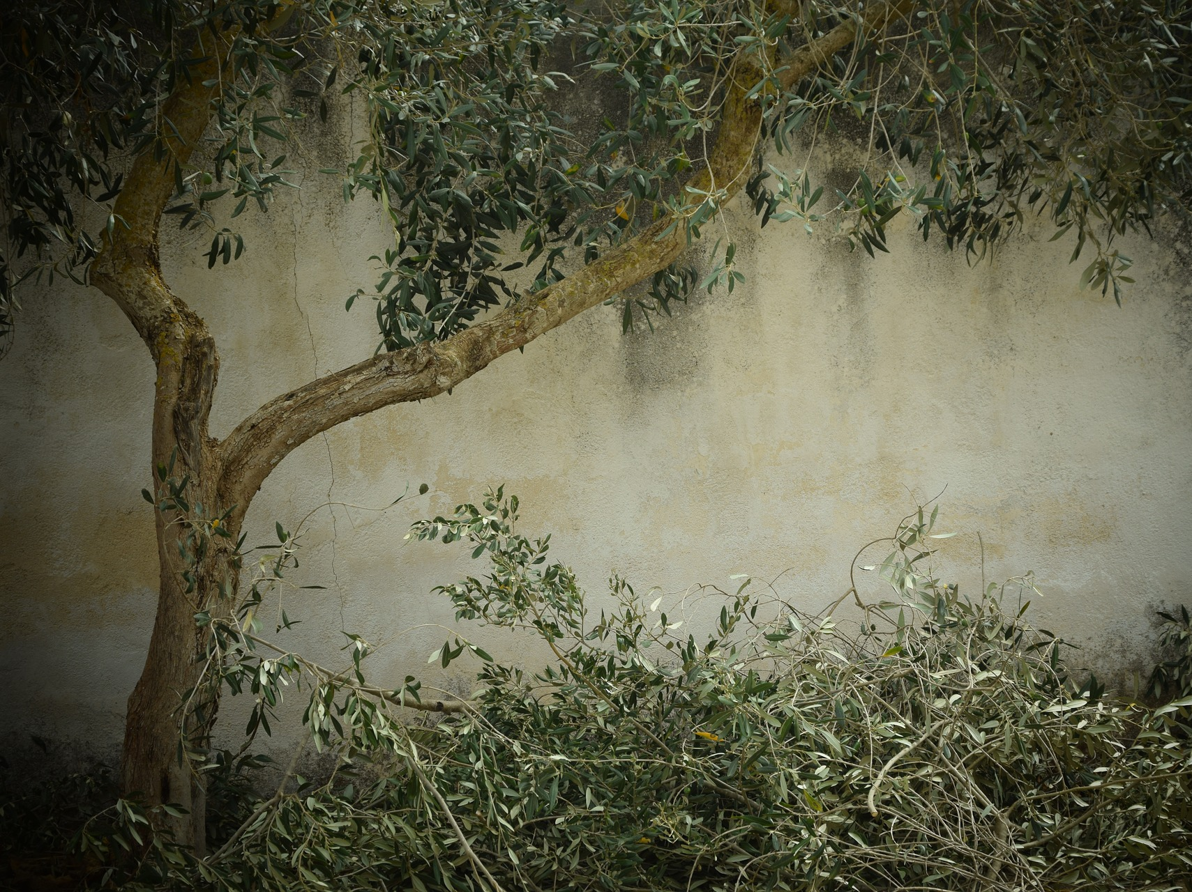
Singing at Home with Sister Montgomery March 22, 2020
Image: Ulrike Leone
Notes:
Leone, Ulrike (Ulleo). (2016, Oct. 21). Pixabay. Retrieved March 9, 2020, from https://pixabay.com/photos/olive-tree-nostalgia-background-1756611/ Used under a Pixabay License. Free for commercial use. No attribution required.

Slide 2
Image: The Church of Jesus Christ
Notes:
Wright, Jordon Monson. (2020, Mar.). Friend. Retrieved March 21, 2020, from https://www.churchofjesuschrist.org/study/friend/2020/03/feasting-on-the-scriptures?lang=eng

Slide 3
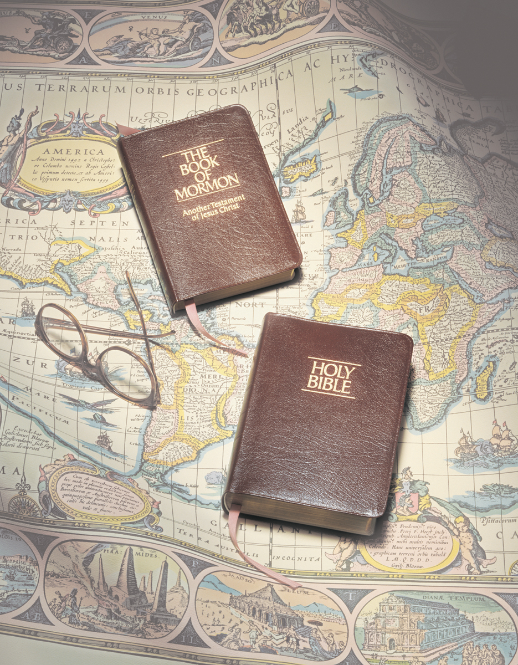
Image: Grant Heaton
Notes:
Heaton, Grant. (n.d.). Scriptures, by Grant Heaton. Gospel Media Library. Retrieved March 31, 2020, from https://www.churchofjesuschrist.org/media-library/images/bible-and-book-of-mormon-261218?lang=eng

Slide 4
Image: Robert Stinnett
Notes:
Stinnett, Robert. (2018, May 8). McDonalds’ China. Flickr. Retrieved March 8, 2020, from https://www.flickr.com/photos/rstinnett/42137735531/

Slide 5
Symbols remind us
and teach us
Image: John R. Perry
Notes:
Perry, John R. (jp26jp) (2014, Sept. 16). Pixabay. Retrieved April 1, 2020, from https://pixabay.com/photos/salt-lake-city-church-utah-landmark-438715/ Used under a Pixabay License. Free for commercial use. No attribution required.

Slide 6
The temple reminds us to love and serve others.
Image: Don Par
Notes:
Par, Don (Donie_tinmp). (2017, Apr. 27). Pixabay. Retrieved April 1, 2020, from https://pixabay.com/photos/salt-lake-city-lds-temple-2229285/

Slide 7
We don’t have to be afraid of the things we feel like we are losing!
Image: Spenser Heaps
Notes:
Heaps, Spenser. (2018, Mar. 18). Salt Lake Temple sustains minor damage as 5.7 magnitude earthquake hits Utah. Deseret News. Retrieved April 1, 2020, from https://www.thechurchnews.com/temples/2020-03-18/utah-earthquake-salt-lake-city-temple-angel-moroni-177657

Slide 8
Basil is squished!
Image: Tesa Robbins
Notes:
Robbins, Tesa. (2015, Jun. 2). Pixabay. Retrieved April 1, 2020, from https://pixabay.com/photos/basil-plant-green-herb-wood-785099/ Used under a Pixabay License. Free for commercial use. No attribution required.

Slide 9
Sometimes when we lose things, it is to make space for better things and to help us grow.
Image: Monicore
Notes:
Monicore. (2018, Oct. 18). Pixabay. Retrieved April 1, 2020, from https://pixabay.com/photos/basil-herb-green-healthy-herbs-3729618/ Used under a Pixabay License. Free for commercial use. No attribution required.

Slide 10
The Wise Man and The Foolish Man
Play some INSTRUMENTS
OR
Do the ACTIONS with me!
Notes:
Hull, Richard. (n.d.). A house surrounded by a flood. A family stands outside their house, which is standing strong despite floodwaters all around it. From the Children’s Songbook, page 281, “The Wise Man and the Foolish Man”; watercolor illustration by Richard Hull. Gospel Media. Retrieved April 1, 2020, from https://www.churchofjesuschrist.org/media-library/images/children-songbook-art-153070?lang=eng

Slide 11
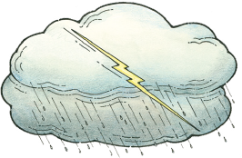
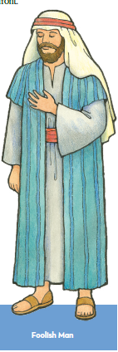
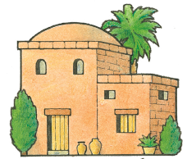
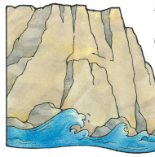
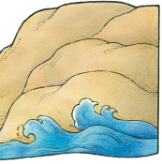

Slide 12
What rock is the song talking about?
“Build upon my rock, which is my gospel” (Doctrine and Covenants 11:24)
Faith ♥ Repentance ♥ Baptism ♥ Holy Ghost

Slide 13
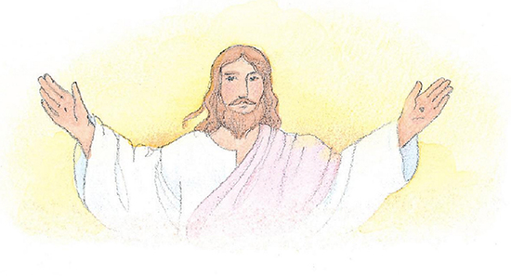
What is the gospel of Jesus Christ?
The gospel means the things Jesus taught us to do when he lived on earth.
Image: Phyllis Luch
Notes:
Luch, Phyllis (n.d.). The resurrected Savior. Jesus Christ with His arms outstretched. From the Children’s Songbook, page 76, “This Is My Beloved Son”; watercolor illustration by Phyllis Luch. Gospel Media. Retrieved April 1, 2020, from https://www.churchofjesuschrist.org/media-library/images/jesus-holding-children-phyllis-luch-358169?lang=eng&clang=ase

Slide 14
Image: Grant Heaton
Notes:
Heaton, Grant. (n.d.). Scriptures, by Grant Heaton. Gospel Media Library. Retrieved March 31, 2020, from https://www.churchofjesuschrist.org/media-library/images/bible-and-book-of-mormon-261218?lang=eng

Slide 15
If we are scared, we can look
for Jesus.

Slide 16
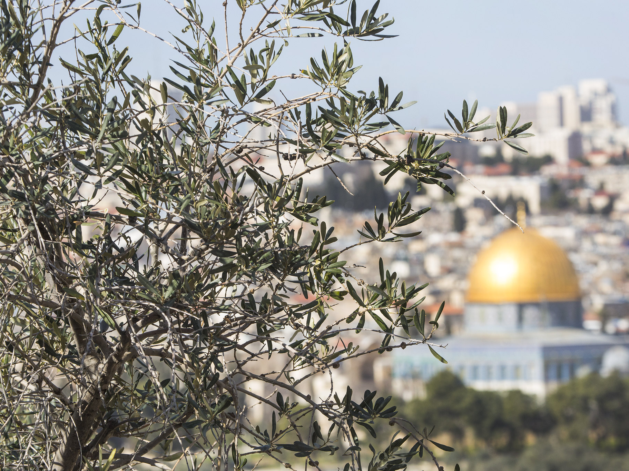
Image: Steve Evans
Notes:
Evans, Steve. (2016, Feb. 5). Olive tree, Jerusalem: Overlooking the old city of Jerusalem, this was taken form the Mount of Olives. Flickr. Retrieved March 8, 2020, from https://www.flickr.com/photos/babasteve/26319511901/ Used under a Creative Commons Attribution Non-commercial License.

Slide 17
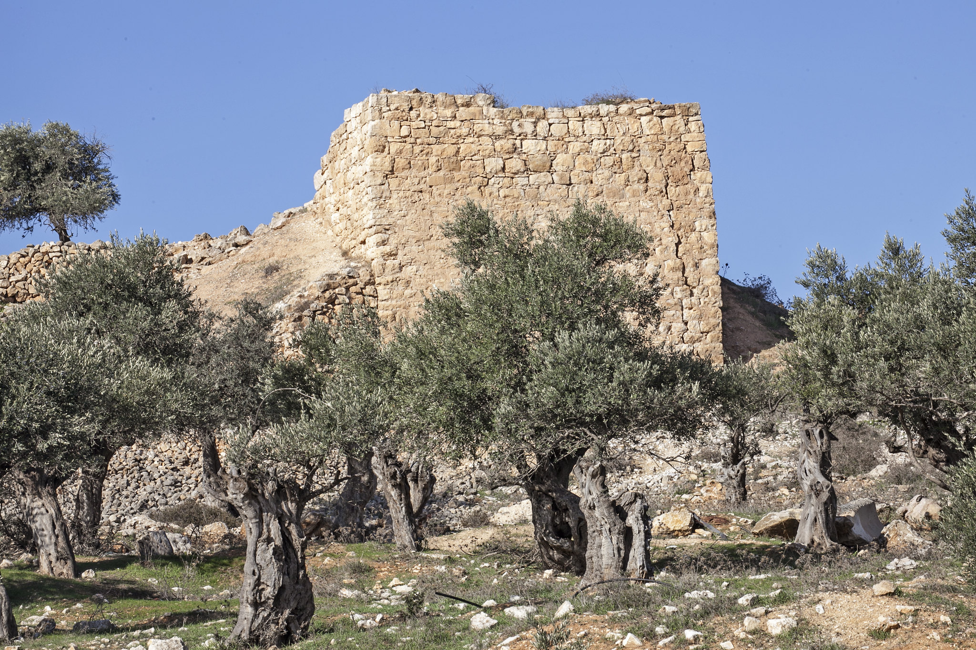
Image: Zeeveez
Notes:
Zeevveez. (2014, Nov. 20). Ruins and olive trees: Near Mar Elias, Jerusalem. Flickr. Retrieved March 8, 2020, from https://www.flickr.com/photos/zeevveez/15647790520/ Used under a Creative Commons Attribution License.

Slide 18
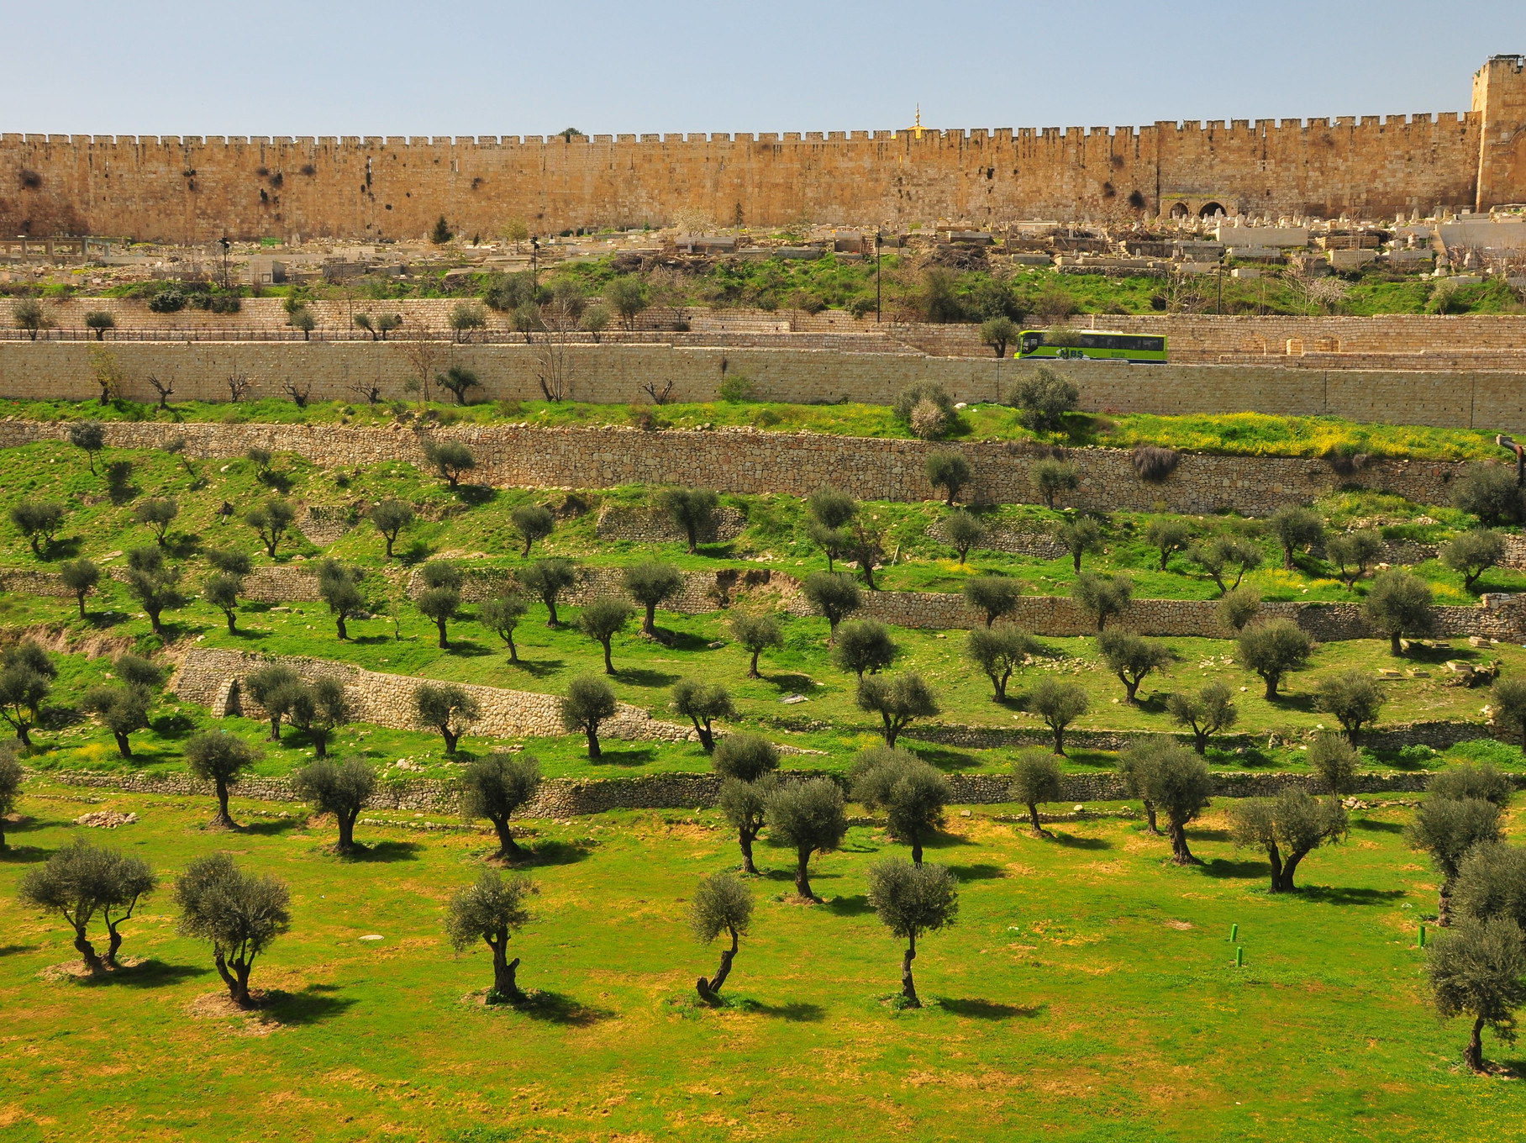
Image: Patrick
Notes:
Patrick. (2008, Mar. 6). DSC_0975: Some olive trees between the Mount of Olives and the Old City. Flickr. Retrieved March 8, 2020, from https://www.flickr.com/photos/pboyd04/2318624994/ Used under a Creative Commons Attribution Share Alike License.

Slide 19
Image: Ulrike Leone
Notes:
Leone, Ulrike (Ulloa). (2018, Sept. 9). Pixabay. Retrieved March 9, 2020, from https://pixabay.com/photos/olive-tree-olive-field-mediterranean-3662716/ Used under a Pixabay License. Free for commercial use. No attribution required.

Slide 20
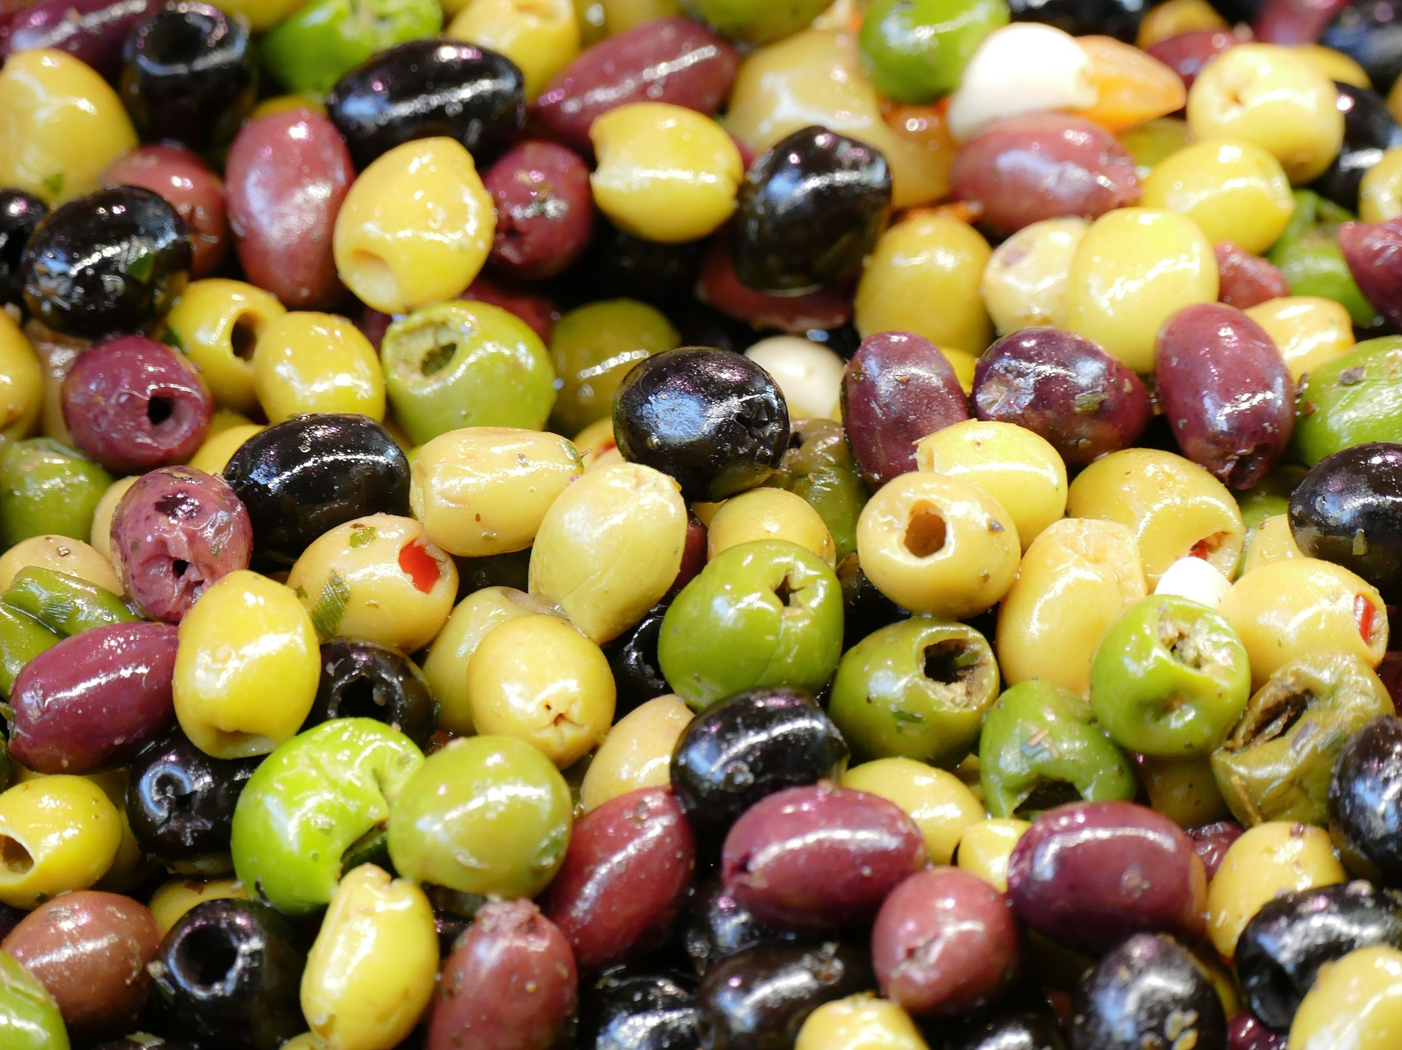
Image: Michaelmep
Notes:
Michaelmep. (2017, Apr. 24). Pixabay. Retrieved March 9, 2020, from https://pixabay.com/photos/olives-market-market-hall-2251260/ Used under a Pixabay License. Free for commercial use. No attribution required.

Slide 21
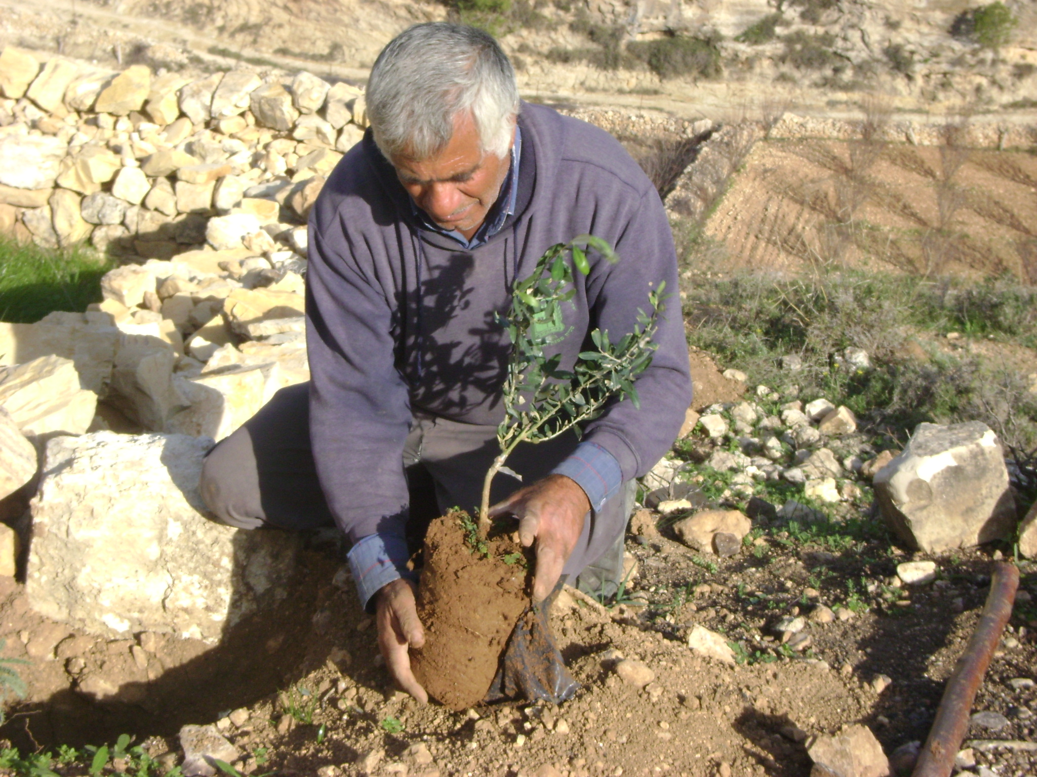
Image: Palestine Solidarity Project
Notes:
Palestine Solidarity Project. (2010, Jan. 11). Beit Ommar farmer plants olive trees. PSP Palestine. Flickr. Retrieved March 8, 2020, from https://www.flickr.com/photos/palestineproject/6099524658/ Used under a Creative Commons Attribution Share Alike License.

Slide 22
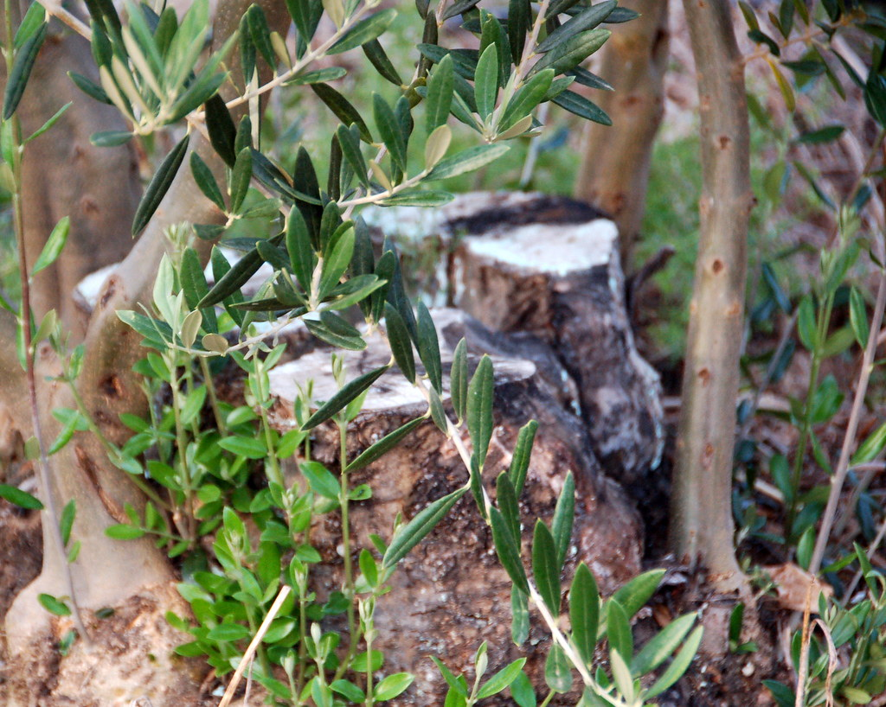
Image: Robert Wallace
Notes:
Wallace, Robert. (2007, Jan. 25). Heavily pruned olive tree: ..cut almost to the ground, with plenty of new growth, the whole olive grove had been pruned in this fashion. Flickr. Retrieved March 8, 2020, from https://www.flickr.com/photos/robwallace/371883657/ Used under a Creative Commons Attribution Non-commercial No Derivatives License.

Slide 23
Image: EU Civil Protection & Humanitarian Aid
Notes:
EU Civil Protection & Humanitarian Aid’s Photostream. (2013, Oct. 22). Olive Harvesting in Palestine. The annual olive harvest is a key economic, social and cultural moment in the life of Palestinians. This traditional economic activity accounts for about 25% of the production in the agricultural sector; It is, however, being undermined by the ongoing physical restrictions and bureaucratic impediments on access to agricultural lands and resources, as well as Trade Markets, throughout Palestine. Persistent settler’s violence, including attacks on Palestinians and their property, also prevents access to land and resources, including the olive groves. Photos and story by: Fadwa Baroud AbedRabo. Flickr. Retrieved March 9, 2020, from https://www.flickr.com/photos/eu_echo/10589261814 Used under a Creative Commons Attribution No Derivatives License.

Slide 24
Image: Ulrike Leone
Notes:
Leone, Ulrike (Ulleo). (2018, Sept. 9). Pixabay. Retrieved March 9, 2020, from https://pixabay.com/photos/olive-tree-olive-field-mediterranean-3662751/ Used under a Pixabay License. Free for commercial use. No attribution required.

Slide 25
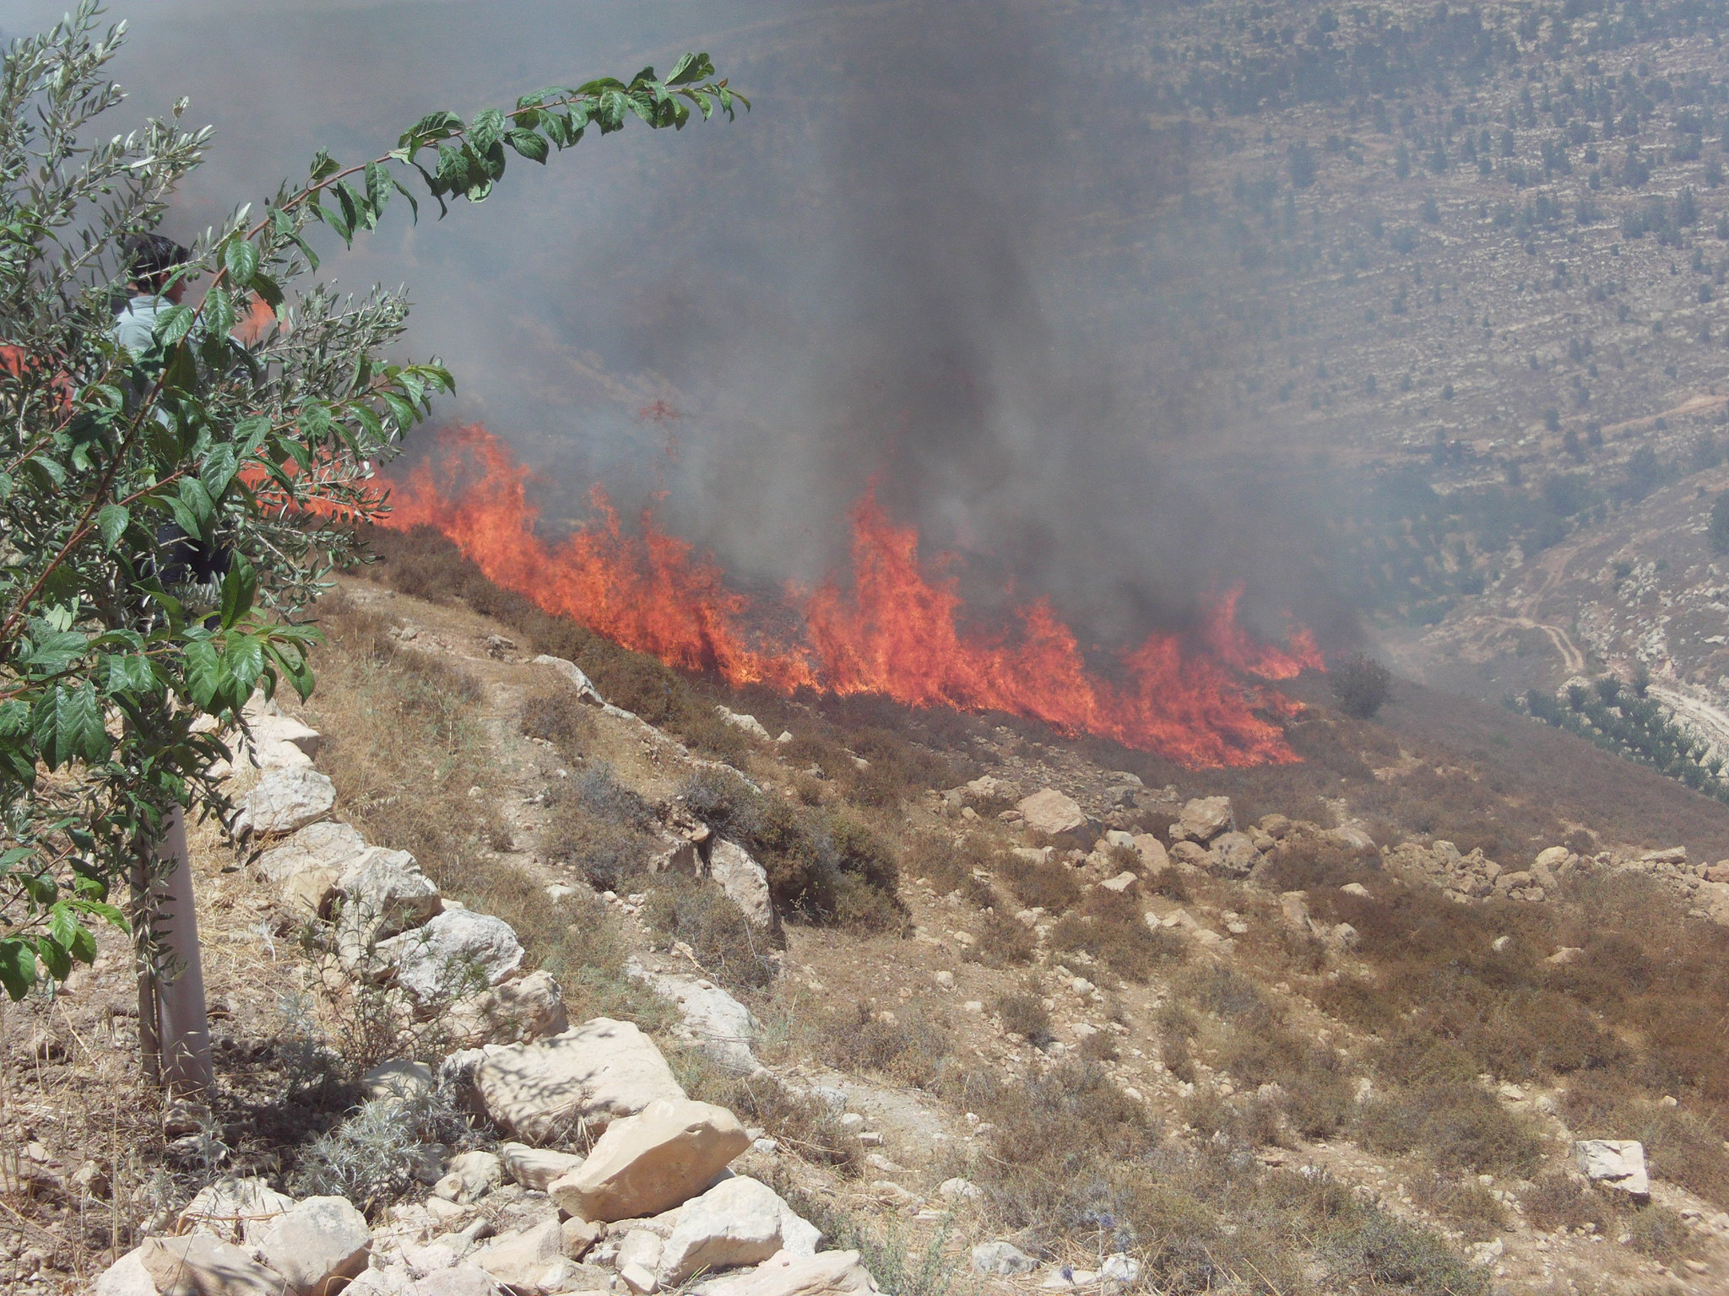
Image: Palestine Solidarity Project
Notes:
Palestine Solidarity Project. (2012, Jul. 19). Settlers burn Beit Ommar land and olive trees. PSP Palestine. Flickr. Retrieved March 8, 2020, from https://www.flickr.com/photos/palestineproject/6098970567/ Used under a Creative Commons Attribution Share Alike License.

Slide 26
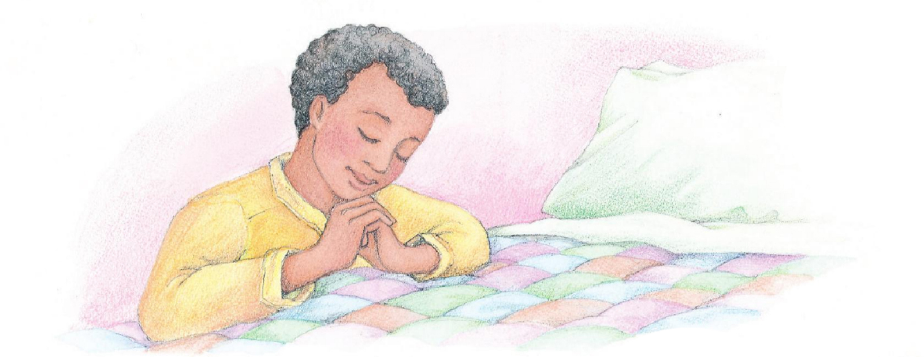
A Child’s Prayer
Do the actions with me!
Image: Phyllis Luch
Notes:
Luch, Phyllis. (n.d.). Morning prayer. A boy kneeling by his bed and praying. From the Children’s Songbook, page 6, “Thanks to Thee”; watercolor illustration by Phyllis Luch. Retrieved April 1, 2020, from https://www.churchofjesuschrist.org/media-library/images/children-songbook-art-153088?lang=eng

Slide 27
Do you think Basil liked it when I took him out of his pot?
Image: Tesa Robbins
Notes:
Robbins, Tesa. (2015, Jun. 2). Pixabay. Retrieved April 1, 2020, from https://pixabay.com/photos/basil-plant-green-herb-wood-785099/ Used under a Pixabay License. Free for commercial use. No attribution required.

Slide 28
Image: EU Civil Protection & Humanitarian Aid
Notes:
EU Civil Protection & Humanitarian Aid’s Photostream. (2013, Oct. 31). Olive Harvesting in Palestine. Like Mohammad, thousands of villagers across the West Bank depend on an Israeli permit system to access their lands. It grants limited access to their trees for about 3-6 days during the olive harvesting season. This permit system creates economic hardships for families who cannot finish harvesting on time. They lose part of the harvest and thus part of their basic livelihood. Consequently they rely on humanitarian assistance. Moreover, access permits are generally limited to one or two members of the family only, often to elderly ones. Mohammad himself finds it difficult to harvest his land within the limited time and the limit resources. “One hand can’t clap” says Mohammad. Photos and story by: Fadwa Baroud AbedRabo. Flickr. Retrieved March 9, 2020, from https://www.flickr.com/photos/eu_echo/10589299964/ Used under a Creative Commons Attribution No Derivatives License.

Slide 29
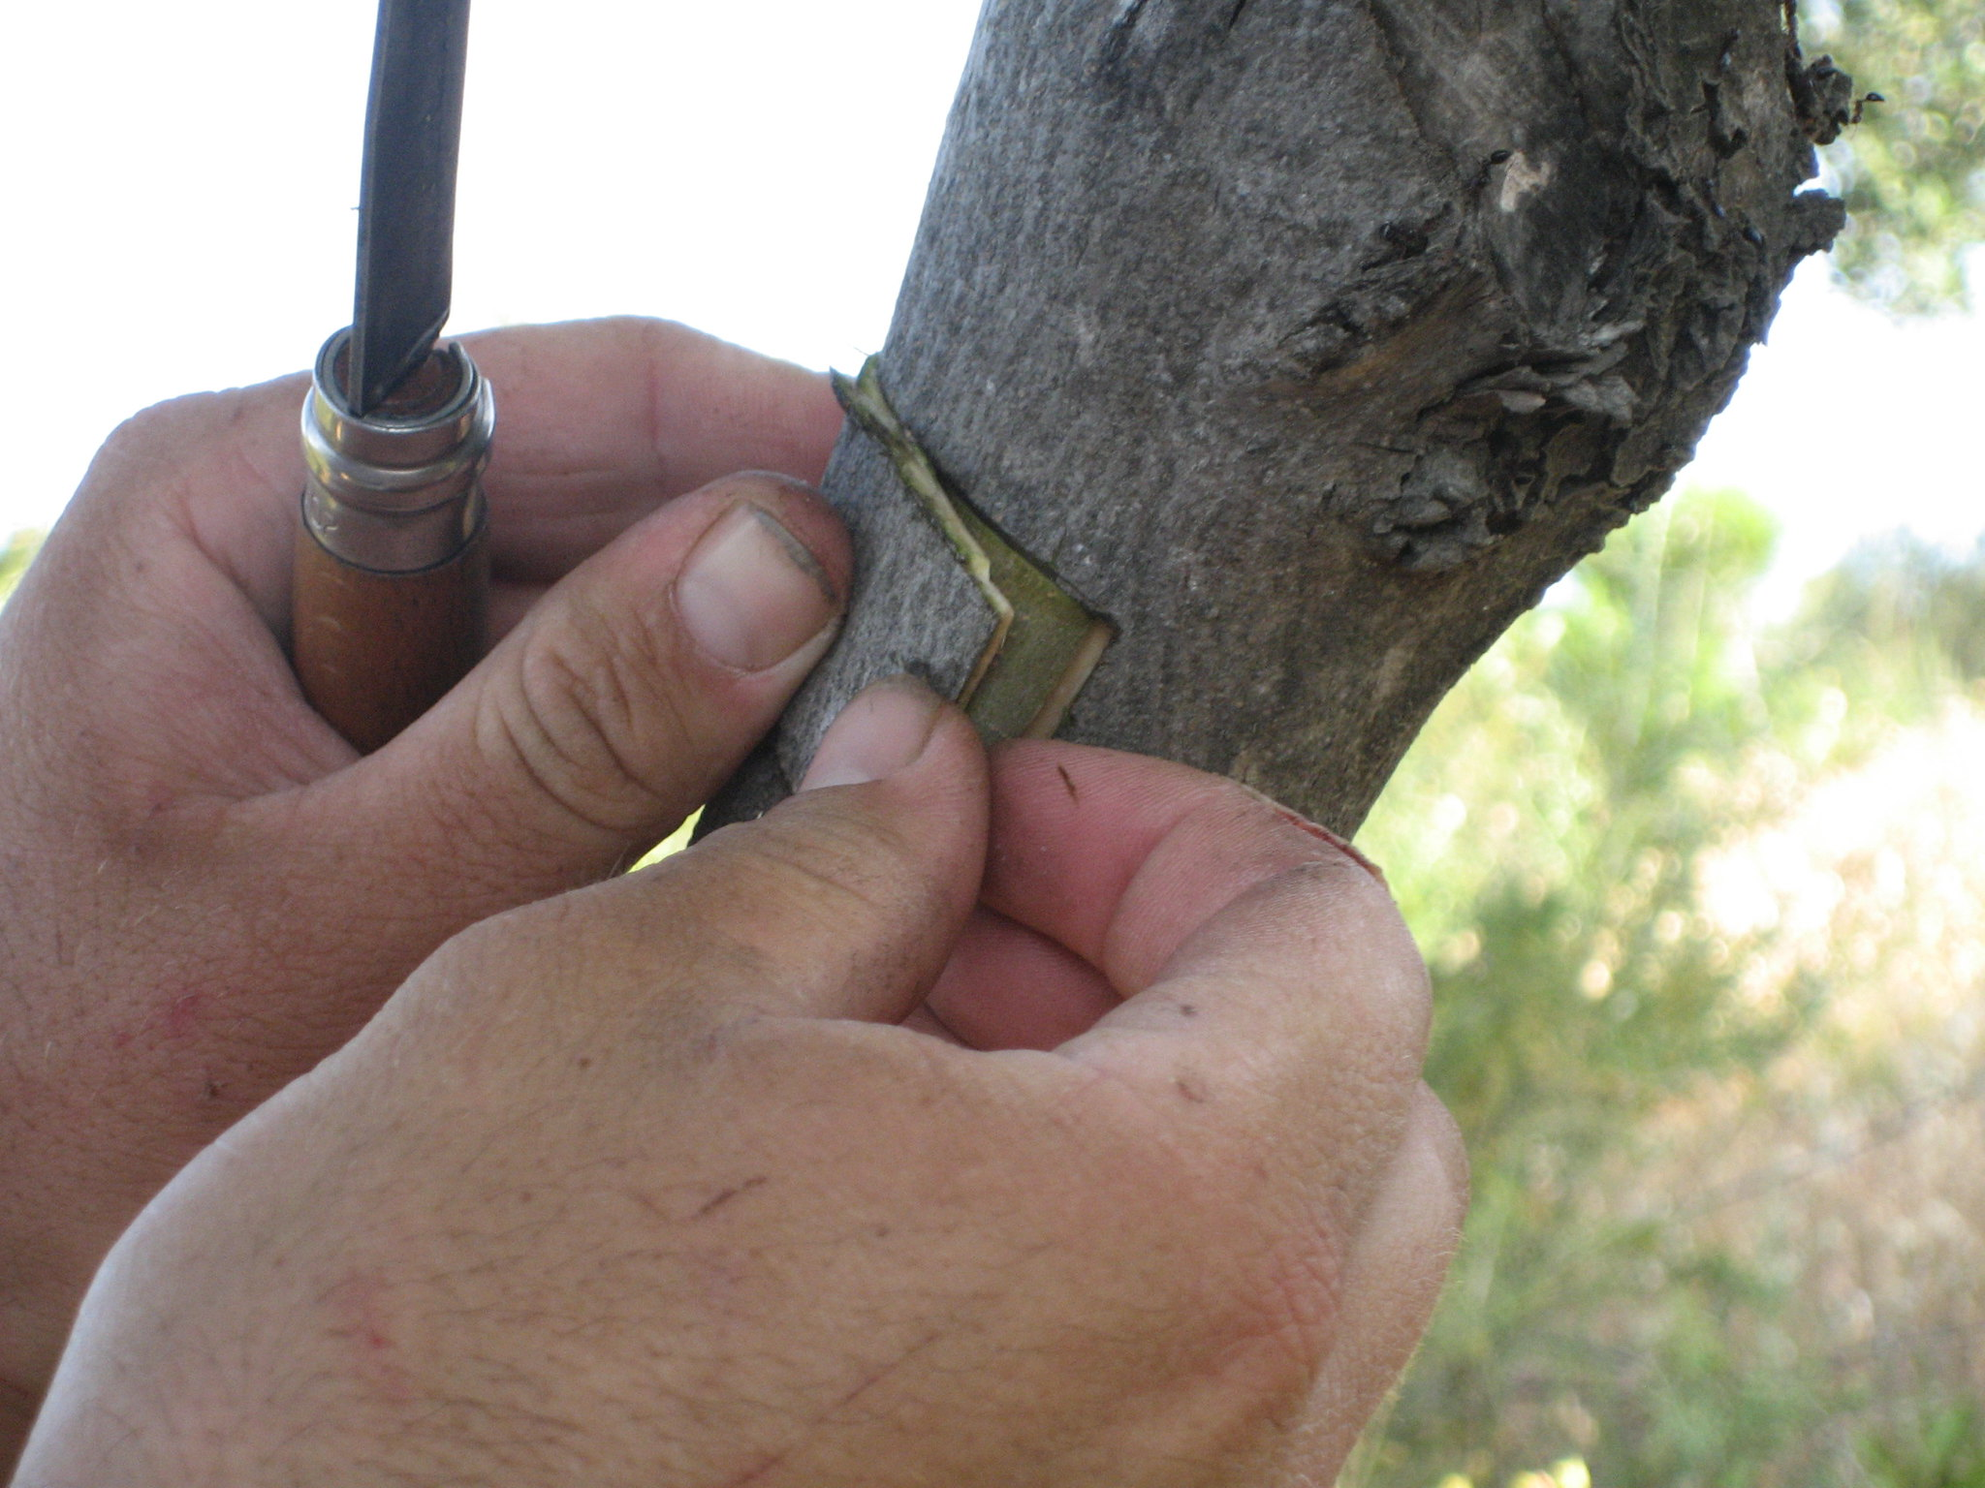
Image: Ria Beck
Notes:
Beck, Ria. (2008, May 28). Grafting olive trees: The bark of the wild tree is tend folded over the little square bark from the good tree. Flickr. Retrieved March 8, 2020, from https://www.flickr.com/photos/51691575@N00/2540483417/ Used under a Creative Commons Attribution Share-Alike License.

Slide 30
Image: Derek Winterburn
Notes:
Winterburn, Derek. (2016, Sept. 19). Olive tree graft. Flickr. Retrieved March 8, 2020, from https://www.flickr.com/photos/dnwinterburn/29401261223/ Used under a Creative Commons Attribution No Derivatives License.

Slide 31
Image: Orna Wachman
Notes:
Wachman, Orna (OrnaW). (2019, May 7). Pixabay. Retrieved March 9, 2020, from https://pixabay.com/photos/tree-olive-tree-park-mediterranean-4183690/ Used under a Pixabay License. Free for commercial use. No attribution required.

Slide 32
Image: Svetlanabar
Notes:
Svetlanabar. (2020, Mar. 3). Pixabay. Retrieved March 9, 2020, from https://pixabay.com/photos/olives-tree-israel-green-jerusalem-4896510/ Used under a Pixabay License. Free for commercial use. No attribution required.

Slide 33
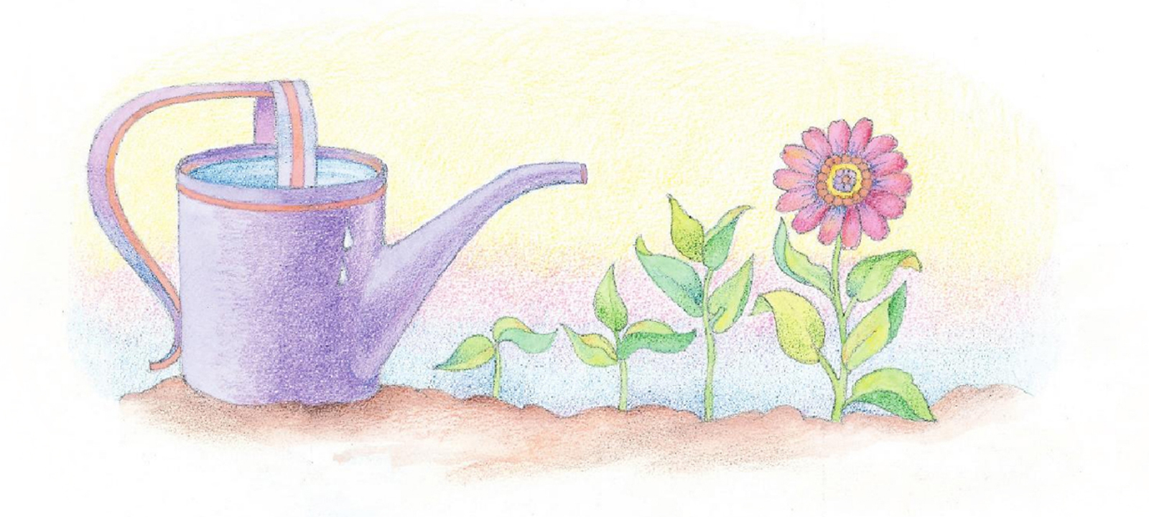
Faith
Do the actions with me!
Image: Phyllis Luch
Notes:
Luch, Phyllis. (n.d.). A watering can. A watering can full of water next to a row of sprouts. From the Children’s Songbook, page 96, “Faith”; watercolor illustration by Phyllis Luch.. Retrieved April 1, 2020, from https://www.churchofjesuschrist.org/media-library/images/children-songbook-153101?lang=eng&_r=1

Slide 34
Image: The Church of Jesus Christ
Notes:
The Church of Jesus Christ of Latter-day Saints. (n.d.). Laborers in the vineyard. Gospel Media Library. Retrieved March 8, 2020, from https://www.churchofjesuschrist.org/media-library/images/laboring-in-the-vineyard-1456725?lang=eng

Slide 35
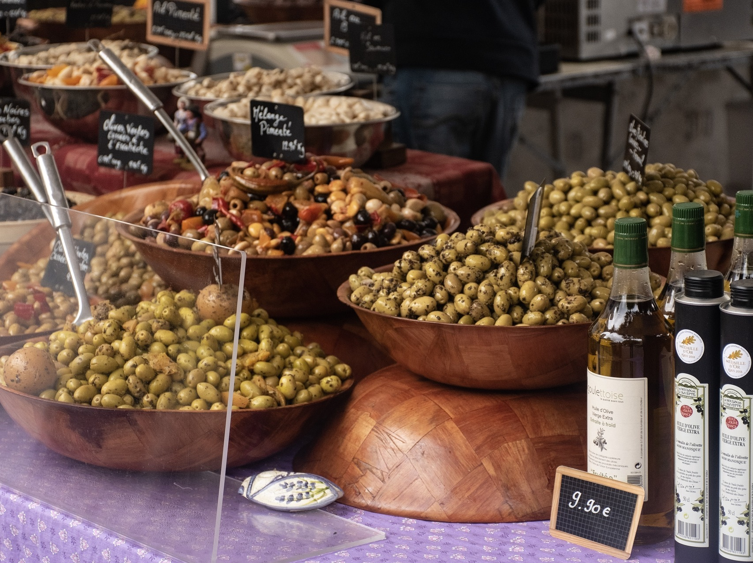
Image: RDLH
Notes:
RDLH. (2018, Nov. 13). Pixabay. Retrieved March 9, 2020, from https://pixabay.com/photos/olives-olive-oil-market-day-market-3793693/ Used under a Pixabay License. Free for commercial use. No attribution required.

Slide 36
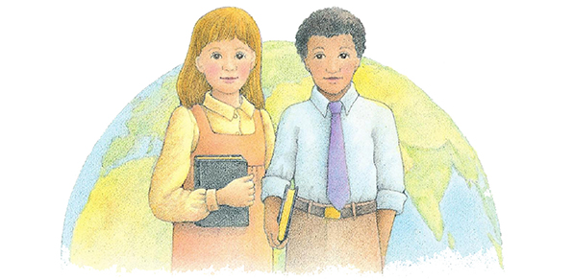
Dare to Do Right
Do the actions, then crack the code!
Image: Beth Whittaker
Notes:
Whittaker, Beth. (n.d.). Future missionaries. Two children holding scriptures, standing in front of an image of the earth. From the Children’s Songbook, page 172, “We’ll Bring the World His Truth (Army of Helaman)”; watercolor illustration by Beth Whittaker. Retrieved April 1, 2020, from https://www.churchofjesuschrist.org/media-library/images/children-songbook-art-153023?lang=eng&_r=1

Slide 37
Dare to Do Right
TO
TO
BE
TO
TO
TO
BE
TO
BE
TO
BE

Slide 38
Image: Andrzej_b
Notes:
Andrzej_b. (2016, Aug. 12). Pixabay. Retrieved March 9, 2020, from https://pixabay.com/photos/greece-mountains-way-sand-1585824/ Used under a Pixabay License. Free for commercial use. No attribution required.

Slide 39
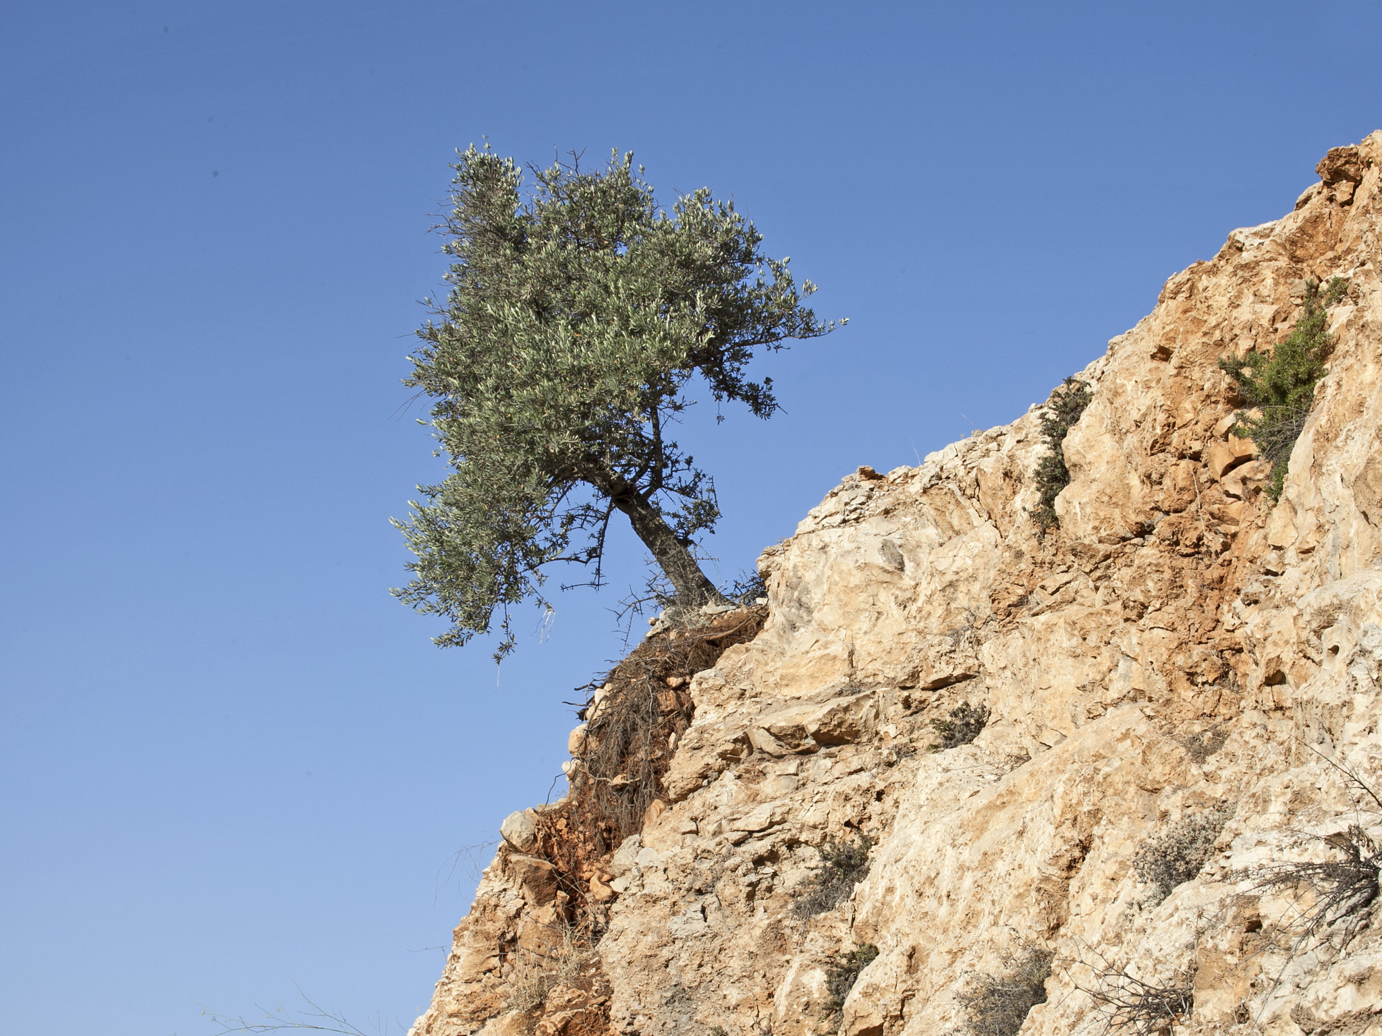
Image: Zeevveez
Notes:
Zeevveez. (2014, Jun. 30). Symbolic photography: This olive tree, photographed on the road from Jerusalem to Bethlehem, looks healthy and happy, even though it is growing on a thin layer of soil, and despite the strong wind that bent its trunk. It is the fertile green between the white barren rock and the blue emptiness of the sky. Flickr. Retrieved March 8, 2020, from https://www.flickr.com/photos/zeevveez/14540772235/ Used under a Creative Commons Attribution License.

Slide 40
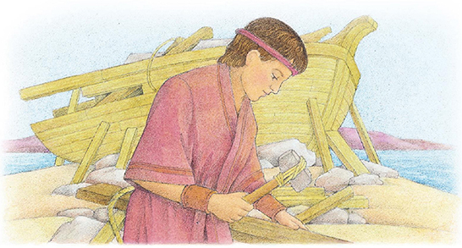
Nephi’s Courage
Do the ACTIONS with me then
Sing to a PARTNER (breakout rooms)
Image: Beth Whittaker
Notes:
Whittaker, Beth. (n.d.). Nephi builds the ship. Nephi working to construct a ship. From the Children’s Songbook, page 120, “Nephi’s Courage”; watercolor illustration by Beth Whittaker.. Retrieved April 1, 2020, from https://www.churchofjesuschrist.org/media-library/images/children-songbook-art-153008?lang=eng&_r=1

Slide 41
Image: The Church of Jesus Christ
Notes:
Missionaries in Ethiopia. Gospel Media Library. Retrieved March 8, 2020, from https://www.churchofjesuschrist.org/media-library/images/senior-missionaries-ethiopia-846898?lang=eng&_r=1

Slide 42
Image: The Church of Jesus Christ
Notes:
The Church of Jesus Christ of Latter-day Saints. (n.d.). Master of the vineyard. Gospel Media Library. Retrieved March 8, 2020, from
https://www.churchofjesuschrist.org/media-library/images/bible-videos-parable-vineyard-1426723?lang=eng&_r=1

Slide 43
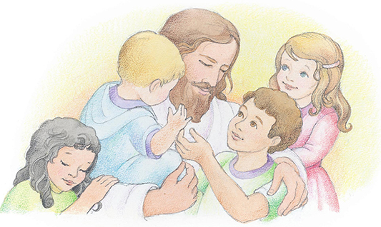
Love One Another
Do the sign language with me!
Image: Phyllis Luch
Notes:
Luch, Phyllis (n.d.). Children with Christ. Jesus hugging four children. From the Children’s Songbook, page 82, “When He Comes Again”; watercolor illustration by Phyllis Luch. Gospel Media. Retrieved April 1, 2020, from https://www.churchofjesuschrist.org/media-library/images/jesus-holding-children-phyllis-luch-358169?lang=eng&clang=ase

Slide 44
Image: Jennifer Harward
Notes:
Harward, Jennifer. (n.d.). Sign language for “love one another.” A series of sign language illustrations to help children learn the signs for “Love One Another.” From the Children’s Songbook, page 137, “Love One Another”; illustration by Jennifer Harward. Gospel Media. Retrieved April 1, 2020, from https://www.churchofjesuschrist.org/media-library/images/sign-language-love-one-another-1416354?lang=eng&clang=ase

Slide 45
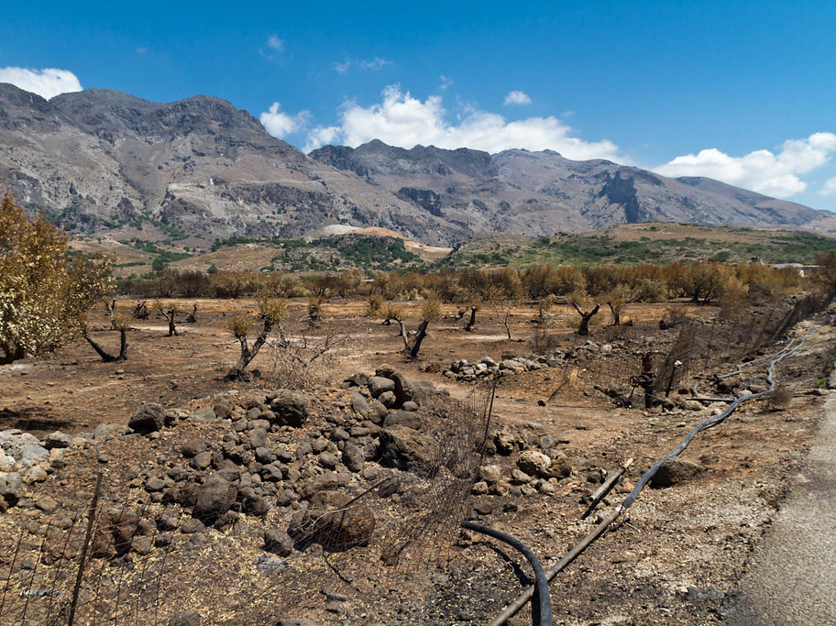
Growing takes work!
Image: Jechstra
Notes:
Jechstra. (2011, Aug. 13). Burned olive trees: Loutro. Flickr. Retrieved March 8, 2020, from https://www.flickr.com/photos/jechstra/6059732772/ Used under a Creative Commons Attribution Non-commercial No Derivatives License.

Slide 46
Image: LDS Scriptures
Notes:
LDS Scriptures. (2019, Sept. 29). Facebook. Retrieved March 21, 2020, from https://www.facebook.com/LDSScriptures/posts/i-made-a-printable-for-children-youth-and-adults-for-the-new-children-and-youth-/10162215806570257/

Slide 47
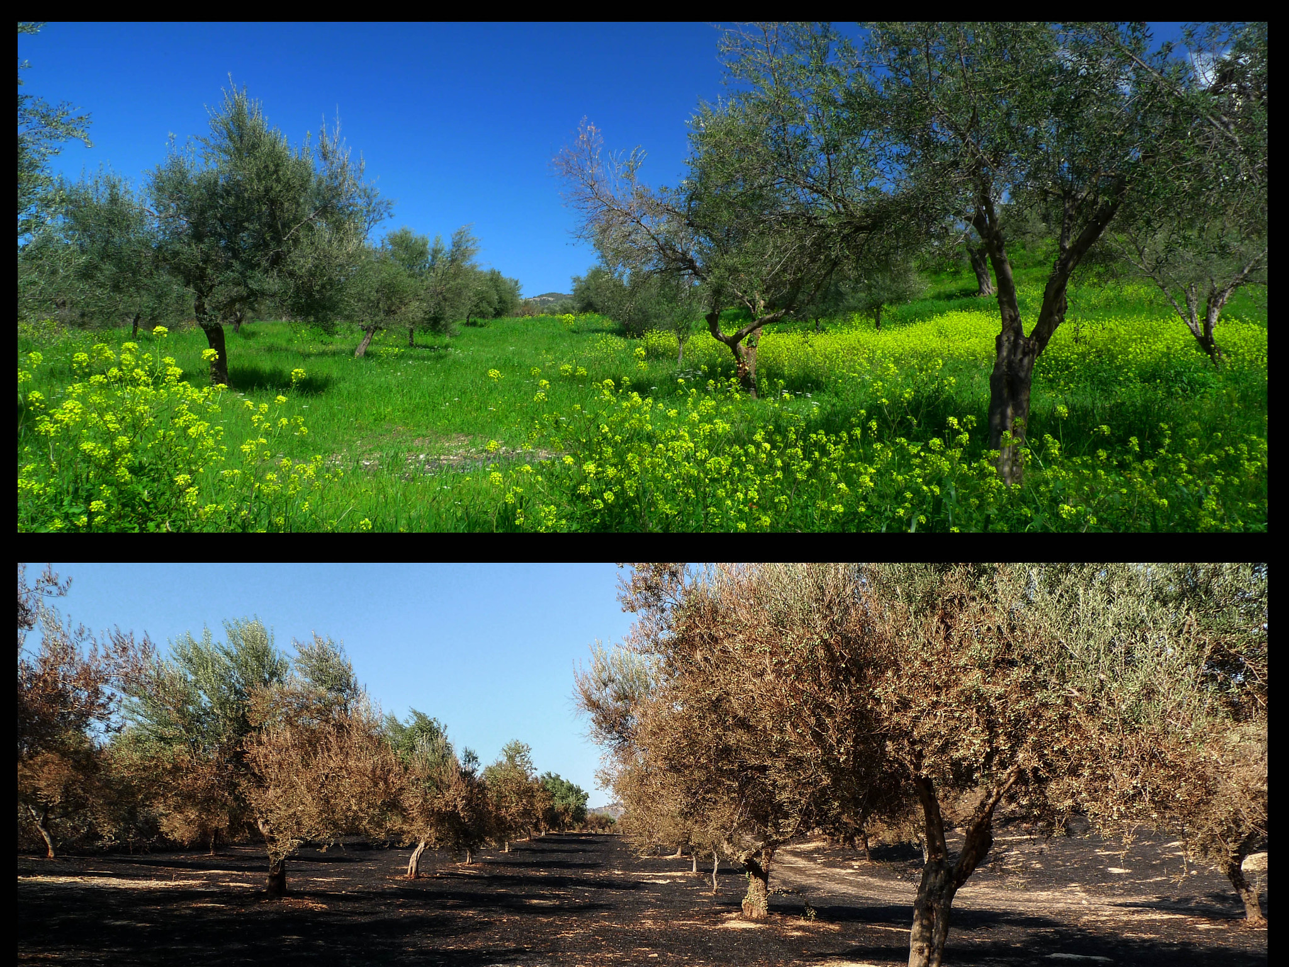
Dare to do right puts good fruit into our lives
Repentance: Gets bad fruit out of our lives
Image: Spiros Vathis
Notes:
Vathis, Spiros. (2012, Jul. 19). Before/After: Field of olive trees before and after the July,18 2012 fire, a few kilometers outside Patra, Greece. Flickr. Retrieved March 8, 2020, from https://www.flickr.com/photos/vathis/7604799698/ Used under a Creative Commons Attribution No Derivatives License.

Slide 48
Peace in Christ
Write down one change you will make in each category as you listen
Image: Phyllis Luch
Notes:
Luch, Phyllis (n.d.). The resurrected Savior. Jesus Christ with His arms outstretched. From the Children’s Songbook, page 76, “This Is My Beloved Son”; watercolor illustration by Phyllis Luch. Gospel Media. Retrieved April 1, 2020, from https://www.churchofjesuschrist.org/media-library/images/jesus-holding-children-phyllis-luch-358169?lang=eng&clang=ase

