Slide 1
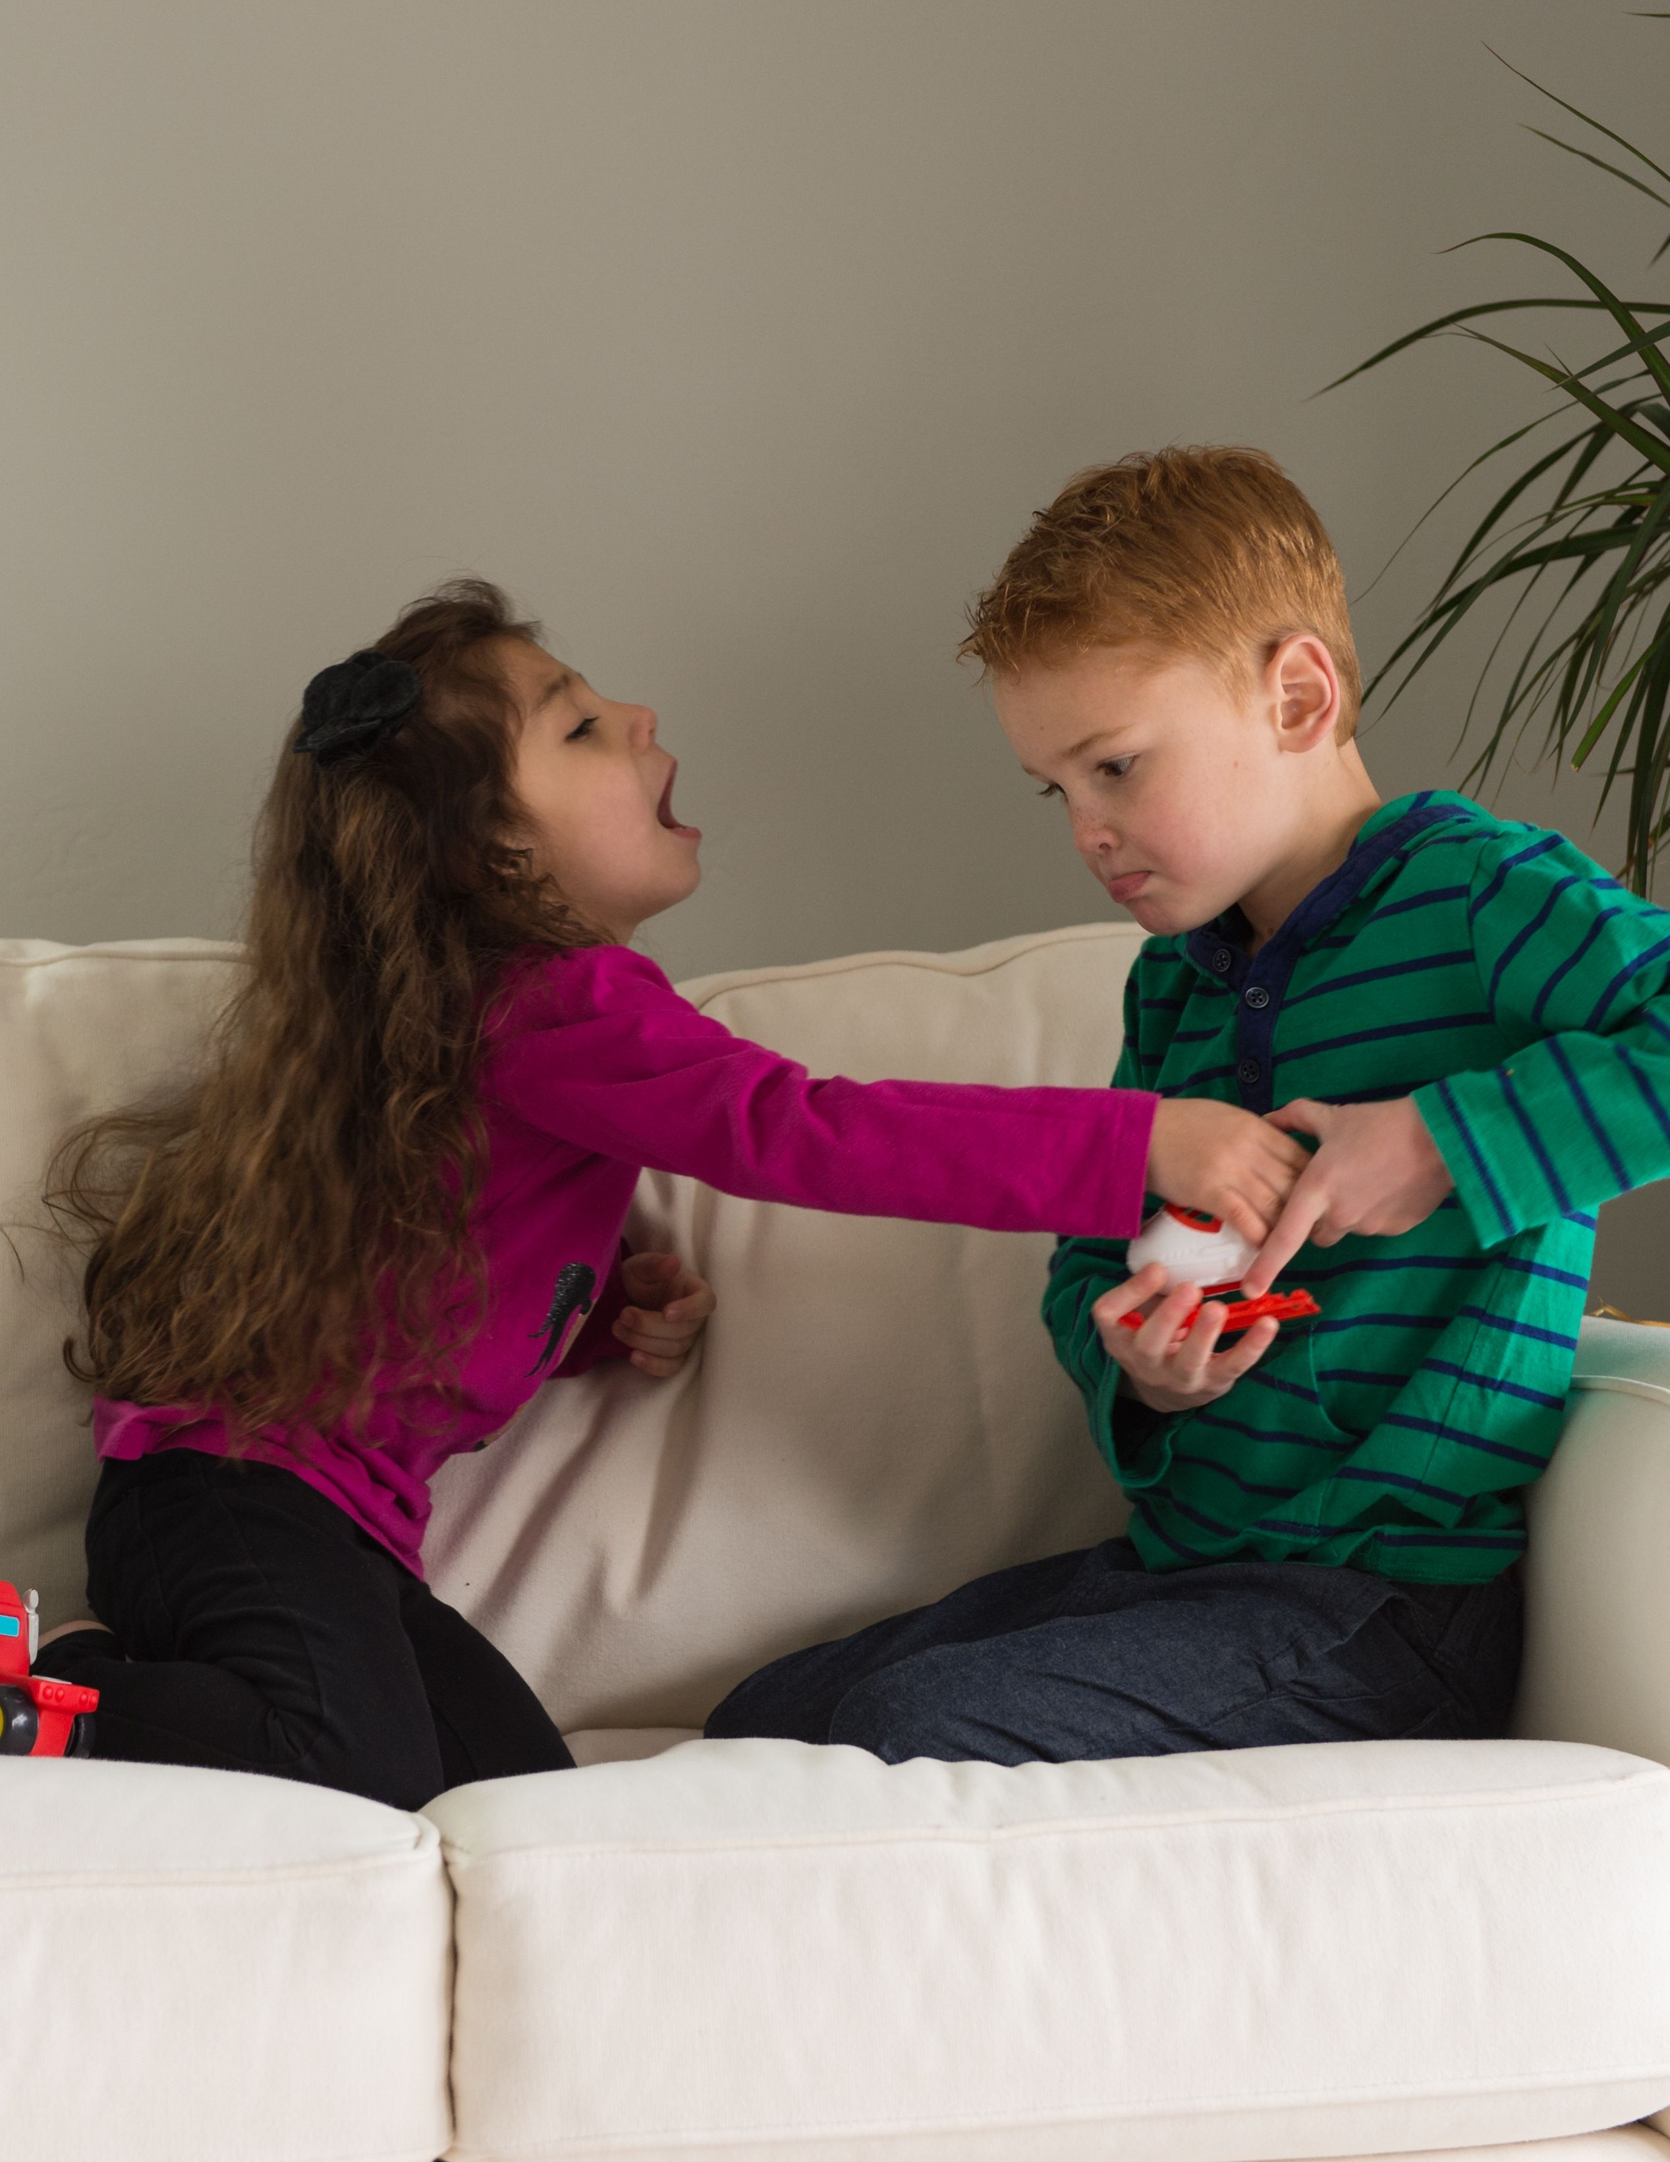
Help Me,
Dear Father
(Verses 1 & 2)
Children’s Songbook, p. 99
Words & Music: Francis K. Taylor
Flipchart: Cherice Montgomery
Notes:
The Church of Jesus Christ of Latter-Day Saints. (n.d). Fighting: Two children fighting over toys. The Church of Jesus Christ of Latter-Day Saints Media Library. Retrieved Jun. 23, 2023 from https://www.churchofjesuschrist.org/media/image/children-childhood-fighting-toys-e215b87?lang=eng

Slide 2
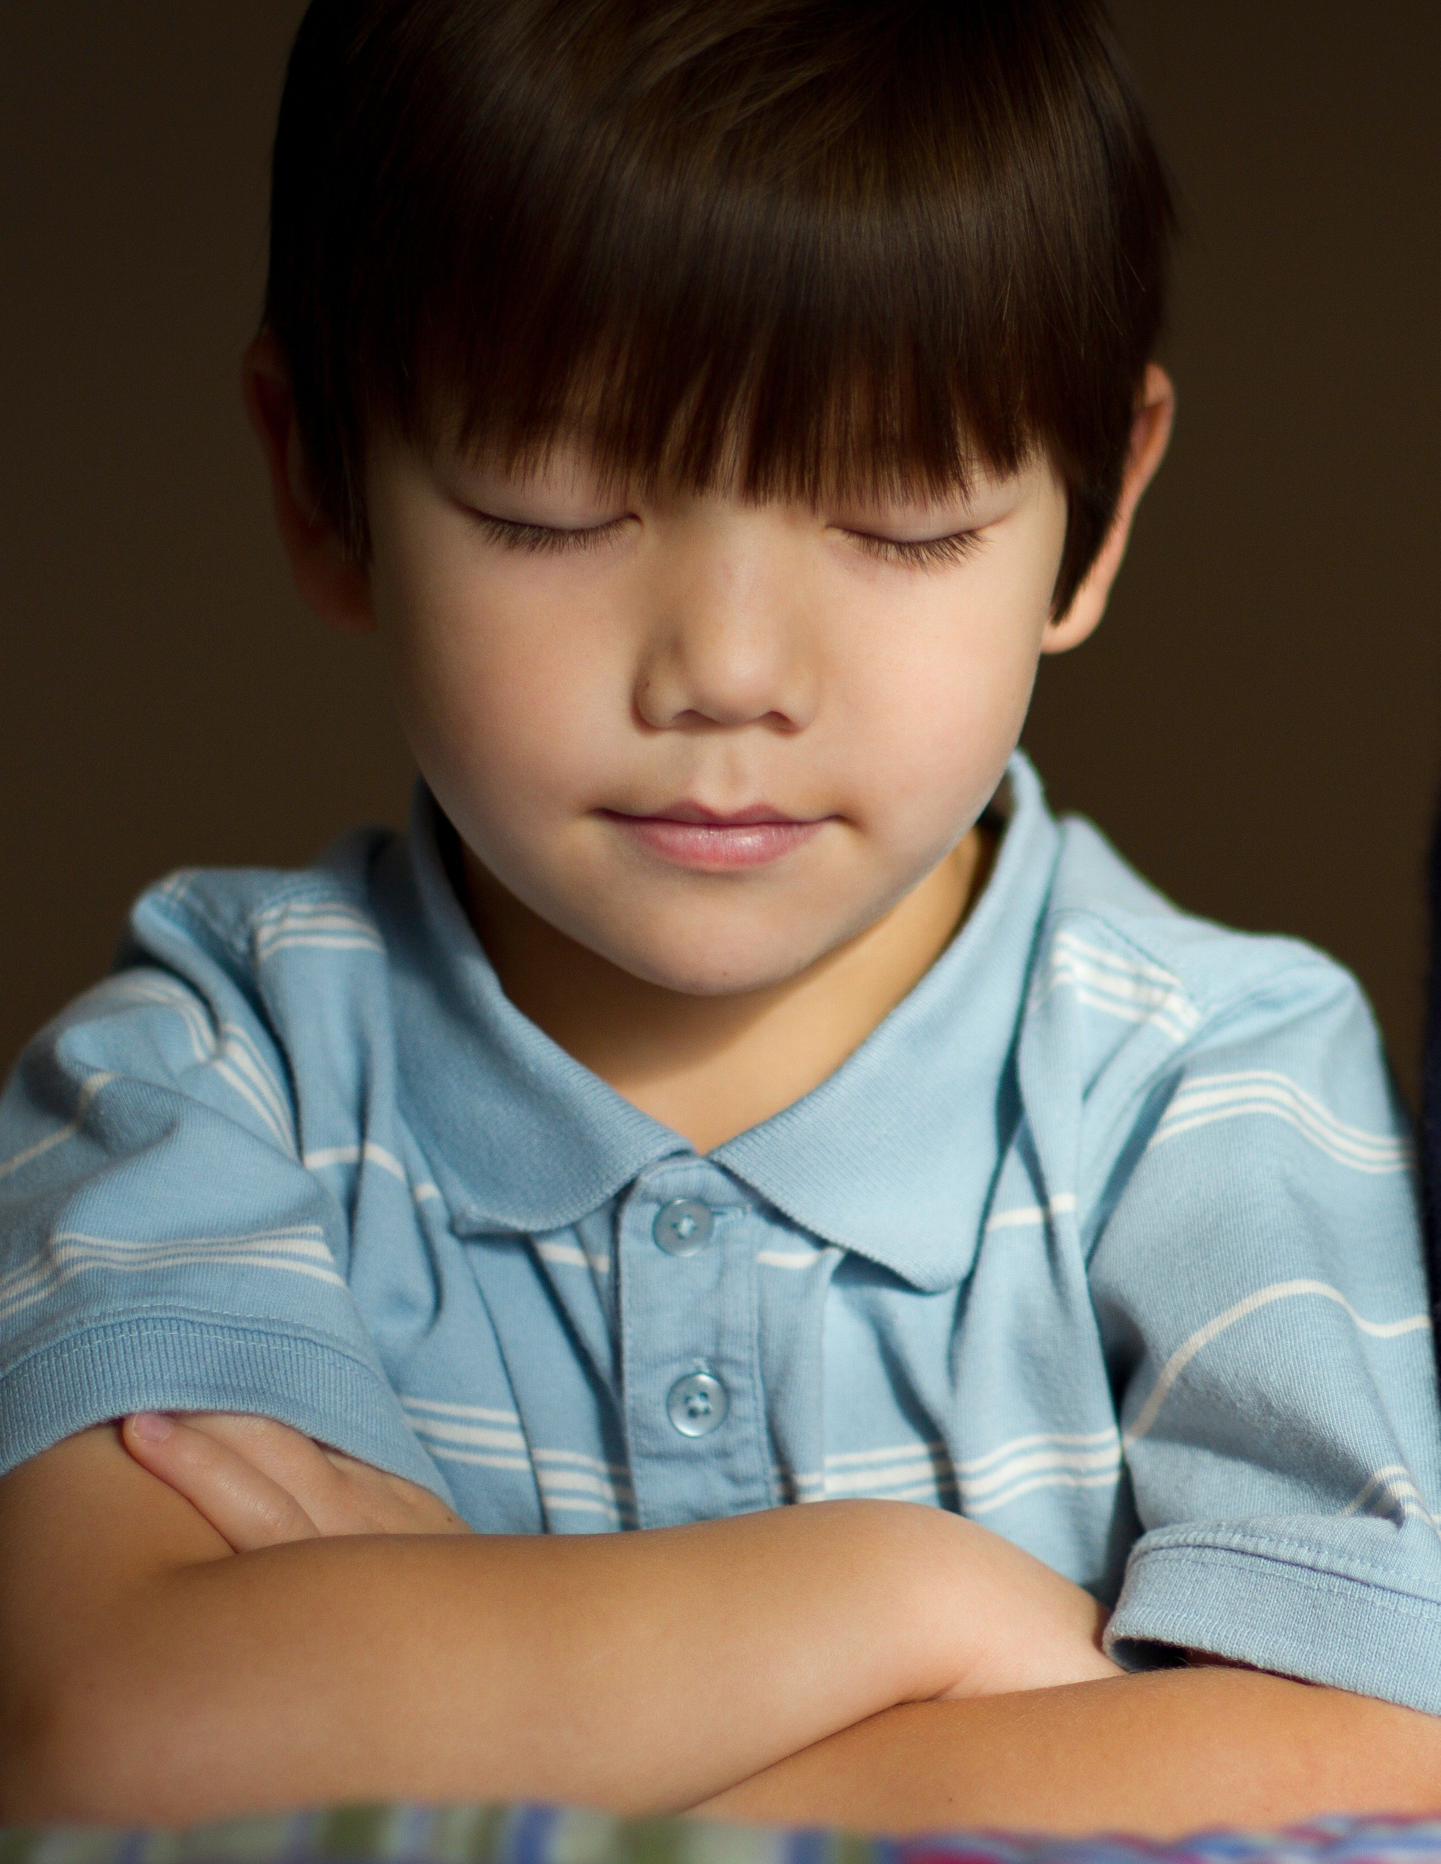
Help me, dear Father,
Notes:
The Church of Jesus Christ of Latter-Day Saints. (n.d). Prayer: A boy kneeling by his bed with his eyes closed and arms folded in prayer. The Church of Jesus Christ of Latter-Day Saints Media Library. Retrieved Jun. 23, 2023 from https://www.churchofjesuschrist.org/media/image/boy-prayer-f7345ef?lang=eng&collectionId=1d5d569ab33dea67f63cbcdcc87bc8756d679194

Slide 3
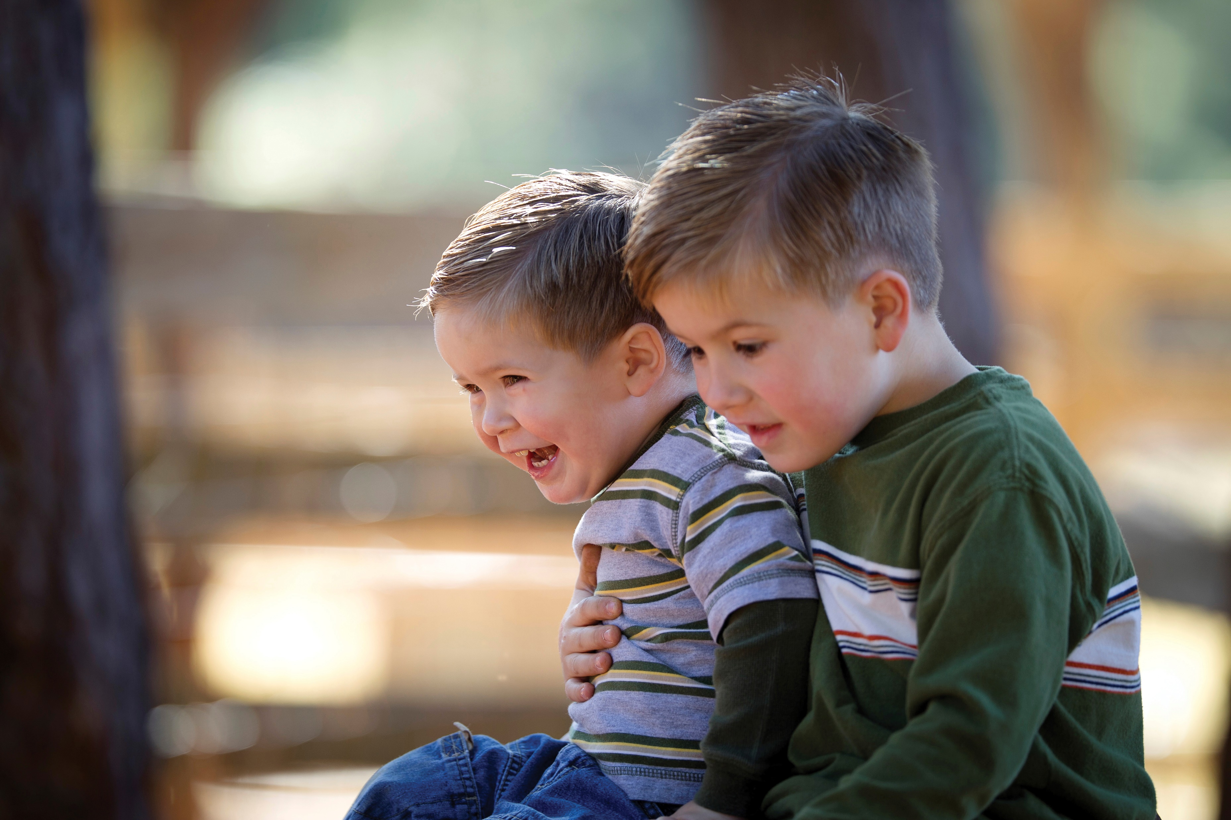
to freely forgive
Notes:
The Church of Jesus Christ of Latter-Day Saints. (n.d). Brothers: A portrait of two young brothers sitting together. The Church of Jesus Christ of Latter-Day Saints Media Library. Retrieved Jun. 23, 2023 from https://www.churchofjesuschrist.org/media/image/brothers-fa8d444?lang=eng

Slide 4
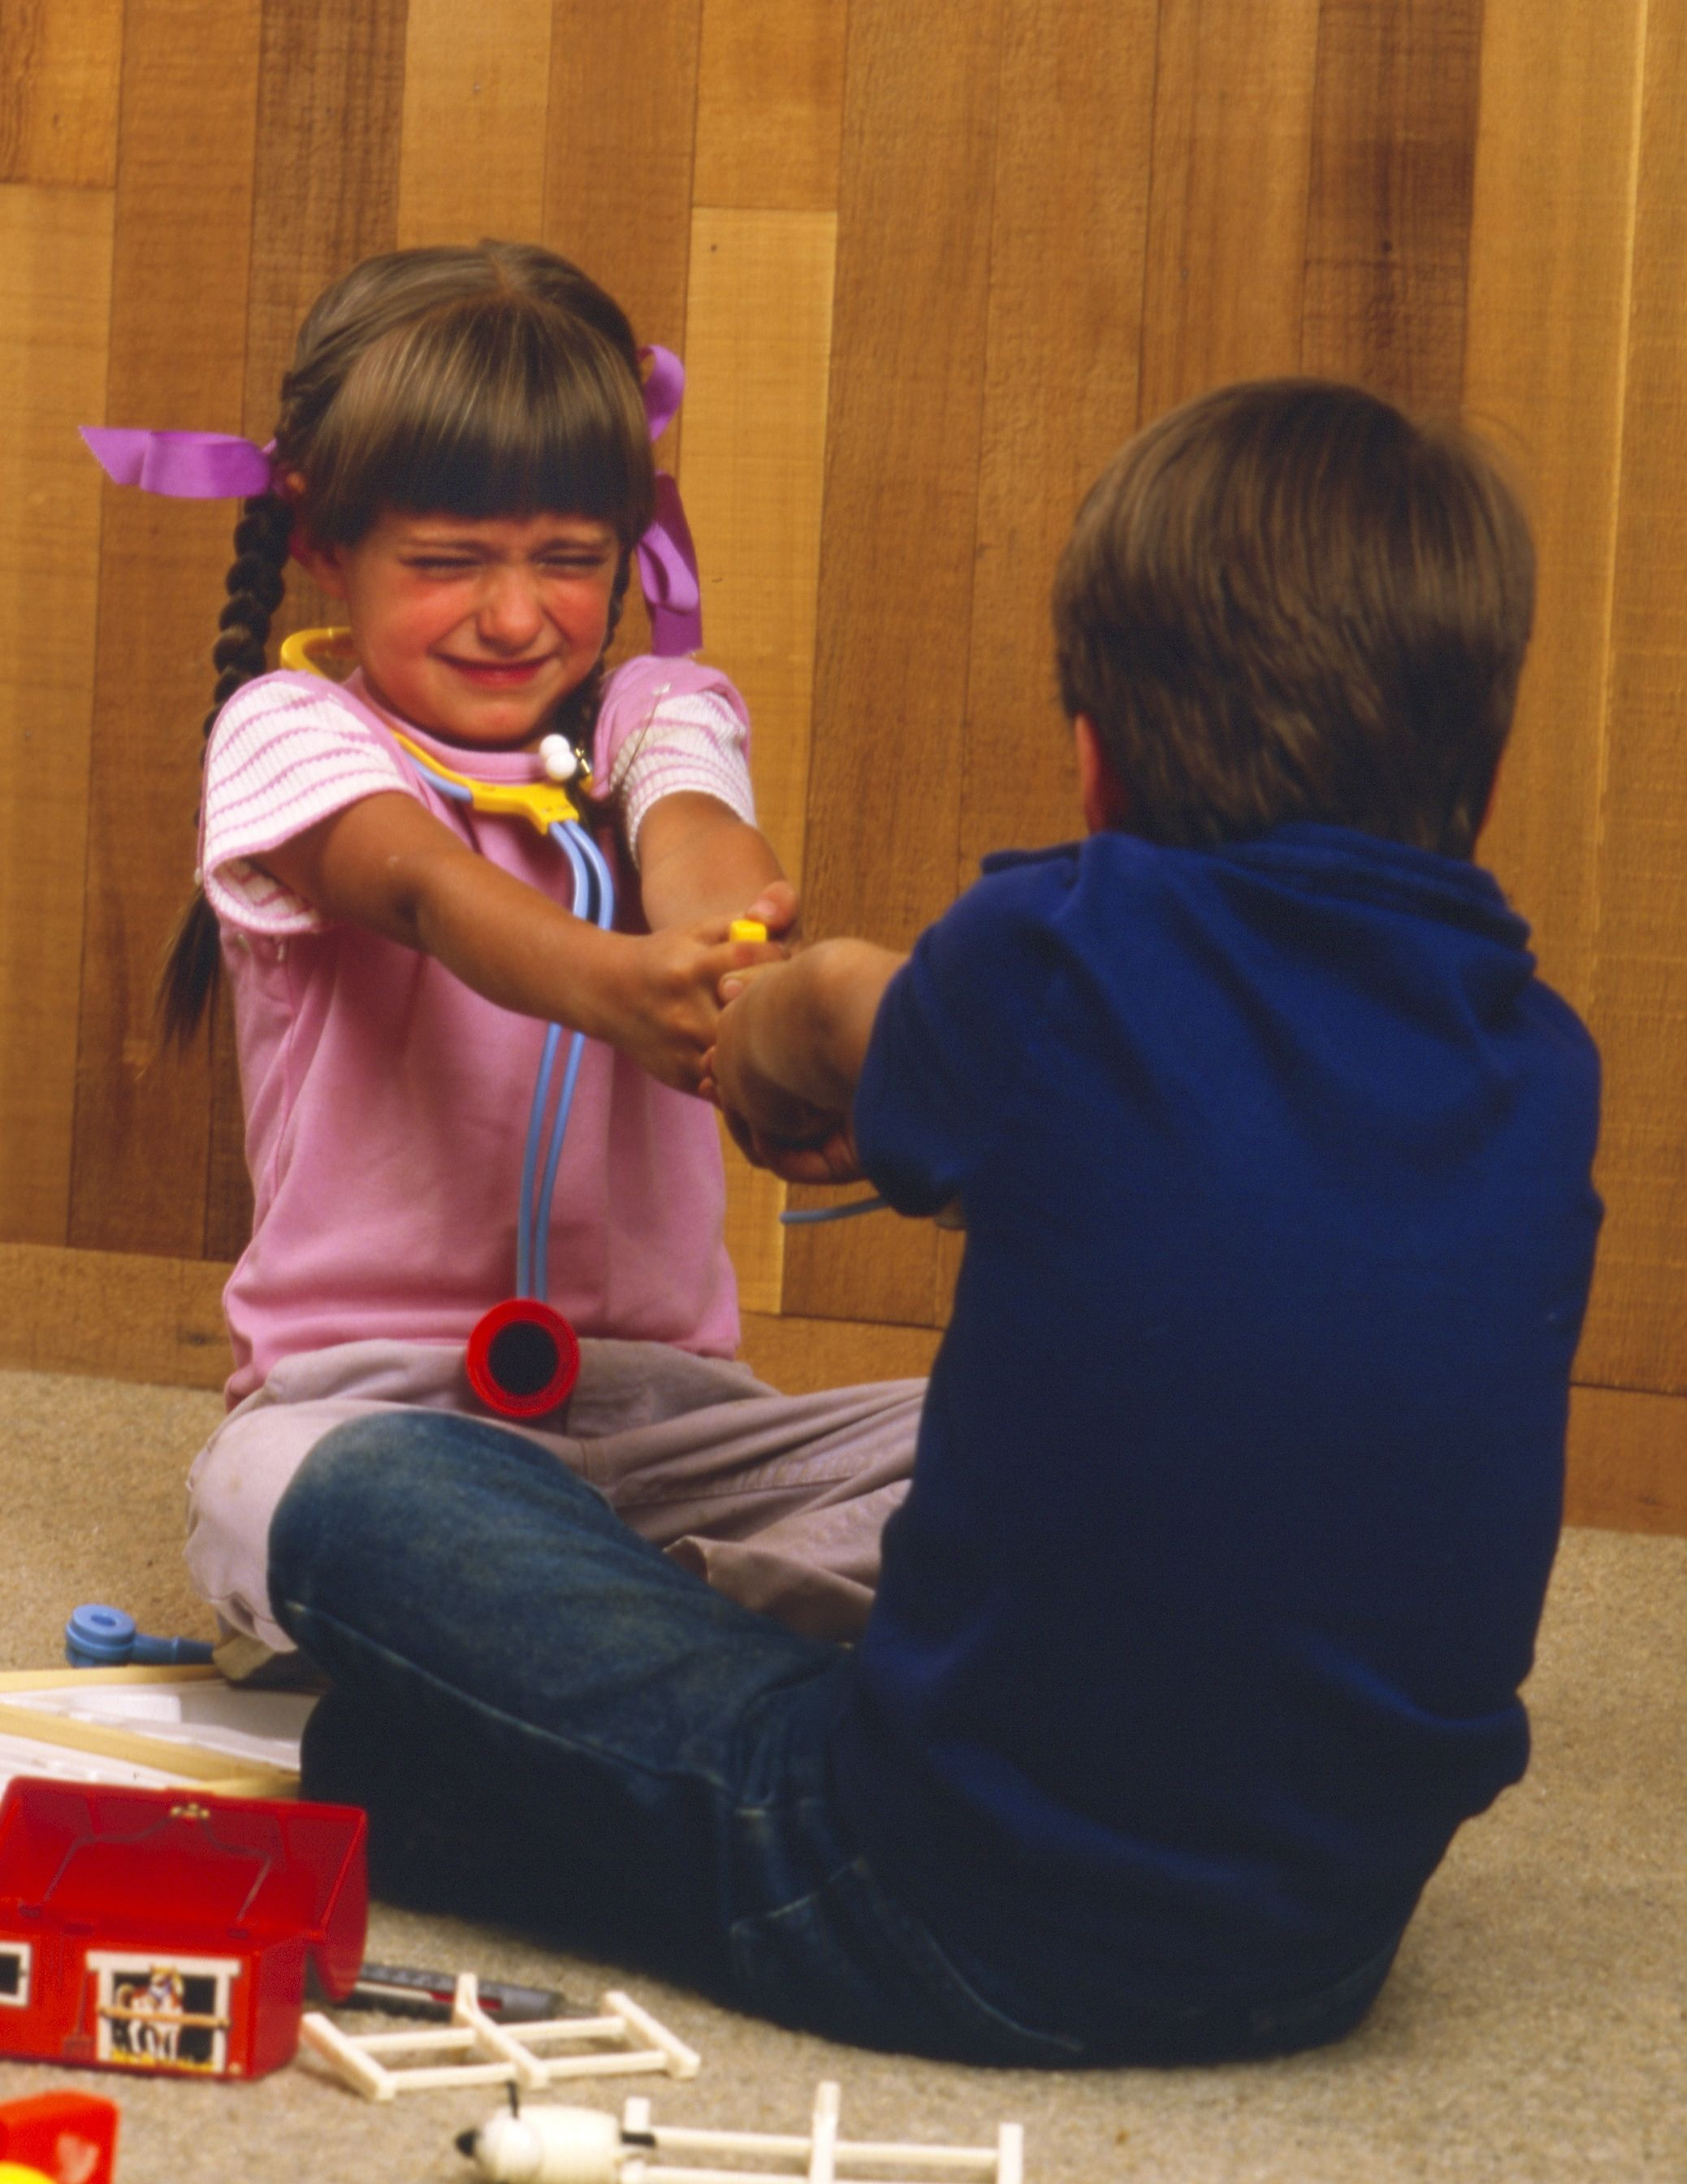
All who may seem unkind-- to me.
Notes:
The Church of Jesus Christ of Latter-Day Saints. (n.d). Childhood: A little boy and a little girl fighting over a toy. The Church of Jesus Christ of Latter-Day Saints Media Library. Retrieved Jun. 23, 2023 from https://www.churchofjesuschrist.org/media/image/children-childhood-fighting-toys-8911272?lang=eng

Slide 5
Help me each day,
Notes:
The Church of Jesus Christ of Latter-Day Saints. (n.d). Sunrise: The sun rises in the sky, radiating long rays. The Church of Jesus Christ of Latter-Day Saints Media Library. Retrieved Jun. 23, 2023 from https://www.churchofjesuschrist.org/media/image/sunshine-21c0afe?lang=eng&collectionId=a2afde622a5c44ab9db658065a378385

Slide 6
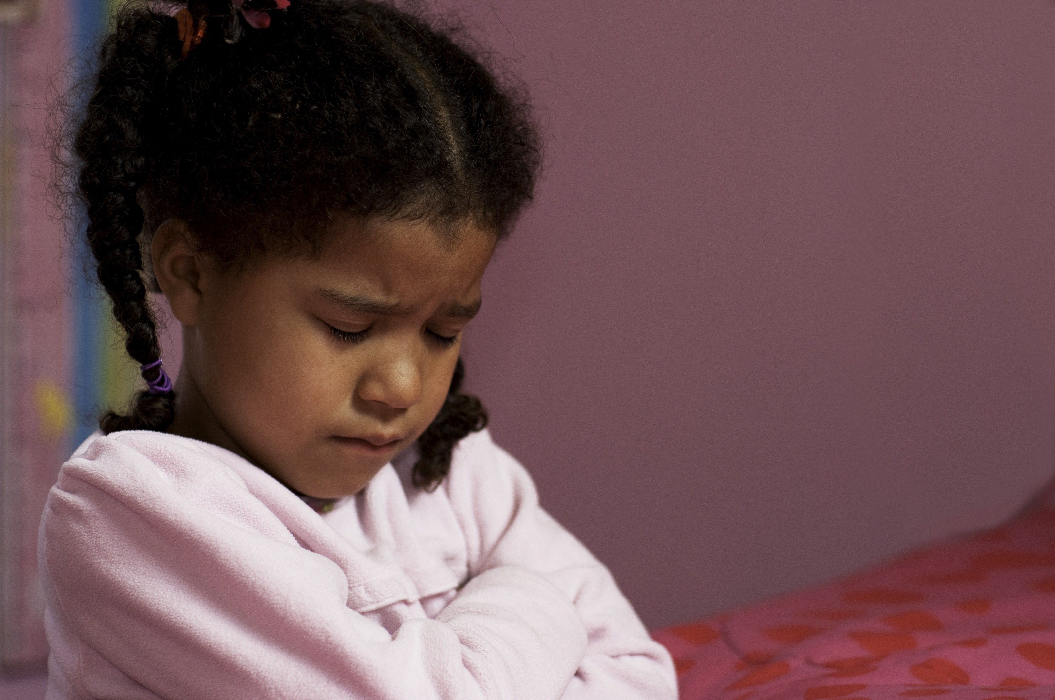
Father, I pray;
Notes:
The Church of Jesus Christ of Latter-Day Saints. (n.d). Young girl praying: A young girl prays before she goes to bed. The Church of Jesus Christ of Latter-Day Saints Media Library. Retrieved Jun. 23, 2023 from https://www.churchofjesuschrist.org/media/image/young-girl-praying-fe34640?lang=eng

Slide 7
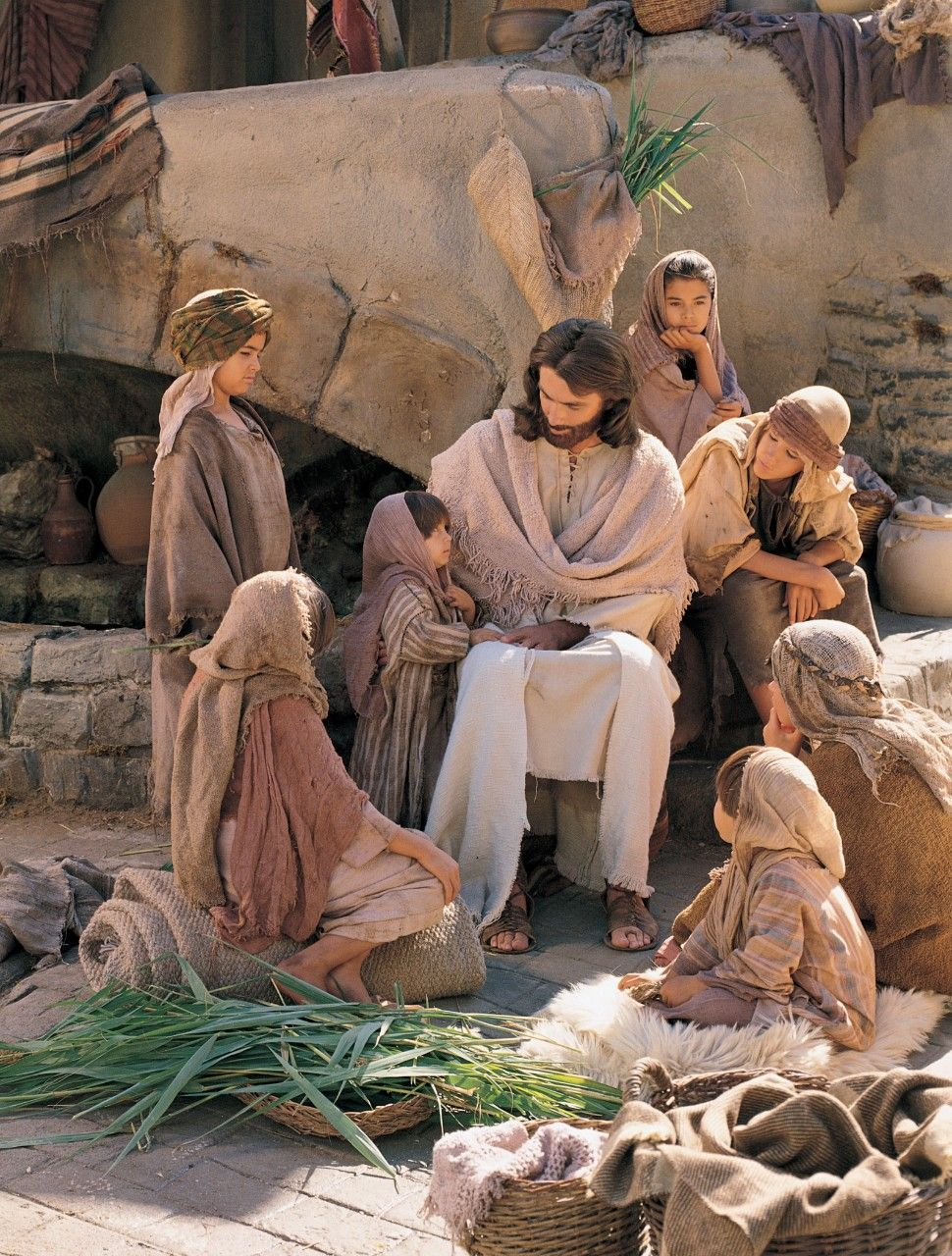
Help me live nearer, nearer to thee.
Notes:
The Church of Jesus Christ of Latter-Day Saints. (n.d). Re-enactment of Christ with children: A reenactment showing Christ sitting with a group of children. The Church of Jesus Christ of Latter-Day Saints Media Library. Retrieved Jun. 23, 2023 from https://www.churchofjesuschrist.org/media/image/jesus-with-children-aed01f4?lang=eng

Slide 8
Help me, dear Father,
Notes:
The Church of Jesus Christ of Latter-Day Saints. (n.d). Prayer: A boy kneeling by his bed with his eyes closed and arms folded in prayer. The Church of Jesus Christ of Latter-Day Saints Media Library. Retrieved Jun. 23, 2023 from https://www.churchofjesuschrist.org/media/image/boy-prayer-f7345ef?lang=eng&collectionId=1d5d569ab33dea67f63cbcdcc87bc8756d679194

Slide 9
to truly repent,
Notes:
The Church of Jesus Christ of Latter-Day Saints. (n.d). A child taking the sacrament: A young child reaches out to take a sacrament cup. The Church of Jesus Christ of Latter-Day Saints Media Library. Retrieved Jun. 23, 2023 from https://www.churchofjesuschrist.org/media/image/sacrament-meetings-9d0478a?lang=eng&collectionId=1d5d569ab33dea67f63cbcdcc87bc8756d679194

Slide 10
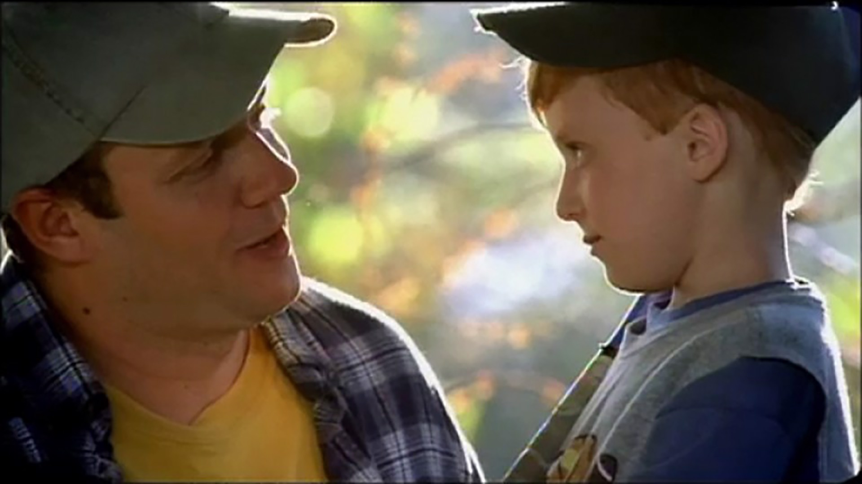
Making things right and changing my ways.
Notes:
The Church of Jesus Christ of Latter-Day Saints. (n.d). I’ve put it off too long: A father finds time to play ball with his children. The Church of Jesus Christ of Latter-Day Saints Media Library. Retrieved Jun. 23, 2023 from https://www.churchofjesuschrist.org/media/video/2009-04-0026-ive-put-it-off-too-long?lang=eng

Slide 11
Help me each day,
Notes:
The Church of Jesus Christ of Latter-Day Saints. (n.d). Sunrise: The sun rises in the sky, radiating long rays. The Church of Jesus Christ of Latter-Day Saints Media Library. Retrieved Jun. 23, 2023 from https://www.churchofjesuschrist.org/media/image/sunshine-21c0afe?lang=eng&collectionId=a2afde622a5c44ab9db658065a378385

Slide 12
Father, I pray;
Notes:
The Church of Jesus Christ of Latter-Day Saints. (n.d). Young girl praying: A young girl prays before she goes to bed. The Church of Jesus Christ of Latter-Day Saints Media Library. Retrieved Jun. 23, 2023 from https://www.churchofjesuschrist.org/media/image/young-girl-praying-fe34640?lang=eng

Slide 13
Help me live nearer, nearer to thee.
Notes:
The Church of Jesus Christ of Latter-Day Saints. (n.d). Re-enactment of Christ with children: A reenactment showing Christ sitting with a group of children. The Church of Jesus Christ of Latter-Day Saints Media Library. Retrieved Jun. 23, 2023 from https://www.churchofjesuschrist.org/media/image/jesus-with-children-aed01f4?lang=eng

Slide 14
Image Credits:
The Church of Jesus Christ of Latter-Day Saints. (n.d). A child taking the sacrament: A young child reaches out to take a sacrament cup. The Church of Jesus Christ of Latter-Day Saints Media Library. Retrieved Jun. 23, 2023 from https://www.churchofjesuschrist.org/media/image/sacrament-meetings-9d0478a?lang=eng&collectionId=1d5d569ab33dea67f63cbcdcc87bc8756d679194
The Church of Jesus Christ of Latter-Day Saints. (n.d). Brothers: A portrait of two young brothers sitting together. The Church of Jesus Christ of Latter-Day Saints Media Library. Retrieved Jun. 23, 2023 from https://www.churchofjesuschrist.org/media/image/brothers-fa8d444?lang=eng
The Church of Jesus Christ of Latter-Day Saints. (n.d). Childhood: A little boy and a little girl fighting over a toy. The Church of Jesus Christ of Latter-Day Saints Media Library. Retrieved Jun. 23, 2023 from https://www.churchofjesuschrist.org/media/image/children-childhood-fighting-toys-8911272?lang=eng
The Church of Jesus Christ of Latter-Day Saints. (n.d). Fighting: Two children fighting over toys. The Church of Jesus Christ of Latter-Day Saints Media Library. Retrieved Jun. 23, 2023 from https://www.churchofjesuschrist.org/media/image/children-childhood-fighting-toys-e215b87?lang=eng
The Church of Jesus Christ of Latter-Day Saints. (n.d). I’ve put it off too long: A father finds time to play ball with his children. The Church of Jesus Christ of Latter-Day Saints Media Library. Retrieved Jun. 23, 2023 from https://www.churchofjesuschrist.org/media/video/2009-04-0026-ive-put-it-off-too-long?lang=eng
The Church of Jesus Christ of Latter-Day Saints. (n.d). Prayer: A boy kneeling by his bed with his eyes closed and arms folded in prayer. The Church of Jesus Christ of Latter-Day Saints Media Library. Retrieved Jun. 23, 2023 from https://www.churchofjesuschrist.org/media/image/boy-prayer-f7345ef?lang=eng&collectionId=1d5d569ab33dea67f63cbcdcc87bc8756d679194
The Church of Jesus Christ of Latter-Day Saints. (n.d). Re-enactment of Christ with children: A reenactment showing Christ sitting with a group of children. The Church of Jesus Christ of Latter-Day Saints Media Library. Retrieved Jun. 23, 2023 from https://www.churchofjesuschrist.org/media/image/jesus-with-children-aed01f4?lang=eng
The Church of Jesus Christ of Latter-Day Saints. (n.d). Sunrise: The sun rises in the sky, radiating long rays. The Church of Jesus Christ of Latter-Day Saints Media Library. Retrieved Jun. 23, 2023 from https://www.churchofjesuschrist.org/media/image/sunshine-21c0afe?lang=eng&collectionId=a2afde622a5c44ab9db658065a378385
The Church of Jesus Christ of Latter-Day Saints. (n.d). Young girl praying: A young girl prays before she goes to bed. The Church of Jesus Christ of Latter-Day Saints Media Library. Retrieved Jun. 23, 2023 from https://www.churchofjesuschrist.org/media/image/young-girl-praying-fe34640?lang=eng

Slide 15
Help me, dear Father,
Notes:
The Church of Jesus Christ of Latter-Day Saints. (n.d). Fighting: Two children fighting over toys. The Church of Jesus Christ of Latter-Day Saints Media Library. Retrieved Jun. 23, 2023 from https://www.churchofjesuschrist.org/media/image/children-childhood-fighting-toys-e215b87?lang=eng

Slide 16
All who may seem unkind-- to me.
Notes:
The Church of Jesus Christ of Latter-Day Saints. (n.d). Fighting: Two children fighting over toys. The Church of Jesus Christ of Latter-Day Saints Media Library. Retrieved Jun. 23, 2023 from https://www.churchofjesuschrist.org/media/image/children-childhood-fighting-toys-e215b87?lang=eng

