Slide 1
Singing Time with Sister Montgomery
Image: Prawny
Notes:
Prawny. (2017, Jul. 27). Retrieved May 3, 2020, from https://pixabay.com/illustrations/watercolor-watercolour-paper-2543729/ Used under a Pixabay License. Free for commercial use. No attribution required.

Slide 2
Prophets Bravely Testify of Christ
Mosiah 11-17
King Noah
Abinadi
Image: The Church
of Jesus Christ
Notes:
The Church of Jesus Christ of Latter-day Saints. (2020). Abinadi before King Noah. Abinadi before King Noah, by Andrew Bosley. Gospel Media Library. Retrieved May 3, 2020, from https://www.churchofjesuschrist.org/media-library/images/illustrations-scriptures-book-of-mormon-abinadi-1929889?lang=eng

Slide 3
King Noah
Abinadi
Image: The Church
of Jesus Christ
Notes:
The Church of Jesus Christ of Latter-day Saints. (2020). Abinadi before King Noah (Abinadi Appearing before King Noah). Abinadi before King Noah (Abinadi Appearing before King Noah), by Arnold Friberg (62042); GAK 308; GAB 75; Primary manual 3-47; Primary manual 4-22; Mosiah 11:20–29, 12:17–37; 13–17. Gospel Media Library. Retrieved May 3, 2020, from https://www.churchofjesuschrist.org/media-library/images/abinadi-before-king-noah-39651?lang=eng

Slide 4
Alma
Image: The Church
of Jesus Christ
Notes:
The Church of Jesus Christ of Latter-day Saints. (2020). Alma Baptizes in the Waters of Mormon. Alma Baptizes in the Waters of Mormon, by Arnold Friberg (62332); GAK 309; GAB 76; Primary manual 3-48; Primary manual 4-23; Mosiah 18:7–17. Gospel Media Library. Retrieved May 3, 2020, from https://www.churchofjesuschrist.org/media-library/images/alma-baptizing-people-39653?lang=eng

Slide 5
Mothers
from the Scriptures
Image: Prawny
Notes:
Prawny. (2016, Oct. 17). Retrieved May 3, 2020, from https://pixabay.com/illustrations/watercolour-watercolor-painting-1742987/ Used under a Pixabay License. Free for commercial use. No attribution required.

Slide 6
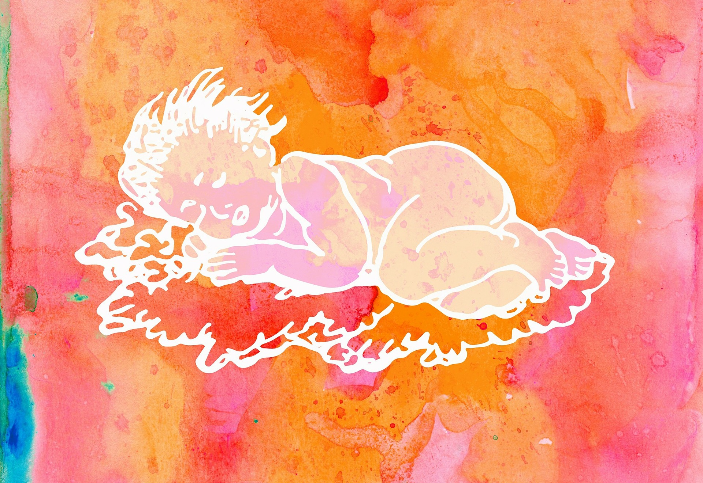
?
Genesis 3:20
“mother
of all living”
Image: Prawny
Notes:
Prawny. (2016, Oct. 27). Retrieved May 3, 2020, from https://pixabay.com/illustrations/watercolour-watercolor-paint-ink-1768978/ Used under a Pixabay License. Free for commercial use. No attribution required.

Slide 7
Eve
Image: Del Parson
Notes:
Parson, Del. (n.d.). Adam and Eve Teaching Their Children. Adam and Eve Teaching Their Children, by Del Parson; GAK 119; GAB 5; Primary manual 1-34; Primary manual 3-05; Moses 5:12. Gospel Media Library. Retrieved May 9, 2020, from https://www.churchofjesuschrist.org/media-library/images/adam-eve-teaching-children-82611?lang=eng

Slide 8
Keep the Commandments,
p. 146
1: p, f
Image: Prawny
Notes:
Prawny. (2017, Feb. 15). Retrieved April 11, 2020, from https://pixabay.com/illustrations/watercolour-watercolor-paint-effect-2069802/ Used under a Pixabay License. Free for commercial use. No attribution required.

Slide 9
Can you name them?
2:
Image: The Church
of Jesus Christ
Notes:
The Church of Jesus Christ of Latter-day Saints. (2020). They Are Ten Commandments. They Are Ten Commandments, Not Ten Suggestions. (See Exodus 20:1–17.) Feb. 2010. Gospel Media Library. Retrieved May 3, 2020, from https://www.churchofjesuschrist.org/media-library/images/mormonad-commandments-not-suggestions-1118430?lang=eng

Slide 10
Jochebed
“hid her baby in an ark in the river” (Exodus 2:2-8)
Pharoah’s daughter
Moses
Image: The Church
of Jesus Christ
Notes:
Soper, George. (n.d.). Moses in the Bulrushes. Moses in the Bulrushes, by George Soper; GAK 106; Primary manual 1-2; Primary manual 6-21; Exodus 2:5. Gospel Media Library. Retrieved May 9, 2020, from https://www.churchofjesuschrist.org/media-library/images/baby-moses-82602?lang=eng&clang=ase

Slide 11
Image: Robert T. Barrett
Notes:
Barrett, Robert T. (n.d.). Moses Parting the Red Sea. Moses Parting the Red Sea, by Robert T. Barrett. Gospel Media Library. Retrieved May 10, 2020, from https://www.churchofjesuschrist.org/media-library/images/moses-parting-red-sea-barrett-301889?lang=eng

Slide 12
Image: The Church
of Jesus Christ
Notes:
Mehr, Judith. (n.d.). Moses and the Brass Serpent. Moses and the Brass Serpent, by Judith Mehr (62202); GAK 123; GAB 16; Primary manual 6-25; Numbers 21:4–9; John 3:14; Alma 33:19–21
. Gospel Media Library. Retrieved May 10, 2020, from https://www.churchofjesuschrist.org/media-library/images/moses-brass-serpent-39479?lang=eng

Slide 13
I Will Be Valiant,
p. 162
1: 2:
Image: Prawny
Notes:
Prawny. (2017, Feb. 8). Retrieved April 10, 2020, from https://pixabay.com/illustrations/watercolour-watercolor-painting-2049635/ Used under a Pixabay License. Free for commercial use. No attribution required.

Slide 14
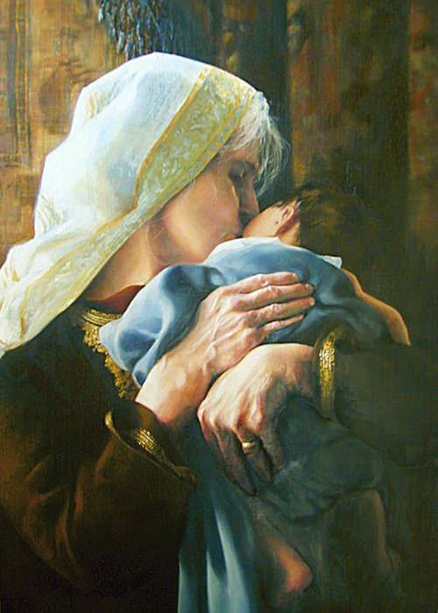
Isaac
Sarah
Image: Elspeth Young
Notes:
Young, Elspeth. (2006, Sept.). Is Anything Too Hard for the Lord? by Elspeth Young. Sarah in Hebrew means “princess.” She was of royal lineage, the wife of the prophet Abraham and the mother of Isaac. Abraham and Sarah, his barren wife, were in their old age when the Lord spoke to Abraham saying, “And I will bless her, and give thee a son also of her: yea, I will bless her, and she shall be a mother of nations” (Genesis 17:16). They named the promised heir Isaac. Isaac’s son Jacob became known as Israel, and his descendants became the twelve tribes of Israel. Through the house of Israel, the covenants and promises made to Adam and Eve were restored. She Shall Be Called Woman: Women of the Old Testament. Ensign. Retrieved May 10, 2020, from https://www.churchofjesuschrist.org/study/ensign/2006/09/she-shall-be-called-woman-women-of-the-old-testament?lang=eng Direct link: https://www.churchofjesuschrist.org/bc/content/shared/content/images/gospel-library/magazine/en06sep38b_young.jpg

Slide 15
Faith, p. 96
1:
2:
Image: Prawny
Notes:
Ozdemir, Evren (Lexotan). (2018, Feb. 8). Retrieved April 11, 2020, https://pixabay.com/illustrations/eggs-easter-colorful-watercolor-3136975/ Used under a Pixabay License. Free for commercial use. No attribution required.

Slide 16
Hannah
“I will lend him unto the Lord” (1 Samuel 1:11)
Samuel
Image: Robert T. Barrett
Notes:
Barrett, Robert T. (n.d.). Hannah Presenting Her Son Samuel to Eli. Hannah Presenting Her Son Samuel to Eli, by Robert T. Barrett. Gospel Media Library. Retrieved May 9, 2020, from https://www.churchofjesuschrist.org/media-library/images/hannah-presents-son-samuel-barrett-82857?lang=eng

Slide 17
A Child’s
Prayer,
p. 12
1:
Image: Prawny
Notes:
Prawny. (2017, Mar. 22). Retrieved April 10, 2020, from https://pixabay.com/illustrations/watercolour-watercolor-ink-stain-2164992/ Used under a Pixabay License. Free for commercial use. No attribution required.

Slide 18
Rebekah
“I will draw waters for thy camels also” (Genesis 24:19)
Image: Michael Deas
Notes:
Deas, Michael. (n.d.). Rebekah at the Well. Rebekah at the Well, by Michael Deas (62160); GAK 121; GAB 10; Primary manual 6-15; Genesis 24:17–18. Gospel Media Library. Retrieved May 9, 2020, from https://www.churchofjesuschrist.org/media-library/images/rebekah-at-the-well-39477?lang=eng

Slide 19
Love One Another,
p. 190
Image: Prawny
Notes:
Prawny. (2017, Feb. 15). Retrieved April 11, 2020, from https://pixabay.com/illustrations/watercolour-watercolor-paint-effect-2069802/ Used under a Pixabay License. Free for commercial use. No attribution required.

Slide 20
Image: Jennifer Harward
Notes:
Harward, Jennifer. (n.d.). Sign language for “love one another.” A series of sign language illustrations to help children learn the signs for “Love One Another.” From the Children’s Songbook, page 137, “Love One Another”; illustration by Jennifer Harward. Gospel Media. Retrieved April 1, 2020, from https://www.churchofjesuschrist.org/media-library/images/sign-language-love-one-another-1416354?lang=eng&clang=ase

Slide 21
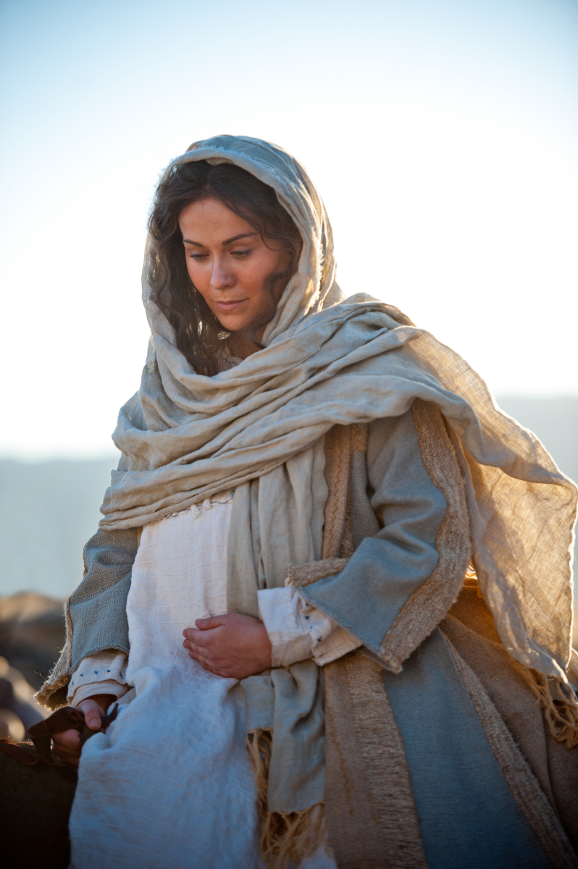
Mary
?
Image: The Church
of Jesus Christ
Notes:
The Church of Jesus Christ of Latter-day Saints. (n.d.). Mary, Mother of Jesus. Mary rides the donkey on the journey to Bethlehem. Gospel Media Library. Retrieved May 10, 2020, from https://www.churchofjesuschrist.org/media-library/images/mary-mother-of-jesus-958713?lang=eng

Slide 22
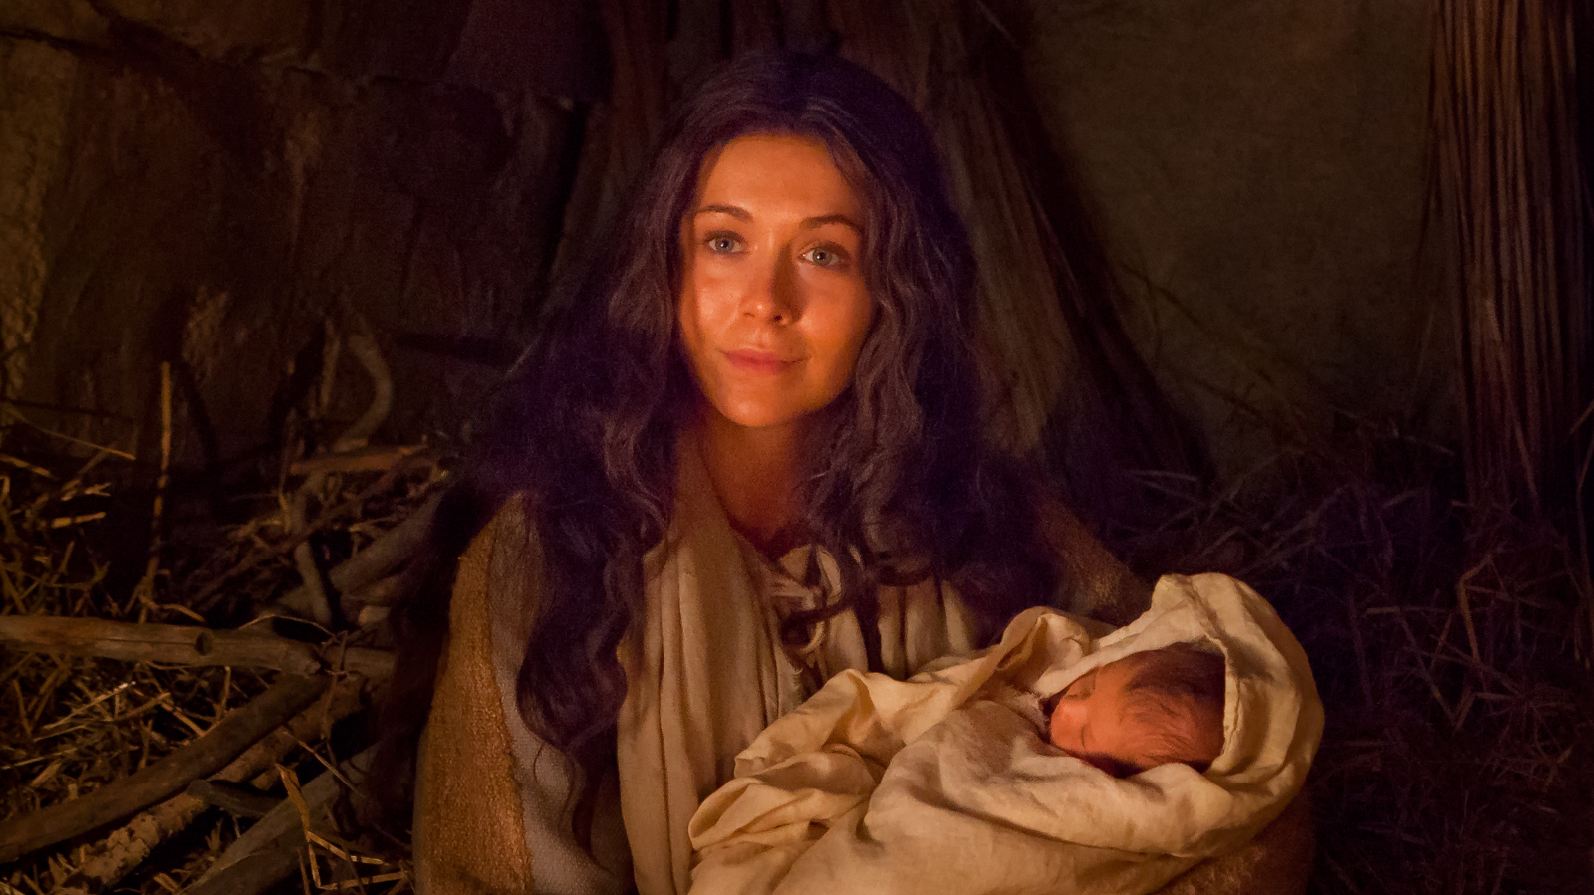
Mary
Jesus
Image: The Church
of Jesus Christ
Notes:
The Church of Jesus Christ of Latter-day Saints. (n.d.). Mary and Baby Jesus. Mary holds the infant Jesus on the night of His birth. Gospel Media Library. Retrieved May 10, 2020, from https://www.churchofjesuschrist.org/media-library/images/nativity-mary-mother-of-jesus-baby-jesus-1301892?lang=eng

Slide 23
Jesus
Mary
“And the child grew, and ªwaxed strong in spirit” (Luke 2:40)
Image: Del Parson
Notes:
Parson, Del. (n.d.). Jesus and His Mother. Jesus and His Mother, by Del Parson: GAK 242; Isaiah 7:14; Matthew 2:13; Joseph Smith Translation, John 2:4 (in John 2:4, footnote a); John 19:26–27; 1 Nephi 11:18–20; Mosiah 3:8; Alma 7:10. Gospel Media Library. Retrieved May 10, 2020, from https://www.churchofjesuschrist.org/media-library/images/young-jesus-comforting-his-mother-82711?lang=eng&_r=1

Slide 24
This is My Beloved Son, p. 76
Image: Prawny
Notes:
Prawny. (2017, Feb. 9). Retrieved April 10, 2020, from https://pixabay.com/illustrations/watercolour-watercolor-paint-2050755/ Used under a Pixabay License. Free for commercial use. No attribution required.

Slide 25
Mary
?
Elisabeth
Mary
Jesus
Image: The Church
of Jesus Christ
Notes:
The Church of Jesus Christ of Latter-day Saints. (n.d.). Mary Visits Elisabeth. Mary visiting her cousin Elisabeth, who is also expecting a child. Gospel Media Library. Retrieved May 10, 2020, from https://www.churchofjesuschrist.org/media-library/images/christmas-pictures-mary-elizabeth-958739?lang=eng

Slide 26
Elisabeth
John the Baptist
Image: The Church
of Jesus Christ
Notes:
The Church of Jesus Christ of Latter-day Saints. (n.d.). John, Elisabeth, and Zacharias. A portrait of Elisabeth and Zacharias with baby John. Gospel Media Library. Retrieved May 9, 2020, from https://www.churchofjesuschrist.org/media-library/images/elizabeth-zacharias-john-the-baptist-1102132?lang=eng

Slide 27
Dare to Do Right,
p. 158
1:
Image: Prawny
Notes:
Prawny. (2017, Mar. 20). Retrieved April 10, 2020, from https://pixabay.com/illustrations/watercolour-watercolor-ink-paint-2159970/ Used under a Pixabay License. Free for commercial use. No attribution required.

Slide 28
Sariah
Image: The Church
of Jesus Christ
Notes:
The Church of Jesus Christ of Latter-day Saints. (n.d.). Lehi comforts Sariah who is worried about their sons. Lehi comforts Sariah who is worried about their sons. Gospel Media Library. Retrieved May 9, 2020, from https://www.churchofjesuschrist.org/media-library/images/sariah-lehi-f4f3d9?lang=eng

Slide 29
Sam
Nephi
Sariah
Image: The Church
of Jesus Christ
Notes:
The Church of Jesus Christ of Latter-day Saints. (n.d.). Sariah, Nephi, and Sam reaching for the fruit of the tree of life. Sariah, Nephi, and Sam reach for the fruit of the tree of life. Gospel Media Library. Retrieved May 10, 2020, from https://www.churchofjesuschrist.org/media-library/images/lehi-dreams-of-tree-of-life-f9340d?lang=eng

Slide 30
The Iron Rod, #247
Image: Prawny
Notes:
Prawny. (2017, Mar. 1). Retrieved April 10, 2020, from https://pixabay.com/illustrations/watercolour-watercolor-painting-ink-2109383/ Used under a Pixabay License. Free for commercial use. No attribution required.

Slide 31
2,000 Stripling Warriors
Image: Arnold Friberg
Notes:
Friberg, Arnold. (n.d.). Two Thousand Young Warriors (Two Thousand Stripling Warriors). Two Thousand Young Warriors (Two Thousand Stripling Warriors), by Arnold Friberg (62050); GAK 313; GAB 80; Primary manual 1-65; Primary manual 3-38; Primary manual 4-40; Alma 53:10–22; 56; 57:19–27. Gospel Media Library. Retrieved May 9, 2020, from https://www.churchofjesuschrist.org/media-library/images/two-thousand-stripling-warriors-39660?lang=eng

Slide 32
Nephi’s Courage,
p. 120
Image: Prawny
Notes:
Prawny. (2017, Feb. 8). Retrieved April 10, 2020, from https://pixabay.com/illustrations/watercolour-watercolor-ink-stain-2049446/ Used under a Pixabay License. Free for commercial use. No attribution required.

Slide 33
Lucy Mack Smith
Image: Sutcliffe Maudsley
Notes:
Maudsley, Sutcliffe. (n.d.). Painting of Lucy Mack Smith in Nauvoo by Sutcliffe Maudsley. Lucy Mack Smith. The Church of Jesus Christ of Latter-day Saints. Retrieved May 9, 2020, from https://www.churchofjesuschrist.org/study/history/topics/lucy-mack-smith?lang=eng

Slide 34
I Will Be
What I Believe
Image: Prawny
Notes:
Prawny. (2017, Mar. 23). Retrieved April 10, 2020, from https://pixabay.com/illustrations/watercolour-watercolor-art-painting-2168655/ Used under a Pixabay License. Free for commercial use. No attribution required.

Slide 35
Emma Hale Smith
Image: The Church
of Jesus Christ
Notes:
Richards, Lee Greene. (n.d.). Emma Smith (Emma Hale Smith), by Lee Greene Richards (62509); GAK 405; GAB 88; Primary manual 5-22; Doctrine and Covenants 25. Emma Smith was the first Relief Society General President, serving from 1842 to 1844. The Church of Jesus Christ of Latter-day Saints. Retrieved May 9, 2020, from https://www.churchofjesuschrist.org/media-library/images/emma-hale-smith-lee-richards-82669?lang=eng&_r=1

Slide 36
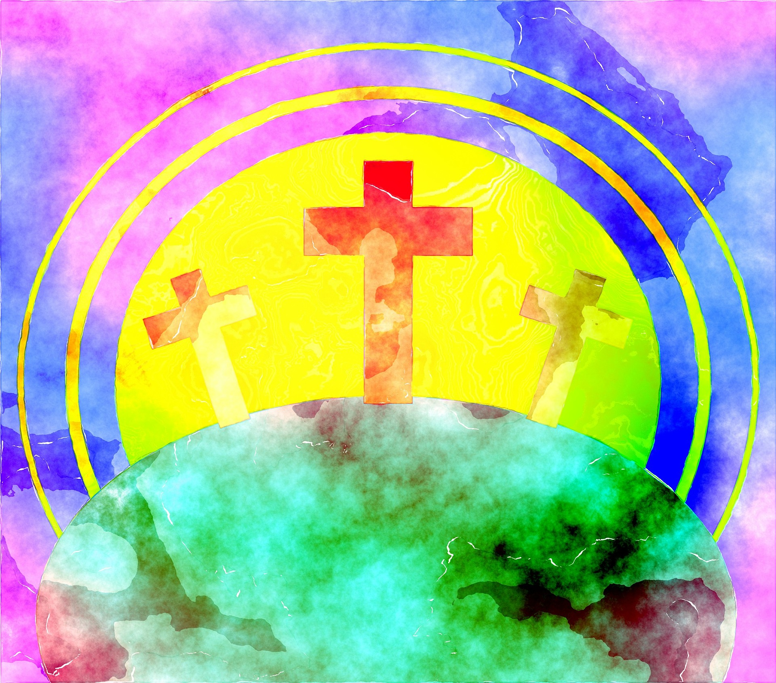
Peace in Christ
Image: Prawny
Notes:
Prawny. (2017, Feb. 9). Retrieved April 11, 2020, from https://pixabay.com/illustrations/watercolour-watercolor-paint-2052243/ Used under a Pixabay License. Free for commercial use. No attribution required.

Slide 37
Write the gospel on our hearts
Image: Prawny
Notes:
Prawny. (2016, Oct. 27). Retrieved May 3, 2020, from https://pixabay.com/illustrations/watercolour-watercolor-paint-ink-1769005/ Used under a Pixabay License. Free for commercial use. No attribution required.

Slide 38
Notes:
The Church of Jesus Christ of Latter-day Saints. (2020). Boy at Church. A portrait of a young boy folding his arms at church. Gospel Media Library. Retrieved May 3, 2020, from https://www.churchofjesuschrist.org/media-library/images/young-boy-1136108?lang=eng
The Church of Jesus Christ of Latter-day Saints. (2020). Obedience: Choose the Right. An illustration of the CTR symbol. Gospel Media Library. Retrieved May 3, 2020, from https://www.churchofjesuschrist.org/media-library/images/ctr-logo-696056?lang=eng

Slide 39
We Do Not Stand Alone
“Wherefore, be of good ªcheer, and do not ^{b}fear, for I the Lord am with you, and will stand by you; and ye shall bear record of me, even Jesus Christ, that I am the Son of the living God, that I ^{c}was, that I am, and that I am to come” (Doctrine & Covenants 68:6).
Image: Prawny
Notes:
Prawny. (2017, Jul. 3). Retrieved May 3, 2020, from https://pixabay.com/illustrations/watercolour-watercolor-paint-ink-2467834/ Used under a Pixabay License. Free for commercial use. No attribution required.

Slide 40
Songs
Keep the Commandments
I Will Be Valiant
Faith
A Child’s Prayer
Love One Another
This Is My Beloved Son
Dare to Do Right
The Iron Rod
Nephi’s Courage
I Will Be What I Believe
Peace in Christ

