Slide 1
Singing Time with Sister Montgomery
April 26, 2020
King Benjamin’s Teachings
(Mosiah 4-6)

Slide 2
What other words can you think of that begin with B?
Image: Gerd Altmann
Notes:
Altmann, Gerd (Geralt). (2016, Sept. 14). Pi2abay. Retrieved April 25, 2020, from https://pixabay.com/illustrations/abc-alphabet-smiley-letters-read-1663385/ Used under a Pixabay License. Free for commercial use. No attribution required.

Slide 3
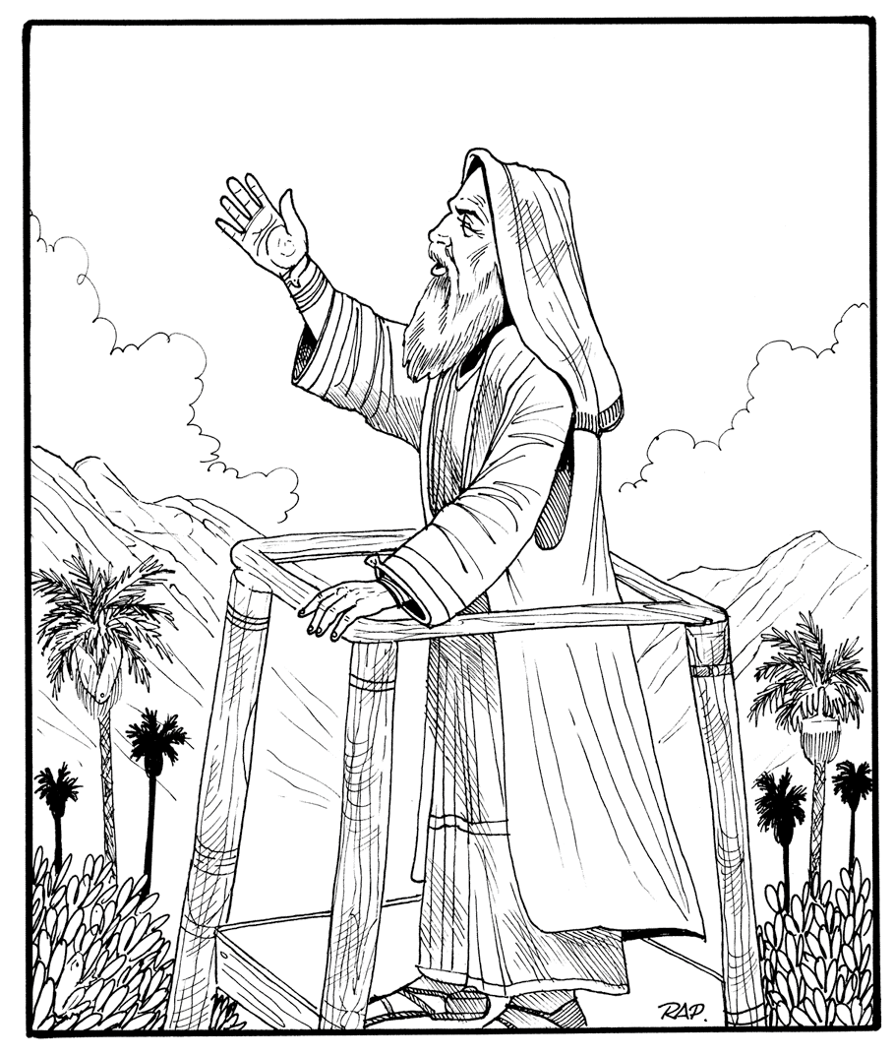
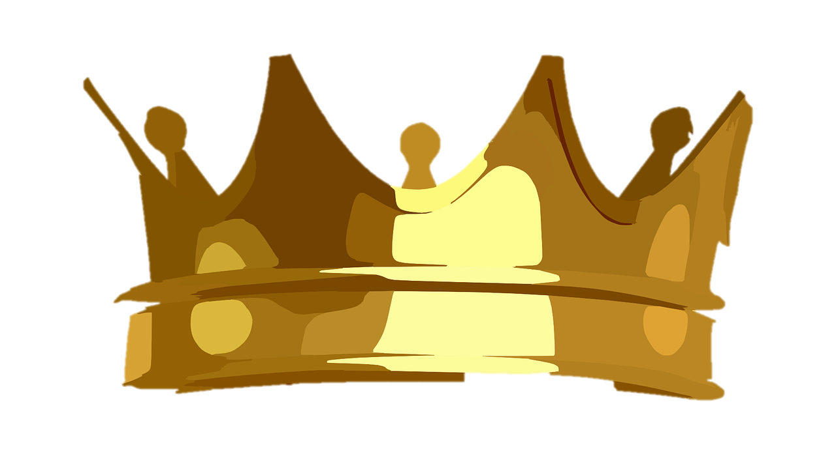

enjamin
Images: Clker Free Vector Images, Gerhard Gellinger, & The Church of Jesus Christ
Notes:
Clker Free Vector Images. (2014, Aug. 4). Pixabay. Retrieved April 26, 2020, from https://pixabay.com/vectors/crown-golden-royal-shining-shiny-312734/ Used under a Pixabay License. Free for commercial use. No attribution required.
Gellinger, Gerhard (Gellinger). (2017, Feb. 18). Pixabay. Retrieved April 25, 2020, from https://pixabay.com/illustrations/letters-abc-b-alphabet-learn-2077227/ Used under a Pixabay License. Free for commercial use. No attribution required.
The Church of Jesus Christ. (n.d.). King Benjamin. King Benjamin stands on his tower and preaches to his people. Gospel Media Library. Retrieved April 26, 2020, from
https://www.churchofjesuschrist.org/media-library/images/king-benjamin-tower-sermon-477453?lang=eng&clang=ase

Slide 4






Be-long: Be grateful
Be-lieve : Be smart
Be-gan: Be clean
Be-have: Be true
Be-loved: Be prayerful
Be-come: Be humble
(See Mosiah 4:9-11, 27)
Images: Microsoft Word
Notes:
All other images on this slide are from the Microsoft Word Symbol library (Webdings and Wingdings).

Slide 5
King Benjamin loved his people and wanted them to be happy.
☺
Image: The Church of Jesus Christ
Image: The Church of Jesus Christ
Notes:
The Church of Jesus Christ of Latter-day Saints. (1997). CHAPTER 12: King Benjamin. “Chapter 12: King Benjamin,” Book of Mormon Stories (1997), 32–35. Retrieved April 25, 2020, from https://www.churchofjesuschrist.org/manual/book-of-mormon-stories/chapter-12-king-benjamin?lang=eng

Slide 6
He taught them to focus their lives
on Jesus Christ & the temple.

Image: The Church of Jesus Christ
Notes:
The Church of Jesus Christ of Latter-day Saints. (1997). CHAPTER 12: King Benjamin. “Chapter 12: King Benjamin,” Book of Mormon Stories (1997), 32–35. Retrieved April 25, 2020, from https://www.churchofjesuschrist.org/manual/book-of-mormon-stories/chapter-12-king-benjamin?lang=eng

Slide 7
He taught them from a tower
and also sent his words to them.
Image: The Church of Jesus Christ
Notes:
The Church of Jesus Christ of Latter-day Saints. (n.d.). King Benjamin Addresses His People (King Benjamin Preaches to the Nephites). King Benjamin Addresses His People (King Benjamin Preaches to the Nephites), by Gary L. Kapp (62298); GAK 307; GAB 74; Primary manual 4-21; Mosiah 1:9–11, 18; 2:2–6. Retrieved April 25, 2020, from https://www.churchofjesuschrist.org/media-library/images/king-benjamin-addresses-people-39650?lang=eng

Slide 8
He
taught
them
to keep the ___
Images: Clker Free Vector Images & The Church of Jesus Christ
Notes:
The Church of Jesus Christ of Latter-day Saints. (1997). CHAPTER 12: King Benjamin. “Chapter 12: King Benjamin,” Book of Mormon Stories (1997), 32–35. Retrieved April 25, 2020, from https://www.churchofjesuschrist.org/manual/book-of-mormon-stories/chapter-12-king-benjamin?lang=eng
Clker Free Vector Images. (2014, Aug. 4). Pixabay. Retrieved April 26, 2020, from https://pixabay.com/vectors/crown-golden-royal-shining-shiny-312734/ Used under a Pixabay License. Free for commercial use. No attribution required.

Slide 9
Nephi’s Courage, p. 120
He
taught
them
to be…
Image: The Church of Jesus Christ
Notes:
The Church of Jesus Christ of Latter-day Saints. (1997). CHAPTER 12: King Benjamin. “Chapter 12: King Benjamin,” Book of Mormon Stories (1997), 32–35. Retrieved April 25, 2020, from https://www.churchofjesuschrist.org/manual/book-of-mormon-stories/chapter-12-king-benjamin?lang=eng
Clker Free Vector Images. (2014, Aug. 4). Pixabay. Retrieved April 26, 2020, from https://pixabay.com/vectors/crown-golden-royal-shining-shiny-312734/ Used under a Pixabay License. Free for commercial use. No attribution required.

Slide 10
A Child’s Prayer, p. 12
Prayerful
(Mosiah 4:11)l
Image: The Church of Jesus Christ
Notes:
The Church of Jesus Christ of Latter-day Saints. (1997). CHAPTER 12: King Benjamin. “Chapter 12: King Benjamin,” Book of Mormon Stories (1997), 32–35. Retrieved April 25, 2020, from https://www.churchofjesuschrist.org/manual/book-of-mormon-stories/chapter-12-king-benjamin?lang=eng

Slide 11
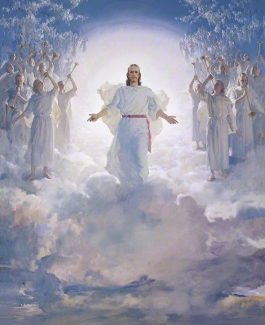
Faith, p. 96
Faithful
(Mosiah 4:30)
Image: Harry Anderson
Notes:
Anderson, Harry. (2020). The Second Coming. The Second Coming, by Harry Anderson (62562); GAK 238; GAB 66; Primary manual 5-28; Primary manual 6-28; Primary manual 7-25; Matthew 16:27; 24:30–31; 25:31. Gospel Media Library. Retrieved April 12, 2020, from https://www.churchofjesuschrist.org/media-library/images/the-second-coming-39618?lang=eng&_r=1

Slide 12
Repentance, p. 98
Repentant
(Mosiah 4:10)
Image: The Church of Jesus Christ
Notes:
The Church of Jesus Christ of Latter-day Saints. (1997). CHAPTER 12: King Benjamin. “Chapter 12: King Benjamin,” Book of Mormon Stories (1997), 32–35. Retrieved April 25, 2020, from https://www.churchofjesuschrist.org/manual/book-of-mormon-stories/chapter-12-king-benjamin?lang=eng

Slide 13
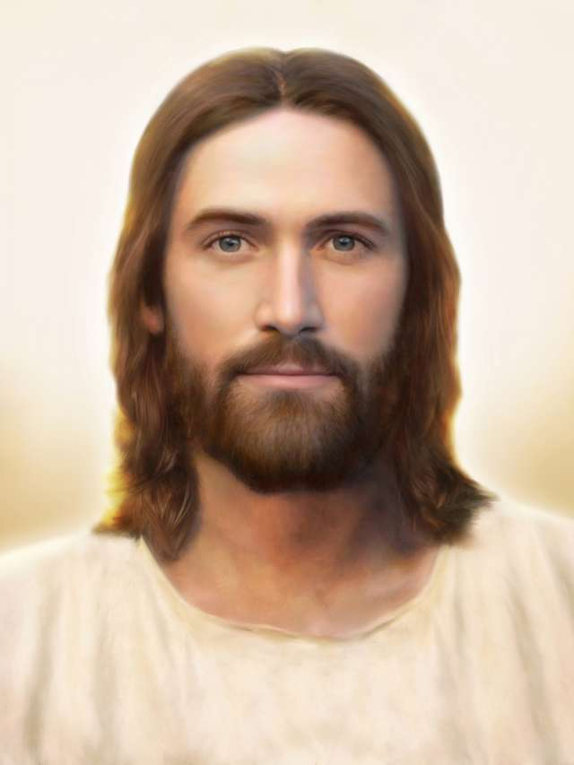
The Church of Jesus Christ, p. 77
True
(Mosiah 5:5, 15)
Image: Brent Borup
Notes:
Borup, Brent. (2020). Light of the World. Light of the World, by Brent Borup. Gospel Media Library. Retrieved April 11, 2020, from https://www.churchofjesuschrist.org/media-library/images/light-of-the-world-jesus-christ-1301483?lang=eng

Slide 14
(Mosiah 4:13)
kind
Image: The Church of Jesus Christ
Notes:
The Church of Jesus Christ of Latter-day Saints. (1997). CHAPTER 12: King Benjamin. “Chapter 12: King Benjamin,” Book of Mormon Stories (1997), 32–35. Retrieved April 25, 2020, from https://www.churchofjesuschrist.org/manual/book-of-mormon-stories/chapter-12-king-benjamin?lang=eng

Slide 15
hard-working
(Mosiah 6:7)
Image: The Church of Jesus Christ
Notes:
The Church of Jesus Christ of Latter-day Saints. (1997). CHAPTER 12: King Benjamin. “Chapter 12: King Benjamin,” Book of Mormon Stories (1997), 32–35. Retrieved April 25, 2020, from https://www.churchofjesuschrist.org/manual/book-of-mormon-stories/chapter-12-king-benjamin?lang=eng

Slide 16
Dare to Do Right: Crack the Code (Plain Version)
TO
TO
BE
-LY
-LY
TO
TO
TO
BE
TO
BE
TO
BE

Slide 17
helpful
service
(Mosiah 2:17)
Image: The Church of Jesus Christ
Notes:
The Church of Jesus Christ of Latter-day Saints. (1997). CHAPTER 12: King Benjamin. “Chapter 12: King Benjamin,” Book of Mormon Stories (1997), 32–35. Retrieved April 25, 2020, from https://www.churchofjesuschrist.org/manual/book-of-mormon-stories/chapter-12-king-benjamin?lang=eng

Slide 18
Love One Another, p. 136
Loving
(Mosiah 4:13)
Image: The Church of Jesus Christ
Notes:
The Church of Jesus Christ of Latter-day Saints. (1997). CHAPTER 12: King Benjamin. “Chapter 12: King Benjamin,” Book of Mormon Stories (1997), 32–35. Retrieved April 25, 2020, from https://www.churchofjesuschrist.org/manual/book-of-mormon-stories/chapter-12-king-benjamin?lang=eng

Slide 19
Image: Jennifer Harward
Notes:
Harward, Jennifer. (n.d.). Sign language for “love one another.” A series of sign language illustrations to help children learn the signs for “Love One Another.” From the Children’s Songbook, page 137, “Love One Another”; illustration by Jennifer Harward. Gospel Media. Retrieved April 1, 2020, from https://www.churchofjesuschrist.org/media-library/images/sign-language-love-one-another-1416354?lang=eng&clang=ase

Slide 20
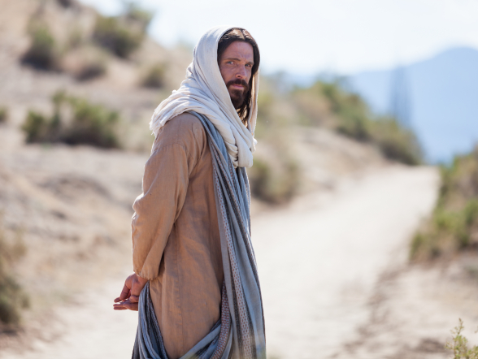
Come,
Follow Me, Hymn #116
Christlike
(Mosiah 5:2)
Image: The Church of Jesus Christ
Notes:
Barrett, Robert T. (2020). Portrait of Christ Looking Back. Portrait of Christ facing away, looking back over His shoulder. Gospel Media Library. Retrieved April 10, 2020, from https://www.churchofjesuschrist.org/media-library/images/pictures-of-jesus-1128833?lang=eng&_r=1

Slide 21
Bee of Service
 

 ☺
Do a chore
Call and talk


Send a letter
 
Smile

Say nice things

Make a treat
Pray
✴
Give a present

Draw a picture
Fill your family’s hive with honey by doing something nice for someone each day.
Spend time
Images: Open Clipart Vectors
& Microsoft Symbols library
Idea: Rachel Davis
Notes:
Open Clipart Vectors. (2017, Jan. 30). Pixabay. Retrieved April 20, 2020, from https://pixabay.com/vectors/bee-beehive-hive-honey-honeycomb-2022492/
Microsoft Symbols Library. (Icons)
Adapted from an idea by Rachel Davis. (2012, Nov. 12). Bee of service! Elder Ballard conference talk. That They Might Know Thee Blog. Retrieved April 20, 2020, from http://thattheymightknowthee.blogspot.com/2012/11/bee-of-service-elder-ballard-conference.html Direct link to game: http://2.bp.blogspot.com/-WUU5p6YPWus/UKHKOR3TTjI/AAAAAAAAB-c/ifWG_JnzcY4/s1600/Service+Honeycomb+copy.jpg

Slide 22
Follow the Prophet, p. 110
Image: The Church of Jesus Christ
Notes:
The Church of Jesus Christ of Latter-day Saints. (n.d.). Russell M. Nelson.
The official portrait of Russell M. Nelson. Retrieved April 25, 2020, from https://www.churchofjesuschrist.org/media-library/images/russell-nelson-official-portrait-2018-2044670?lang=eng

Slide 23
How will you “bee” more like Jesus this week?
Image: Mohammed Hassan
Notes:
Hassan, Mohammed. (2017, Jun. 15). Pixabay. Retrieved April 25, 2020, from https://pixabay.com/illustrations/girl-happy-design-party-flower-2401844/ Used under a Pixabay License. Free for commercial use. No attribution required.
G., J.L. (Ractapopulous). (2017, Jan. 27). Pixabay. Retrieved April 25, 2020, from https://pixabay.com/illustrations/alphabet-letter-initial-background-2010750/ Used under a Pixabay License. Free for commercial use. No attribution required.

Slide 24
I’m Trying to Be
Like Jesus, p. 78
Image: JLG

Slide 25
Set a goal in
each category.
Take a selfie of you working on a goal and share it with the Primary Presidency.
Image: LDS Scriptures
Notes:
LDS Scriptures. (2019, Sept. 29). Facebook. Retrieved March 21, 2020, from https://www.facebook.com/LDSScriptures/posts/i-made-a-printable-for-children-youth-and-adults-for-the-new-children-and-youth-/10162215806570257/

Slide 26
What do you wish you knew
about Jesus’s life?
Keep a Journal
Memories
Sacred experiences
Testimony
Image: Annelise Batista
Notes:
Batista, Annelise (Annelise Art). (2020, Apr. 20). Pixabay. Retrieved April 26, 2020, from https://pixabay.com/illustrations/paper-frame-lace-old-flowers-5066931/ Used under a Pixabay License. Free for commercial use. No attribution required.

