Slide 1
The Church of Jesus Christ, p. 77
Words & music by Janice Kapp Perry

Slide 2
I belong to the Church of Jesus Christ of Latter-Day Saints.

Slide 3
I know who I am.

Slide 4
I know God’s plan.

Slide 5
I’ll follow him in faith.

Slide 6
I believe in the Savior, Jesus Christ.

Slide 7
I’ll honor his name.

Slide 8
I’ll do what is right;

Slide 9
I’ll follow his light.

Slide 10
His truth I will proclaim.

Slide 11
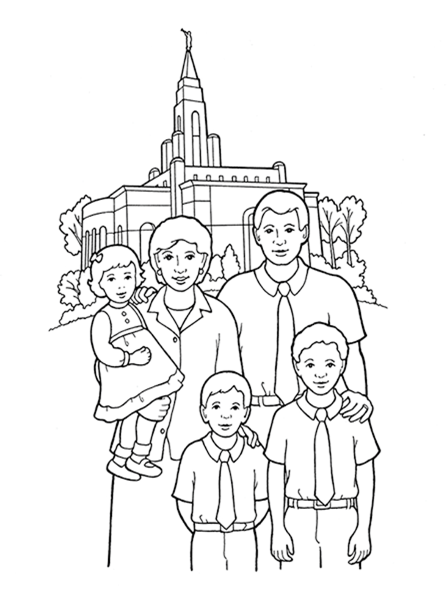
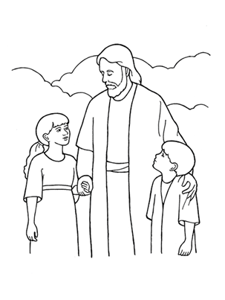
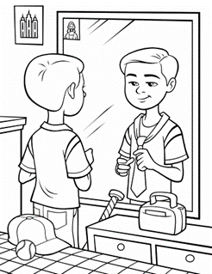
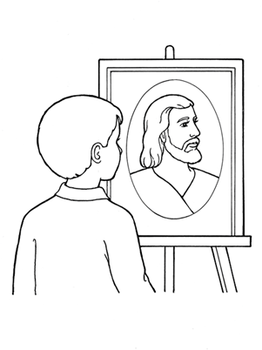
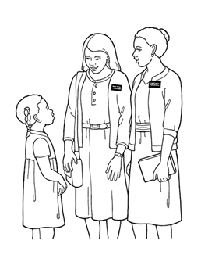
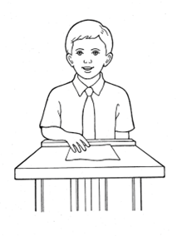
The Church of Jesus Christ, p. 77

