Slide 1
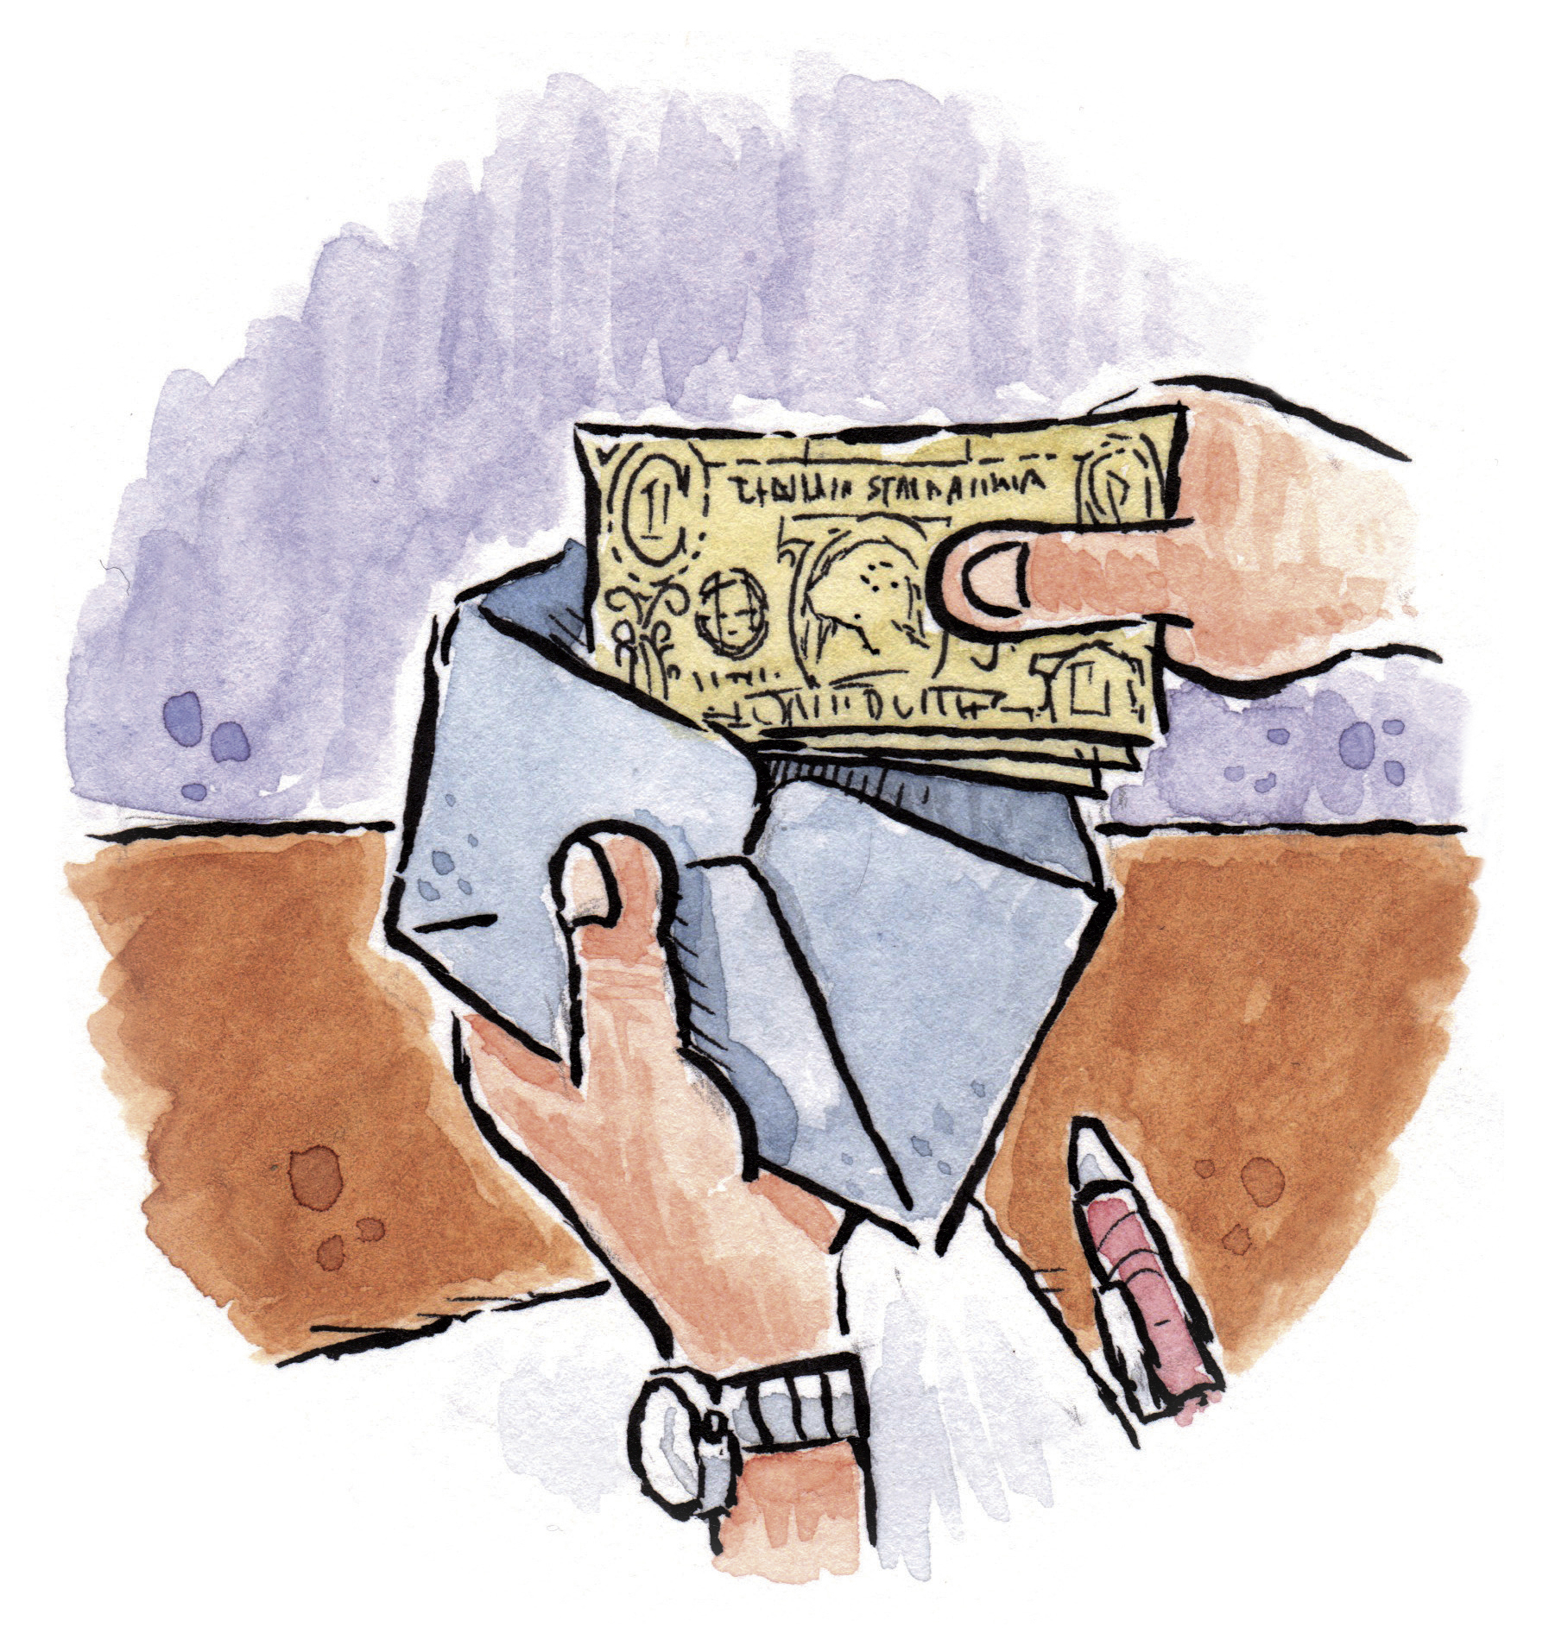
Dare to Do Right Children’s Songbook, p. 158
Words: George L. Taylor Music: William B. Bradbury Flipchart: Cherice Montgomery
Notes:
The Church of Jesus Christ of Latter-Day Saints. (n.d). Tithing: A person puts tithing in a tithing envelope. The Church of Jesus Christ of Latter-Day Saints Media Library. Retrieved Jun. 23, 2023 from https://www.churchofjesuschrist.org/media/image/tithes-offerings-illustration-fdfbb38?lang=eng&collectionId=408040e2e846420e8df818f3169c9543

Slide 2
Dare to do right!
Notes:
The Church of Jesus Christ of Latter-Day Saints. (n.d). Tithing: A person puts tithing in a tithing envelope. The Church of Jesus Christ of Latter-Day Saints Media Library. Retrieved Jun. 23, 2023 from https://www.churchofjesuschrist.org/media/image/tithes-offerings-illustration-fdfbb38?lang=eng&collectionId=408040e2e846420e8df818f3169c9543

Slide 3
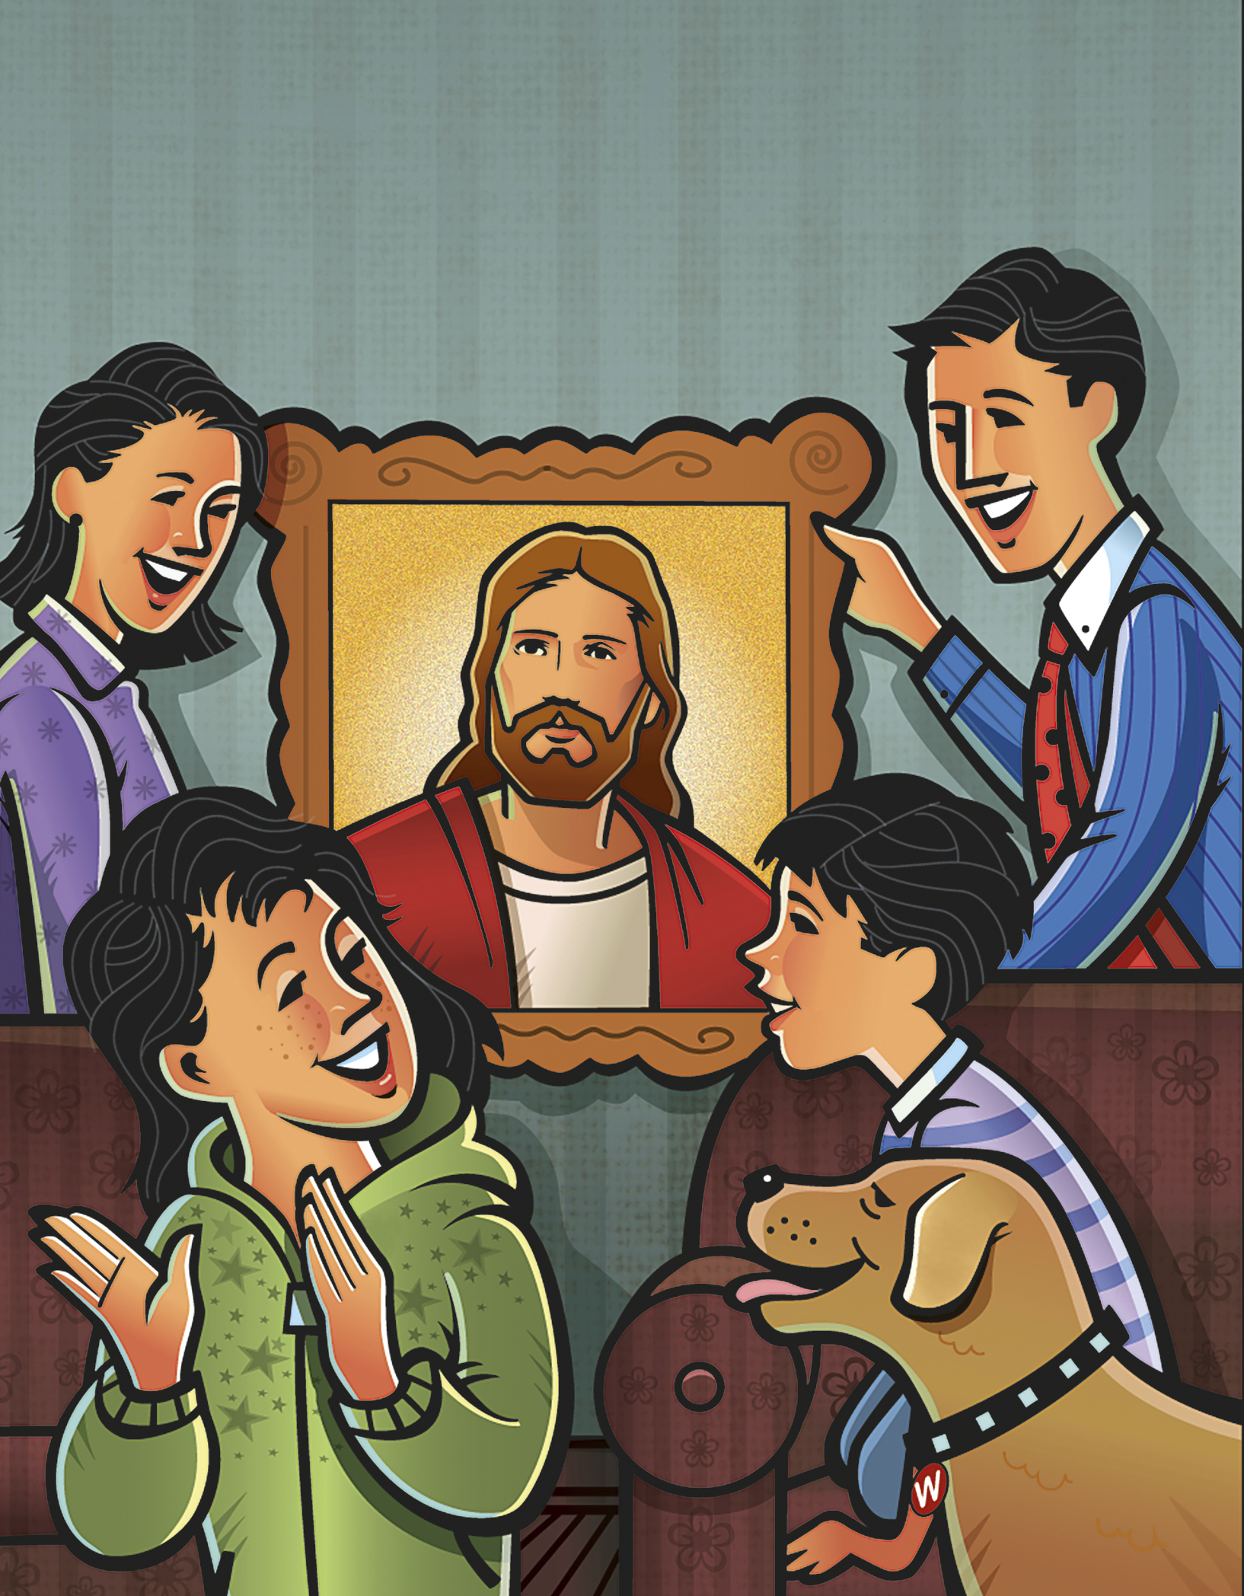
Dare to be true!
Notes:
The Church of Jesus Christ of Latter-Day Saints. (n.d). Picture of Christ: A family hangs a picture of Jesus Christ in their home. The Church of Jesus Christ of Latter-Day Saints Media Library. Retrieved Jun. 23, 2023 from https://www.churchofjesuschrist.org/media/image/family-jesus-christ-picture-d104a0c?lang=eng&collectionId=408040e2e846420e8df818f3169c9543

Slide 4
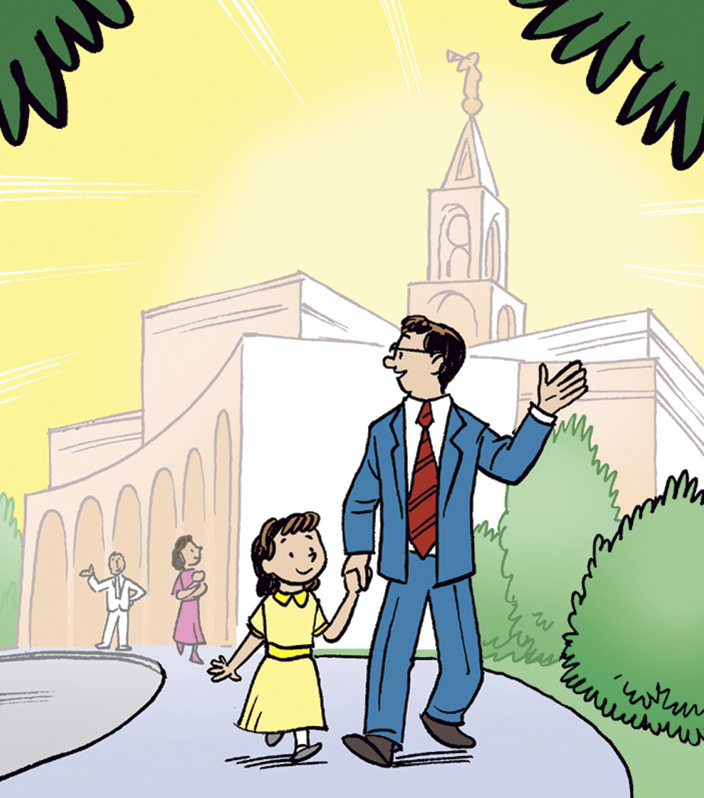
You have a work that no other can do;
Notes:
The Church of Jesus Christ of Latter-Day Saints. (n.d). Father and daughter at the temple: A father walks around the temple grounds while holding his daughter’s hand. The Church of Jesus Christ of Latter-Day Saints Media Library. Retrieved Jun. 23, 2023 from https://www.churchofjesuschrist.org/media/image/girl-father-leaving-temple-7d829e9?lang=eng&collectionId=408040e2e846420e8df818f3169c9543

Slide 5
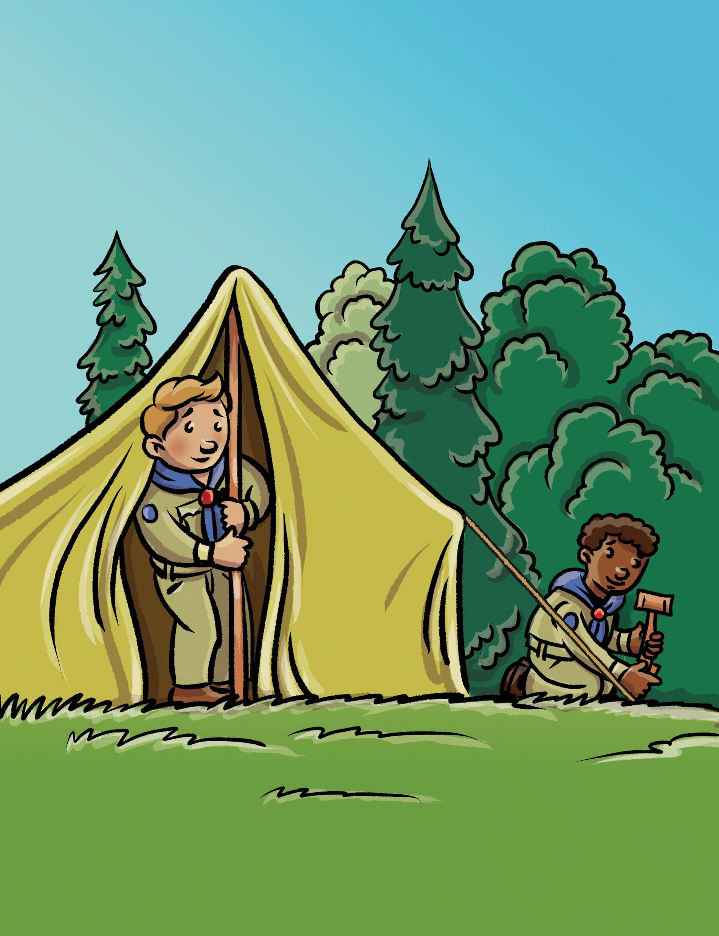
Do it so bravely, so kindly, so well,
Notes:
The Church of Jesus Christ of Latter-Day Saints. (n.d). Scout camp: Two Boy Scouts set up a tent together. The Church of Jesus Christ of Latter-Day Saints Media Library. Retrieved Jun. 23, 2023 from https://www.churchofjesuschrist.org/media/image/illustration-boys-setting-tent-forest-a51b4d8?lang=eng&collectionId=408040e2e846420e8df818f3169c9543

Slide 6
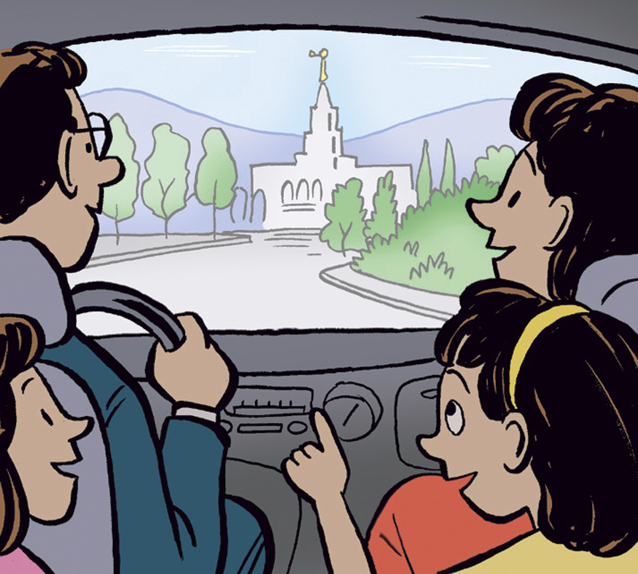
Angels will hasten the story to tell.
Notes:
The Church of Jesus Christ of Latter-Day Saints. (n.d). Family at the temple: A family drives toward the temple. The Church of Jesus Christ of Latter-Day Saints Media Library. Retrieved Jun. 23, 2023 from https://www.churchofjesuschrist.org/media/image/family-approaching-temple-cb07c2d?lang=eng&collectionId=408040e2e846420e8df818f3169c9543

Slide 7
Dare, dare, dare to do right;
Notes:
The Church of Jesus Christ of Latter-Day Saints. (n.d). Tithing: A person puts tithing in a tithing envelope. The Church of Jesus Christ of Latter-Day Saints Media Library. Retrieved Jun. 23, 2023 from https://www.churchofjesuschrist.org/media/image/tithes-offerings-illustration-fdfbb38?lang=eng&collectionId=408040e2e846420e8df818f3169c9543

Slide 8
Dare, dare, dare to be true,
Notes:
The Church of Jesus Christ of Latter-Day Saints. (n.d). Picture of Christ: A family hangs a picture of Jesus Christ in their home. The Church of Jesus Christ of Latter-Day Saints Media Library. Retrieved Jun. 23, 2023 from https://www.churchofjesuschrist.org/media/image/family-jesus-christ-picture-d104a0c?lang=eng&collectionId=408040e2e846420e8df818f3169c9543

Slide 9
Dare to be true,
Notes:
The Church of Jesus Christ of Latter-Day Saints. (n.d). Picture of Christ: A family hangs a picture of Jesus Christ in their home. The Church of Jesus Christ of Latter-Day Saints Media Library. Retrieved Jun. 23, 2023 from https://www.churchofjesuschrist.org/media/image/family-jesus-christ-picture-d104a0c?lang=eng&collectionId=408040e2e846420e8df818f3169c9543

Slide 10
Dare to be true.
Notes:
The Church of Jesus Christ of Latter-Day Saints. (n.d). Picture of Christ: A family hangs a picture of Jesus Christ in their home. The Church of Jesus Christ of Latter-Day Saints Media Library. Retrieved Jun. 23, 2023 from https://www.churchofjesuschrist.org/media/image/family-jesus-christ-picture-d104a0c?lang=eng&collectionId=408040e2e846420e8df818f3169c9543

Slide 11
Image Credits:
The Church of Jesus Christ of Latter-Day Saints. (n.d). Tithing: A person puts tithing in a tithing envelope. The Church of Jesus Christ of Latter-Day Saints Media Library. Retrieved Jun. 23, 2023 from https://www.churchofjesuschrist.org/media/image/tithes-offerings-illustration-fdfbb38?lang=eng&collectionId=408040e2e846420e8df818f3169c9543
The Church of Jesus Christ of Latter-Day Saints. (n.d). Picture of Christ: A family hangs a picture of Jesus Christ in their home. The Church of Jesus Christ of Latter-Day Saints Media Library. Retrieved Jun. 23, 2023 from https://www.churchofjesuschrist.org/media/image/family-jesus-christ-picture-d104a0c?lang=eng&collectionId=408040e2e846420e8df818f3169c9543
The Church of Jesus Christ of Latter-Day Saints. (n.d). Father and daughter at the temple: A father walks around the temple grounds while holding his daughter’s hand. The Church of Jesus Christ of Latter-Day Saints Media Library. Retrieved Jun. 23, 2023 from https://www.churchofjesuschrist.org/media/image/girl-father-leaving-temple-7d829e9?lang=eng&collectionId=408040e2e846420e8df818f3169c9543
The Church of Jesus Christ of Latter-Day Saints. (n.d). Scout camp: Two Boy Scouts set up a tent together. The Church of Jesus Christ of Latter-Day Saints Media Library. Retrieved Jun. 23, 2023 from https://www.churchofjesuschrist.org/media/image/illustration-boys-setting-tent-forest-a51b4d8?lang=eng&collectionId=408040e2e846420e8df818f3169c9543
The Church of Jesus Christ of Latter-Day Saints. (n.d). Family at the temple: A family drives toward the temple. The Church of Jesus Christ of Latter-Day Saints Media Library. Retrieved Jun. 23, 2023 from https://www.churchofjesuschrist.org/media/image/family-approaching-temple-cb07c2d?lang=eng&collectionId=408040e2e846420e8df818f3169c9543
The Church of Jesus Christ of Latter-Day Saints. (n.d). Lily in bloom: A boy and his sister are excited as they watch a lily bloom at the beginning of spring. The Church of Jesus Christ of Latter-Day Saints Media Library. Retrieved Jun. 23, 2023 from https://www.churchofjesuschrist.org/media/image/children-finding-easter-lily-25cb48a?lang=eng&collectionId=408040e2e846420e8df818f3169c9543
The Church of Jesus Christ of Latter-Day Saints. (n.d). Primary class: A little girl sits reverently and looks back at her teacher during Primary. The Church of Jesus Christ of Latter-Day Saints Media Library. Retrieved Jun. 23, 2023 from https://www.churchofjesuschrist.org/media/image/girl-primary-fellowshipping-830258b?lang=eng&collectionId=408040e2e846420e8df818f3169c9543

Slide 12
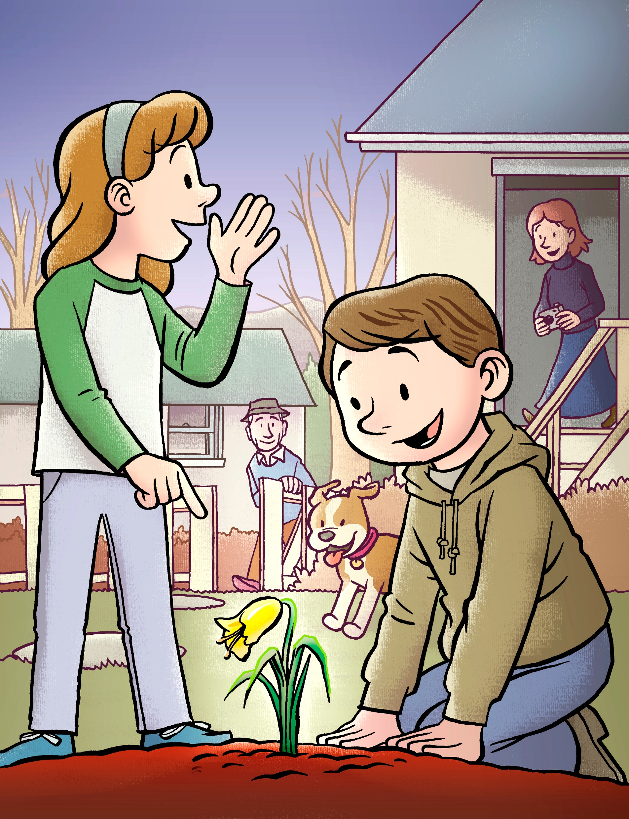
You have a work that no other can do;
Notes:
The Church of Jesus Christ of Latter-Day Saints. (n.d). Lily in bloom: A boy and his sister are excited as they watch a lily bloom at the beginning of spring. The Church of Jesus Christ of Latter-Day Saints Media Library. Retrieved Jun. 23, 2023 from https://www.churchofjesuschrist.org/media/image/children-finding-easter-lily-25cb48a?lang=eng&collectionId=408040e2e846420e8df818f3169c9543

Slide 13
Dare, dare, dare to do right;
Notes:
The Church of Jesus Christ of Latter-Day Saints. (n.d). Primary class: A little girl sits reverently and looks back at her teacher during Primary. The Church of Jesus Christ of Latter-Day Saints Media Library. Retrieved Jun. 23, 2023 from https://www.churchofjesuschrist.org/media/image/girl-primary-fellowshipping-830258b?lang=eng&collectionId=408040e2e846420e8df818f3169c9543

