Slide 1
The Fourth Article of Faith Children’s Songbook, p. 124
Words: Joseph Smith Music: Vanja Y. Watkins Flipchart: Cherice Montgomery
Notes:
The Church of Jesus Christ of Latter-Day Saints. (n.d). 4th Article of Faith—Principles and ordinances: An illustration of the fourth article of faith—“Principles and Ordinances” (a father baptizing his daughter). The Church of Jesus Christ of Latter-Day Saints Media Library. Retrieved Jun. 23, 2023 from https://www.churchofjesuschrist.org/media/image/baptism-steps-b0c2219?lang=eng&collectionId=2cc781dd842042cfbe7cb1933e2a4716

Slide 2
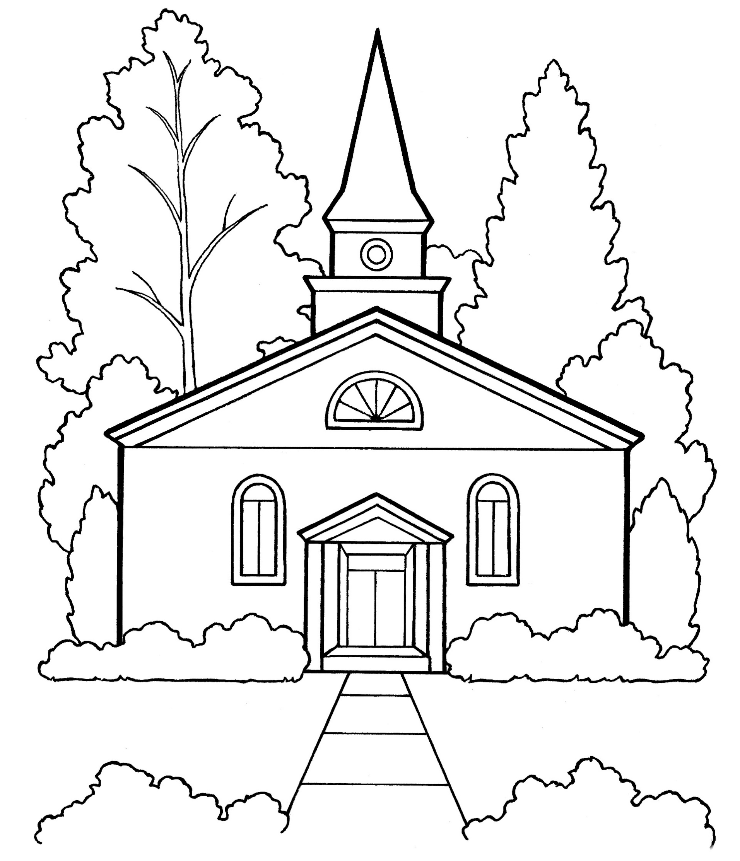
We believe that the first principles and ordinances of the gospel are:
Notes:
The Church of Jesus Christ of Latter-Day Saints. (n.d). 11th Article of Faith: Worship: An illustration of the eleventh article of faith—“Worship” (a Church building). The Church of Jesus Christ of Latter-Day Saints Media Library. Retrieved Jun. 23, 2023 from https://www.churchofjesuschrist.org/media/image/church-building-ee4c821?lang=eng&collectionId=2cc781dd842042cfbe7cb1933e2a4716

Slide 3
First, Faith in the Lord Jesus Christ;
Notes:
The Church of Jesus Christ of Latter-Day Saints. (n.d). Faith in Jesus Christ: An illustration of a boy looking at a portrait of Jesus. The Church of Jesus Christ of Latter-Day Saints Media Library. Retrieved Jun. 23, 2023 from https://www.churchofjesuschrist.org/media/image/boy-portrait-jesus-8a8dead?lang=eng&collectionId=28d3f141a27f495281ed04d6ae40d8b4

Slide 4
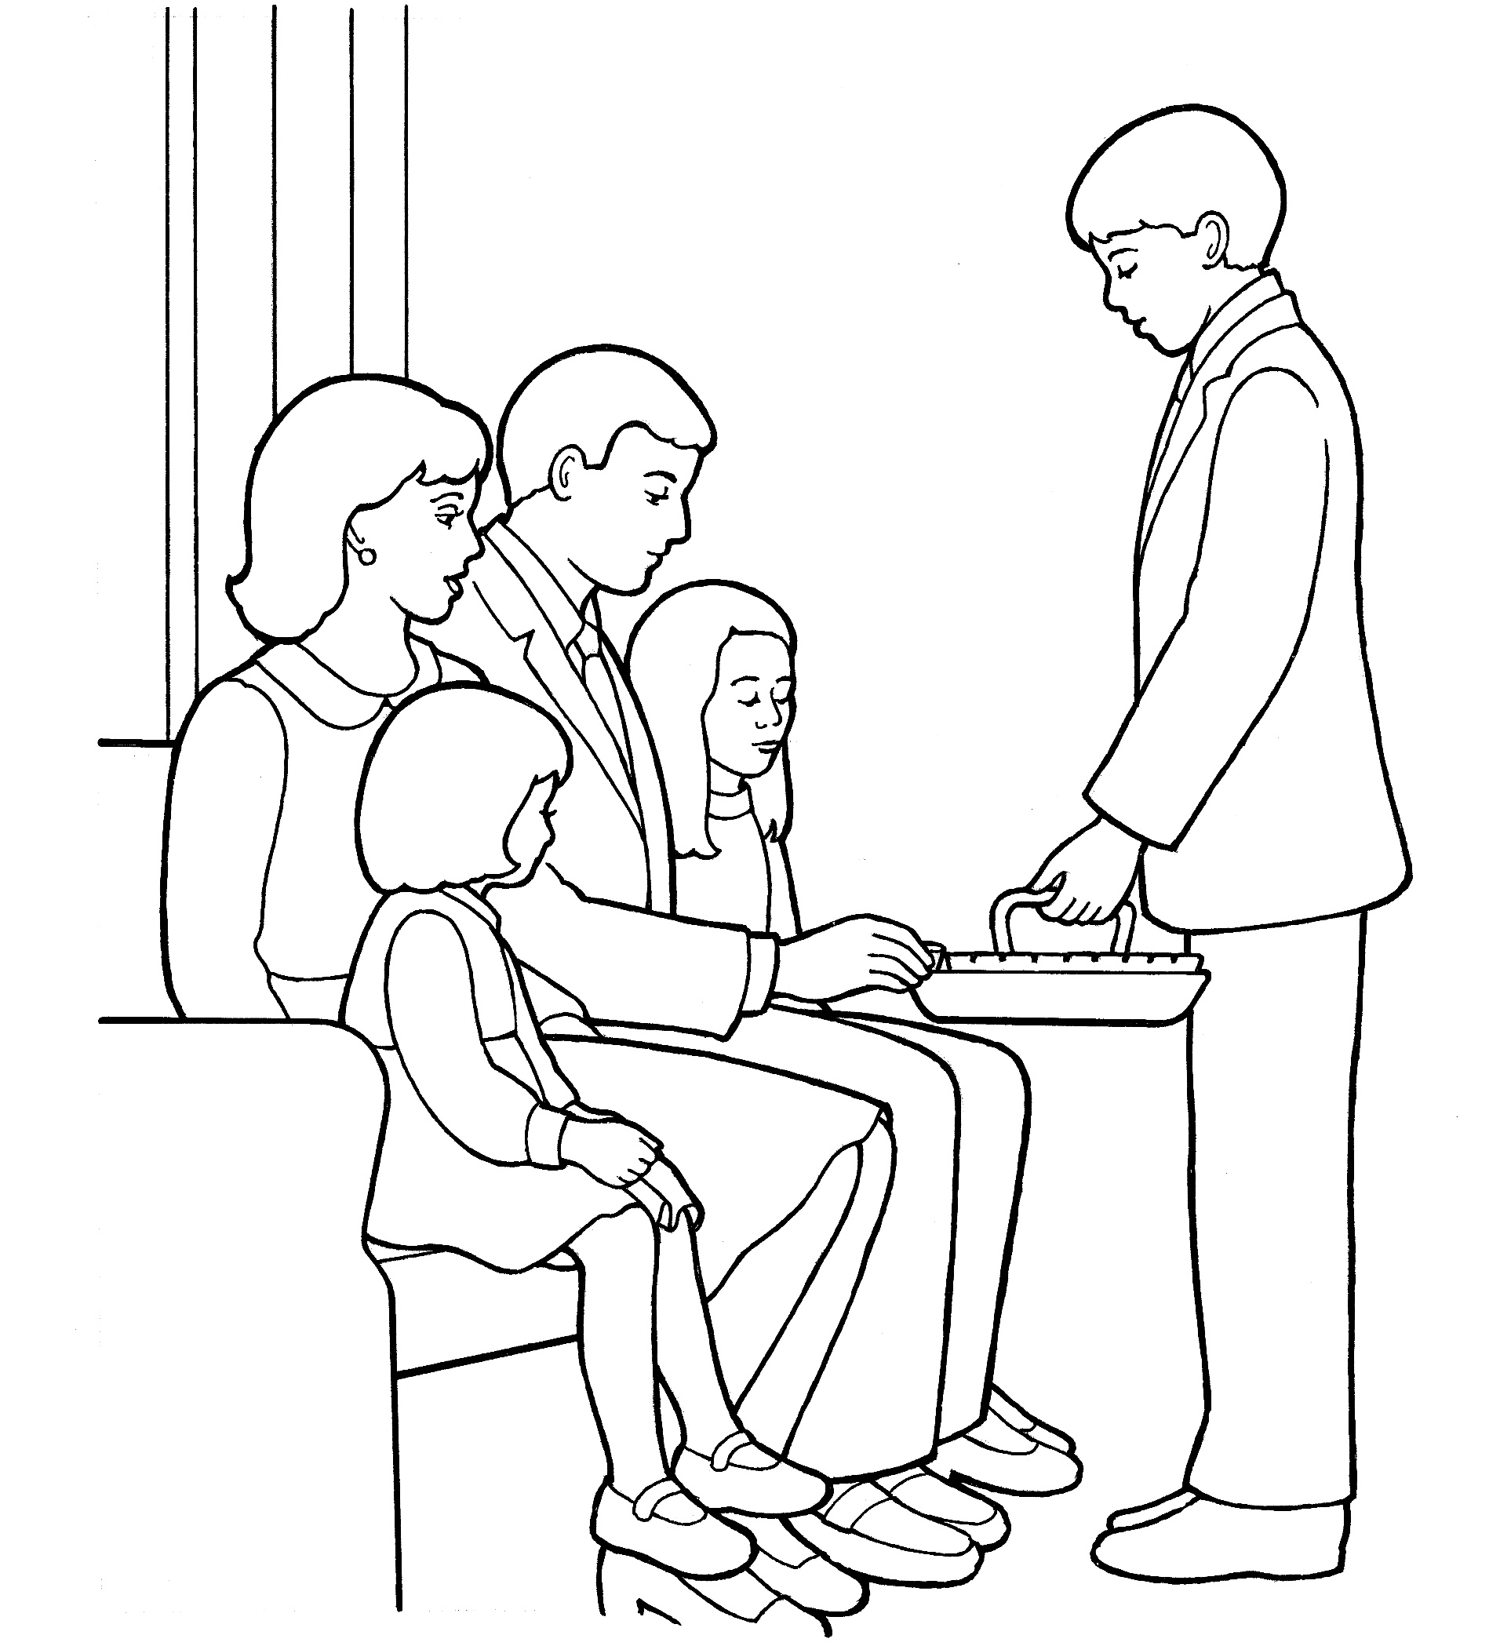
second, Repentance;
Notes:
The Church of Jesus Christ of Latter-Day Saints. (n.d). Deacon administering the sacrament: An illustration of a deacon passing the sacrament, from the nursery manual Behold Your Little Ones (2008), page 119. The Church of Jesus Christ of Latter-Day Saints Media Library. Retrieved Jun. 23, 2023 from https://www.churchofjesuschrist.org/media/image/passing-sacrament-cb3c54f?lang=eng&collectionId=d032668ad7d9496daef639526bd0a37d

Slide 5
third, baptism by immersion for the remission of sins;
Notes:
The Church of Jesus Christ of Latter-Day Saints. (n.d). Young girl baptism: An illustration of a young girl being baptized. The Church of Jesus Christ of Latter-Day Saints Media Library. Retrieved Jun. 23, 2023 from https://www.churchofjesuschrist.org/media/image/girl-being-baptized-4fbc86a?lang=eng&collectionId=d032668ad7d9496daef639526bd0a37d

Slide 6
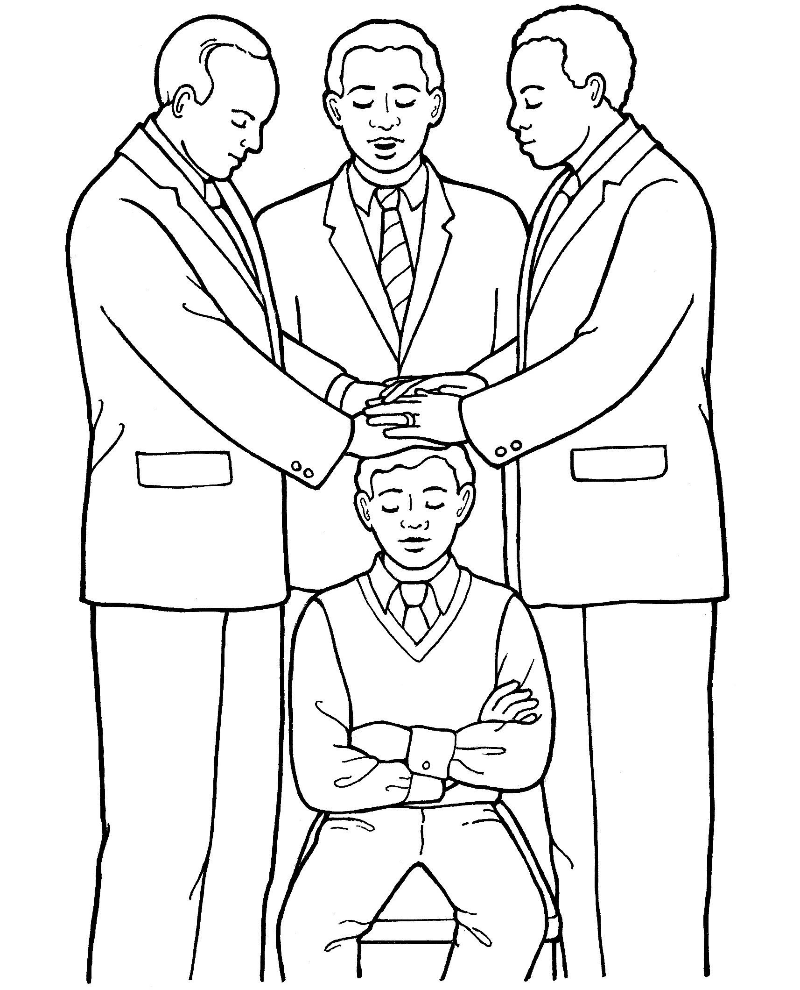
fourth, Laying on of hands for the gift of the Holy Ghost.
Notes:
The Church of Jesus Christ of Latter-Day Saints. (n.d). 5th Article of Faith—hands: An illustration of the fifth article of faith—“Hands” (a young man being ordained to the priesthood). The Church of Jesus Christ of Latter-Day Saints Media Library. Retrieved Jun. 23, 2023 from https://www.churchofjesuschrist.org/media/image/confirmation-priesthood-07f815f?lang=eng&collectionId=2cc781dd842042cfbe7cb1933e2a4716

Slide 7
Image Credits:
The Church of Jesus Christ of Latter-Day Saints. (n.d). Deacon administering the sacrament: An illustration of a deacon passing the sacrament, from the nursery manual Behold Your Little Ones (2008), page 119. The Church of Jesus Christ of Latter-Day Saints Media Library. Retrieved Jun. 23, 2023 from https://www.churchofjesuschrist.org/media/image/passing-sacrament-cb3c54f?lang=eng&collectionId=d032668ad7d9496daef639526bd0a37d
The Church of Jesus Christ of Latter-Day Saints. (n.d). Faith in Jesus Christ: An illustration of a boy looking at a portrait of Jesus. The Church of Jesus Christ of Latter-Day Saints Media Library. Retrieved Jun. 23, 2023 from https://www.churchofjesuschrist.org/media/image/boy-portrait-jesus-8a8dead?lang=eng&collectionId=28d3f141a27f495281ed04d6ae40d8b4
The Church of Jesus Christ of Latter-Day Saints. (n.d). Young girl baptism: An illustration of a young girl being baptized. The Church of Jesus Christ of Latter-Day Saints Media Library. Retrieved Jun. 23, 2023 from https://www.churchofjesuschrist.org/media/image/girl-being-baptized-4fbc86a?lang=eng&collectionId=d032668ad7d9496daef639526bd0a37d
The Church of Jesus Christ of Latter-Day Saints. (n.d). 4th Article of Faith—Principles and ordinances: An illustration of the fourth article of faith—“Principles and Ordinances” (a father baptizing his daughter). The Church of Jesus Christ of Latter-Day Saints Media Library. Retrieved Jun. 23, 2023 from https://www.churchofjesuschrist.org/media/image/baptism-steps-b0c2219?lang=eng&collectionId=2cc781dd842042cfbe7cb1933e2a4716
The Church of Jesus Christ of Latter-Day Saints. (n.d). 5th Article of Faith—hands: An illustration of the fifth article of faith—“Hands” (a young man being ordained to the priesthood). The Church of Jesus Christ of Latter-Day Saints Media Library. Retrieved Jun. 23, 2023 from https://www.churchofjesuschrist.org/media/image/confirmation-priesthood-07f815f?lang=eng&collectionId=2cc781dd842042cfbe7cb1933e2a4716
The Church of Jesus Christ of Latter-Day Saints. (n.d). 11th Article of Faith: Worship: An illustration of the eleventh article of faith—“Worship” (a Church building). The Church of Jesus Christ of Latter-Day Saints Media Library. Retrieved Jun. 23, 2023 from https://www.churchofjesuschrist.org/media/image/church-building-ee4c821?lang=eng&collectionId=2cc781dd842042cfbe7cb1933e2a4716
Alternate image credits:
The Church of Jesus Christ of Latter-Day Saints. (n.d). A Christmas present: A coloring page of a Christmas present. The Church of Jesus Christ of Latter-Day Saints Media Library. Retrieved Jun. 23, 2023 from https://www.churchofjesuschrist.org/media/image/gift-box-f590fb8?lang=eng&collectionId=623efb2673fa4487972fbae3501dc0a0
The Church of Jesus Christ of Latter-Day Saints. (n.d). Eternal life: An illustration of Christ with two children, from the nursery manual Behold Your Little Ones (2008), page 15. The Church of Jesus Christ of Latter-Day Saints Media Library. Retrieved Jun. 23, 2023 from https://www.churchofjesuschrist.org/media/image/jesus-with-children-whittaker-71b0a64?lang=eng&collectionId=cfba124a283645fda1da4f9361fe4afc
The Church of Jesus Christ of Latter-Day Saints. (n.d). Jesus Christ—the Son of God: An illustration of Jesus Christ, the Savior of the world. The Church of Jesus Christ of Latter-Day Saints Media Library. Retrieved Jun. 23, 2023 from https://www.churchofjesuschrist.org/media/image/line-art-jesus-christ-98050ad?lang=eng&collectionId=495bfcea352d4519bf5ecee5b88faf86
The Church of Jesus Christ of Latter-Day Saints. (n.d). Jesus Christ’s second coming: An illustration of Jesus Christ during the Second Coming. The Church of Jesus Christ of Latter-Day Saints Media Library. Retrieved Jun. 23, 2023 from https://www.churchofjesuschrist.org/media/image/second-coming-3ffcfb2?lang=eng&collectionId=495bfcea352d4519bf5ecee5b88faf86
The Church of Jesus Christ of Latter-Day Saints. (n.d). Repentance is a principle of the gospel: A line drawing of a boy who broke a window, showing the power of repentance. The Church of Jesus Christ of Latter-Day Saints Media Library. Retrieved Jun. 23, 2023 from https://www.churchofjesuschrist.org/media/image/repentance-1011bdd?lang=eng&collectionId=28d3f141a27f495281ed04d6ae40d8b4
The Church of Jesus Christ of Latter-Day Saints. (n.d). Scriptures: A line drawing of the scriptures, from the nursery manual Behold Your Little Ones (2008), pages 31, 39, and 107. The Church of Jesus Christ of Latter-Day Saints Media Library. Retrieved Jun. 23, 2023 from https://www.churchofjesuschrist.org/media/image/books-whittaker-b07e0ba?lang=eng&collectionId=cfba124a283645fda1da4f9361fe4afc
The Church of Jesus Christ of Latter-Day Saints. (n.d). Scriptures: An illustration of a book of scripture lying open, with a ribbon bookmark. The Church of Jesus Christ of Latter-Day Saints Media Library. Retrieved Jun. 23, 2023 from https://www.churchofjesuschrist.org/media/image/scriptures-book-81c66e9?lang=eng&collectionId=57d72dc9d46b48f18e3034e5fe4b206b
The Church of Jesus Christ of Latter-Day Saints. (n.d). Temple sealing—family: An illustration of a family standing in front of a temple. The Church of Jesus Christ of Latter-Day Saints Media Library. Retrieved Jun. 23, 2023 from https://www.churchofjesuschrist.org/media/image/family-temple-b4bc12b?lang=eng&collectionId=d032668ad7d9496daef639526bd0a37d
The Church of Jesus Christ of Latter-Day Saints. (n.d). Third Article of Faith—Atonement: An illustration of the third article of faith—“Atonement” (Jesus Christ praying in the Garden of Gethsemane). The Church of Jesus Christ of Latter-Day Saints Media Library. Retrieved Jun. 23, 2023 from https://www.churchofjesuschrist.org/media/image/primary-bible-prayer-0386ca5?lang=eng&collectionId=2cc781dd842042cfbe7cb1933e2a4716

Slide 8
1st Principles
Notes:
The Church of Jesus Christ of Latter-Day Saints. (n.d). 11th Article of Faith: Worship: An illustration of the eleventh article of faith—“Worship” (a Church building). The Church of Jesus Christ of Latter-Day Saints Media Library. Retrieved Jun. 23, 2023 from https://www.churchofjesuschrist.org/media/image/church-building-ee4c821?lang=eng&collectionId=2cc781dd842042cfbe7cb1933e2a4716

Slide 9
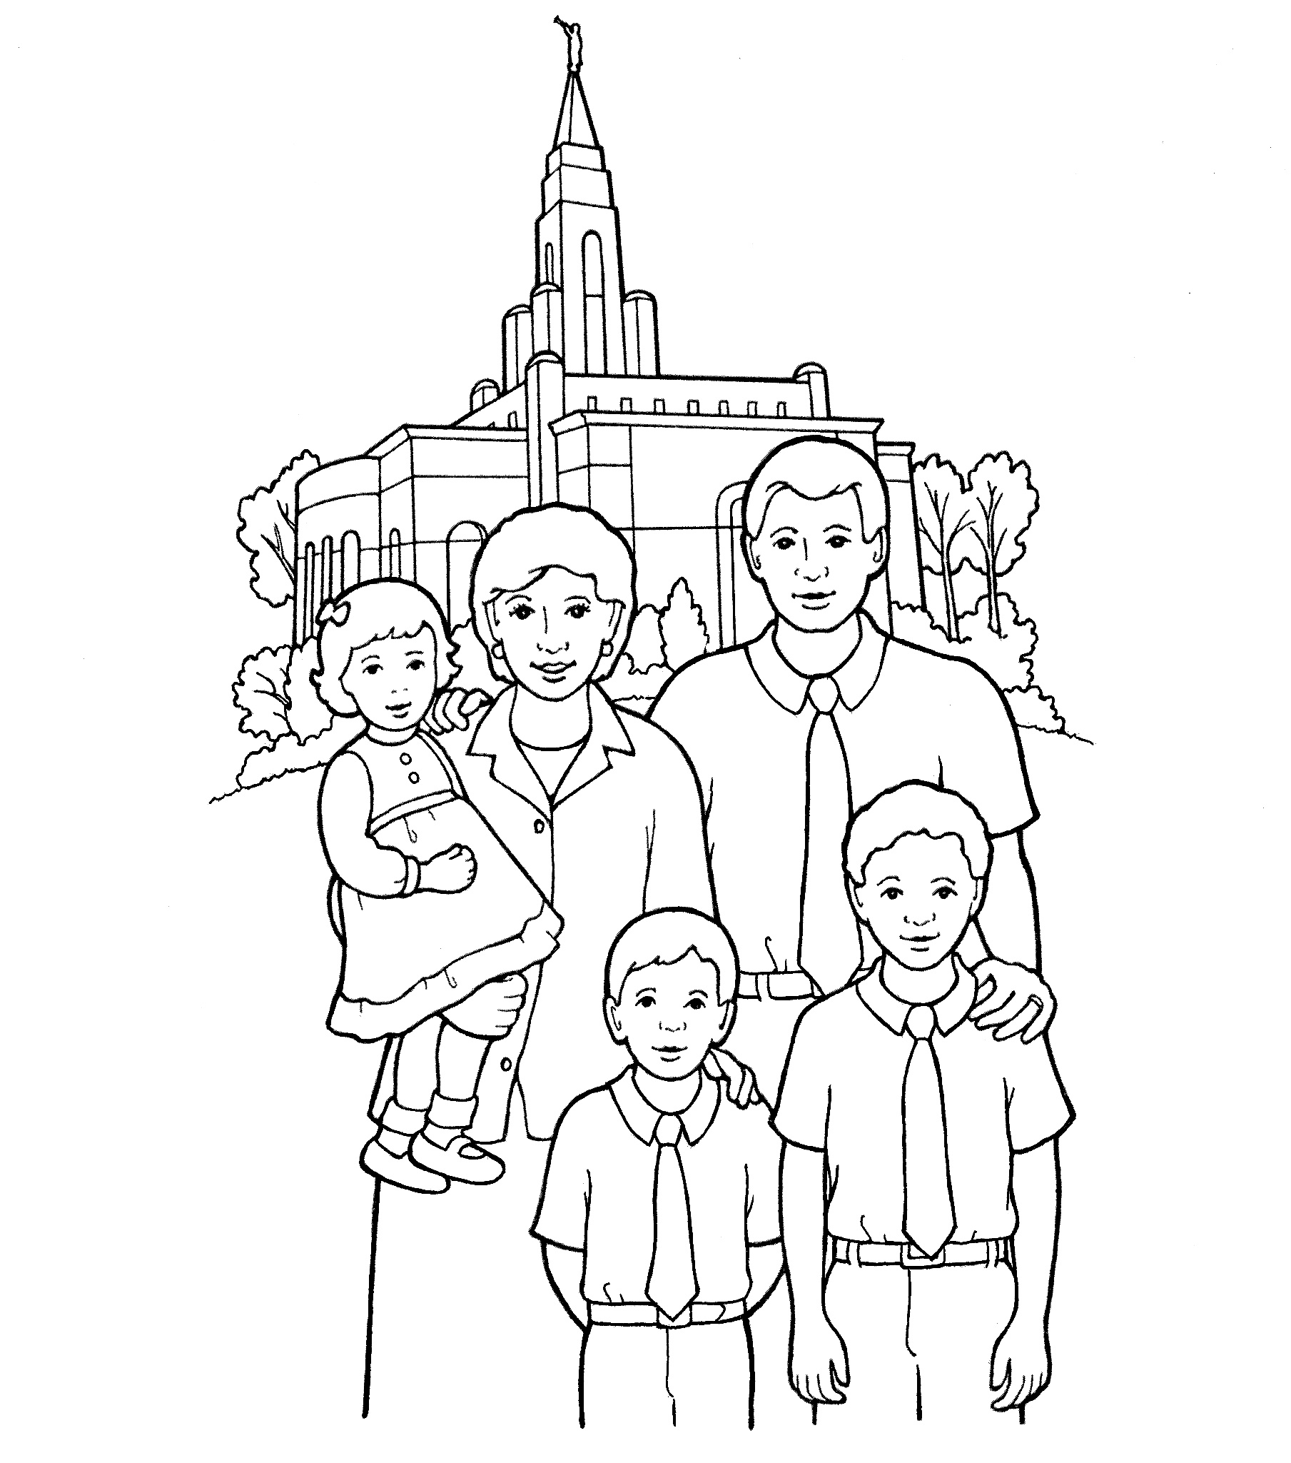
Ordinances
Notes:
The Church of Jesus Christ of Latter-Day Saints. (n.d). Temple sealing—family: An illustration of a family standing in front of a temple. The Church of Jesus Christ of Latter-Day Saints Media Library. Retrieved Jun. 23, 2023 from https://www.churchofjesuschrist.org/media/image/family-temple-b4bc12b?lang=eng&collectionId=d032668ad7d9496daef639526bd0a37d

Slide 10
Gospel
Notes:
The Church of Jesus Christ of Latter-Day Saints. (n.d). Scriptures: An illustration of a book of scripture lying open, with a ribbon bookmark. The Church of Jesus Christ of Latter-Day Saints Media Library. Retrieved Jun. 23, 2023 from https://www.churchofjesuschrist.org/media/image/scriptures-book-81c66e9?lang=eng&collectionId=57d72dc9d46b48f18e3034e5fe4b206b

Slide 11
1st Faith
Notes:
The Church of Jesus Christ of Latter-Day Saints. (n.d). Faith in Jesus Christ: An illustration of a boy looking at a portrait of Jesus. The Church of Jesus Christ of Latter-Day Saints Media Library. Retrieved Jun. 23, 2023 from https://www.churchofjesuschrist.org/media/image/boy-portrait-jesus-8a8dead?lang=eng&collectionId=28d3f141a27f495281ed04d6ae40d8b4

Slide 12
2nd Repentance
Notes:
The Church of Jesus Christ of Latter-Day Saints. (n.d). Deacon administering the sacrament: An illustration of a deacon passing the sacrament, from the nursery manual Behold Your Little Ones (2008), page 119. The Church of Jesus Christ of Latter-Day Saints Media Library. Retrieved Jun. 23, 2023 from https://www.churchofjesuschrist.org/media/image/passing-sacrament-cb3c54f?lang=eng&collectionId=d032668ad7d9496daef639526bd0a37d

Slide 13
3rd Baptism
Notes:
The Church of Jesus Christ of Latter-Day Saints. (n.d). Young girl baptism: An illustration of a young girl being baptized. The Church of Jesus Christ of Latter-Day Saints Media Library. Retrieved Jun. 23, 2023 from https://www.churchofjesuschrist.org/media/image/girl-being-baptized-4fbc86a?lang=eng&collectionId=d032668ad7d9496daef639526bd0a37d

Slide 14
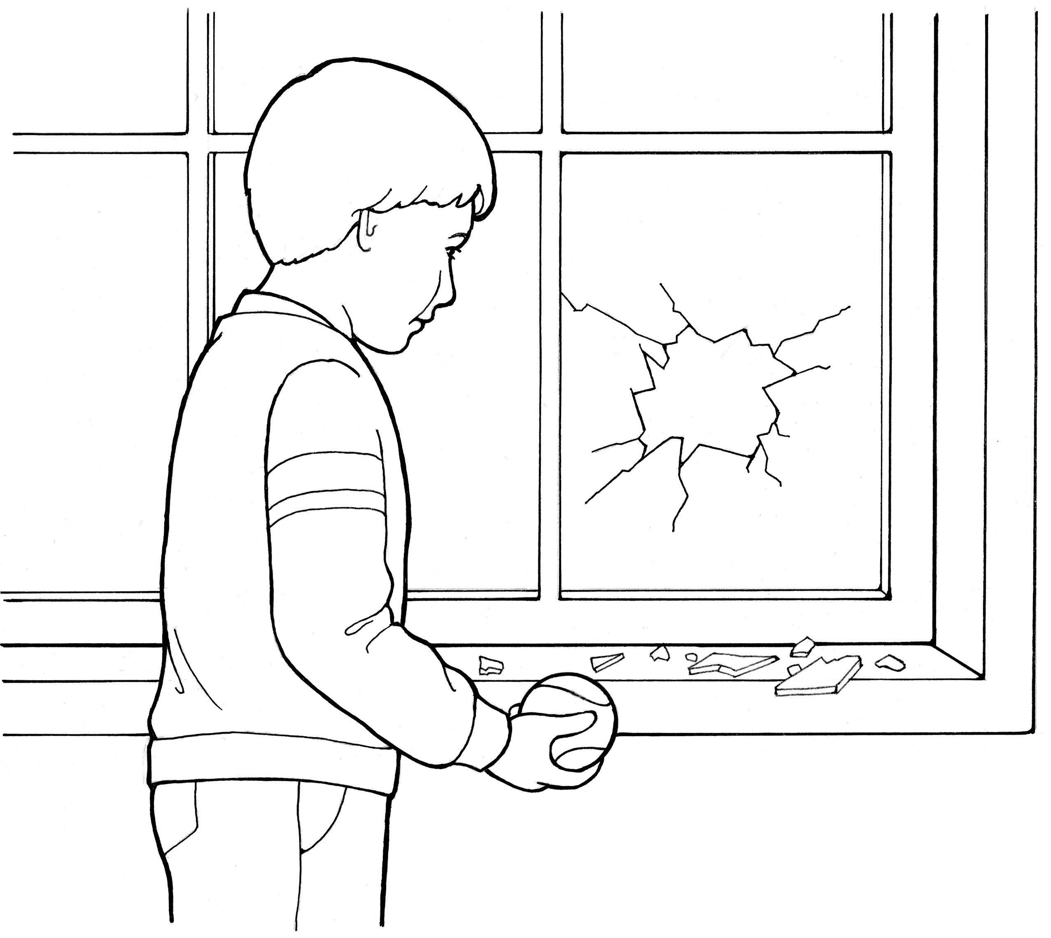
Remission of sins
Notes:
The Church of Jesus Christ of Latter-Day Saints. (n.d). Repentance is a principle of the gospel: A line drawing of a boy who broke a window, showing the power of repentance. The Church of Jesus Christ of Latter-Day Saints Media Library. Retrieved Jun. 23, 2023 from https://www.churchofjesuschrist.org/media/image/repentance-1011bdd?lang=eng&collectionId=28d3f141a27f495281ed04d6ae40d8b4

Slide 15
4th Laying on of Hands
Notes:
The Church of Jesus Christ of Latter-Day Saints. (n.d). 5th Article of Faith—hands: An illustration of the fifth article of faith—“Hands” (a young man being ordained to the priesthood). The Church of Jesus Christ of Latter-Day Saints Media Library. Retrieved Jun. 23, 2023 from https://www.churchofjesuschrist.org/media/image/confirmation-priesthood-07f815f?lang=eng&collectionId=2cc781dd842042cfbe7cb1933e2a4716

Slide 16
Gift of the Holy Ghost
Notes:
The Church of Jesus Christ of Latter-Day Saints. (n.d). A Christmas present: A coloring page of a Christmas present. The Church of Jesus Christ of Latter-Day Saints Media Library. Retrieved Jun. 23, 2023 from https://www.churchofjesuschrist.org/media/image/gift-box-f590fb8?lang=eng&collectionId=623efb2673fa4487972fbae3501dc0a0

Slide 17
We believe that the first principles and ordinances
Notes:
The Church of Jesus Christ of Latter-Day Saints. (n.d). 11th Article of Faith: Worship: An illustration of the eleventh article of faith—“Worship” (a Church building). The Church of Jesus Christ of Latter-Day Saints Media Library. Retrieved Jun. 23, 2023 from https://www.churchofjesuschrist.org/media/image/church-building-ee4c821?lang=eng&collectionId=2cc781dd842042cfbe7cb1933e2a4716

Slide 18
of the gospel are:
Notes:
The Church of Jesus Christ of Latter-Day Saints. (n.d). Scriptures: An illustration of a book of scripture lying open, with a ribbon bookmark. The Church of Jesus Christ of Latter-Day Saints Media Library. Retrieved Jun. 23, 2023 from https://www.churchofjesuschrist.org/media/image/scriptures-book-81c66e9?lang=eng&collectionId=57d72dc9d46b48f18e3034e5fe4b206b

Slide 19
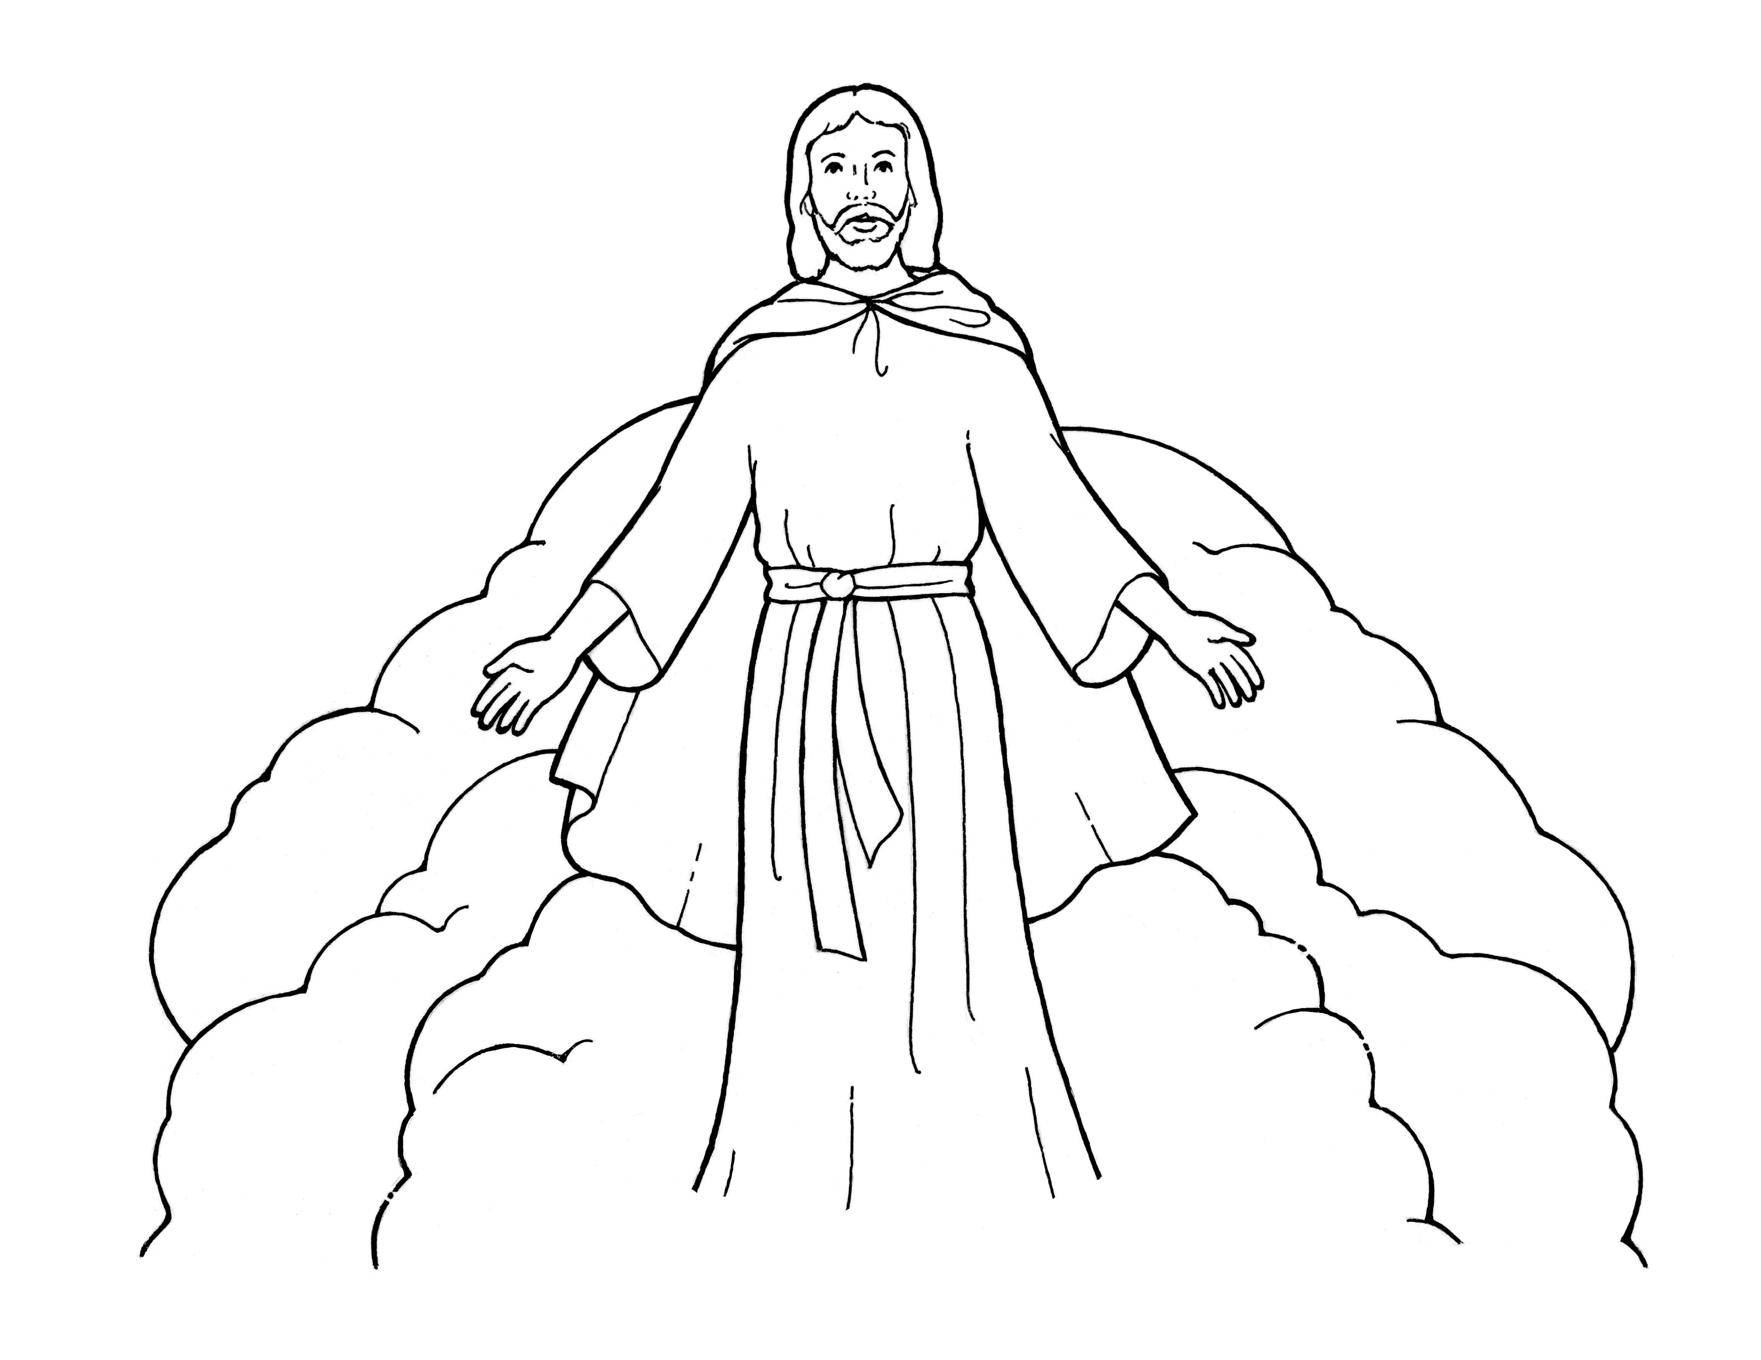
First, Faith in the Lord Jesus Christ;
Notes:
The Church of Jesus Christ of Latter-Day Saints. (n.d). Jesus Christ’s second coming: An illustration of Jesus Christ during the Second Coming. The Church of Jesus Christ of Latter-Day Saints Media Library. Retrieved Jun. 23, 2023 from https://www.churchofjesuschrist.org/media/image/second-coming-3ffcfb2?lang=eng&collectionId=495bfcea352d4519bf5ecee5b88faf86

Slide 20
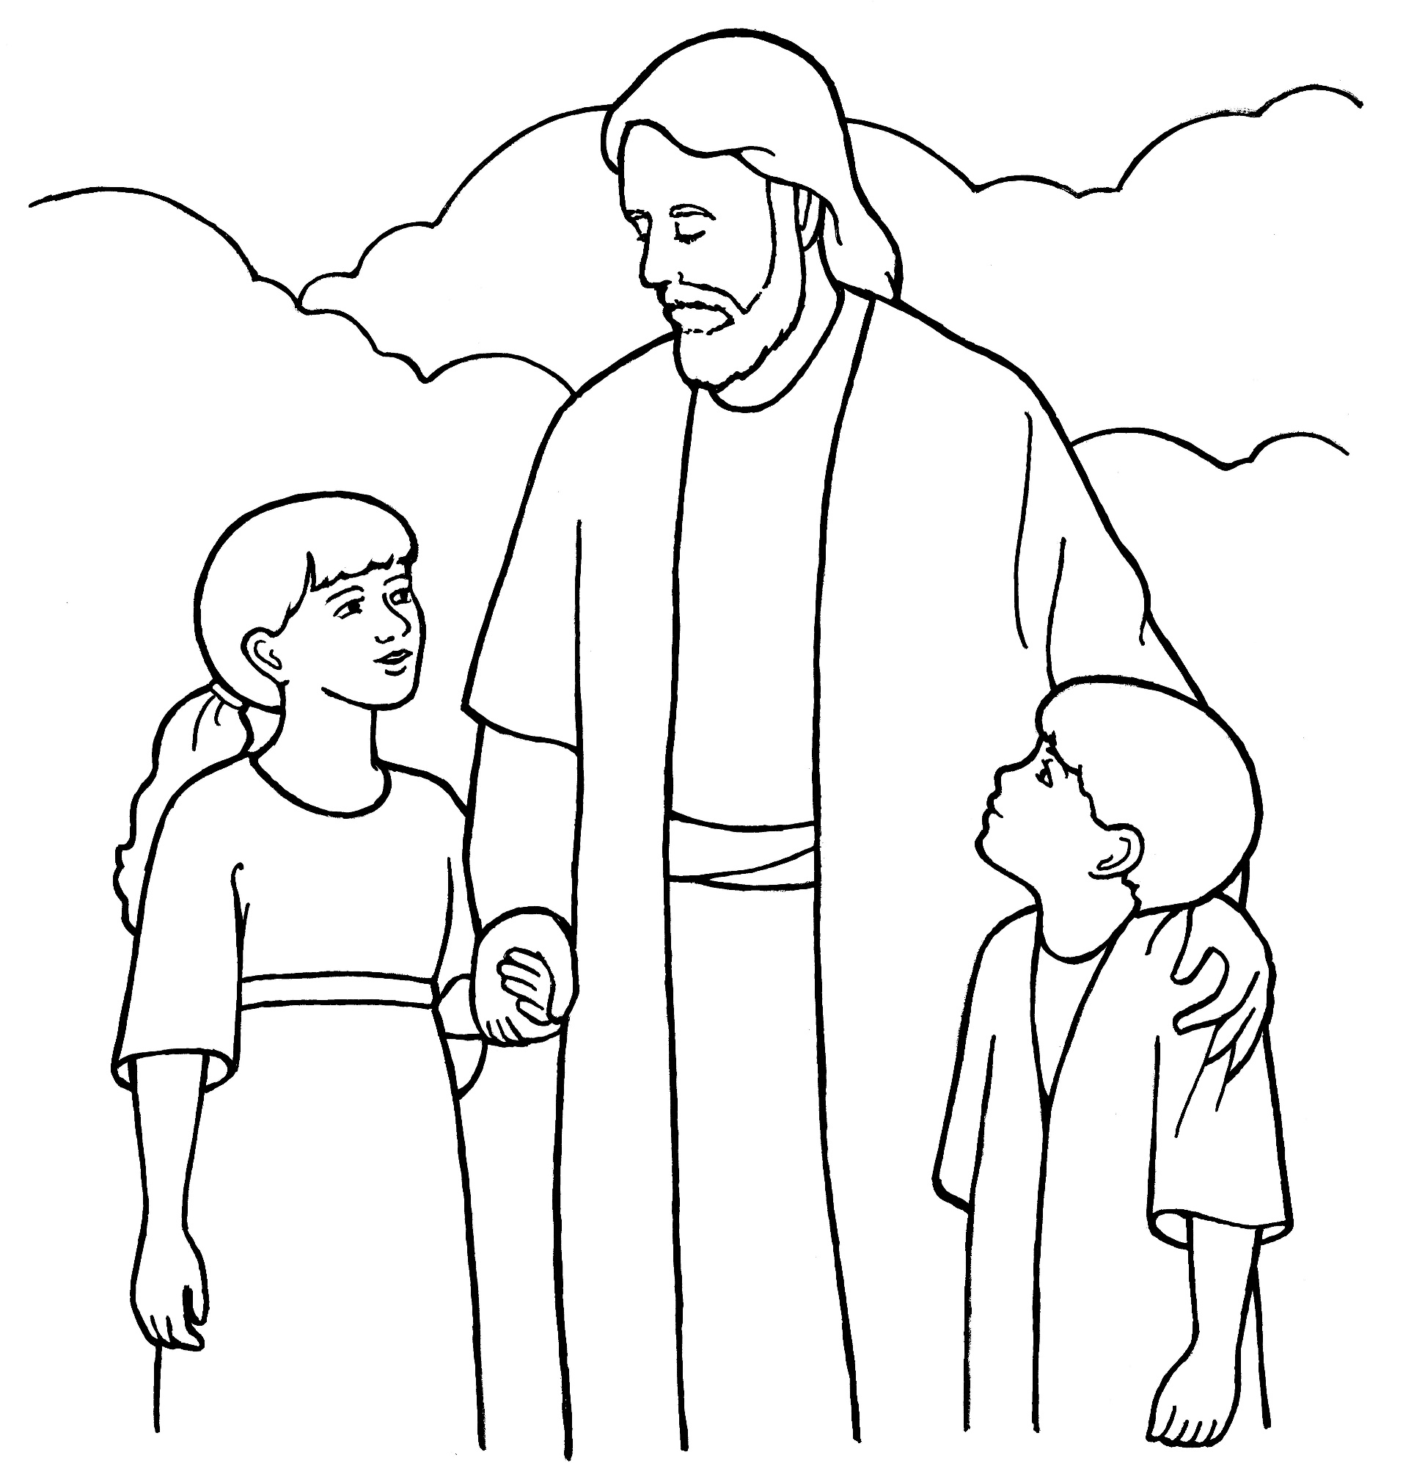
First, Faith in the Lord Jesus Christ;
Notes:
The Church of Jesus Christ of Latter-Day Saints. (n.d). Eternal life: An illustration of Christ with two children, from the nursery manual Behold Your Little Ones (2008), page 15. The Church of Jesus Christ of Latter-Day Saints Media Library. Retrieved Jun. 23, 2023 from https://www.churchofjesuschrist.org/media/image/jesus-with-children-whittaker-71b0a64?lang=eng&collectionId=cfba124a283645fda1da4f9361fe4afc

Slide 21
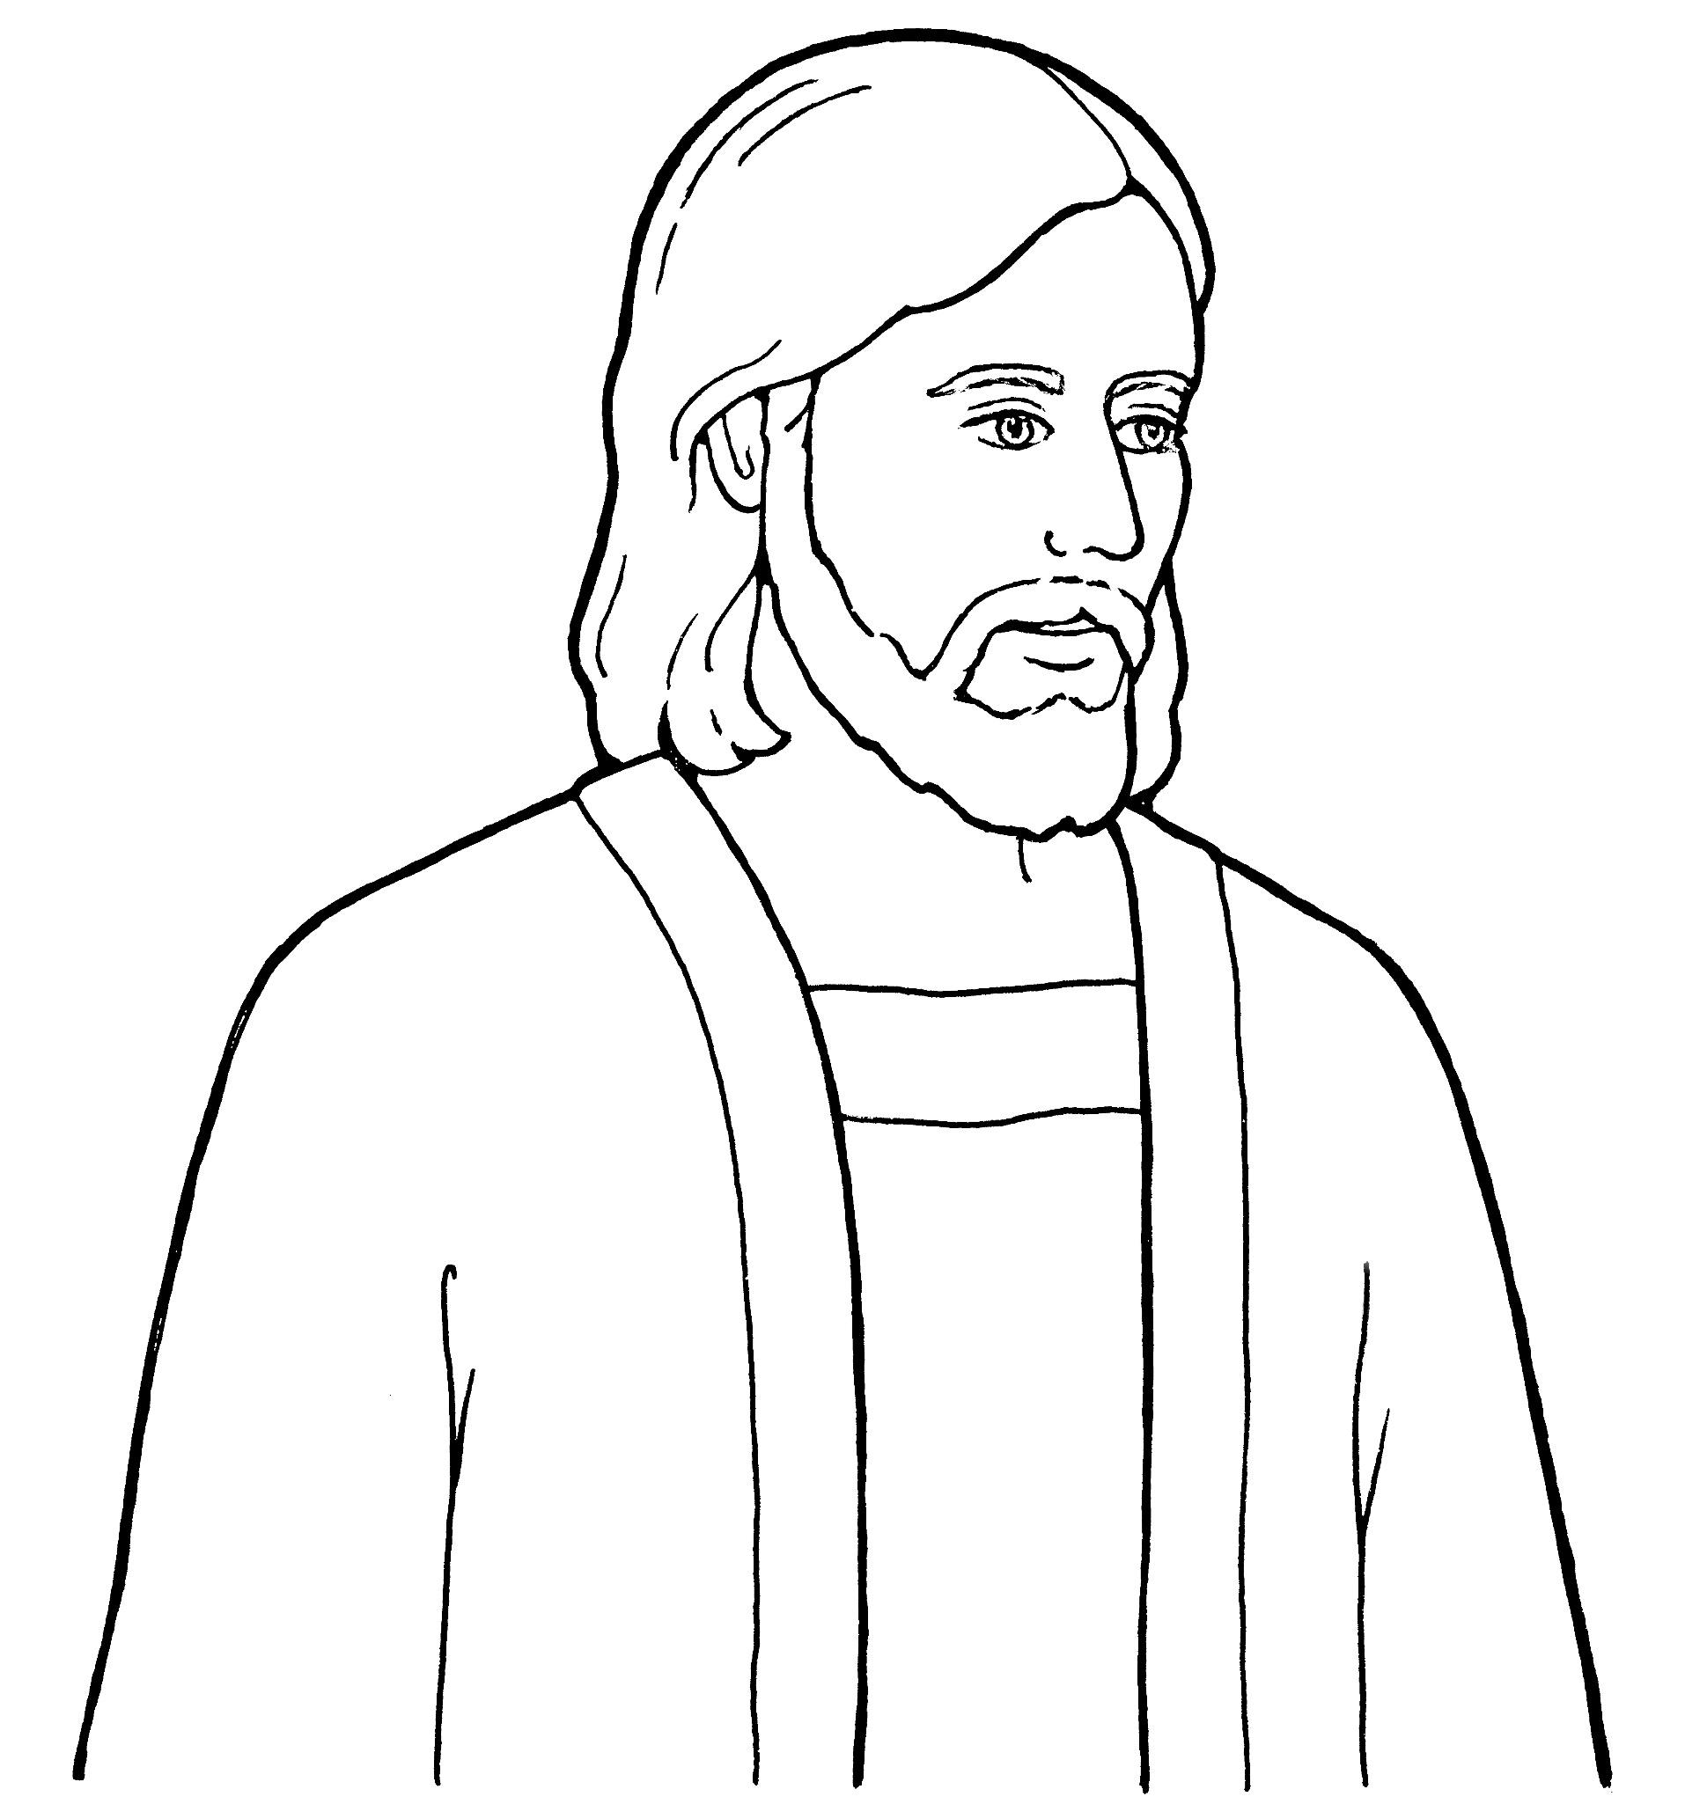
First, Faith in the Lord Jesus Christ;
Notes:
The Church of Jesus Christ of Latter-Day Saints. (n.d). Jesus Christ—the Son of God: An illustration of Jesus Christ, the Savior of the world. The Church of Jesus Christ of Latter-Day Saints Media Library. Retrieved Jun. 23, 2023 from https://www.churchofjesuschrist.org/media/image/line-art-jesus-christ-98050ad?lang=eng&collectionId=495bfcea352d4519bf5ecee5b88faf86

Slide 22
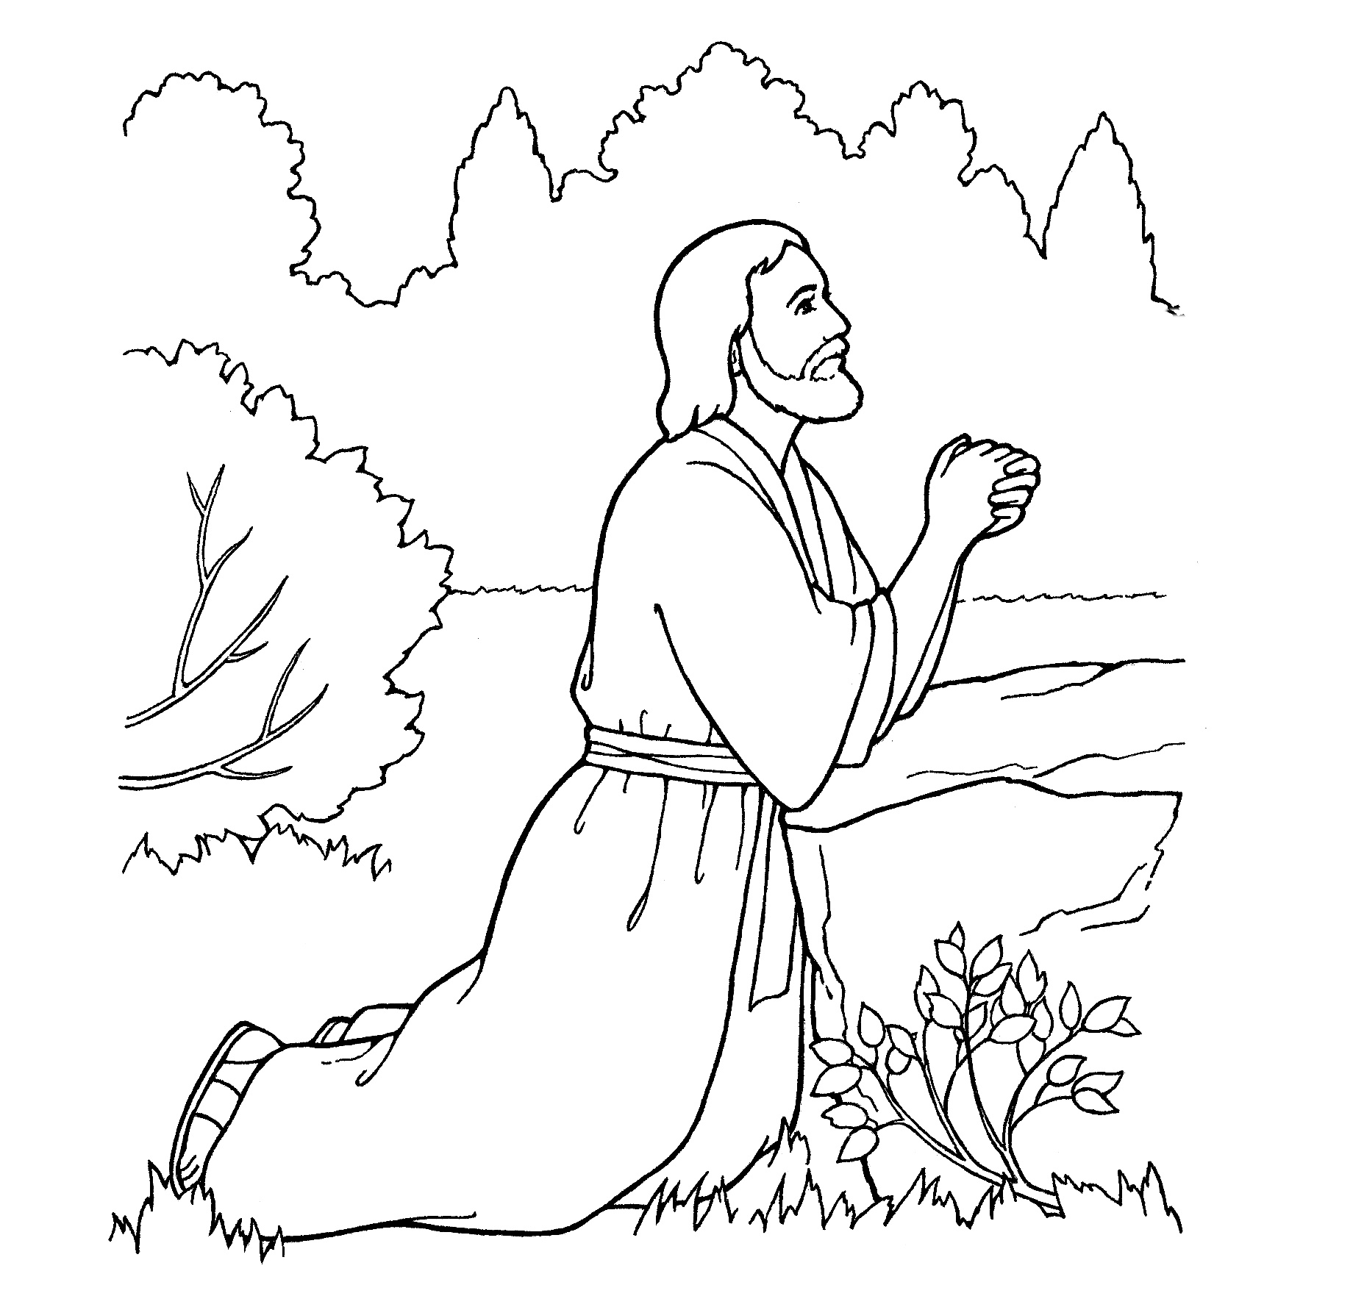
second, Repentance;
Notes:
The Church of Jesus Christ of Latter-Day Saints. (n.d). Third Article of Faith—Atonement: An illustration of the third article of faith—“Atonement” (Jesus Christ praying in the Garden of Gethsemane). The Church of Jesus Christ of Latter-Day Saints Media Library. Retrieved Jun. 23, 2023 from https://www.churchofjesuschrist.org/media/image/primary-bible-prayer-0386ca5?lang=eng&collectionId=2cc781dd842042cfbe7cb1933e2a4716

Slide 23
third, baptism by immersion
Notes:
The Church of Jesus Christ of Latter-Day Saints. (n.d). Young girl baptism: An illustration of a young girl being baptized. The Church of Jesus Christ of Latter-Day Saints Media Library. Retrieved Jun. 23, 2023 from https://www.churchofjesuschrist.org/media/image/girl-being-baptized-4fbc86a?lang=eng&collectionId=d032668ad7d9496daef639526bd0a37d

Slide 24
for the remission of sins
Notes:
The Church of Jesus Christ of Latter-Day Saints. (n.d). Repentance is a principle of the gospel: A line drawing of a boy who broke a window, showing the power of repentance. The Church of Jesus Christ of Latter-Day Saints Media Library. Retrieved Jun. 23, 2023 from https://www.churchofjesuschrist.org/media/image/repentance-1011bdd?lang=eng&collectionId=28d3f141a27f495281ed04d6ae40d8b4

Slide 25
fourth, Laying on of hands
Notes:
The Church of Jesus Christ of Latter-Day Saints. (n.d). 5th Article of Faith—hands: An illustration of the fifth article of faith—“Hands” (a young man being ordained to the priesthood). The Church of Jesus Christ of Latter-Day Saints Media Library. Retrieved Jun. 23, 2023 from https://www.churchofjesuschrist.org/media/image/confirmation-priesthood-07f815f?lang=eng&collectionId=2cc781dd842042cfbe7cb1933e2a4716

Slide 26
for the gift of the Holy Ghost.
Notes:
The Church of Jesus Christ of Latter-Day Saints. (n.d). A Christmas present: A coloring page of a Christmas present. The Church of Jesus Christ of Latter-Day Saints Media Library. Retrieved Jun. 23, 2023 from https://www.churchofjesuschrist.org/media/image/gift-box-f590fb8?lang=eng&collectionId=623efb2673fa4487972fbae3501dc0a0

Slide 27
1st Faith
Notes:
The Church of Jesus Christ of Latter-Day Saints. (n.d). Jesus Christ’s second coming: An illustration of Jesus Christ during the Second Coming. The Church of Jesus Christ of Latter-Day Saints Media Library. Retrieved Jun. 23, 2023 from https://www.churchofjesuschrist.org/media/image/second-coming-3ffcfb2?lang=eng&collectionId=495bfcea352d4519bf5ecee5b88faf86

Slide 28
1st Faith
Notes:
The Church of Jesus Christ of Latter-Day Saints. (n.d). Eternal life: An illustration of Christ with two children, from the nursery manual Behold Your Little Ones (2008), page 15. The Church of Jesus Christ of Latter-Day Saints Media Library. Retrieved Jun. 23, 2023 from https://www.churchofjesuschrist.org/media/image/jesus-with-children-whittaker-71b0a64?lang=eng&collectionId=cfba124a283645fda1da4f9361fe4afc

Slide 29
1st Faith
Notes:
The Church of Jesus Christ of Latter-Day Saints. (n.d). Jesus Christ—the Son of God: An illustration of Jesus Christ, the Savior of the world. The Church of Jesus Christ of Latter-Day Saints Media Library. Retrieved Jun. 23, 2023 from https://www.churchofjesuschrist.org/media/image/line-art-jesus-christ-98050ad?lang=eng&collectionId=495bfcea352d4519bf5ecee5b88faf86

Slide 30
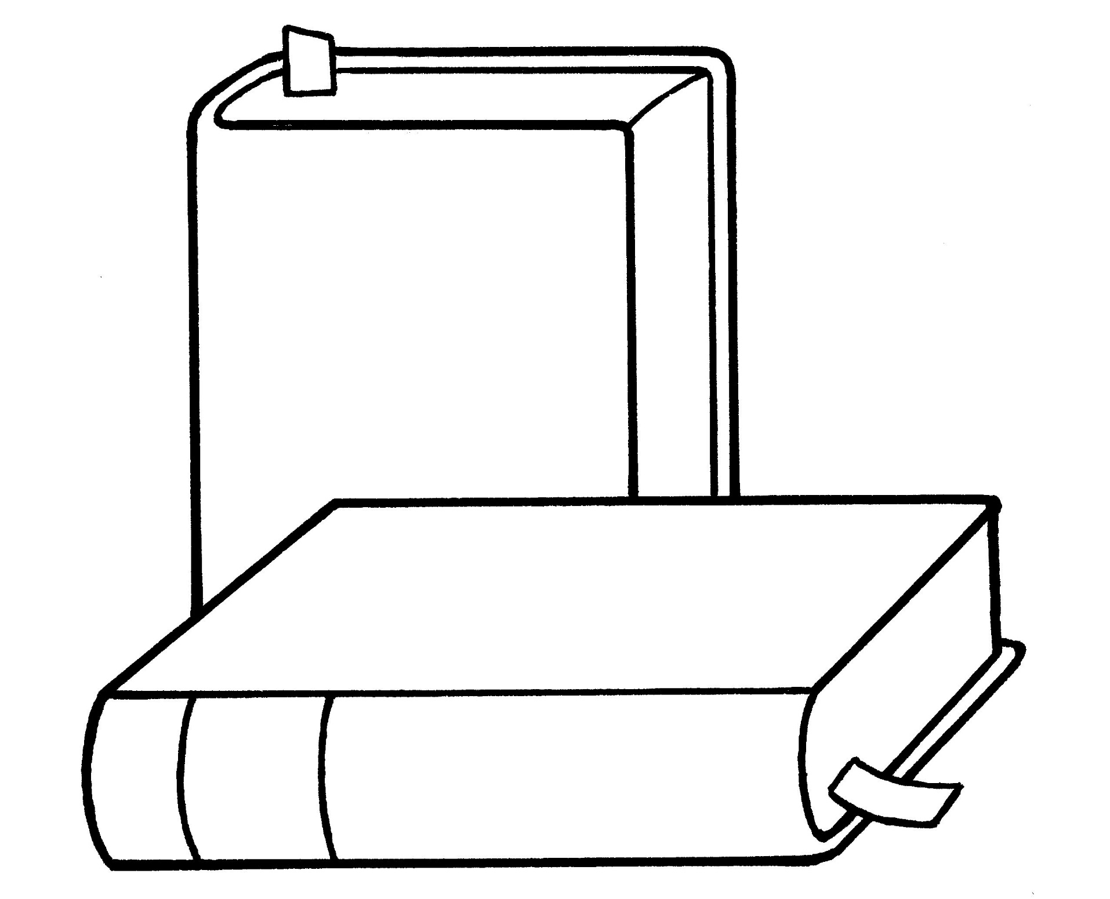
gospel
Notes:
The Church of Jesus Christ of Latter-Day Saints. (n.d). Scriptures: A line drawing of the scriptures, from the nursery manual Behold Your Little Ones (2008), pages 31, 39, and 107. The Church of Jesus Christ of Latter-Day Saints Media Library. Retrieved Jun. 23, 2023 from https://www.churchofjesuschrist.org/media/image/books-whittaker-b07e0ba?lang=eng&collectionId=cfba124a283645fda1da4f9361fe4afc

