Slide 1
Help Me, Dear Father Children’s Songbook, p. 99
Words & Music: Francis K. Taylor Flipchart: Cherice Montgomery
Notes:
The Church of Jesus Christ of Latter-Day Saints. (n.d). Faith in Jesus Christ: An illustration of a boy looking at a portrait of Jesus. The Church of Jesus Christ of Latter-Day Saints Media Library. Retrieved Jun. 23, 2023 from https://www.churchofjesuschrist.org/media/image/boy-portrait-jesus-8a8dead?lang=eng&collectionId=28d3f141a27f495281ed04d6ae40d8b4

Slide 2
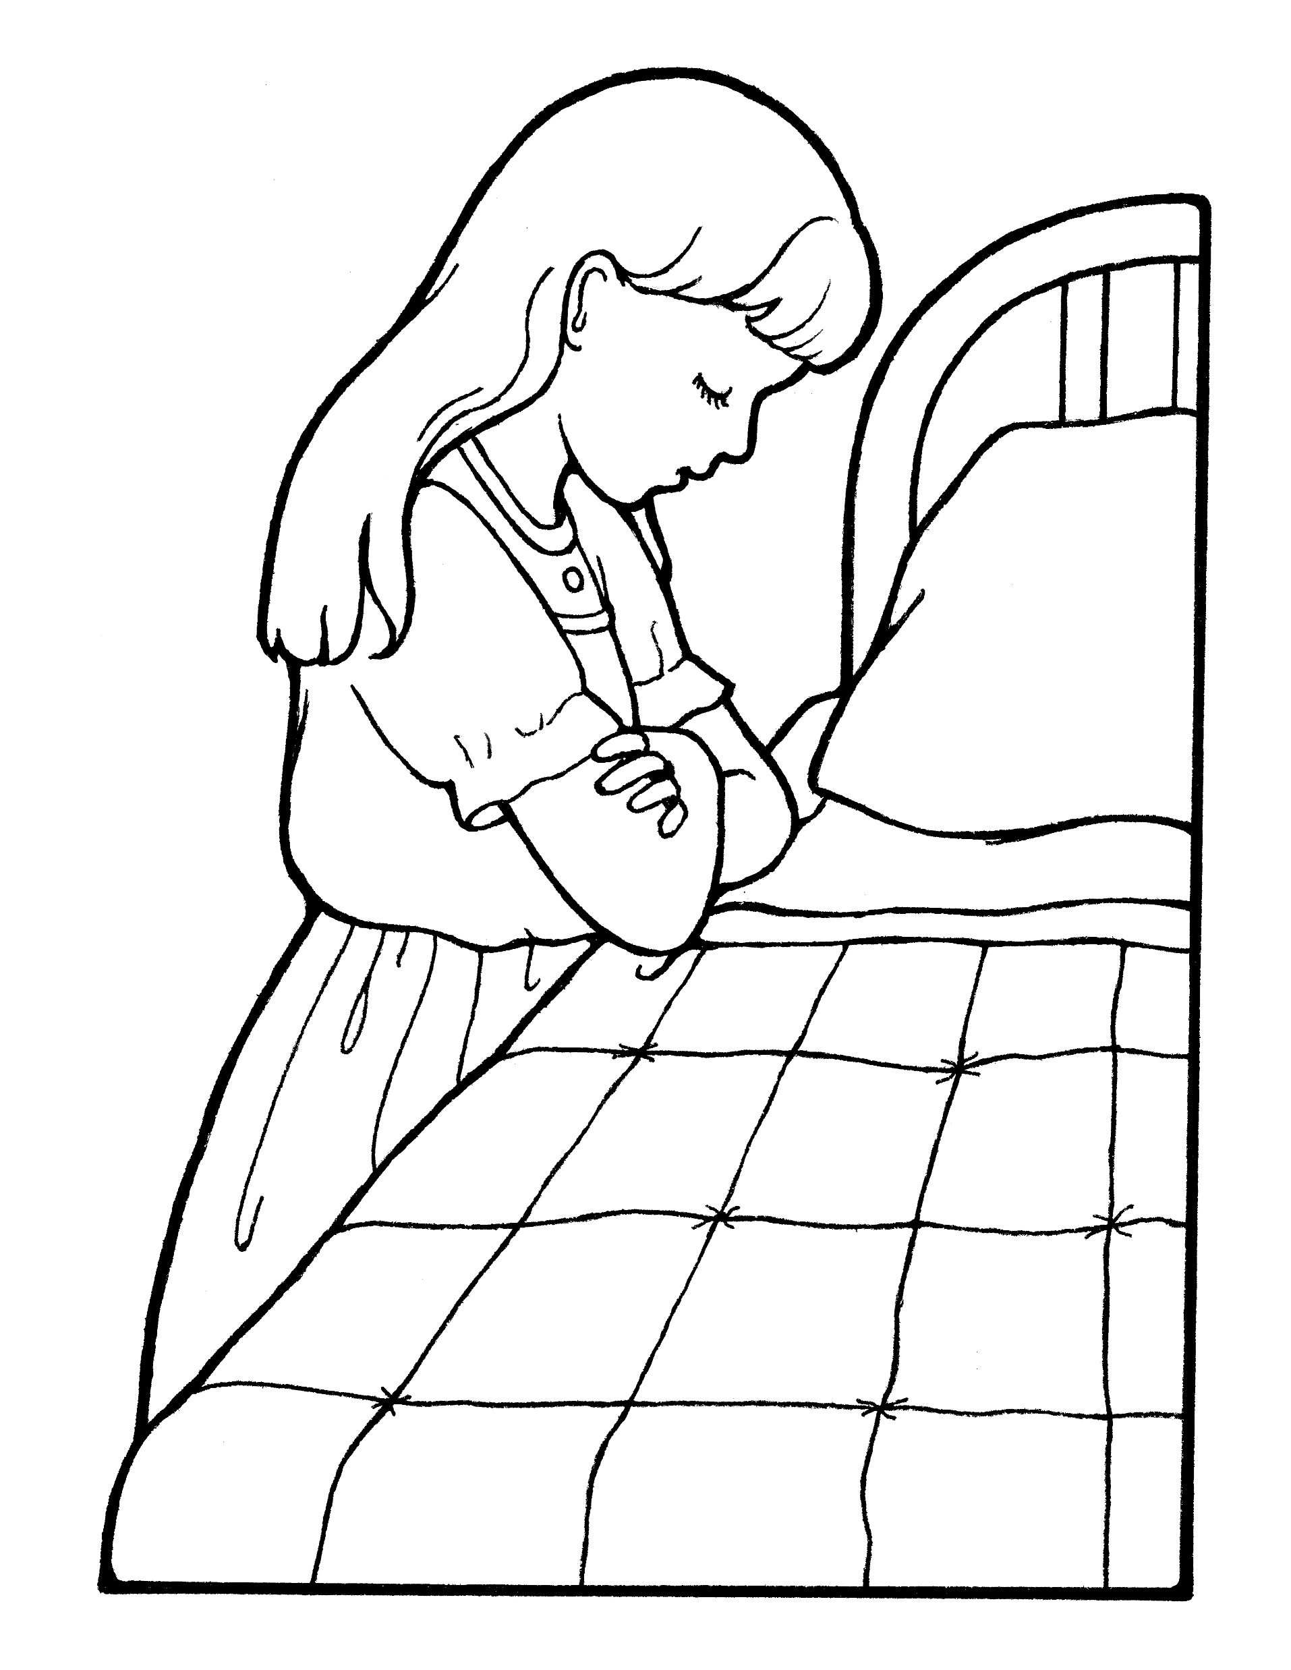
Help me dear Father,
Notes:
The Church of Jesus Christ of Latter-Day Saints. (n.d). Girl praying at her bedside: A picture of a girl praying by her bedside before bed. The Church of Jesus Christ of Latter-Day Saints Media Library. Retrieved Jun. 23, 2023 from https://www.churchofjesuschrist.org/media/image/girl-child-3f4d927?lang=eng&collectionId=28d3f141a27f495281ed04d6ae40d8b4

Slide 3
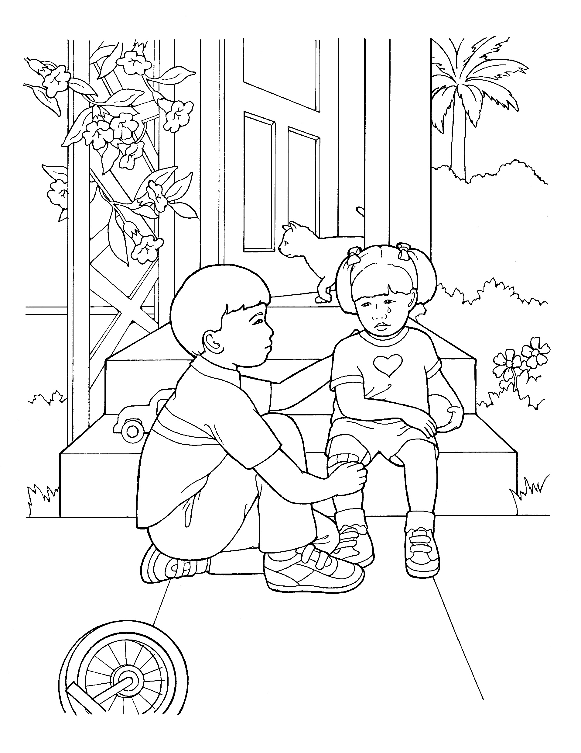
to freely forgive
Notes:
The Church of Jesus Christ of Latter-Day Saints. (n.d). Boy comforting his sister: A picture of a small boy comforting a little girl who has fallen off a bike. The Church of Jesus Christ of Latter-Day Saints Media Library. Retrieved Jun. 23, 2023 from https://www.churchofjesuschrist.org/media/image/boy-comforting-hurt-girl-06252a5?lang=eng&collectionId=c7c087efe31d4825809e8599cf30c117

Slide 4
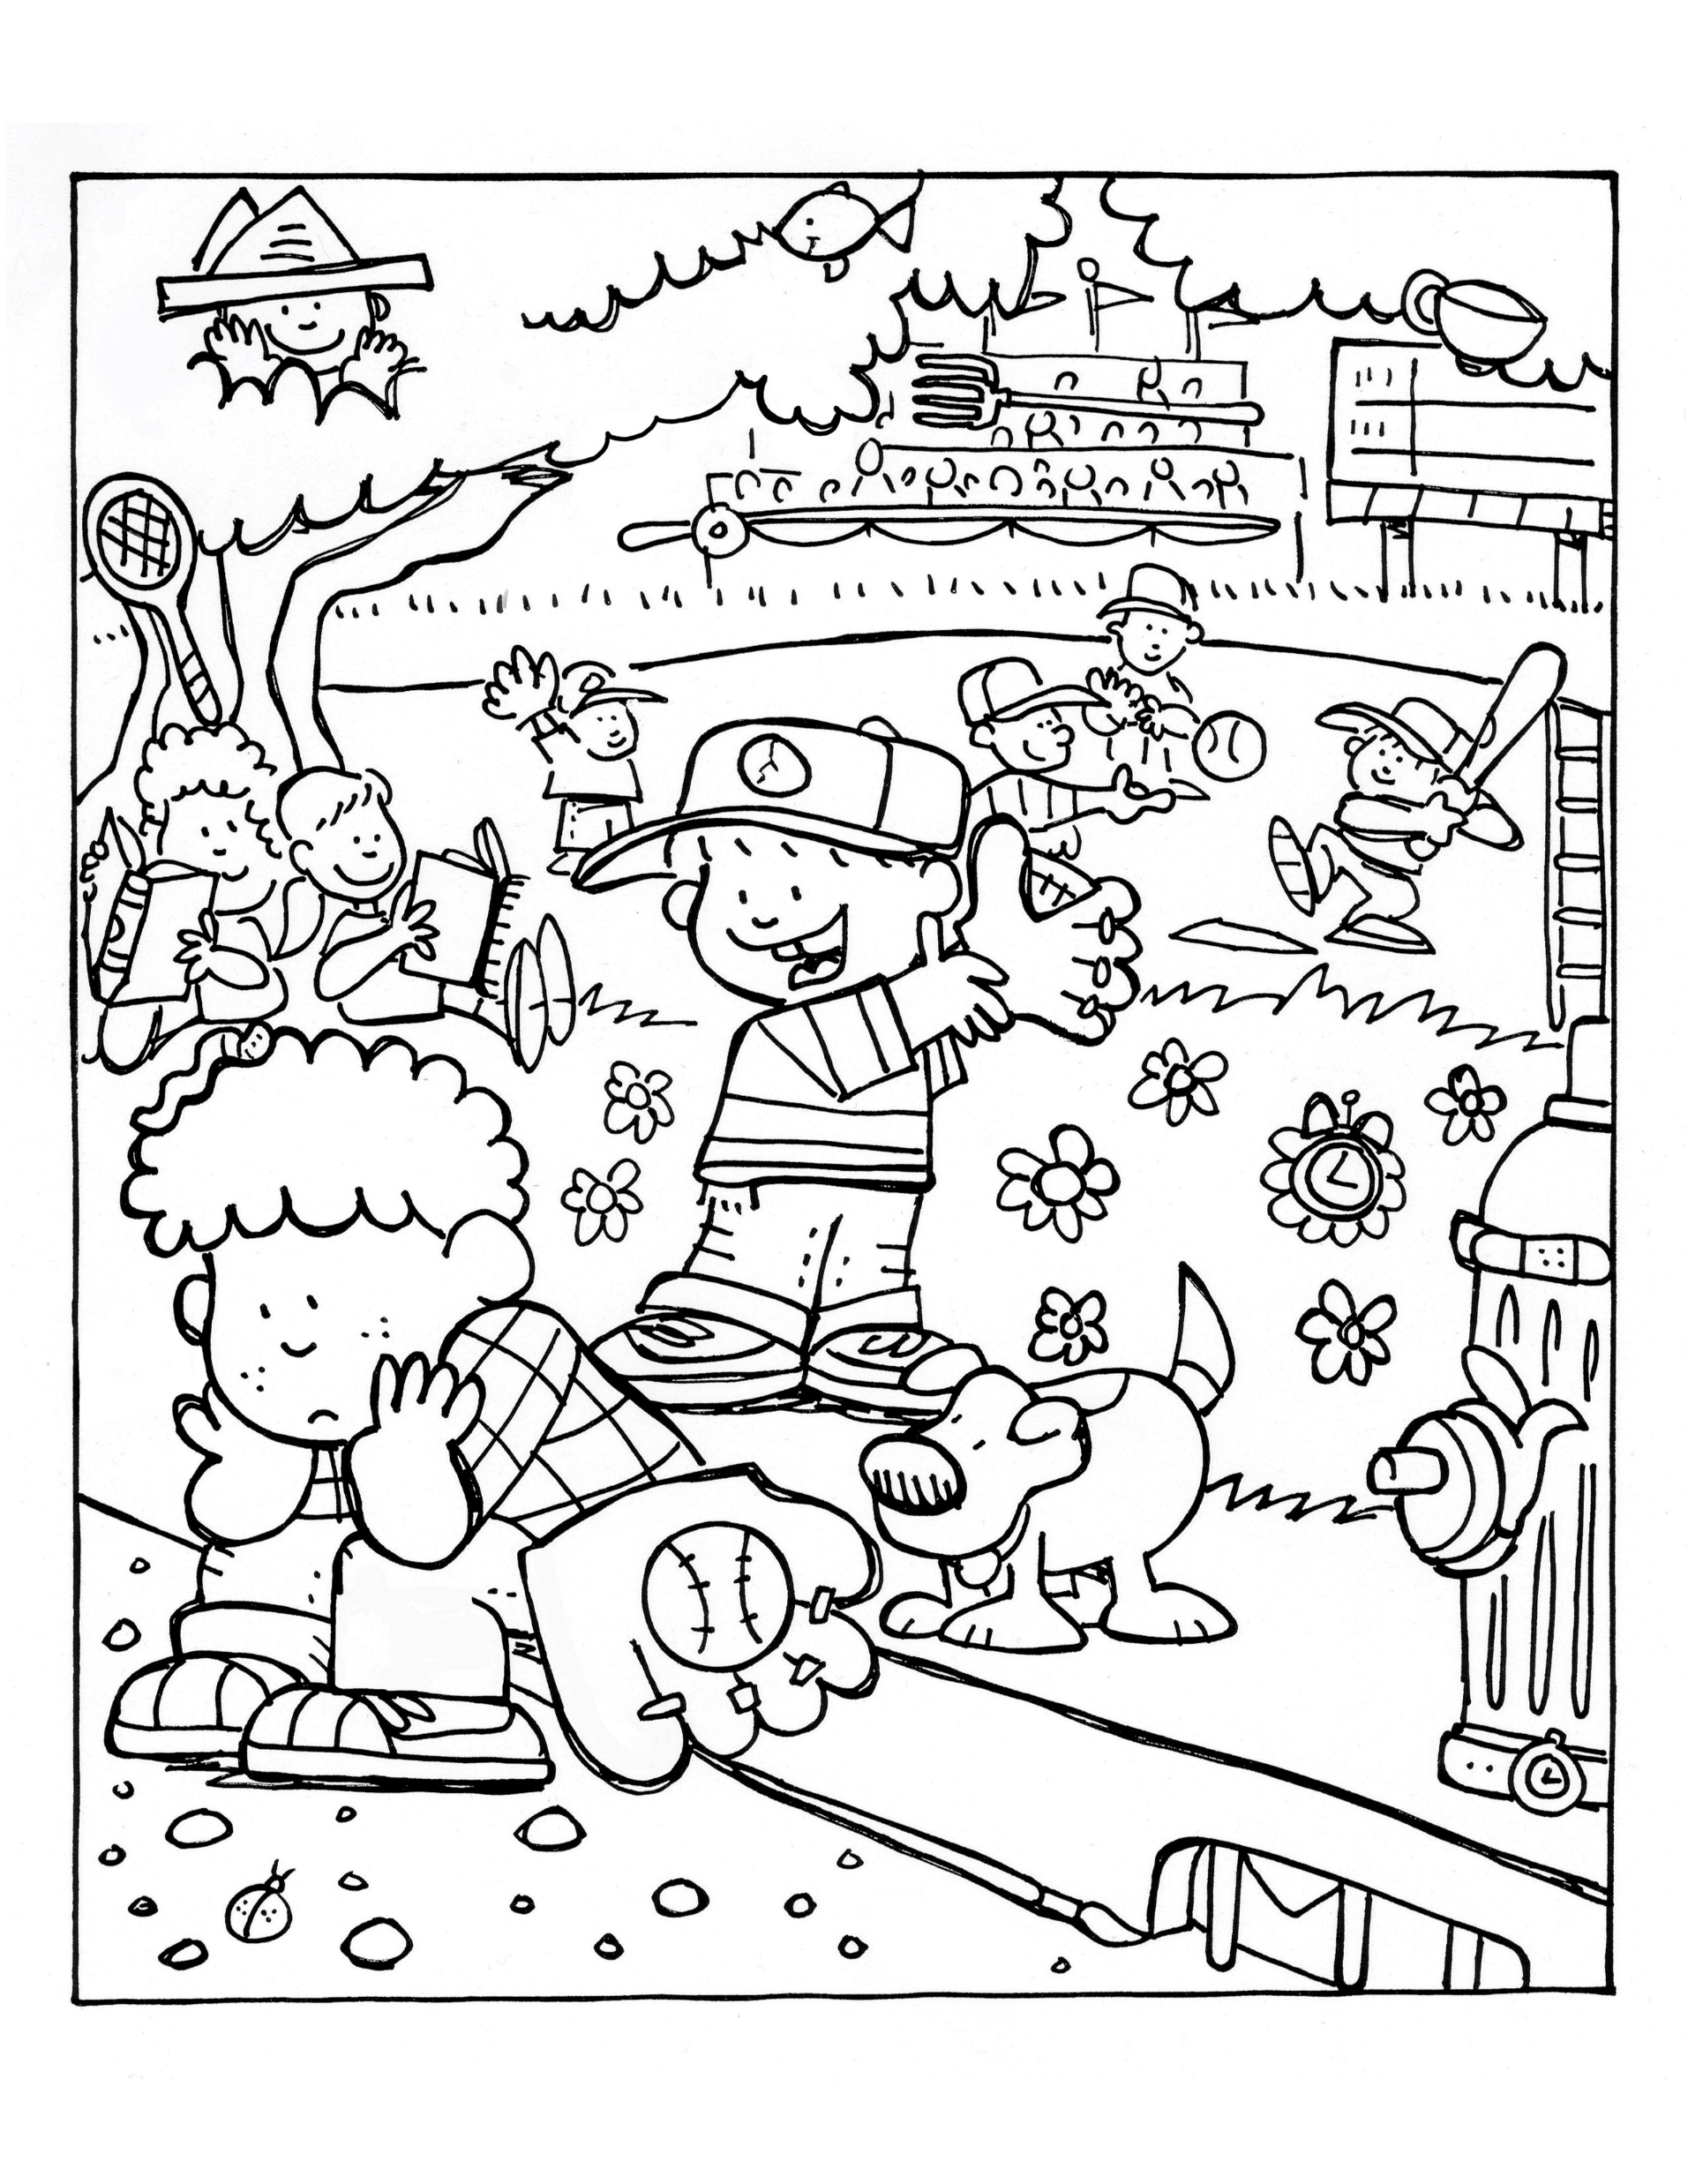
All who may seem unkind-- to me.
Notes:
The Church of Jesus Christ of Latter-Day Saints. (n.d). Baseball game: A boy sitting on a bench is invited by other boys to join them in their baseball game. The Church of Jesus Christ of Latter-Day Saints Media Library. Retrieved Jun. 23, 2023 from https://www.churchofjesuschrist.org/media/image/boys-baseball-game-f954e98?lang=eng&collectionId=6819ec5df2c64c63bf29fdbba3c60125

Slide 5
Help me each day,
Notes:
The Church of Jesus Christ of Latter-Day Saints. (n.d). Sun: A line drawing of the sun from the nursery manual Behold Your Little Ones (2008), page 35. The Church of Jesus Christ of Latter-Day Saints Media Library. Retrieved Jun. 23, 2023 from https://www.churchofjesuschrist.org/media/image/sun-whittaker-73e9eb8?lang=eng&collectionId=cfba124a283645fda1da4f9361fe4afc

Slide 6
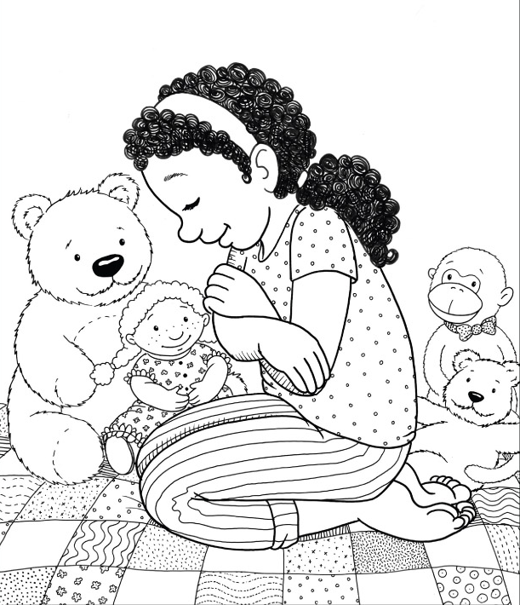
Father, I pray;
Notes:
Stott, Apryl. (2008, Sept.). I can pray to Heavenly Father, and he will hear and answer my prayers. Friend. Retrieved Jun. 23, 2023 from https://www.churchofjesuschrist.org/bc/content/shared/content/images/gospel-library/magazine/fr08sep48_color.jpg

Slide 7
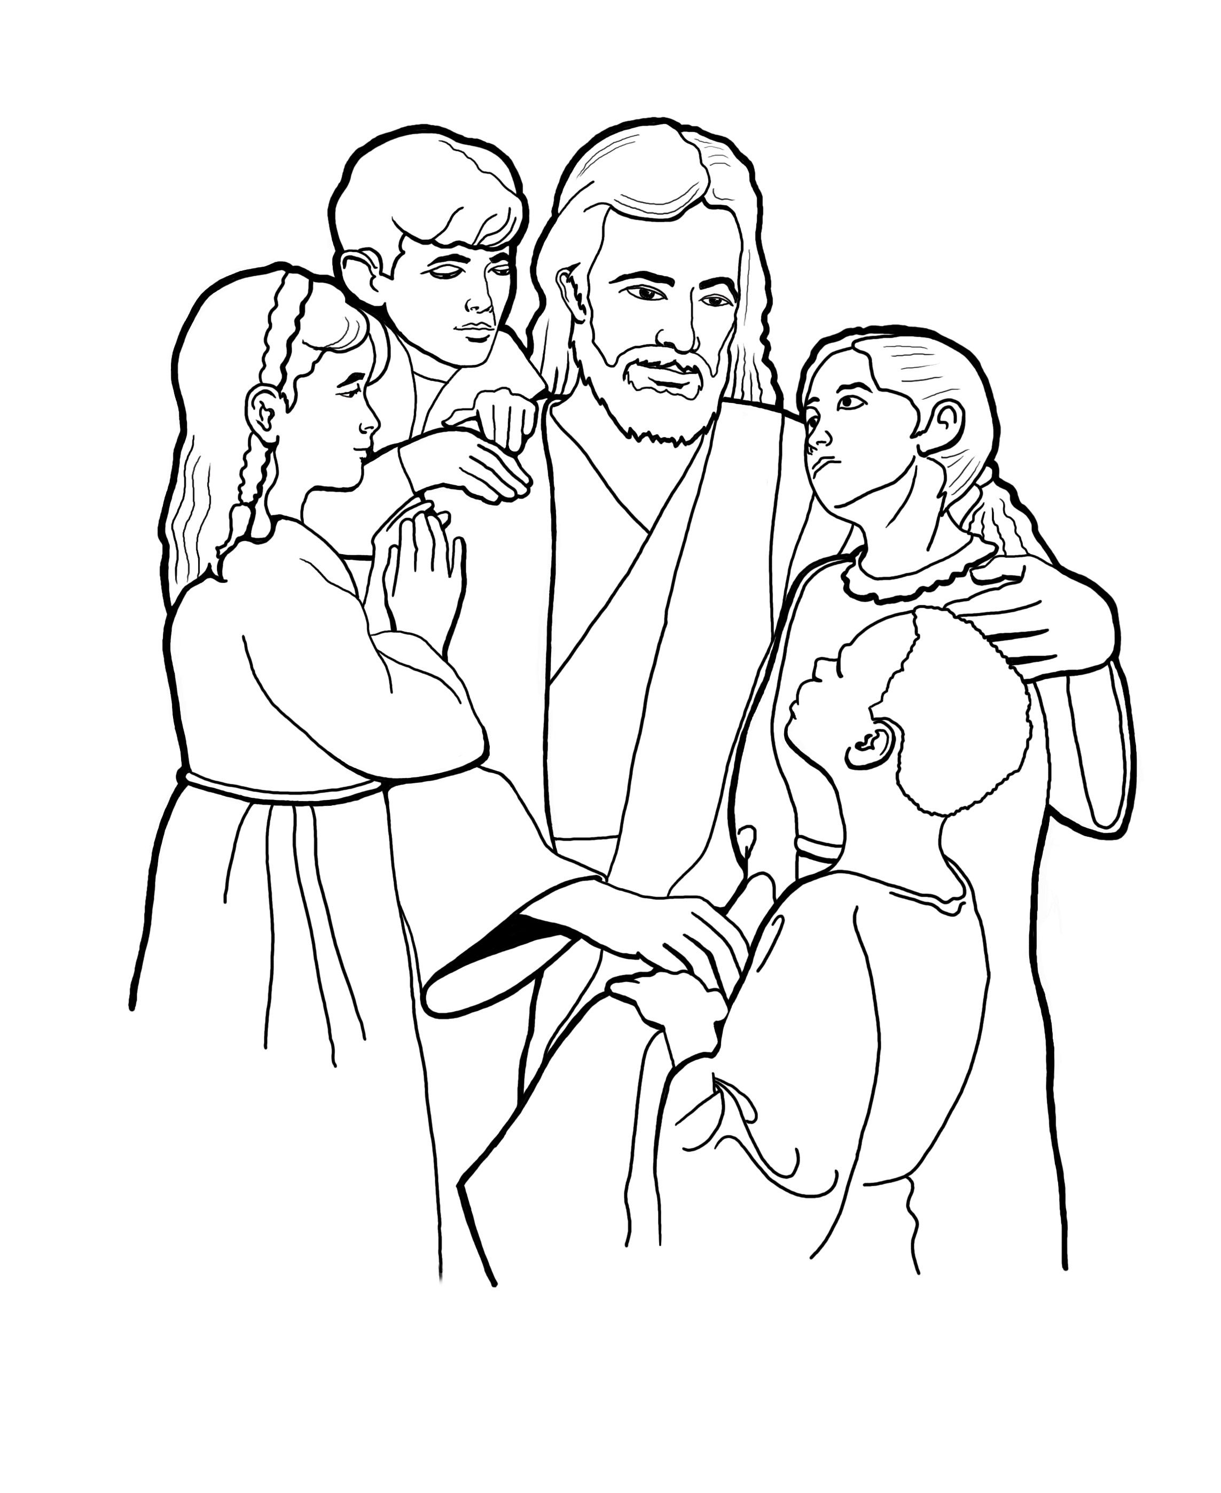
Help me live nearer, nearer to thee.
Notes:
Parson, Del. (n.d). Christ with children coloring page: A sketch of Christ with children, based on the painting by Del Parson. The Church of Jesus Christ of Latter-Day Saints Media Library. Retrieved Jun. 23, 2023 from https://www.churchofjesuschrist.org/media/image/christ-with-children-tom-child-bfc8ec6?lang=eng&collectionId=6819ec5df2c64c63bf29fdbba3c60125

Slide 8
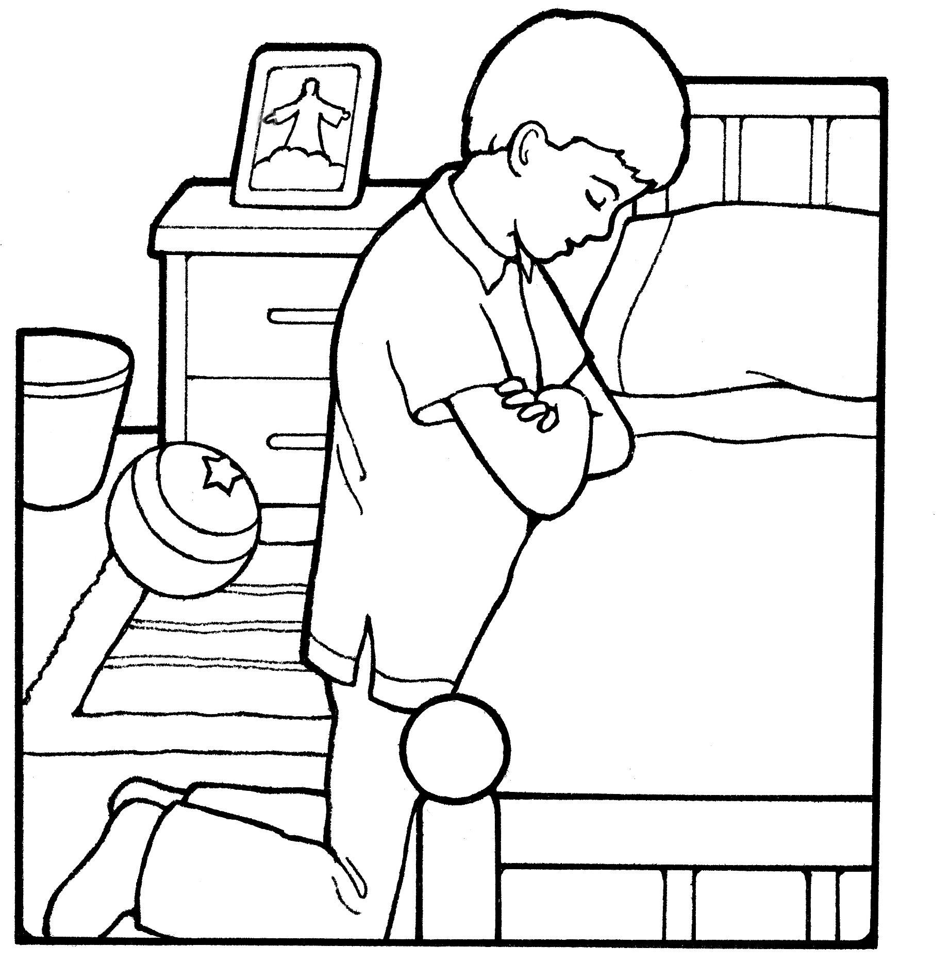
Help me dear Father,
Notes:
The Church of Jesus Christ of Latter-Day Saints. (n.d). Boy praying at bedside: A line drawing of a boy praying near his bedside. The Church of Jesus Christ of Latter-Day Saints Media Library. Retrieved Jun. 23, 2023 from https://www.churchofjesuschrist.org/media/image/children-boy-praying-a6bc25b?lang=eng

Slide 9
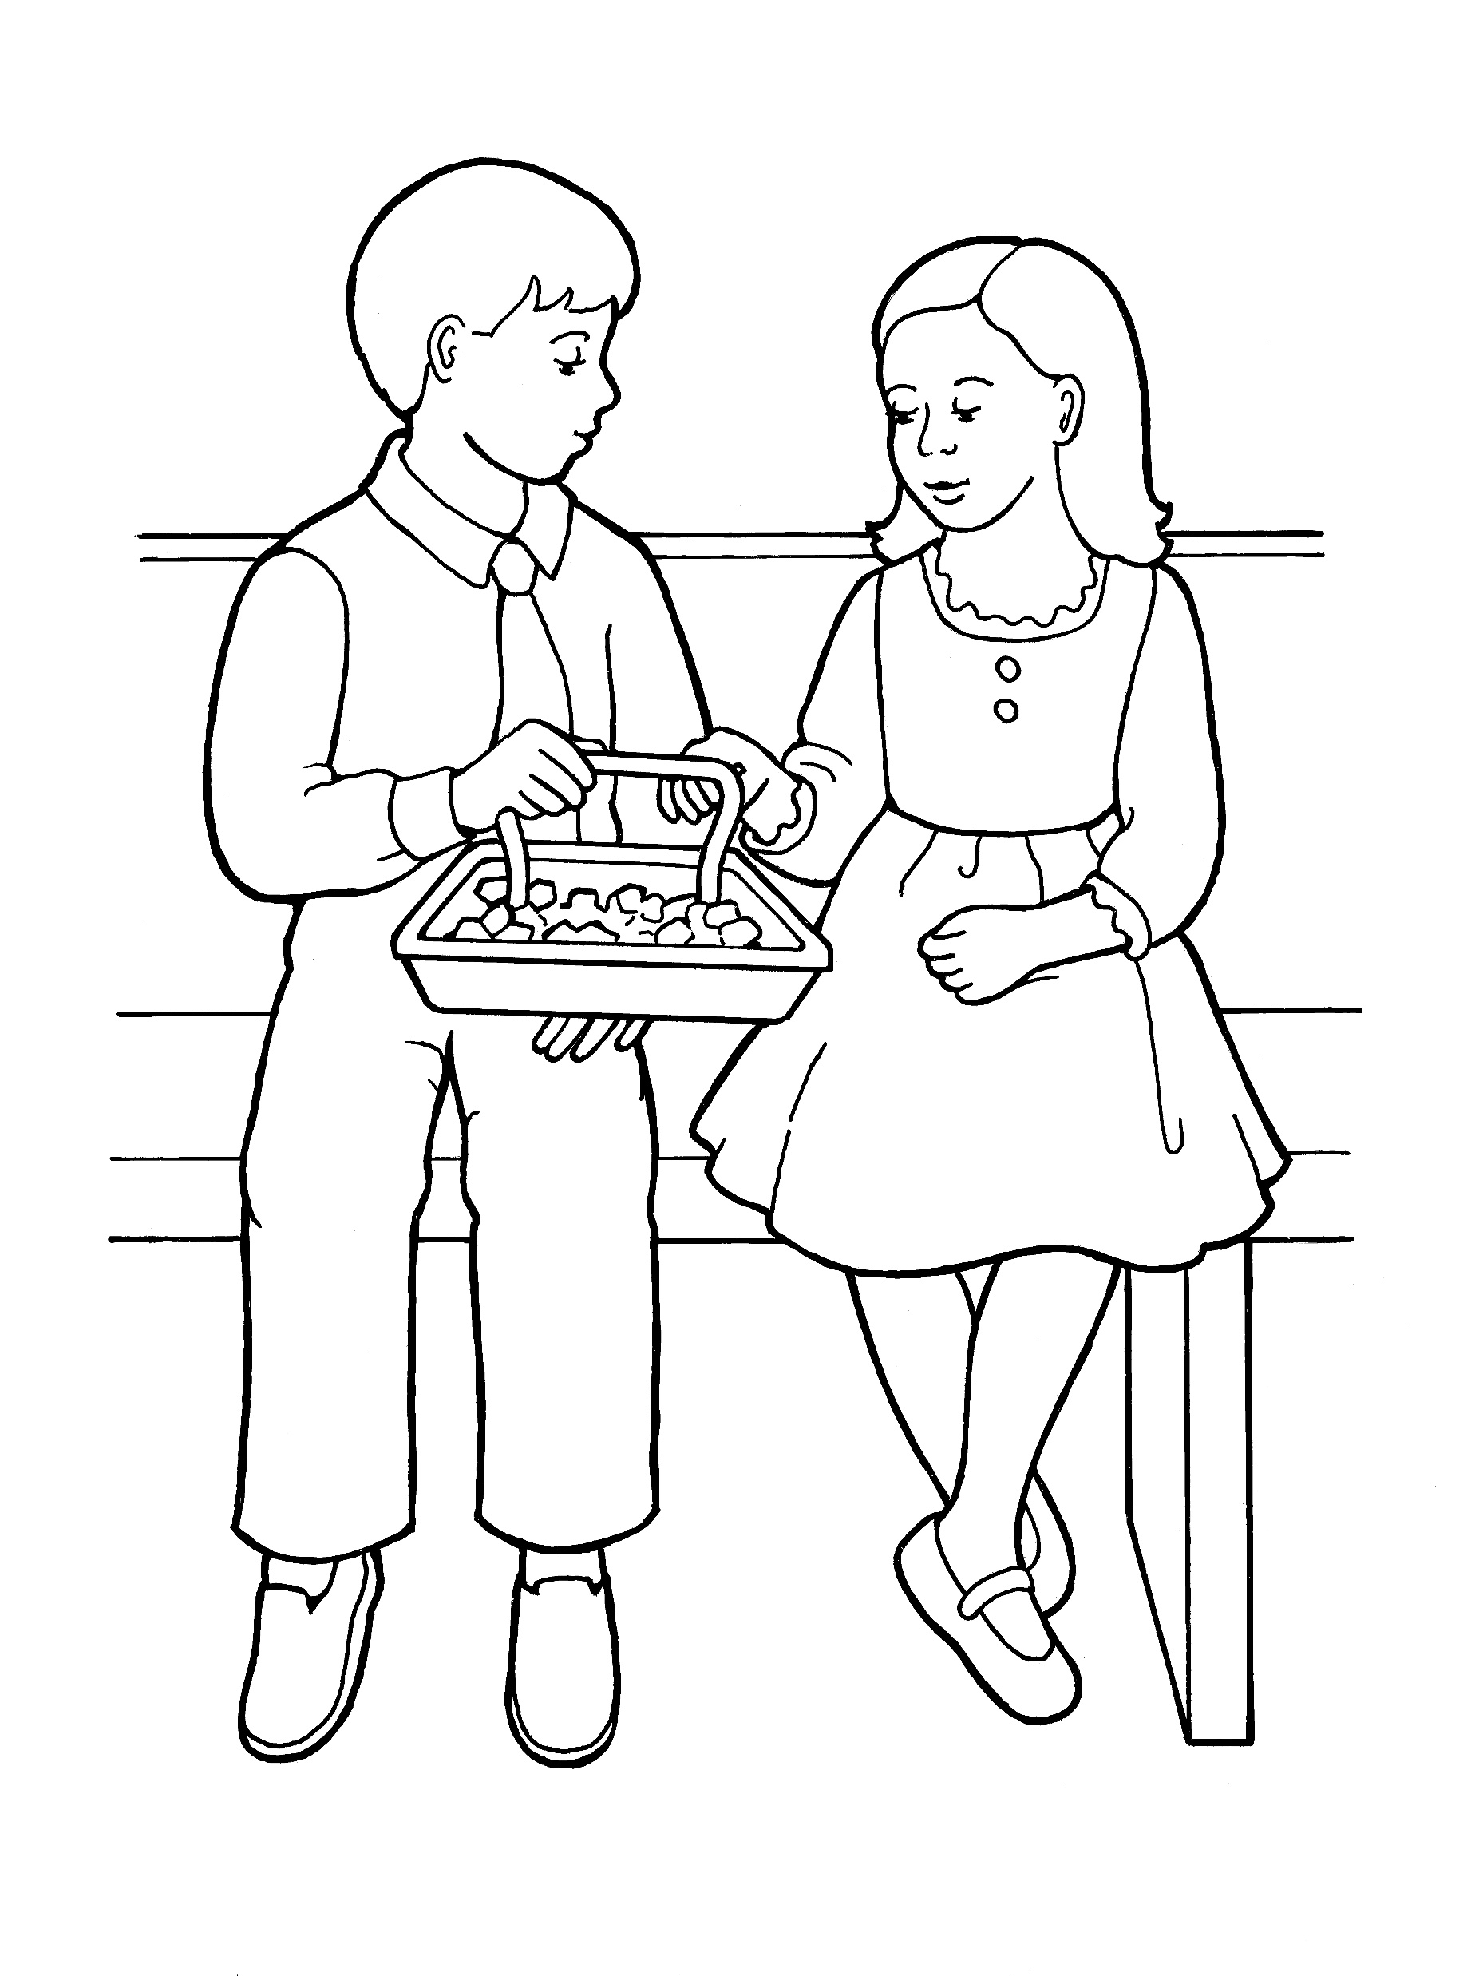
to truly repent,
Notes:
The Church of Jesus Christ of Latter-Day Saints. (n.d). Children partaking of sacrament bread: An illustration of a young girl and young boy partaking of the sacrament bread, from the nursery manual Behold Your Little Ones (2008), page 115. The Church of Jesus Christ of Latter-Day Saints Media Library. Retrieved Jun. 23, 2023 from https://www.churchofjesuschrist.org/media/image/boy-girl-sacrament-nursery-manual-1f97338?lang=eng

Slide 10
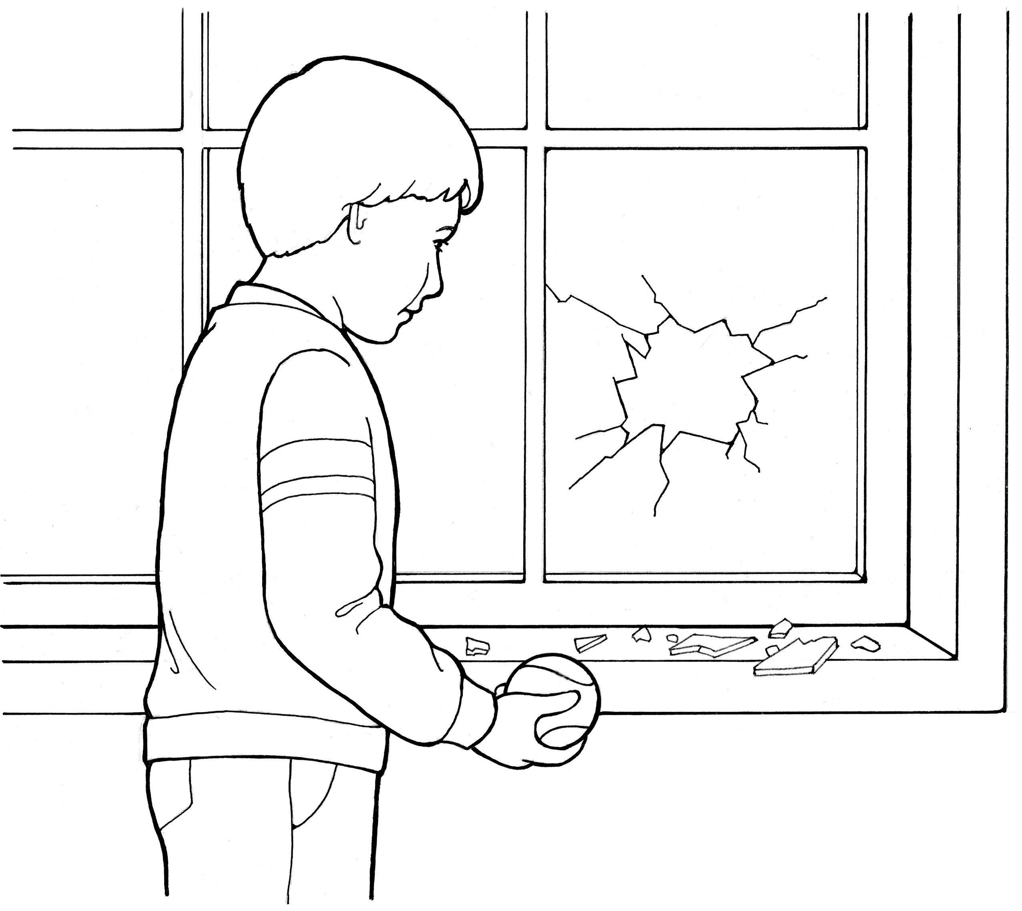
Making things right
Notes:
The Church of Jesus Christ of Latter-Day Saints. (n.d). Repentance is a principle of the gospel: A line drawing of a boy who broke a window, showing the power of repentance. The Church of Jesus Christ of Latter-Day Saints Media Library. Retrieved Jun. 23, 2023 from https://www.churchofjesuschrist.org/media/image/repentance-1011bdd?lang=eng&collectionId=28d3f141a27f495281ed04d6ae40d8b4

Slide 11
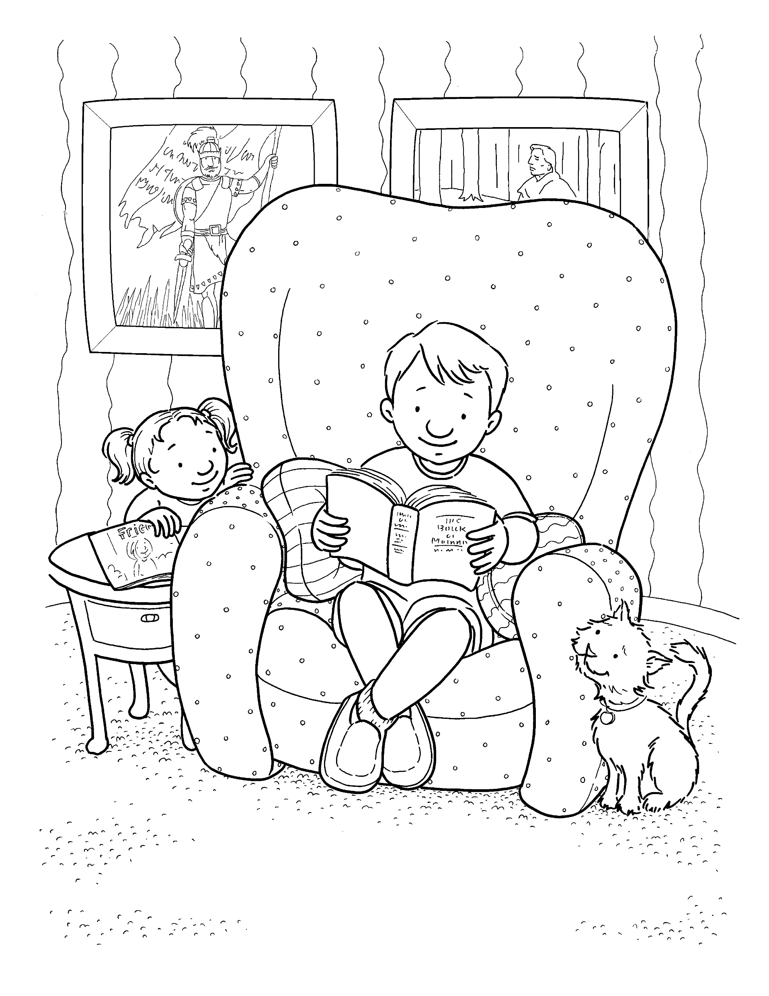
and changing my ways.
Notes:
The Church of Jesus Christ of Latter-Day Saints. (n.d). Reading the scriptures: A boy sits in his armchair and reads his scriptures while his sister and his cat look up at him. The Church of Jesus Christ of Latter-Day Saints Media Library. Retrieved Jun. 23, 2023 https://www.churchofjesuschrist.org/media/image/boy-reading-scriptures-4c85b16?lang=eng&collectionId=6819ec5df2c64c63bf29fdbba3c60125

Slide 12
Help me each day,
Notes:
The Church of Jesus Christ of Latter-Day Saints. (n.d). Sun: A line drawing of the sun from the nursery manual Behold Your Little Ones (2008), page 35. The Church of Jesus Christ of Latter-Day Saints Media Library. Retrieved Jun. 23, 2023 from https://www.churchofjesuschrist.org/media/image/sun-whittaker-73e9eb8?lang=eng&collectionId=cfba124a283645fda1da4f9361fe4afc

Slide 13
Father, I pray;
Notes:
Stott, Apryl. (2008, Sept.). I can pray to Heavenly Father, and he will hear and answer my prayers. Friend. Retrieved Jun. 23, 2023 from https://www.churchofjesuschrist.org/bc/content/shared/content/images/gospel-library/magazine/fr08sep48_color.jpg

Slide 14
Help me live nearer, nearer to thee.
Notes:
Parson, Del. (n.d). Christ with children coloring page: A sketch of Christ with children, based on the painting by Del Parson. The Church of Jesus Christ of Latter-Day Saints Media Library. Retrieved Jun. 23, 2023 from https://www.churchofjesuschrist.org/media/image/christ-with-children-tom-child-bfc8ec6?lang=eng&collectionId=6819ec5df2c64c63bf29fdbba3c60125

Slide 15
Image Credits:
Parson, Del. (n.d). Christ with children coloring page: A sketch of Christ with children, based on the painting by Del Parson. The Church of Jesus Christ of Latter-Day Saints Media Library. Retrieved Jun. 23, 2023 from https://www.churchofjesuschrist.org/media/image/christ-with-children-tom-child-bfc8ec6?lang=eng&collectionId=6819ec5df2c64c63bf29fdbba3c60125
Stott, Apryl. (2008, Sept.). I can pray to Heavenly Father, and he will hear and answer my prayers. Friend. Retrieved Jun. 23, 2023 from https://www.churchofjesuschrist.org/bc/content/shared/content/images/gospel-library/magazine/fr08sep48_color.jpg
The Church of Jesus Christ of Latter-Day Saints. (n.d). Baseball game: A boy sitting on a bench is invited by other boys to join them in their baseball game. The Church of Jesus Christ of Latter-Day Saints Media Library. Retrieved Jun. 23, 2023 from https://www.churchofjesuschrist.org/media/image/boys-baseball-game-f954e98?lang=eng&collectionId=6819ec5df2c64c63bf29fdbba3c60125
The Church of Jesus Christ of Latter-Day Saints. (n.d). Boy comforting his sister: A picture of a small boy comforting a little girl who has fallen off a bike. The Church of Jesus Christ of Latter-Day Saints Media Library. Retrieved Jun. 23, 2023 from https://www.churchofjesuschrist.org/media/image/boy-comforting-hurt-girl-06252a5?lang=eng&collectionId=c7c087efe31d4825809e8599cf30c117
The Church of Jesus Christ of Latter-Day Saints. (n.d). Boy praying at bedside: A line drawing of a boy praying near his bedside. The Church of Jesus Christ of Latter-Day Saints Media Library. Retrieved Jun. 23, 2023 from https://www.churchofjesuschrist.org/media/image/children-boy-praying-a6bc25b?lang=eng
The Church of Jesus Christ of Latter-Day Saints. (n.d). Children partaking of sacrament bread: An illustration of a young girl and young boy partaking of the sacrament bread, from the nursery manual Behold Your Little Ones (2008), page 115. The Church of Jesus Christ of Latter-Day Saints Media Library. Retrieved Jun. 23, 2023 from https://www.churchofjesuschrist.org/media/image/boy-girl-sacrament-nursery-manual-1f97338?lang=eng
The Church of Jesus Christ of Latter-Day Saints. (n.d). Faith in Jesus Christ: An illustration of a boy looking at a portrait of Jesus. The Church of Jesus Christ of Latter-Day Saints Media Library. Retrieved Jun. 23, 2023 from https://www.churchofjesuschrist.org/media/image/boy-portrait-jesus-8a8dead?lang=eng&collectionId=28d3f141a27f495281ed04d6ae40d8b4
The Church of Jesus Christ of Latter-Day Saints. (n.d). Girl praying at her bedside: A picture of a girl praying by her bedside before bed. The Church of Jesus Christ of Latter-Day Saints Media Library. Retrieved Jun. 23, 2023 from https://www.churchofjesuschrist.org/media/image/girl-child-3f4d927?lang=eng&collectionId=28d3f141a27f495281ed04d6ae40d8b4
The Church of Jesus Christ of Latter-Day Saints. (n.d). Helping one another: Two children helping another child who has dropped her belongings. The Church of Jesus Christ of Latter-Day Saints Media Library. Retrieved Jun. 23, 2023 https://www.churchofjesuschrist.org/media/image/children-helping-playing-3d63704?lang=eng&collectionId=6819ec5df2c64c63bf29fdbba3c60125
The Church of Jesus Christ of Latter-Day Saints. (n.d). Obedience: Choose the right: An illustration of the CTR symbol. The Church of Jesus Christ of Latter-Day Saints Media Library. Retrieved Jun. 23, 2023 from https://www.churchofjesuschrist.org/media/image/ctr-logo-62da351?lang=eng&collectionId=28d3f141a27f495281ed04d6ae40d8b4
The Church of Jesus Christ of Latter-Day Saints. (n.d). Picture of Christ: A family hangs a picture of Jesus Christ in their home. The Church of Jesus Christ of Latter-Day Saints Media Library. Retrieved Jun. 23, 2023 from https://www.churchofjesuschrist.org/media/image/family-jesus-christ-picture-d104a0c?lang=eng&collectionId=408040e2e846420e8df818f3169c9543
The Church of Jesus Christ of Latter-Day Saints. (n.d). Premortal life: An illustration of Heavenly Father and Jesus Christ presenting the plan in the premortal life, from the nursery manual Behold Your Little Ones (2008), page 15. The Church of Jesus Christ of Latter-Day Saints Media Library. Retrieved Jun. 23, 2023 from https://www.churchofjesuschrist.org/media/image/god-christ-premortal-existence-whittaker-9d7ac2c?lang=eng&collectionId=3cbf78e787498a07417814a31656063f9227b4c6
The Church of Jesus Christ of Latter-Day Saints. (n.d). Reading the scriptures: A boy sits in his armchair and reads his scriptures while his sister and his cat look up at him. The Church of Jesus Christ of Latter-Day Saints Media Library. Retrieved Jun. 23, 2023 https://www.churchofjesuschrist.org/media/image/boy-reading-scriptures-4c85b16?lang=eng&collectionId=6819ec5df2c64c63bf29fdbba3c60125
The Church of Jesus Christ of Latter-Day Saints. (n.d). Repentance is a principle of the gospel: A line drawing of a boy who broke a window, showing the power of repentance. The Church of Jesus Christ of Latter-Day Saints Media Library. Retrieved Jun. 23, 2023 from https://www.churchofjesuschrist.org/media/image/repentance-1011bdd?lang=eng&collectionId=28d3f141a27f495281ed04d6ae40d8b4
The Church of Jesus Christ of Latter-Day Saints. (n.d). Sun: A line drawing of the sun from the nursery manual Behold Your Little Ones (2008), page 35. The Church of Jesus Christ of Latter-Day Saints Media Library. Retrieved Jun. 23, 2023 from https://www.churchofjesuschrist.org/media/image/sun-whittaker-73e9eb8?lang=eng&collectionId=cfba124a283645fda1da4f9361fe4afc

Slide 16
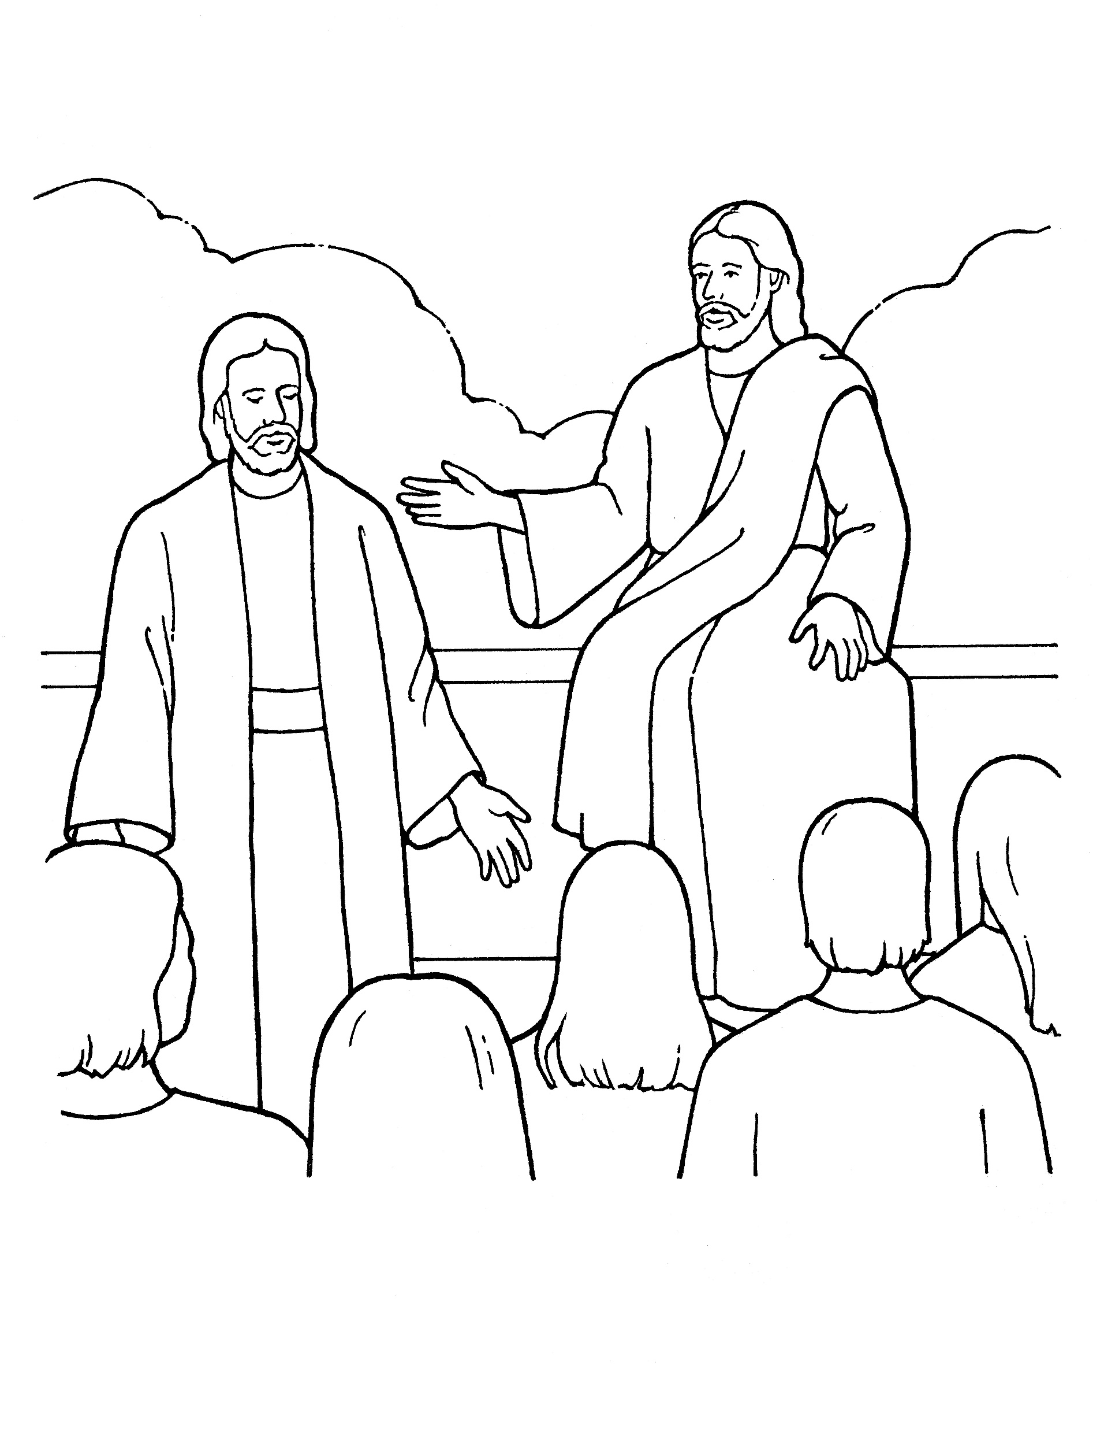
Help me, dear Father,
Notes:
The Church of Jesus Christ of Latter-Day Saints. (n.d). Premortal life: An illustration of Heavenly Father and Jesus Christ presenting the plan in the premortal life, from the nursery manual Behold Your Little Ones (2008), page 15. The Church of Jesus Christ of Latter-Day Saints Media Library. Retrieved Jun. 23, 2023 from https://www.churchofjesuschrist.org/media/image/god-christ-premortal-existence-whittaker-9d7ac2c?lang=eng&collectionId=3cbf78e787498a07417814a31656063f9227b4c6

Slide 17
Making things right
Notes:
The Church of Jesus Christ of Latter-Day Saints. (n.d). Obedience: Choose the right: An illustration of the CTR symbol. The Church of Jesus Christ of Latter-Day Saints Media Library. Retrieved Jun. 23, 2023 from https://www.churchofjesuschrist.org/media/image/ctr-logo-62da351?lang=eng&collectionId=28d3f141a27f495281ed04d6ae40d8b4

Slide 18
Help me each day, Father, I pray;
Notes:
Stott, Apryl. (2008, Sept.). I can pray to Heavenly Father, and he will hear and answer my prayers. Friend. Retrieved Jun. 23, 2023 from https://www.churchofjesuschrist.org/bc/content/shared/content/images/gospel-library/magazine/fr08sep48_color.jpg

Slide 19
Making things right and changing my ways.
Notes:
The Church of Jesus Christ of Latter-Day Saints. (n.d). Helping one another: Two children helping another child who has dropped her belongings. The Church of Jesus Christ of Latter-Day Saints Media Library. Retrieved Jun. 23, 2023 https://www.churchofjesuschrist.org/media/image/children-helping-playing-3d63704?lang=eng&collectionId=6819ec5df2c64c63bf29fdbba3c60125

Slide 20
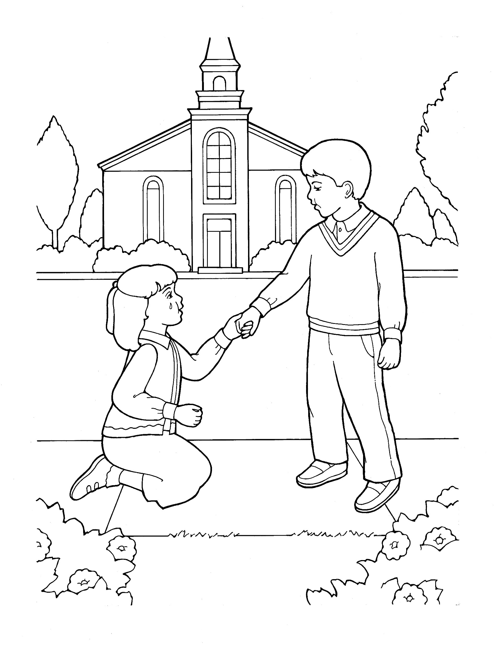
to freely forgive
Notes:
The Church of Jesus Christ of Latter-Day Saints. (n.d). Picture of Christ: A family hangs a picture of Jesus Christ in their home. The Church of Jesus Christ of Latter-Day Saints Media Library. Retrieved Jun. 23, 2023 from https://www.churchofjesuschrist.org/media/image/family-jesus-christ-picture-d104a0c?lang=eng&collectionId=408040e2e846420e8df818f3169c9543

