Slide 1
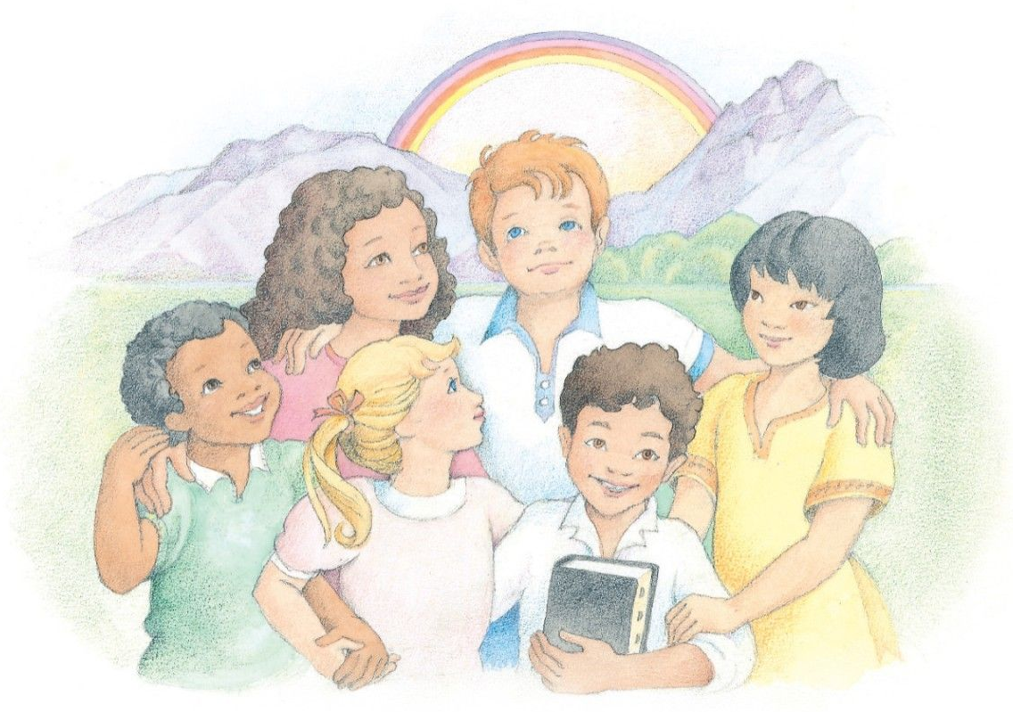
Here We Are Together Children’s Songbook, p. 261 Words: Traditional Music: Old Tune Flipchart: Cherice Montgomery

Slide 2
Here we are together, together, together;
Notes:
Luch, Phyllis. (n.d). Six friends stand together in front of a nature scene. From the Children’s Songbook, page 112, “The Commandments”; watercolor illustration by Phyllis Luch. The Church of Jesus Christ of Latter-Day Saints Media Library. Retrieved Jun. 23, 2023 from https://www.churchofjesuschrist.org/media/image/children-songbook-art-541d19b?lang=eng&collectionId=b0600c95afad44a8b442d37cc9d9b733

Slide 3
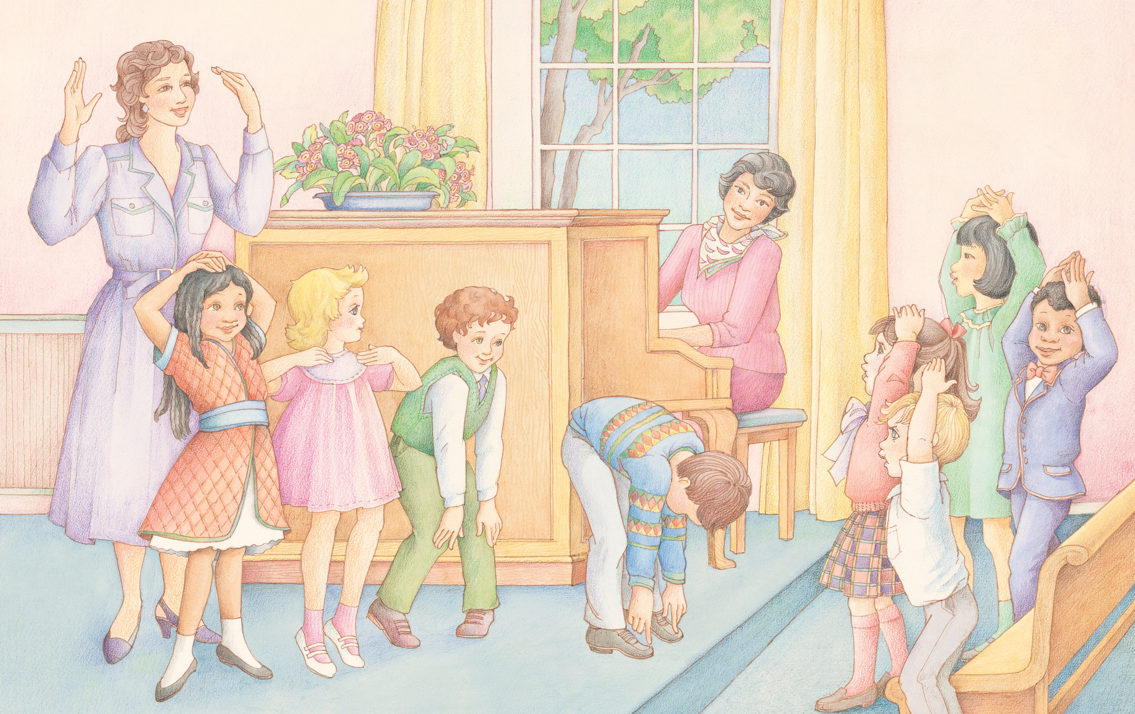
Oh, here we are together in our Primary.
Notes:
Luch, Phyllis. (n.d). A group of Primary children singing a song and doing the motions together. From the section “Fun and Activity” in the Children’s Songbook, pages 250–251; watercolor illustration by Phyllis Luch. The Church of Jesus Christ of Latter-Day Saints Media Library. Retrieved Jun. 23, 2023 from https://www.churchofjesuschrist.org/media/image/lds-primary-children-singing-activity-4d242ad?lang=eng&collectionId=b0600c95afad44a8b442d37cc9d9b733

Slide 4
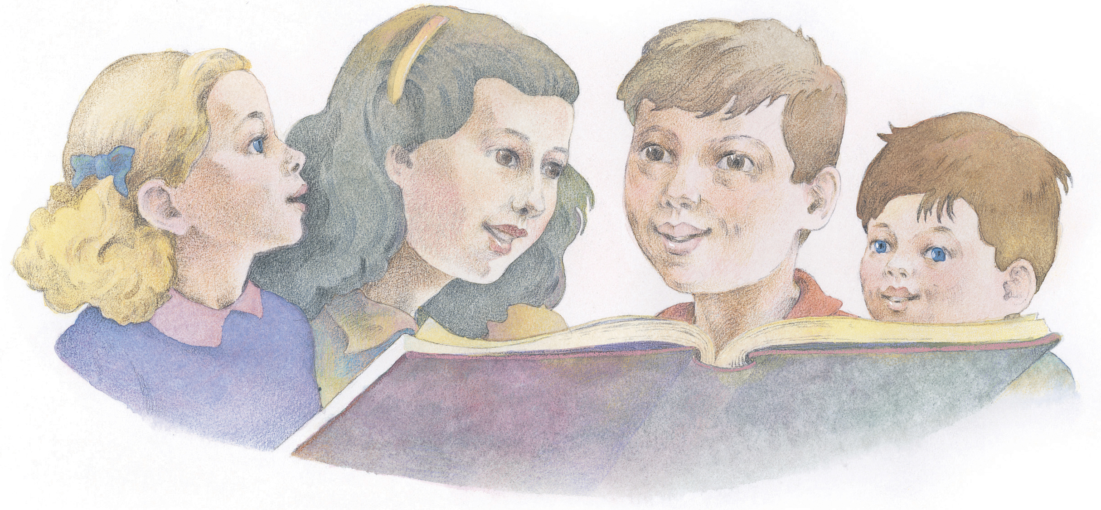
There’s ____ and ____ and ____ and ____;
Notes:
Hull, Richard. (n.d). Four children reading from a book together. From the Children’s Songbook, page 259, “We’re All Together Again”; watercolor illustration by Richard Hull. The Church of Jesus Christ of Latter-Day Saints Media Library. Retrieved Jun. 23, 2023 from https://www.churchofjesuschrist.org/media/image/childrens-songbook-84dd288?lang=eng&collectionId=b0600c95afad44a8b442d37cc9d9b733

Slide 5
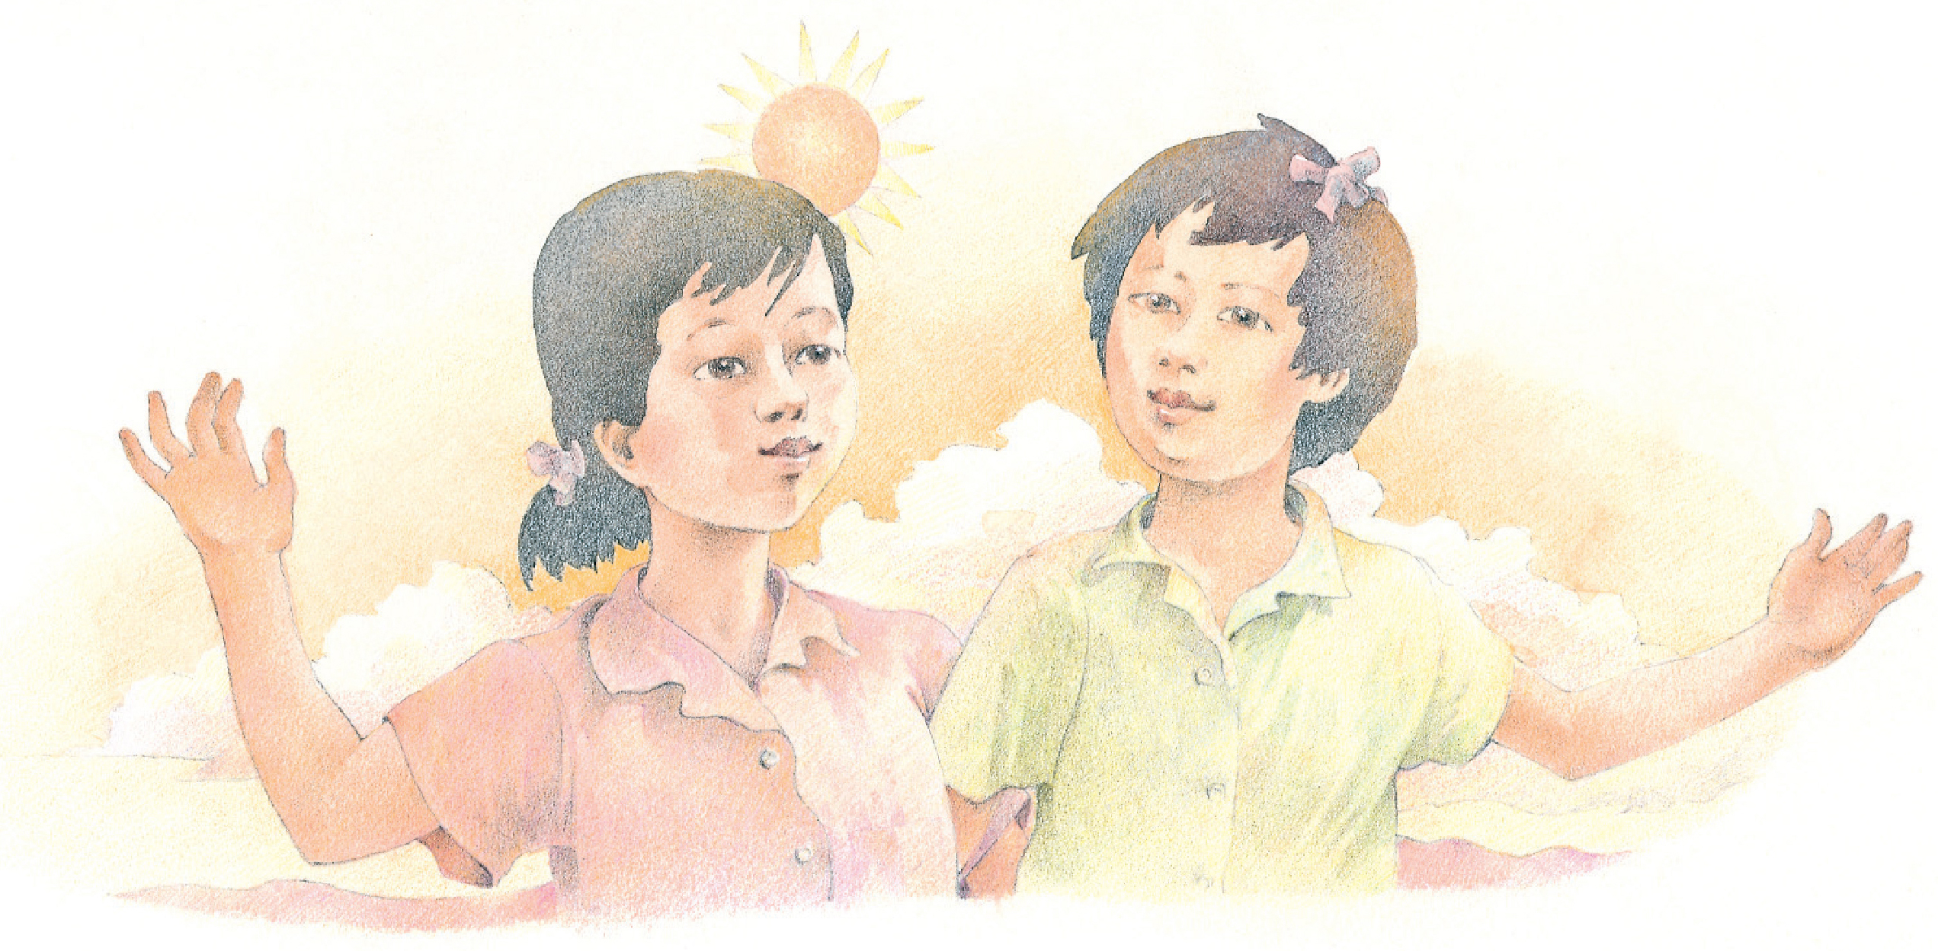
Oh, here we are together this bright, sunny day.
Notes:
Hull, Richard. (n.d). Two friends stand arm in arm in the sunlight. From the Children’s Songbook, page 261, “Here We Are Together”; watercolor illustration by Richard Hull.. The Church of Jesus Christ of Latter-Day Saints Media Library. Retrieved Jun. 23, 2023 from https://www.churchofjesuschrist.org/media/image/children-songbook-art-976153f?lang=eng&collectionId=b0600c95afad44a8b442d37cc9d9b733

Slide 6
Image Credits:
Luch, Phyllis. (n.d). A group of Primary children singing a song and doing the motions together. From the section “Fun and Activity” in the Children’s Songbook, pages 250–251; watercolor illustration by Phyllis Luch. The Church of Jesus Christ of Latter-Day Saints Media Library. Retrieved Jun. 23, 2023 from https://www.churchofjesuschrist.org/media/image/lds-primary-children-singing-activity-4d242ad?lang=eng&collectionId=b0600c95afad44a8b442d37cc9d9b733
Luch, Phyllis. (n.d). Six friends stand together in front of a nature scene. From the Children’s Songbook, page 112, “The Commandments”; watercolor illustration by Phyllis Luch. The Church of Jesus Christ of Latter-Day Saints Media Library. Retrieved Jun. 23, 2023 from https://www.churchofjesuschrist.org/media/image/children-songbook-art-541d19b?lang=eng&collectionId=b0600c95afad44a8b442d37cc9d9b733
Hull, Richard. (n.d). Four children reading from a book together. From the Children’s Songbook, page 259, “We’re All Together Again”; watercolor illustration by Richard Hull. The Church of Jesus Christ of Latter-Day Saints Media Library. Retrieved Jun. 23, 2023 from https://www.churchofjesuschrist.org/media/image/childrens-songbook-84dd288?lang=eng&collectionId=b0600c95afad44a8b442d37cc9d9b733
Hull, Richard. (n.d). Two friends stand arm in arm in the sunlight. From the Children’s Songbook, page 261, “Here We Are Together”; watercolor illustration by Richard Hull.. The Church of Jesus Christ of Latter-Day Saints Media Library. Retrieved Jun. 23, 2023 from https://www.churchofjesuschrist.org/media/image/children-songbook-art-976153f?lang=eng&collectionId=b0600c95afad44a8b442d37cc9d9b733

