Slide 1
Singing Time with Sister Montgomery

Slide 2
This is My Beloved Son, p. 76
Notes:
The Church of Jesus Christ of Latter-day Saints. (n.d.). The First Vision, by Del Parson (62470); GAK 403; Primary manual 1-04; Primary manual 2-38; Primary manual 3-10; Primary manual 5-06; Primary manual 6-40; Primary manual 7-40; Joseph Smith—History 1:14–20. Gospel Media Library. Retrieved May 24, 2020, from https://www.churchofjesuschrist.org/media/image/the-first-vision-fe5db8d?lang=eng

Slide 3
Love One Another, p. 136
Notes:
The Church of Jesus Christ of Latter-day Saints. (n.d.). Be ye kind one to another….Ephesians 4:32. Retrieved May 24, 2020, from
https://www.churchofjesuschrist.org/bc/content/shared/content/images/gospel-library/magazine/fr10feb27_poster.jpg

Slide 4
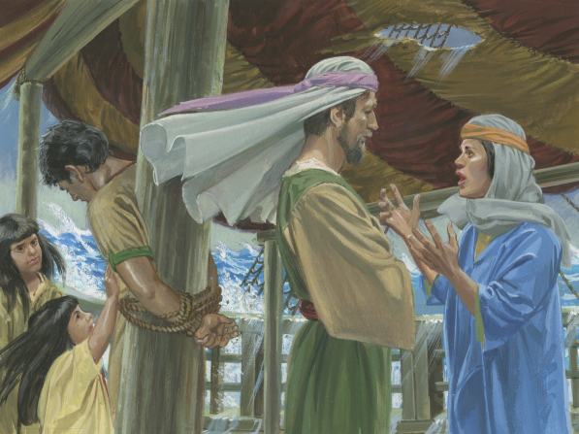
Nephi’s Courage, p. 120
Notes:
The Church of Jesus Christ of Latter-day Saints. (n.d.). Joseph sold into slavery. Gospel Media Library. Retrieved May 24, 2020, from http://media.ldscdn.org/images/media-library/gospel-art/old-testament/joseph-sold-into-slavery-82603-wallpaper.jpg
Thompson, Jerry. (n.d.). Nephi tied up. A painting by Jerry Thompson depicting Nephi tied up on the ship; Primary manual 4-19. Gospel Media Library. Retrieved May 24, 2020, from https://www.churchofjesuschrist.org/media/image/nephi-wife-prayers-mormon-thompson-4db006f?lang=eng

Slide 5
Faith,
p. 96
Notes:
Thompson, Jerry. (n.d.). Angel Appears to Alma and the Sons of Mosiah. Gospel Media Library. Retrieved May 24, 2020, from https://www.churchofjesuschrist.org/media/image/mosiah-alma-angel-mormon-thompson-642df0d?lang=eng

Slide 6
Repentance, p. 98
Notes:
The Church of Jesus Christ of Latter-day Saints. (n.d.). Childhood. A little boy and a little girl fighting over a toy. Gospel Media Library. Retrieved May 24, 2020, from https://www.churchofjesuschrist.org/media-library/images/children-childhood-fighting-toys-2054087?lang=eng

Slide 7
Dare to Do Right, p. 158
Notes:
The Church of Jesus Christ of Latter-day Saints. (n.d.). Childhood. A little boy and a little girl fighting over a toy. Gospel Media Library. Retrieved May 24, 2020, from https://www.churchofjesuschrist.org/media-library/images/children-childhood-fighting-toys-2054087?lang=eng

Slide 8
The Church of Jesus Christ, p. 77
Notes:
Parson, Del. (n.d.). Christ and Children from around the World (Christ with Children), by Del Parson (62190); GAK 608; GAB 116; Matthew 19:13–15; Mark 10:13–16; Luke 18:15–17. Gospel Media Library. Retrieved May 24, 2020, from https://www.churchofjesuschrist.org/media/image/jesus-children-334a1d2?lang=eng

Slide 9
Jesus promises to help us repent and forgive
Notes:
The Church of Jesus Christ of Latter-day Saints. (n.d.). Crucifixion of Christ. Gospel Media Library. Retrieved May 24, 2020, from http://media.ldscdn.org/images/media-library/gospel-art/new-testament/crucifixion-christ-anderson-39598-wallpaper.jpg

Slide 10
I Will Be What I Believe
Notes:
The Church of Jesus Christ of Latter-day Saints. (n.d.). Prayer. Gospel Media Library. Retrieved May 24, 2020, from A boy kneeling by his bed with his eyes closed and arms folded in prayer.

