Slide 1
Singing Time with Sister Montgomery
Image: Prawny
Notes:
Prawny. (2017, Jul. 27). Retrieved May 3, 2020, from https://pixabay.com/illustrations/watercolor-watercolour-paper-2543729/ Used under a Pixabay License. Free for commercial use. No attribution required.

Slide 2
?
Image: Prawny
Notes:
Prawny. (2016, Oct. 27). Retrieved May 3, 2020, from https://pixabay.com/illustrations/watercolour-watercolor-paint-ink-1768921/ Used under a Pixabay License. Free for commercial use. No attribution required.

Slide 3
A Happy Family, p. 198a
?
Image: Open Clipart Vectors
Notes:
Open Clipart Vectors. (2016, Apr. 1). Retrieved May 10, 2020, from https://pixabay.com/vectors/boy-child-comic-characters-dad-1300136/Used under a Pixabay License. Free for commercial use. No attribution required.

Slide 4
?
Image: Prawny
Notes:
Prawny. (2017, Feb. 8). Retrieved April 10, 2020, from https://pixabay.com/illustrations/watercolour-watercolor-paint-ink-2045917/ Used under a Pixabay License. Free for commercial use. No attribution required.

Slide 5
Happy Mother’s Day!
Image: Prawny
Notes:
Prawny. (2016, Oct. 20). Retrieved May 3, 2020, from https://pixabay.com/illustrations/watercolour-paint-dripping-ink-1755734/ Used under a Pixabay License. Free for commercial use. No attribution required.

Slide 6
Mwah
Air Hug
High Five
Image: Prawny
Notes:
Prawny. (2017, Jul. 10). Retrieved May 3, 2020, from https://pixabay.com/illustrations/watercolour-watercolor-paint-blend-2490212/ Used under a Pixabay License. Free for commercial use. No attribution required.

Slide 7
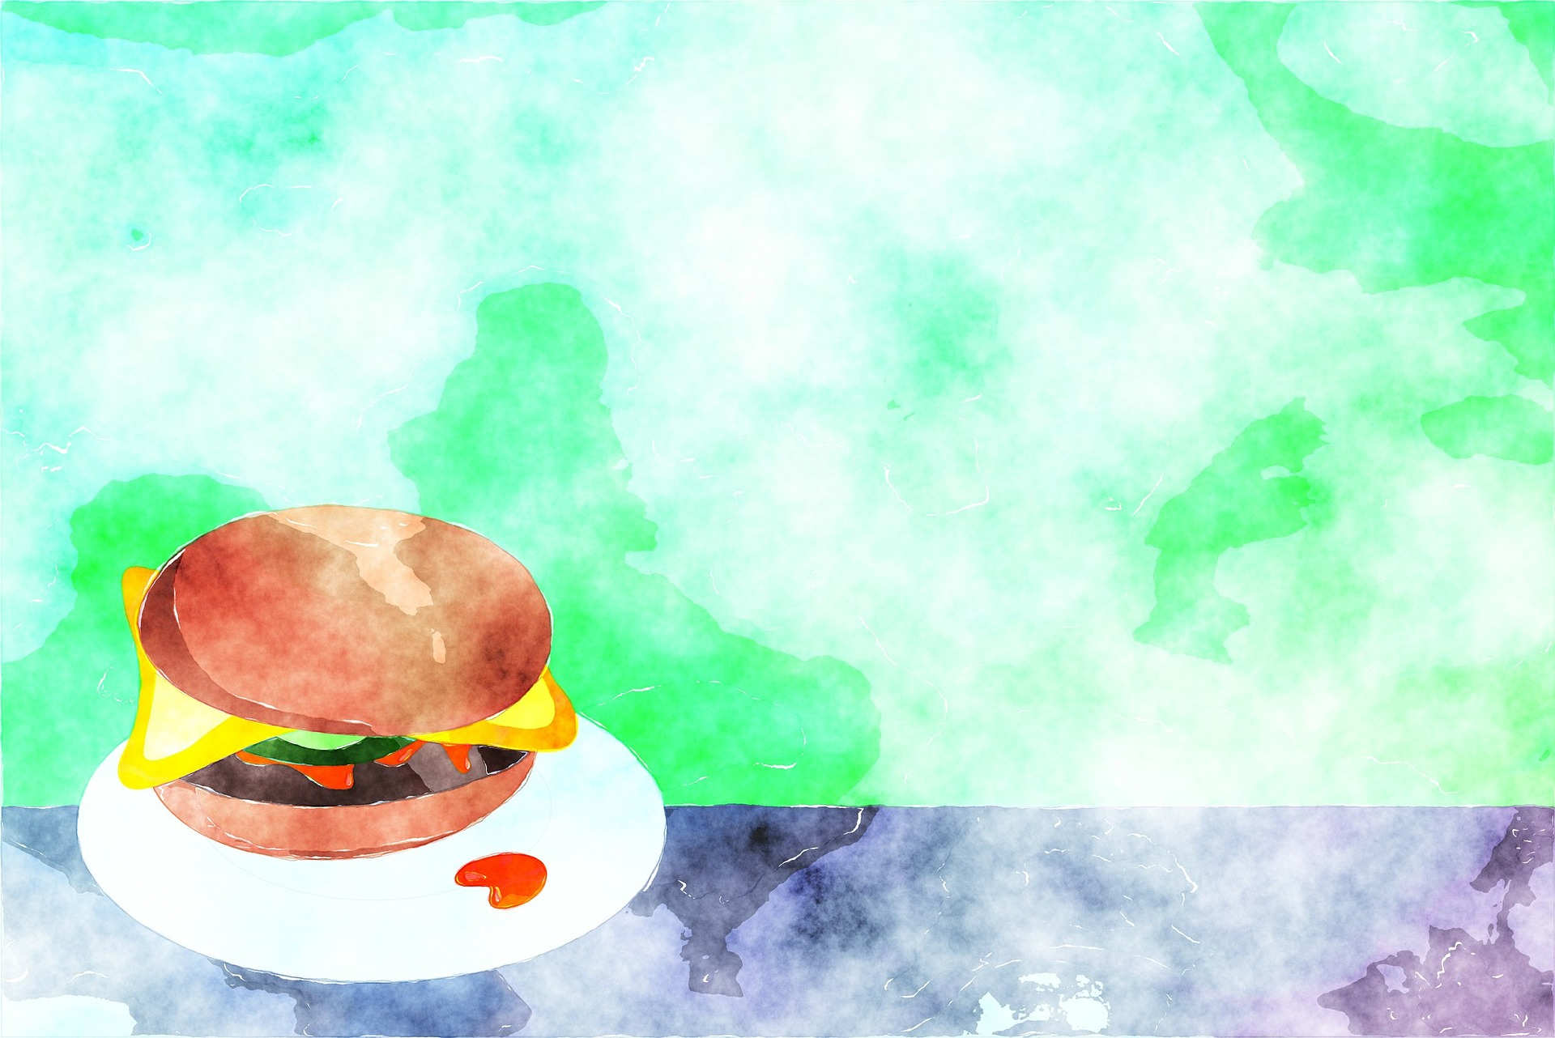
Image: Prawny
Notes:
Prawny. (2017, Feb. 9). Retrieved April 11, 2020, from https://pixabay.com/illustrations/watercolour-watercolor-paint-2053269/ Used under a Pixabay License. Free for commercial use. No attribution required.

Slide 8
Image: Prawny
Notes:
Prawny. (2017, Feb. 10). Retrieved May 3, 2020, from https://pixabay.com/illustrations/watercolour-watercolor-paint-2053660/ Used under a Pixabay License. Free for commercial use. No attribution required.

Slide 9
When We’re Helping,
p. 198b
Image: Prawny
Notes:
Prawny. (2017, Mar. 23). Retrieved May 3, 2020, from https://pixabay.com/illustrations/watercolour-watercolor-art-painting-2168673/ Used under a Pixabay License. Free for commercial use. No attribution required.

Slide 10
We do nice things to show love!
Image: Prawny
Notes:
Prawny. (2017, Jul. 7). Retrieved May 3, 2020, from https://pixabay.com/illustrations/watercolour-watercolor-paint-ink-2482351/ Used under a Pixabay License. Free for commercial use. No attribution required.

Slide 11
I Often
Go Walking,
p. 202
Image: Prawny
Notes:
Prawny. (2017, Feb. 10). Retrieved May 3, 2020, from https://pixabay.com/illustrations/watercolour-watercolor-paint-2053671/ Used under a Pixabay License. Free for commercial use. No attribution required.

Slide 12
Our mothers love us!
Image: Prawny
Notes:
Prawny. (2016, Oct. 27). Retrieved May 3, 2020, from https://pixabay.com/illustrations/watercolour-watercolor-paint-ink-1768988/ Used under a Pixabay License. Free for commercial use. No attribution required.

Slide 13
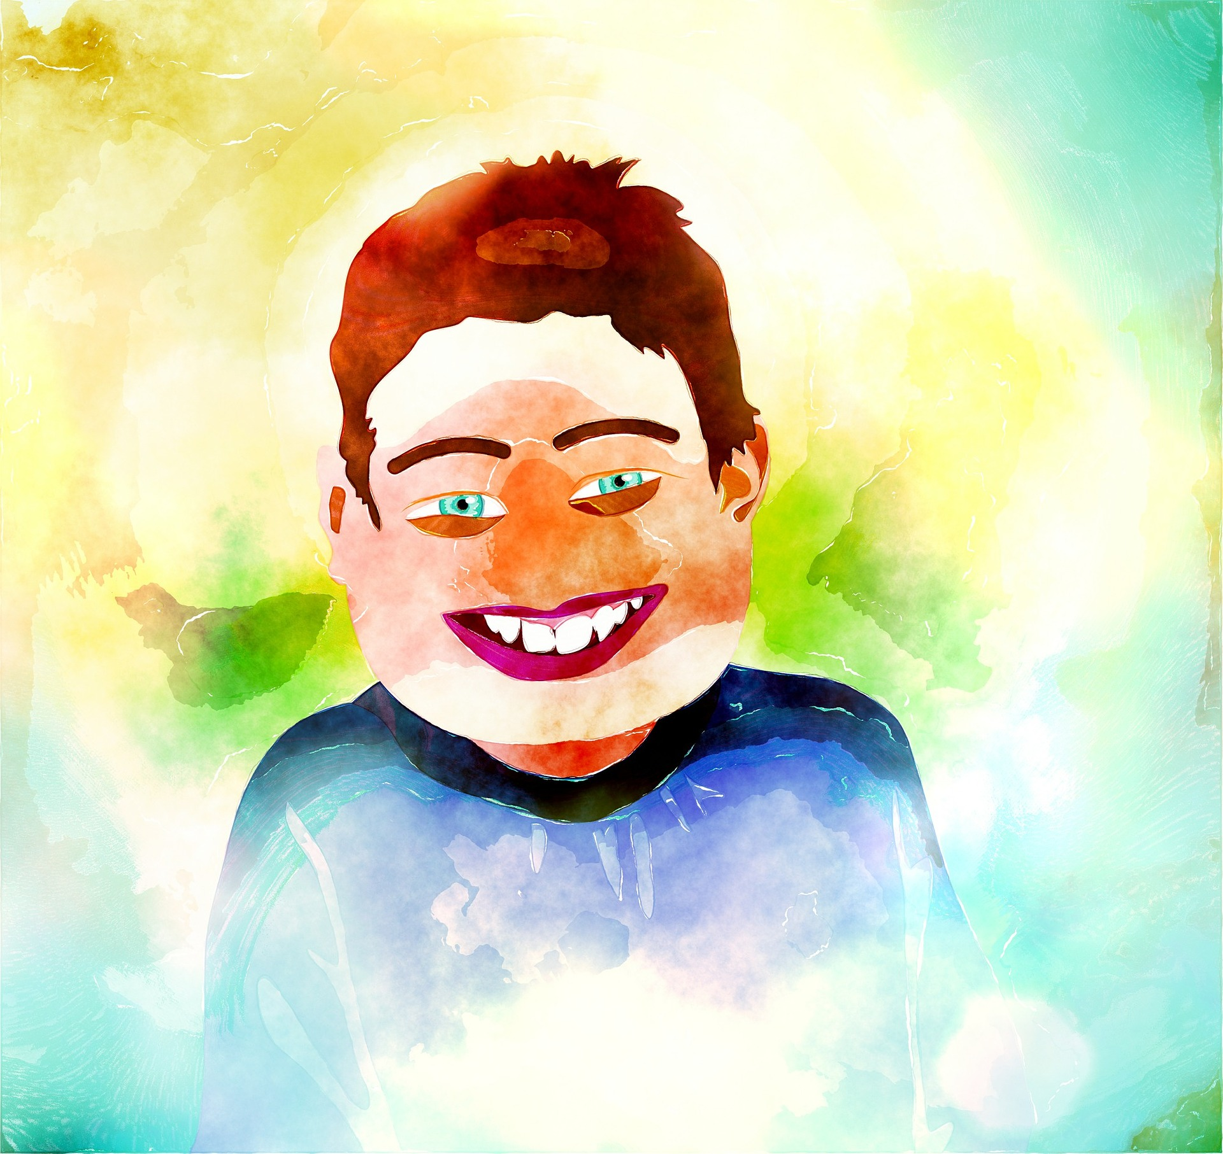
Our mothers want
us to be happy!
Image: Prawny
Notes:
Prawny. (2017, Mar. 22). Retrieved May 3, 2020, from https://pixabay.com/illustrations/watercolour-watercolor-ink-stain-2164998/ Used under a Pixabay License. Free for commercial use. No attribution required.

Slide 14
Teach Me
to Walk
in the Light, p. 177
Image: Prawny
Notes:
Prawny. (2017, Feb. 9). Retrieved May 3, 2020, from https://pixabay.com/illustrations/watercolour-watercolor-paint-2052316/ Used under a Pixabay License. Free for commercial use. No attribution required.

Slide 15
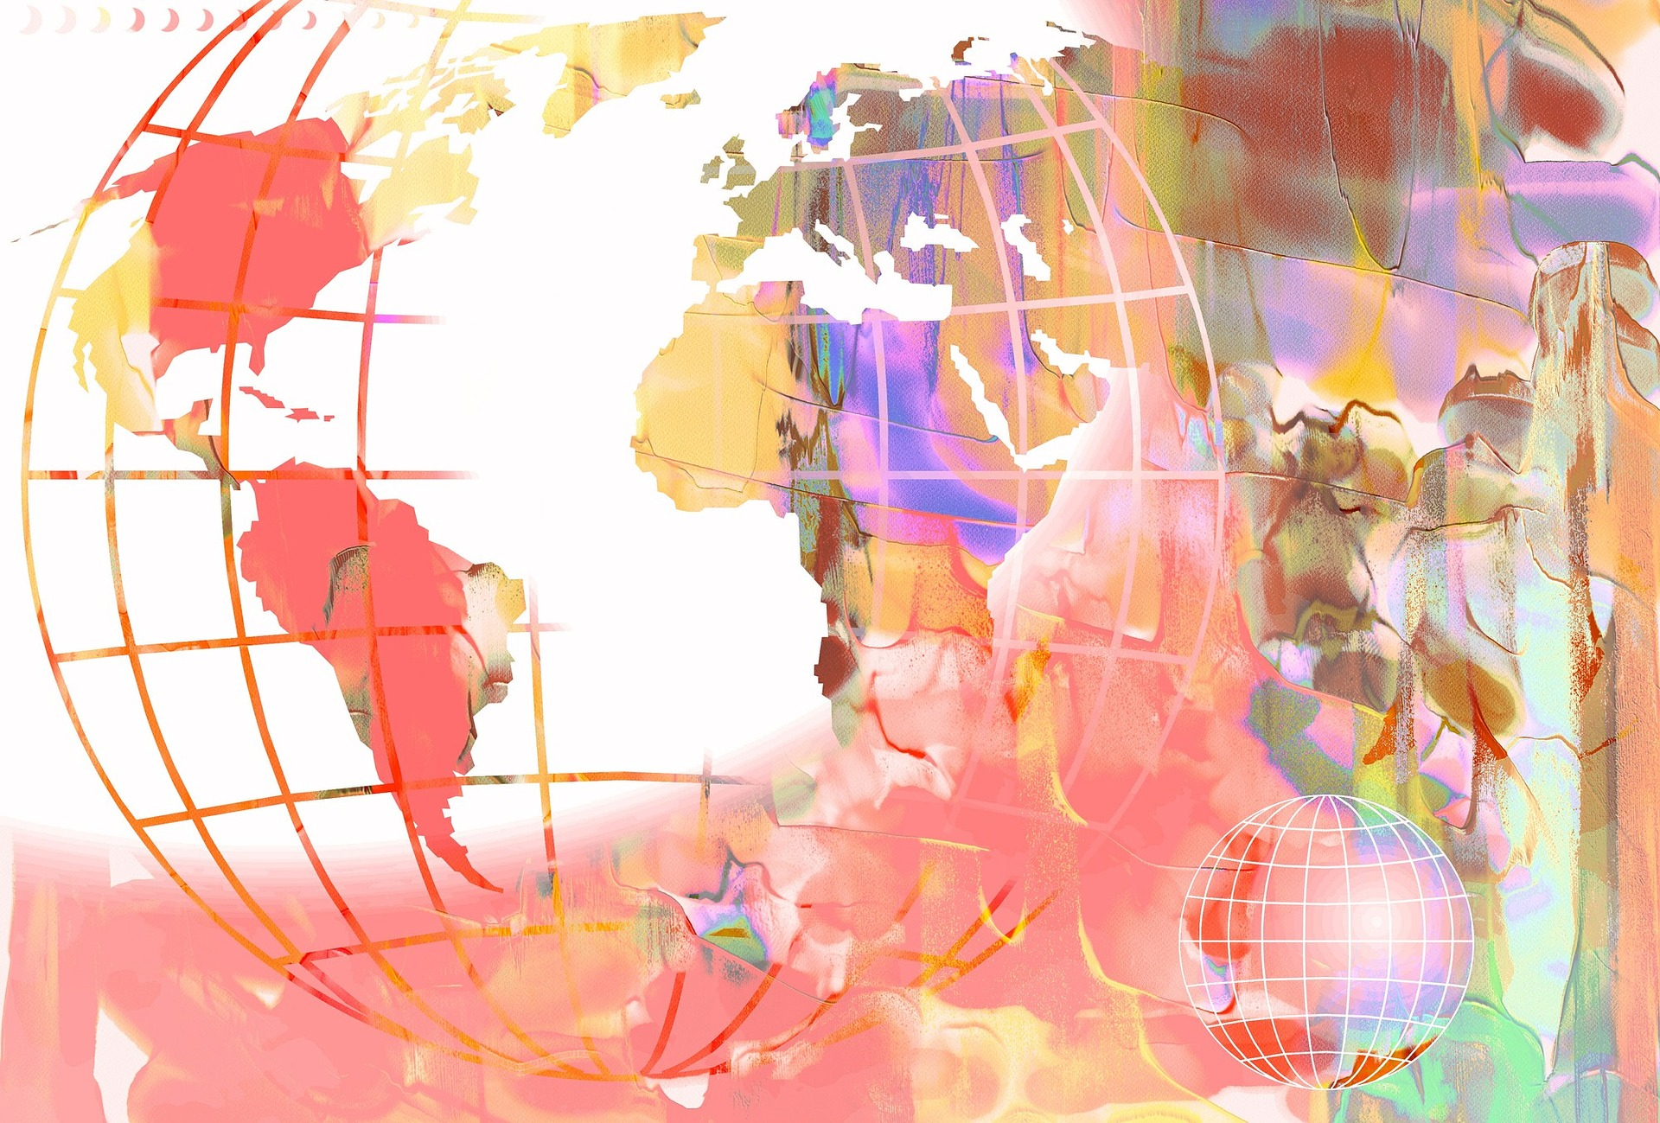
Our mothers
want
us
safe
Image: Prawny
Notes:
Prawny. (2016, Oct. 27). Retrieved May 3, 2020, from https://pixabay.com/illustrations/watercolour-watercolor-paint-ink-1768912/ Used under a Pixabay License. Free for commercial use. No attribution required.

Slide 16
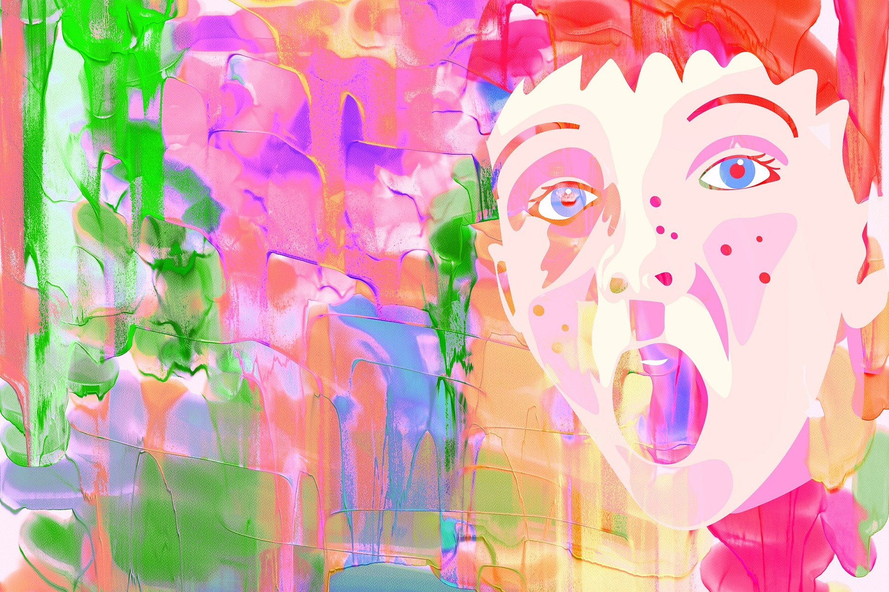
Quickly I’ll Obey, p. 197b
Image: Prawny
Notes:
Prawny. (2016, Oct. 26). Retrieved May 3, 2020, from https://pixabay.com/illustrations/watercolour-watercolor-paint-ink-1766301/ Used under a Pixabay License. Free for commercial use. No attribution required.

Slide 17
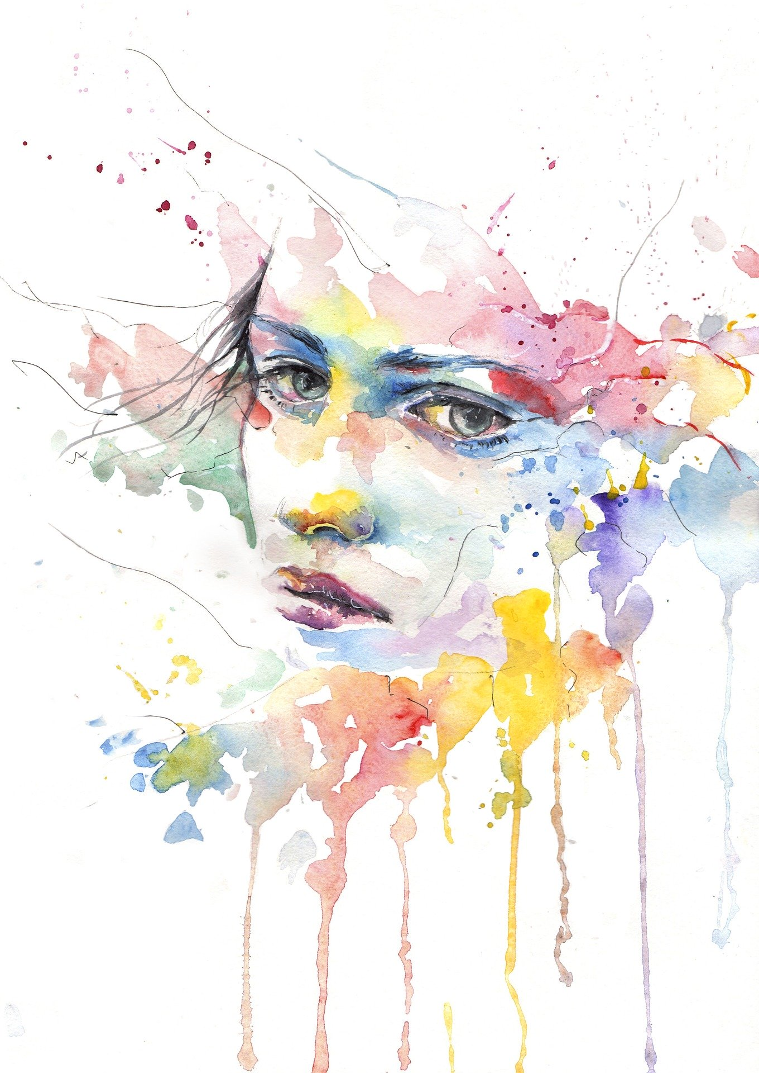
Thank your mother for something she’s taught you
Image: Prawny
Notes:
Haynak, Alexandra (tsukiko-kiyomidzu). (2017, Jan. 27). Retrieved May 3, 2020, from https://pixabay.com/illustrations/people-girl-woman-face-portrait-2013447/ Used under a Pixabay License. Free for commercial use. No attribution required.

Slide 18
Text
What Mother’s Day song will you sing today?
Image: Prawny
Notes:
Prawny. (2017, Apr. 8). Retrieved April 11, 2020, https://pixabay.com/illustrations/watercolour-watercolor-painting-2208200/ Used under a Pixabay License. Free for commercial use. No attribution required.

Slide 19
Dearest Mother, p. 206b

Slide 20
I Often Go Walking, p. 202

Slide 21
Mother Dear, p. 206a

Slide 22
Mother, I Love You, p. 206

Slide 23
My Mother Dear, p. 203

Slide 24
Songs
A Happy Family
When We’re Helping, We’re Happy
I Often Go Walking
Teach Me to Walk in the Light
Quickly I’ll Obey

