Slide 1
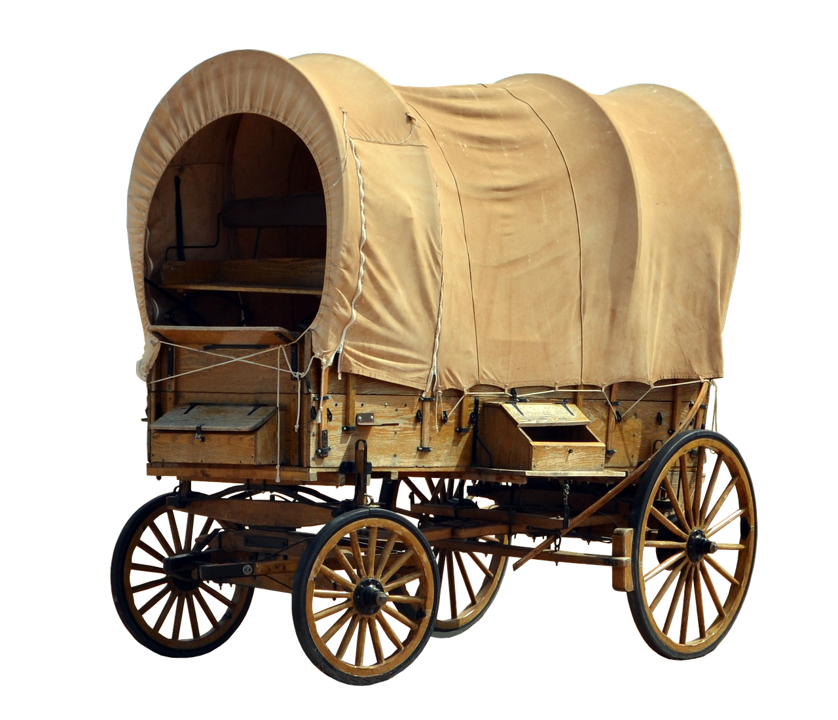
Pictures for Primary Pioneer Activity Day
Compiled by Cherice Montgomery
2024

Slide 2
Image: Momentmal
Notes:
Momentmal. (2017, Nov. 21). Pixabay. Retrieved Feb. 16, 2024 from https://pixabay.com/photos/covered-wagon-usa-america-dare-2967229/ Free for use under the Pixabay License.

Slide 3
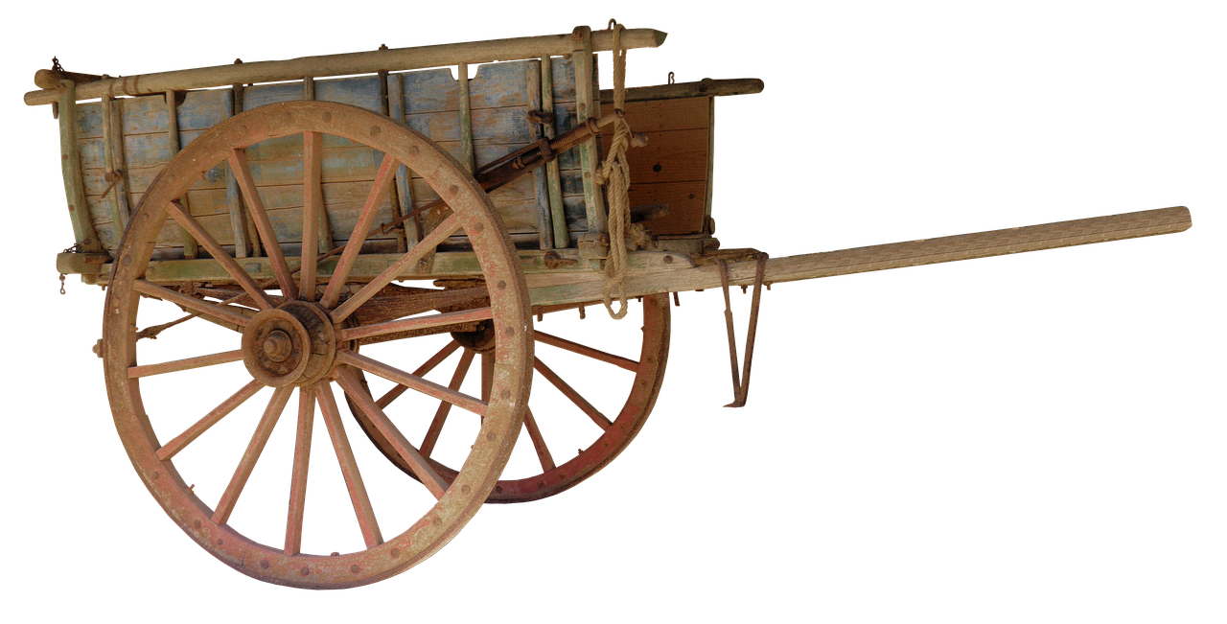
Image: Momentmal
Notes:
Momentmal. (2017, Oct. 11). Pixabay. Retrieved Feb. 16, 2024 from https://pixabay.com/photos/carts-wooden-cart-handcart-dare-2845274/ Free for use under the Pixabay License.

Slide 4
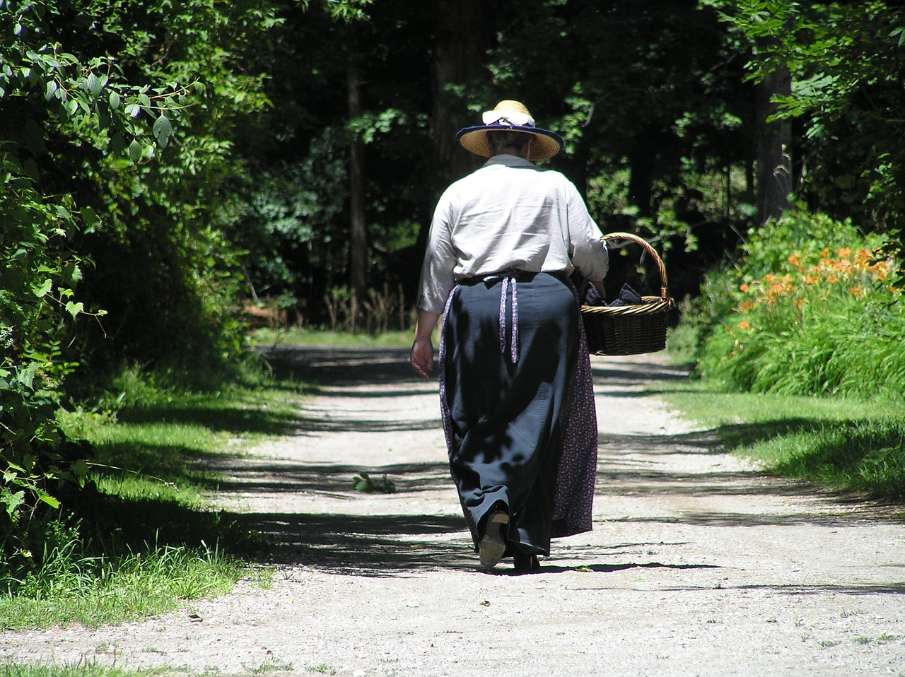
Image: Writerchick
Notes:
Writerchick. (2015, Feb. 15). Pixabay. Retrieved Feb. 16, 2024 from https://pixabay.com/photos/pioneer-walking-path-outdoors-637838/ Free for use under the Pixabay License.

Slide 5
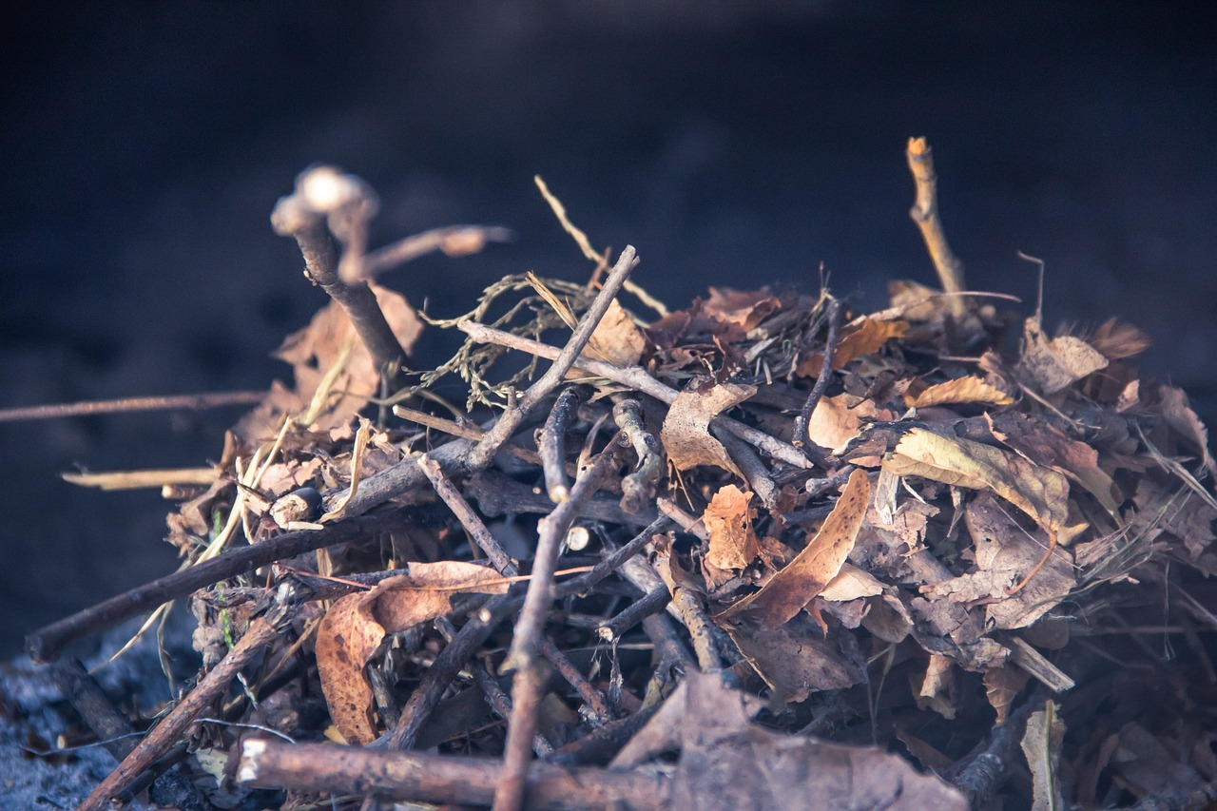
Image: Ha11ok
Notes:
Ha11ok. (2019, May 5). Pixabay. Retrieved Feb. 16, 2024 from https://pixabay.com/photos/bread-furnace-firebox-kindling-4183105/ Free for use under the Pixabay License.

Slide 6
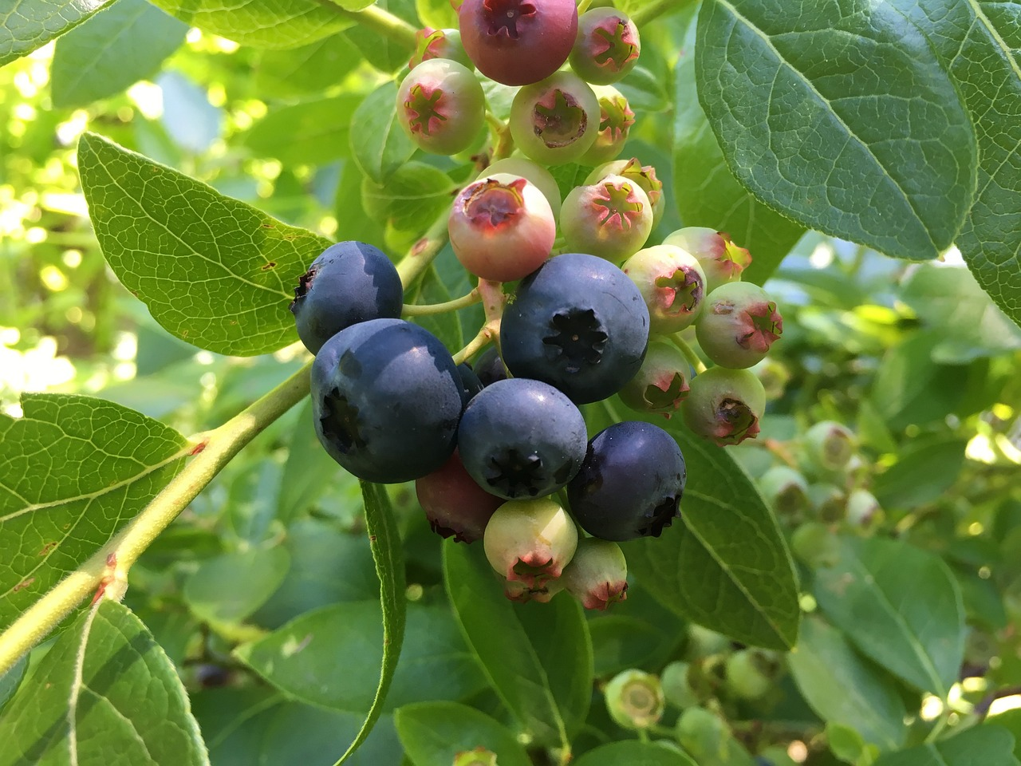
Image: Jensb
Notes:
Jensb. (2016, Aug. 3). Pixabay. Retrieved Feb. 16, 2024 from https://pixabay.com/photos/blueberries-shrub-sweet-1567336/ Free for use under the Pixabay License.
Alternate image: Woroniecki, Joshua. (2021, Jun. 23). Pixabay. Retrieved Feb. 16, 2024 from https://pixabay.com/photos/blueberries-picking-harvest-farm-6359432/ Free for use under the Pixabay License.

Slide 7
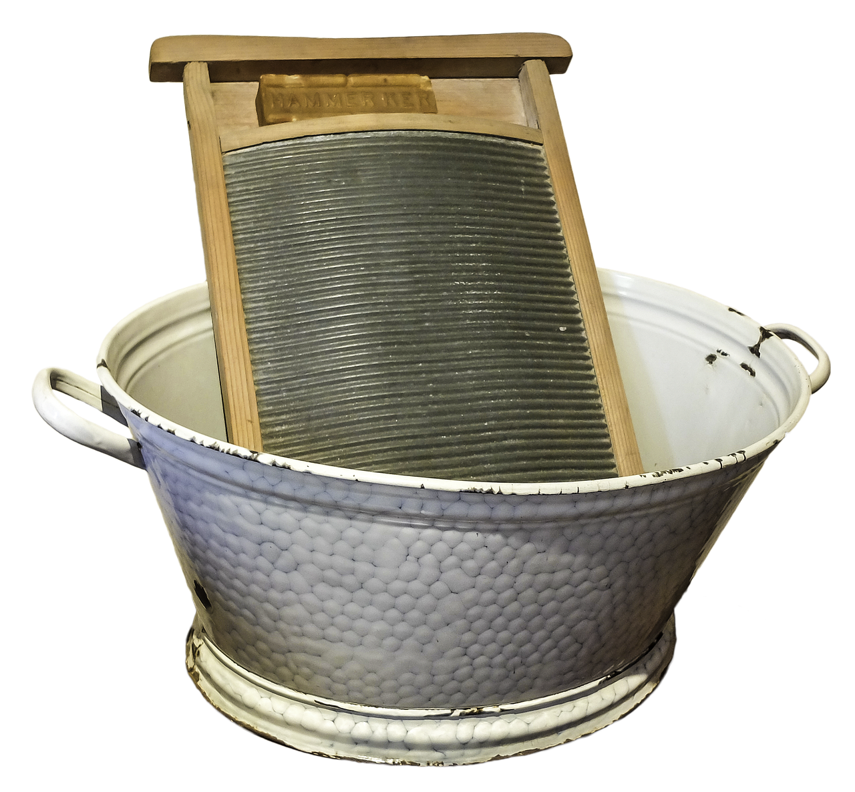
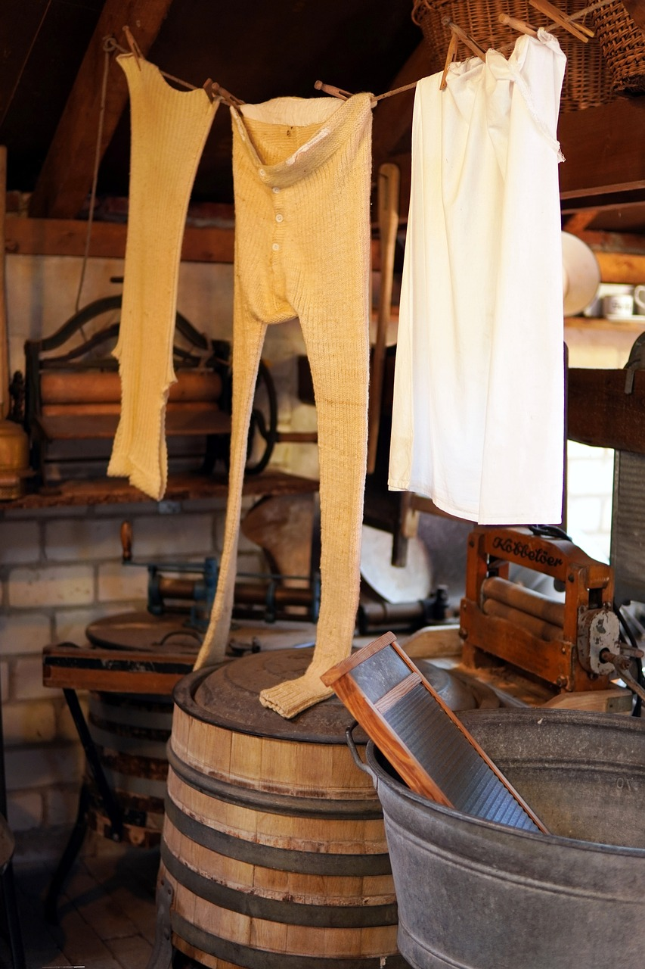
Image: Thomas Wolter
Image: Matthiasboeckel
Notes:
Wolter, Thomas. (2015, Oct. 12). Pixabay. Retrieved Feb. 16, 2024 from https://pixabay.com/photos/washboard-to-wash-tub-old-formerly-982990/ Free for use under the Pixabay License.
Matthiasboeckel. (2022, Apr. 26). Pixabay. Retrieved Feb. 16, 2024 from https://pixabay.com/photos/washroom-laundry-laundry-tub-7158379/ Free for use under the Pixabay License.

Slide 8
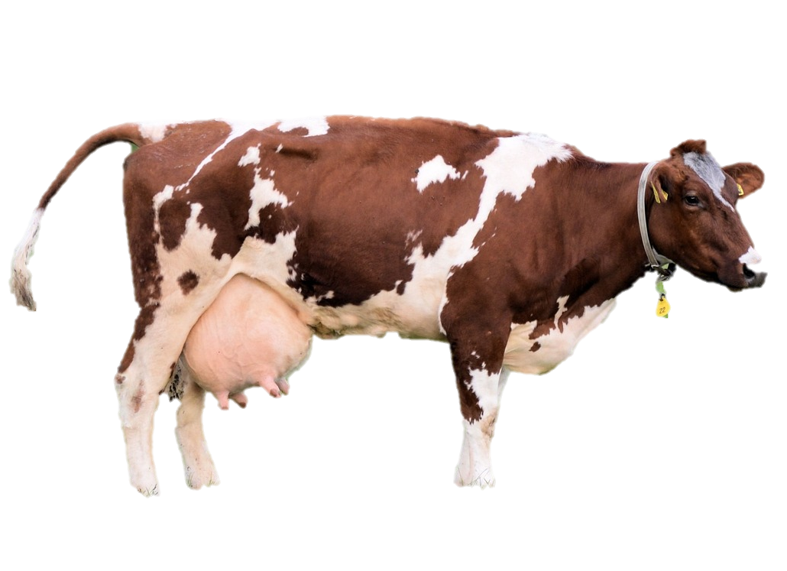
Image: Public Domain Pictures
Notes:
Public Domain Pictures. (2013, Nov. 21). Pixabay. Retrieved Feb. 16, 2024 https://pixabay.com/photos/cow-farm-animal-cattle-milk-rural-215839/ Free for use under the Pixabay License.

Slide 9
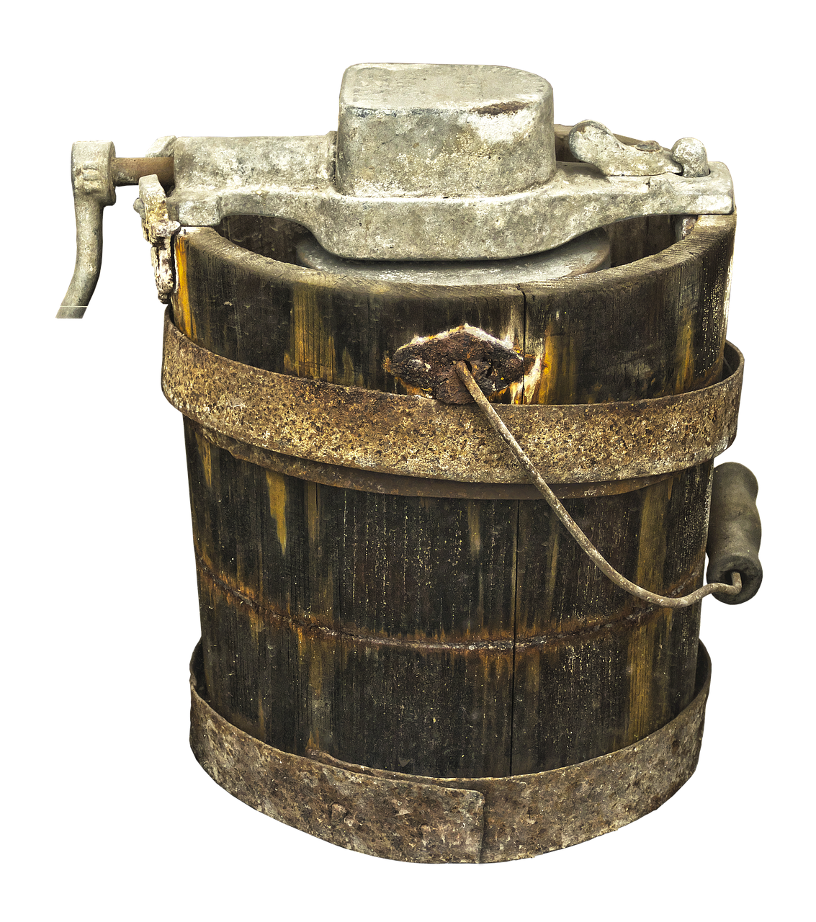
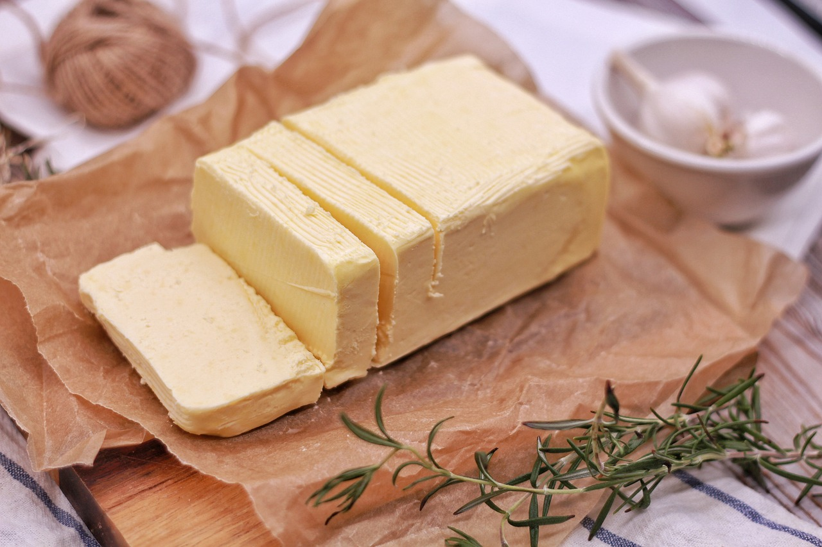
Image: Anterate
Image: Rodeopix
Notes:
Anaterate. (2018, Apr. 11). Pixabay. Retrieved Feb. 16, 2024 from https://pixabay.com/photos/wooden-bucket-container-butter-churn-3314779/ Free for use under the Pixabay License.
Rodeopix. (2018, Feb. 24). Pixabay. Retrieved Feb. 16, 2024 from https://pixabay.com/photos/food-butter-table-milk-3179853/ Free for use under the Pixabay License.

Slide 10
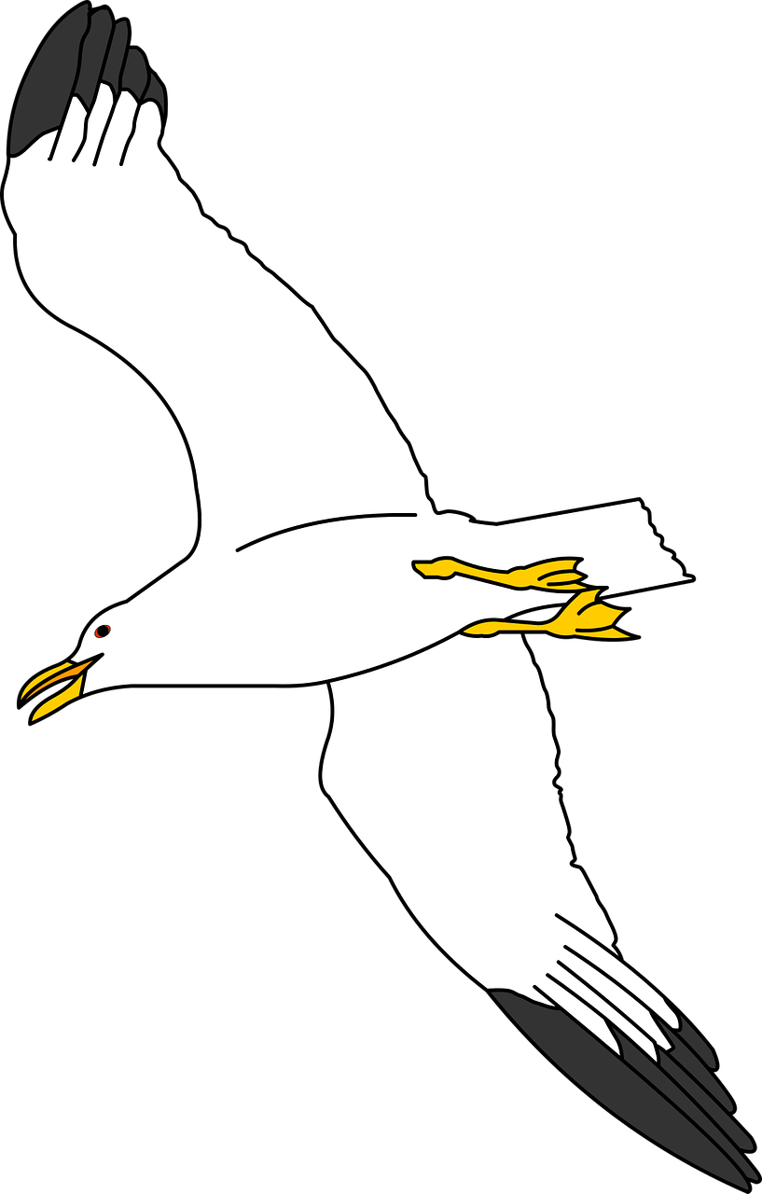
Images: GDJ
Images: Mdherren
Notes:
Mdherren. (2018, Dec. 23). Pixabay. Retrieved Feb. 16, 2024 from https://pixabay.com/vectors/seagull-ocean-avian-wildlife-sea-3891955/ Free for use under the Pixabay License.
GDJ. (2020, May 13). Pixabay. Retrieved Feb. 16, 2024 from https://pixabay.com/vectors/grasshopper-cricket-silhouette-5164442/ Free for use under the Pixabay License.

Slide 11
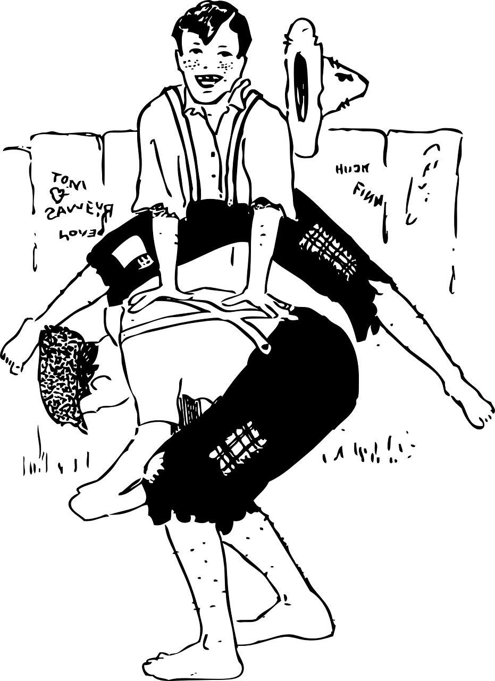
Image: Clker-Free-Vector-Images
Notes:
Clker-Free-Vector-Images. (2012, Apr. 12). Pixabay. Retrieved Feb. 16, 2024 from https://pixabay.com/vectors/boys-game-old-fashioned-leap-frog-33654/ Free for use under the Pixabay License.

Slide 12
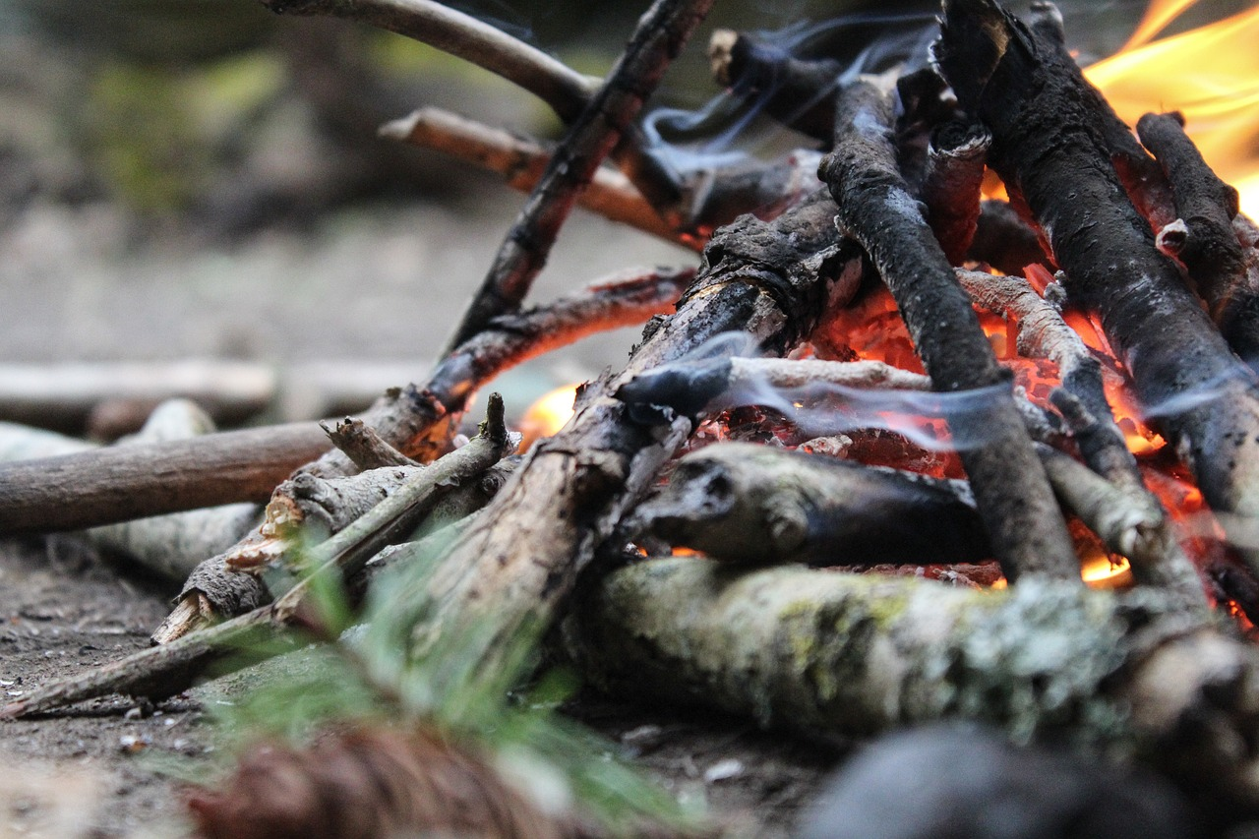
Image: NatWhitePhotography
Notes:
NatWhitePhotography. (2017, Jul. 12). Pixabay. Retrieved Feb. 16, 2024 from https://pixabay.com/photos/campire-fire-summer-camp-wood-2494721/ Free for use under the Pixabay License.

Slide 13
Leave your wagons here!
¡Dejen sus carromatos aquí!
Notes:
Momentmal. (2017, Nov. 21). Pixabay. Retrieved Feb. 16, 2024 from https://pixabay.com/photos/covered-wagon-usa-america-dare-2967229/ Free for use under the Pixabay License.

Slide 14
They pulled handcarts.
Tiraron de carros de mano.
Notes:
Momentmal. (2017, Oct. 11). Pixabay. Retrieved Feb. 16, 2024 from https://pixabay.com/photos/carts-wooden-cart-handcart-dare-2845274/ Free for use under the Pixabay License.

Slide 15
They walked.
Caminaron.
Notes:
Writerchick. (2015, Feb. 15). Pixabay. Retrieved Feb. 16, 2024 from https://pixabay.com/photos/pioneer-walking-path-outdoors-637838/ Free for use under the Pixabay License.

Slide 16
They gathered wood.
Recogieron leña.
Notes:
Ha11ok. (2019, May 5). Pixabay. Retrieved Feb. 16, 2024 from https://pixabay.com/photos/bread-furnace-firebox-kindling-4183105/ Free for use under the Pixabay License.

Slide 17
They picked berries.
Recogieron bayas.
Notes:
Jensb. (2016, Aug. 3). Pixabay. Retrieved Feb. 16, 2024 from https://pixabay.com/photos/blueberries-shrub-sweet-1567336/ Free for use under the Pixabay License.
Alternate image: Woroniecki, Joshua. (2021, Jun. 23). Pixabay. Retrieved Feb. 16, 2024 from https://pixabay.com/photos/blueberries-picking-harvest-farm-6359432/ Free for use under the Pixabay License.

Slide 18
They washed and hung clothes.
Lavaron y colgaron la ropa.
Notes:
Wolter, Thomas. (2015, Oct. 12). Pixabay. Retrieved Feb. 16, 2024 from https://pixabay.com/photos/washboard-to-wash-tub-old-formerly-982990/ Free for use under the Pixabay License.
Matthiasboeckel. (2022, Apr. 26). Pixabay. Retrieved Feb. 16, 2024 from https://pixabay.com/photos/washroom-laundry-laundry-tub-7158379/ Free for use under the Pixabay License.

Slide 19
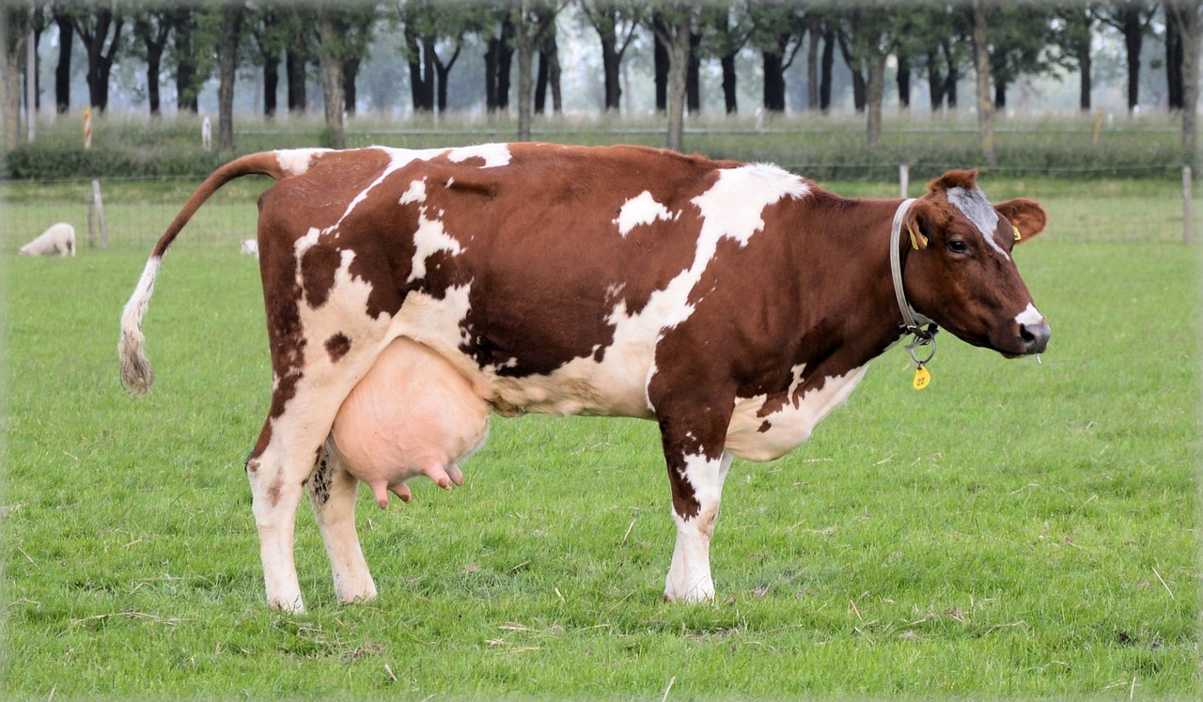
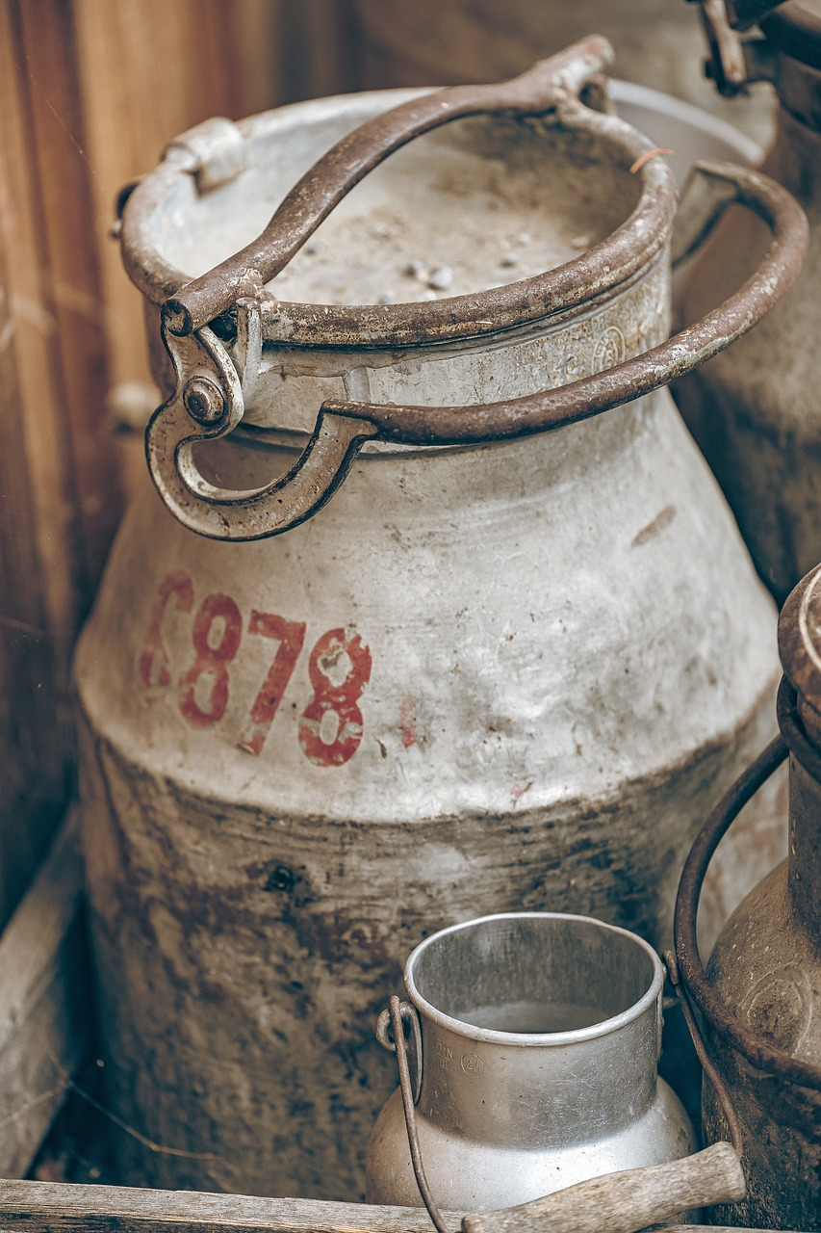
They milked the cow.
Ellos ordeñaron a la vaca.
Notes:
Daschorsch. (2022, Aug. 10). Pixabay. Retrieved Feb. 16, 2024 https://pixabay.com/photos/milk-can-old-milk-can-milk-jug-7378105/ Free for use under the Pixabay License.
Public Domain Pictures. (2013, Nov. 21). Pixabay. Retrieved Feb. 16, 2024 https://pixabay.com/photos/cow-farm-animal-cattle-milk-rural-215839/ Free for use under the Pixabay License.

Slide 20
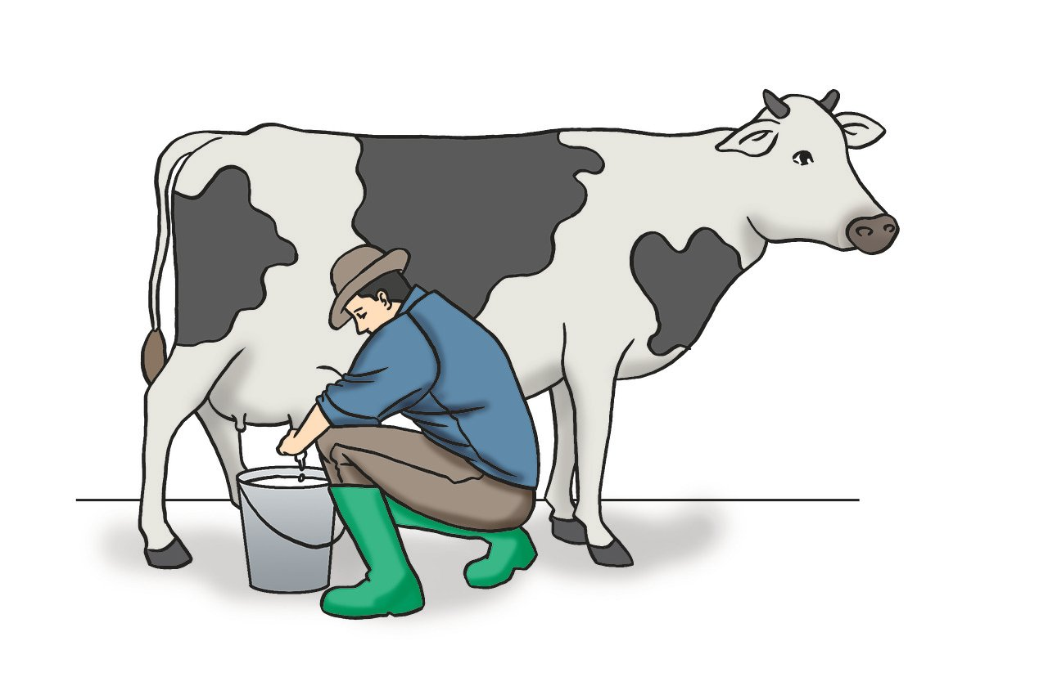
They milked the cow.
Ellos ordeñaron a la vaca.
Notes:
Larsninoy110. (2017, Dec. 14). Pixabay. Retrieved Feb. 16, 2024 https://pixabay.com/illustrations/cow-milking-dairy-milk-animal-3014201/ Free for use under the Pixabay License.

Slide 21
They churned butter.
Hicieron mantequilla.
Notes:
Anaterate. (2018, Apr. 11). Pixabay. Retrieved Feb. 16, 2024 from https://pixabay.com/photos/wooden-bucket-container-butter-churn-3314779/ Free for use under the Pixabay License.
Rodeopix. (2018, Feb. 24). Pixabay. Retrieved Feb. 16, 2024 from https://pixabay.com/photos/food-butter-table-milk-3179853/ Free for use under the Pixabay License.

Slide 22
They watched the seagulls eat the crickets.
Observaron las gaviotas comer los grillos.
Notes:
Mdherren. (2018, Dec. 23). Pixabay. Retrieved Feb. 16, 2024 from https://pixabay.com/vectors/seagull-ocean-avian-wildlife-sea-3891955/ Free for use under the Pixabay License.
GDJ. (2020, May 13). Pixabay. Retrieved Feb. 16, 2024 from https://pixabay.com/vectors/grasshopper-cricket-silhouette-5164442/ Free for use under the Pixabay License.

Slide 23
They played games.
Jugaron juegos.
Notes:
Clker-Free-Vector-Images. (2012, Apr. 12). Pixabay. Retrieved Feb. 16, 2024 from https://pixabay.com/vectors/boys-game-old-fashioned-leap-frog-33654/ Free for use under the Pixabay License.

Slide 24
They built campfires.
Construyeron fogatas.
Notes:
NatWhitePhotography. (2017, Jul. 12). Pixabay. Retrieved Feb. 16, 2024 from https://pixabay.com/photos/campire-fire-summer-camp-wood-2494721/ Free for use under the Pixabay License.

