Slide 1

Singing Time with Sis. Montgomery
Image: The Cozy Cottage
Notes:
The Cozy Cottage. (2018, Apr. 15). By small and simple things FHE. The Cozy Cottage. Retrieved July 26, 2020, from https://www.thecozyredcottage.com/2018/04/small-and-simple-things-fhe.html
Direct link: https://drive.google.com/file/d/1foWKoqE8G_ewYQYpQuwz1JFCXtHG-akk/view

Slide 2

Can you think of something really small?
Image: Microsoft
Notes:
Microsoft.

Slide 3


2 minute Scavenger Hunt
Search, Ponder, & Pray, 109
Image: Hebi B
Notes:
B, Hebi (422737). (2014, Oct. 14). Pixabay. Retrieved July 26, 2020, from https://pixabay.com/photos/google-www-online-search-search-485611/ Used under a Pixabay License. Free for commercial use. No attribution required.
Microsoft Icons. House. Retrieved July 26, 2020.

Slide 4

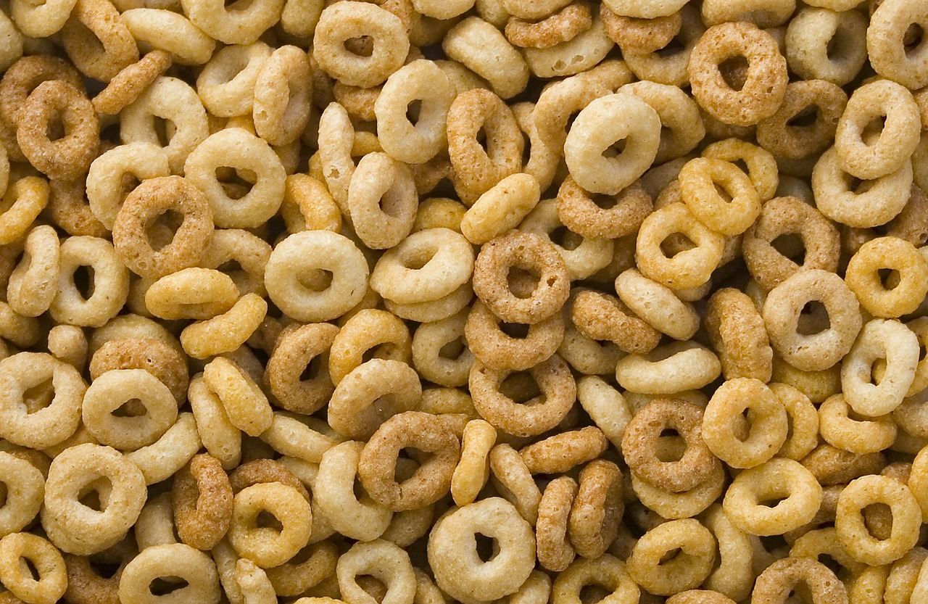
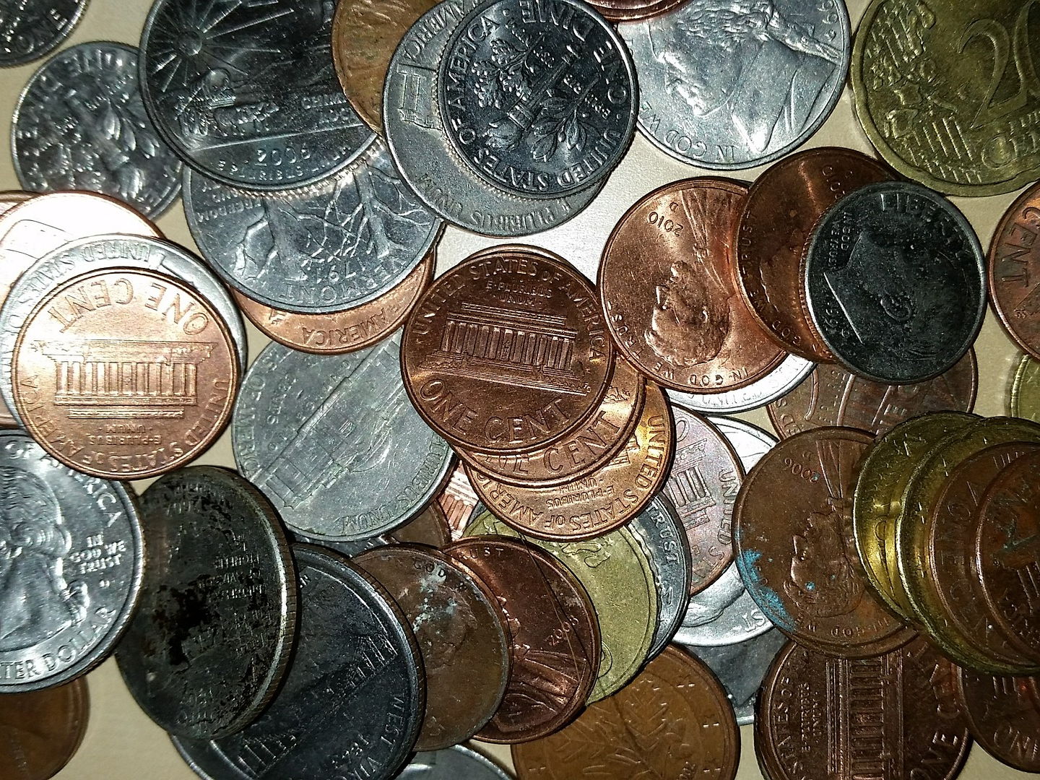
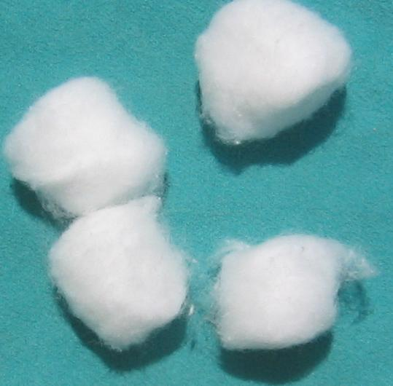
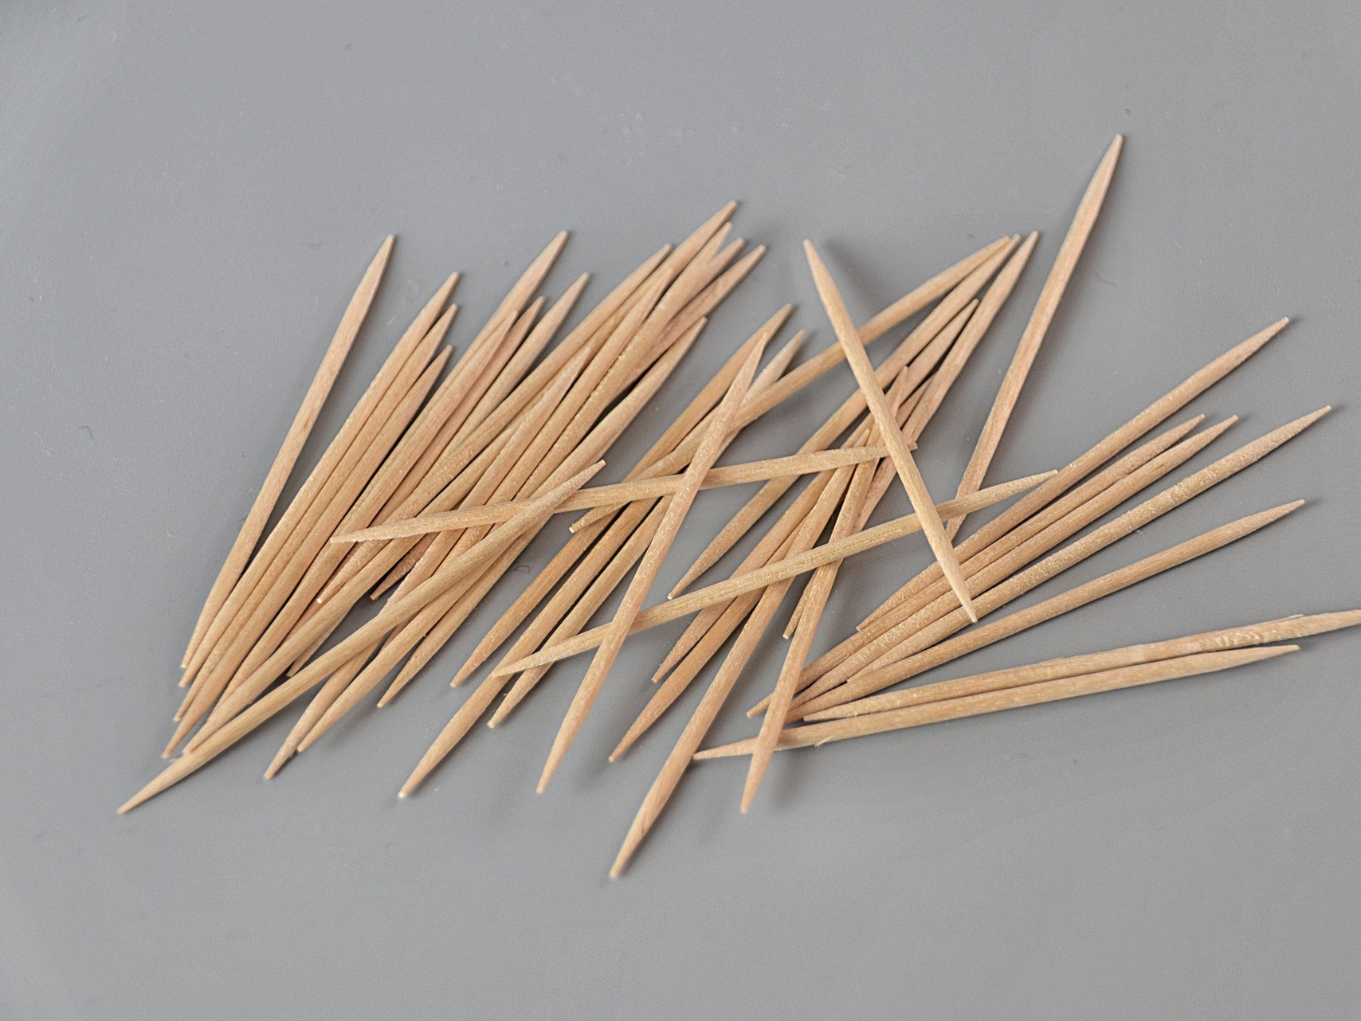
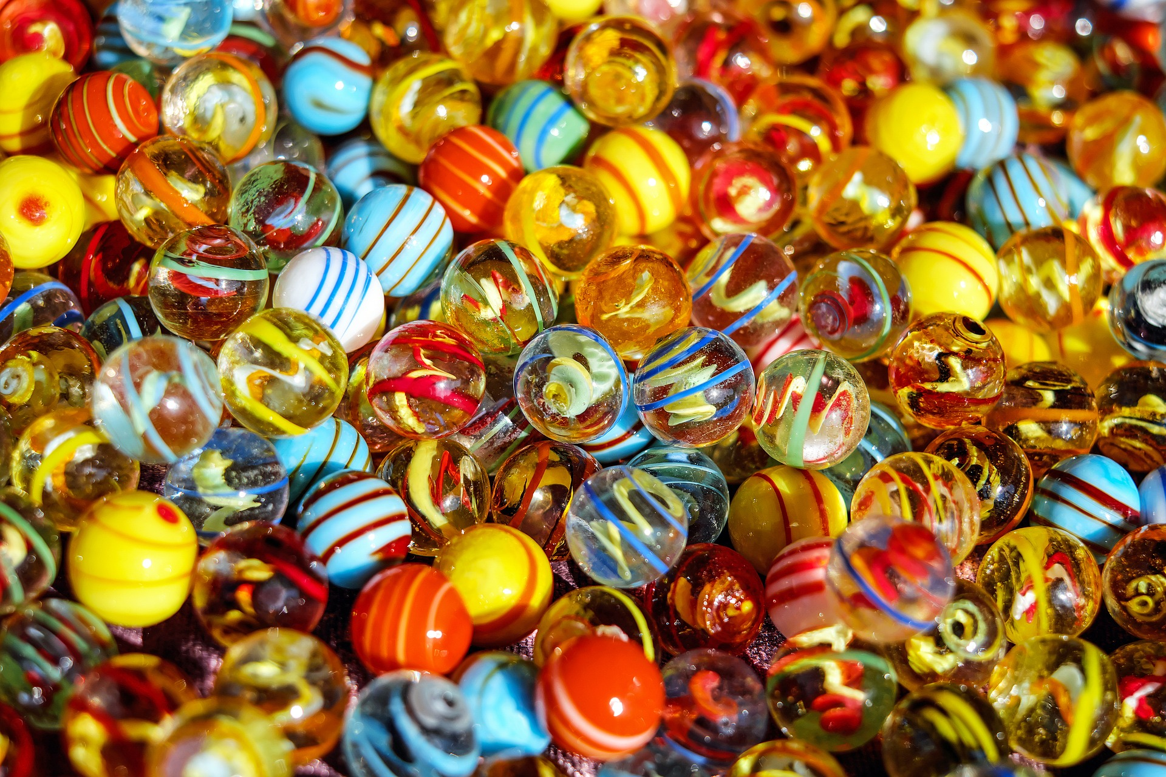
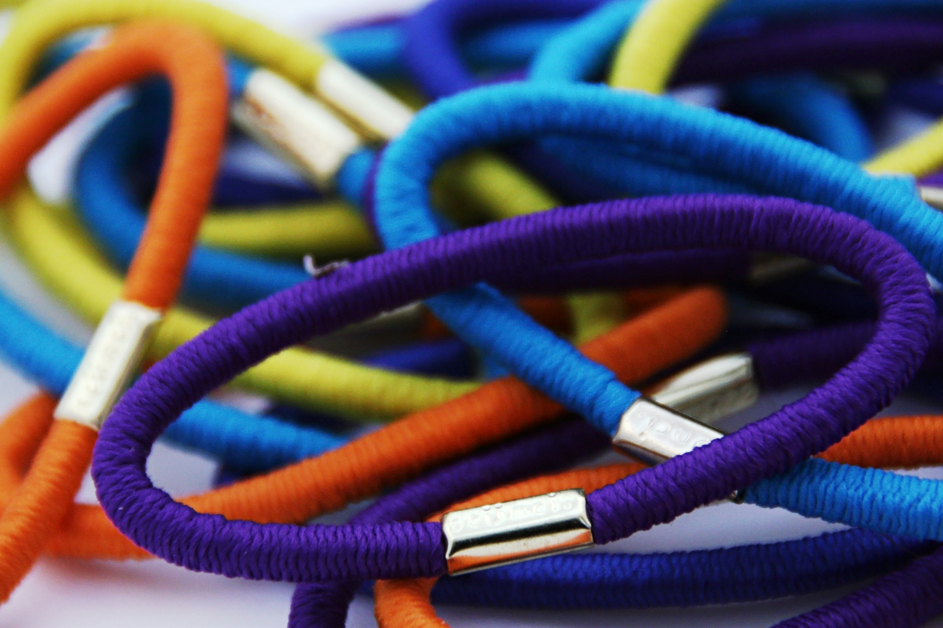
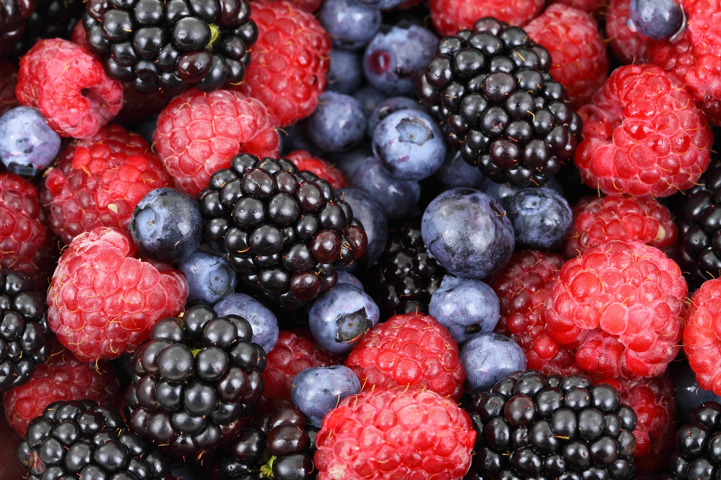
What “small and simple things”
did you find in your house?
Images: Alexas Fotos, Alex Hbaiu, Coleur, Foxumon, MathBfc, Public Domain Pictures, & Richard Revel
Notes:
Alexas Fotos. (2015, Mar. 16). Pixabay. Retrieved July 25, 2020, from https://pixabay.com/photos/lego-children-toys-colorful-play-674880/ Used under a Pixabay License. Free for commercial use. No attribution required.

Slide 5

Ants can lift 50 times their own body weight!
Image: LDS Daily on Instagram
Notes:
LDS Daily. (2016, Jun. 10). Instagram. Retrieved July 26, 2020, from https://www.instagram.com/p/BGe-uMYmktQ/

Slide 6
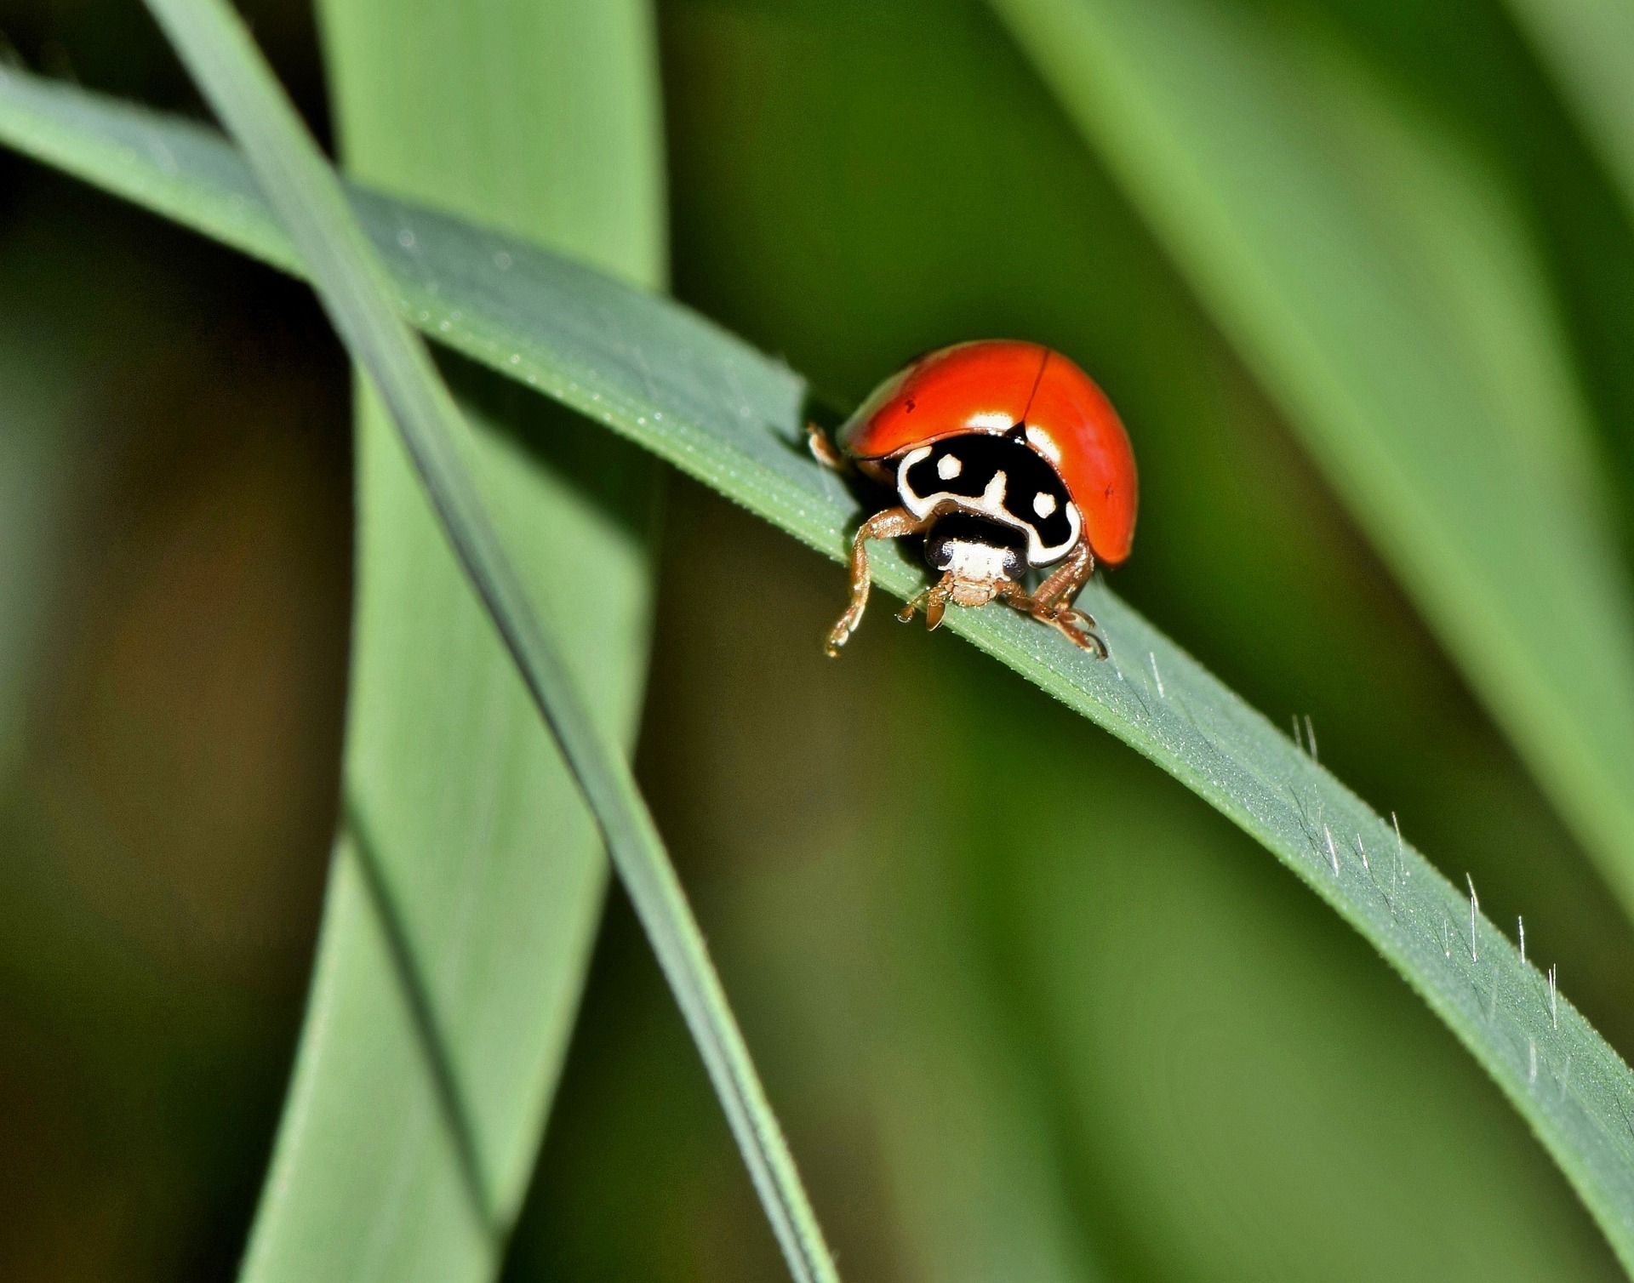
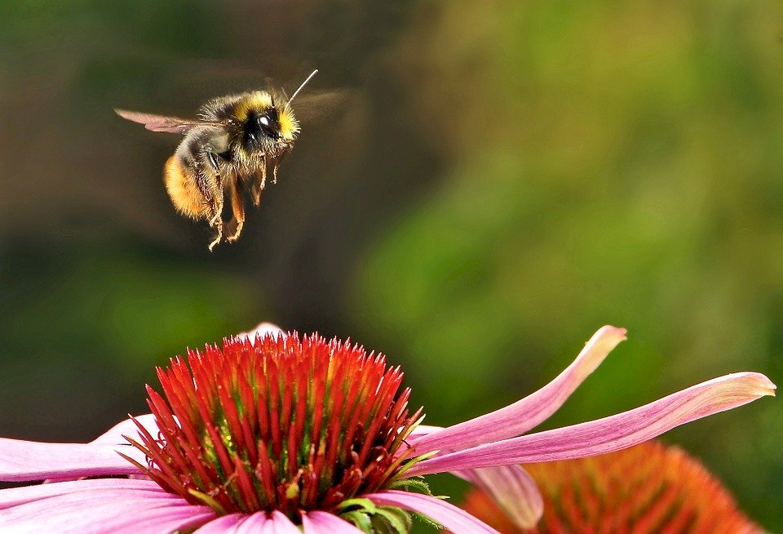
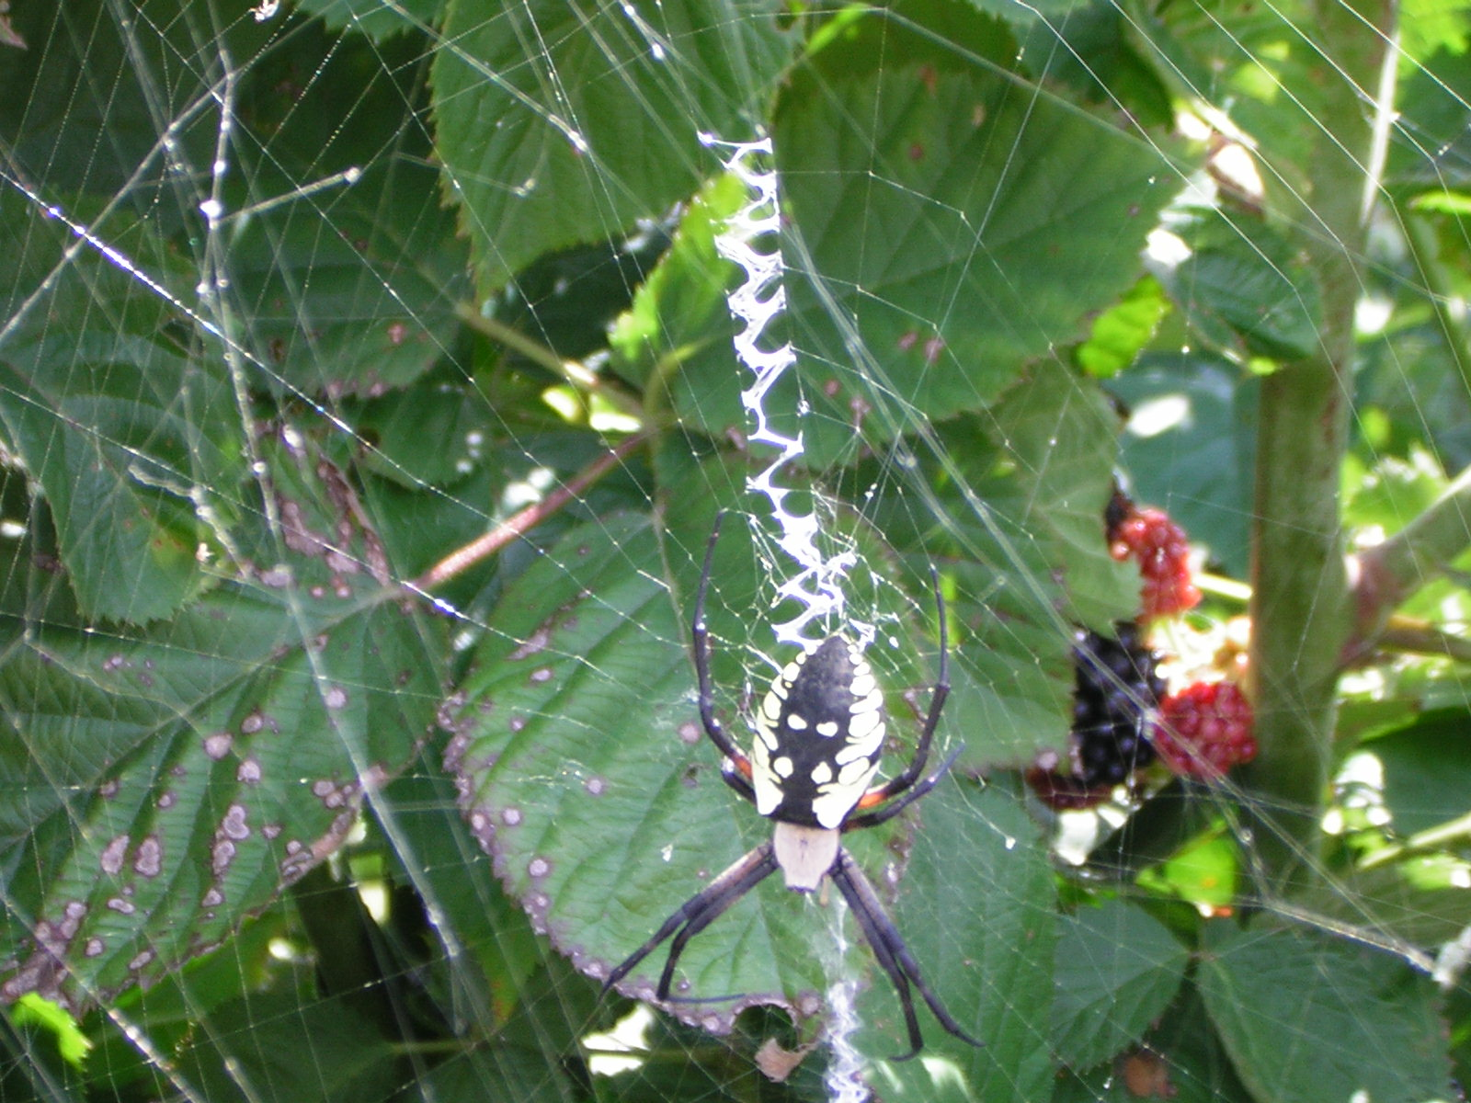
How do these bugs help us?
Tiny things
make a big
difference!
Images: Brett Hondow, Cherice Montgomery, & Skeeze
Notes:
Hondow, Brett. (2016, Aug. 30). Pixabay. Retrieved July 26, 2020, from https://pixabay.com/photos/polished-lady-beetle-lady-beetle-1626462/ Used under a Pixabay License. Free for commercial use. No attribution required.
Montgomery, Cherice. (2010, Oct. 26). Garden spider and web in raspberry bush.
Skeeze. (2015, Sept. 22). Pixabay. Retrieved April 5, 2020, from https://pixabay.com/photos/bumblebee-landing-flower-vertical-951083/

Slide 7

Go for a walk and look for other small, simple things that help us.
Image: Daniel Reche
Notes:
Reche, Daniel (Fotorech). (2017, Aug. 13). Pixabay. Retrieved July 26, 2020, from https://pixabay.com/photos/walk-path-walking-feet-trail-2635038/ Used under a Pixabay License. Free for commercial use. No attribution required.

Slide 8
1 + 1 = ?
2+ 2 = ?
4 + 4 = ?
8 + 8 = ?
Little things add up to
big problems
or a lot of happiness.
(See Alma 41:15)

Slide 9

What is the ocean made of?
Image: Rony Michaud
Notes:
Michaud, Rony. (2014, Dec. 28). Pixabay. Retrieved July 26, 2020, from https://pixabay.com/photos/drops-of-water-water-liquid-fresh-578897/ Used under a Pixabay License. Free for commercial use. No attribution required.

Slide 10

What is the beach made of?
Image: Nikola Belopitov
Notes:
Belopitov, Nikola. (2017, Jan. 24). Pixabay. Retrieved March 18, 2020, from https://pixabay.com/photos/sand-pattern-wave-background-white-2005066/ Used under a Pixabay License. Free for commercial use. No attribution required.

Slide 11
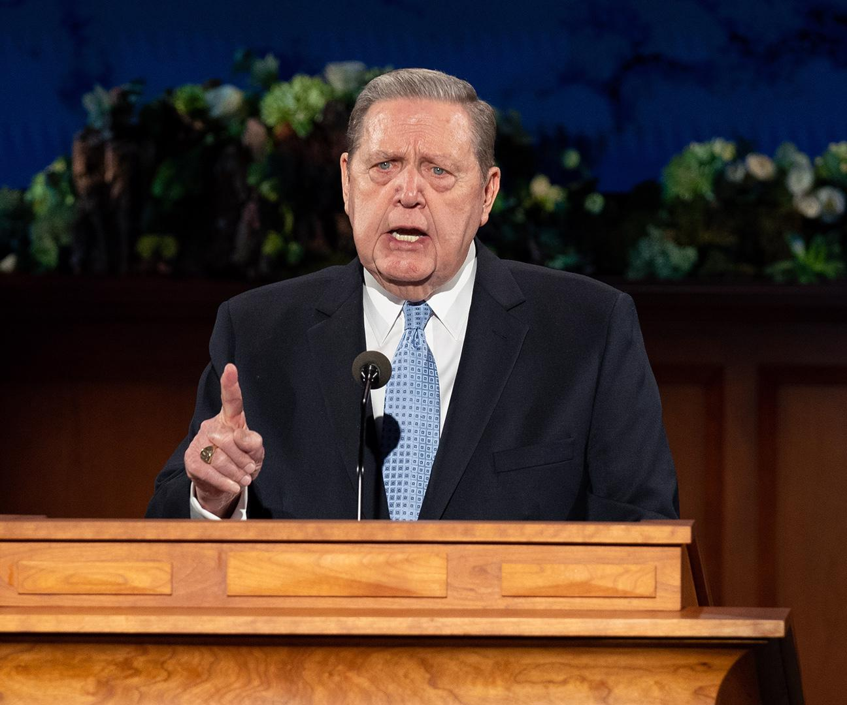
What is a
testimony
made of?
Image: The Church of Jesus Christ
Notes:
The Church of Jesus Christ. (2020, Apr.). A perfect brightness of hope. The Church of Jesus Christ of Latter-day Saints. Retrieved July 26, 2020, from https://www.churchofjesuschrist.org/study/general-conference/2020/04/43holland?lang=eng

Slide 12
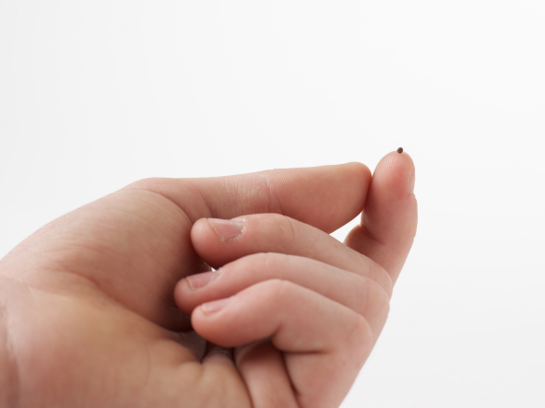
Faith, 96
Alma 32:28
Image: The Church of Jesus Christ
Notes:
“…If ye have faith as a grain of mustard seed, ye shall say unto this mountain, Remove hence to yonder place; and it shall remove; and nothing shall be impossible unto you” (Matthew 17:20).

Slide 13
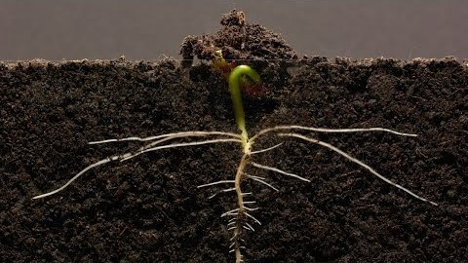
Alma 33:1
How do seeds grow? How is a testimony of Jesus Christ like a seed?
https://www.youtube.com/watch?v=w77zPAtVTuI
Image: GPhase
Notes:
Gphase. (2018, Mar. 7). Bean time-lapse – 25 days – soil cross-section. YouTube. Retrieved July 26, 2020, from https://www.youtube.com/watch?v=w77zPAtVTuI

Slide 14
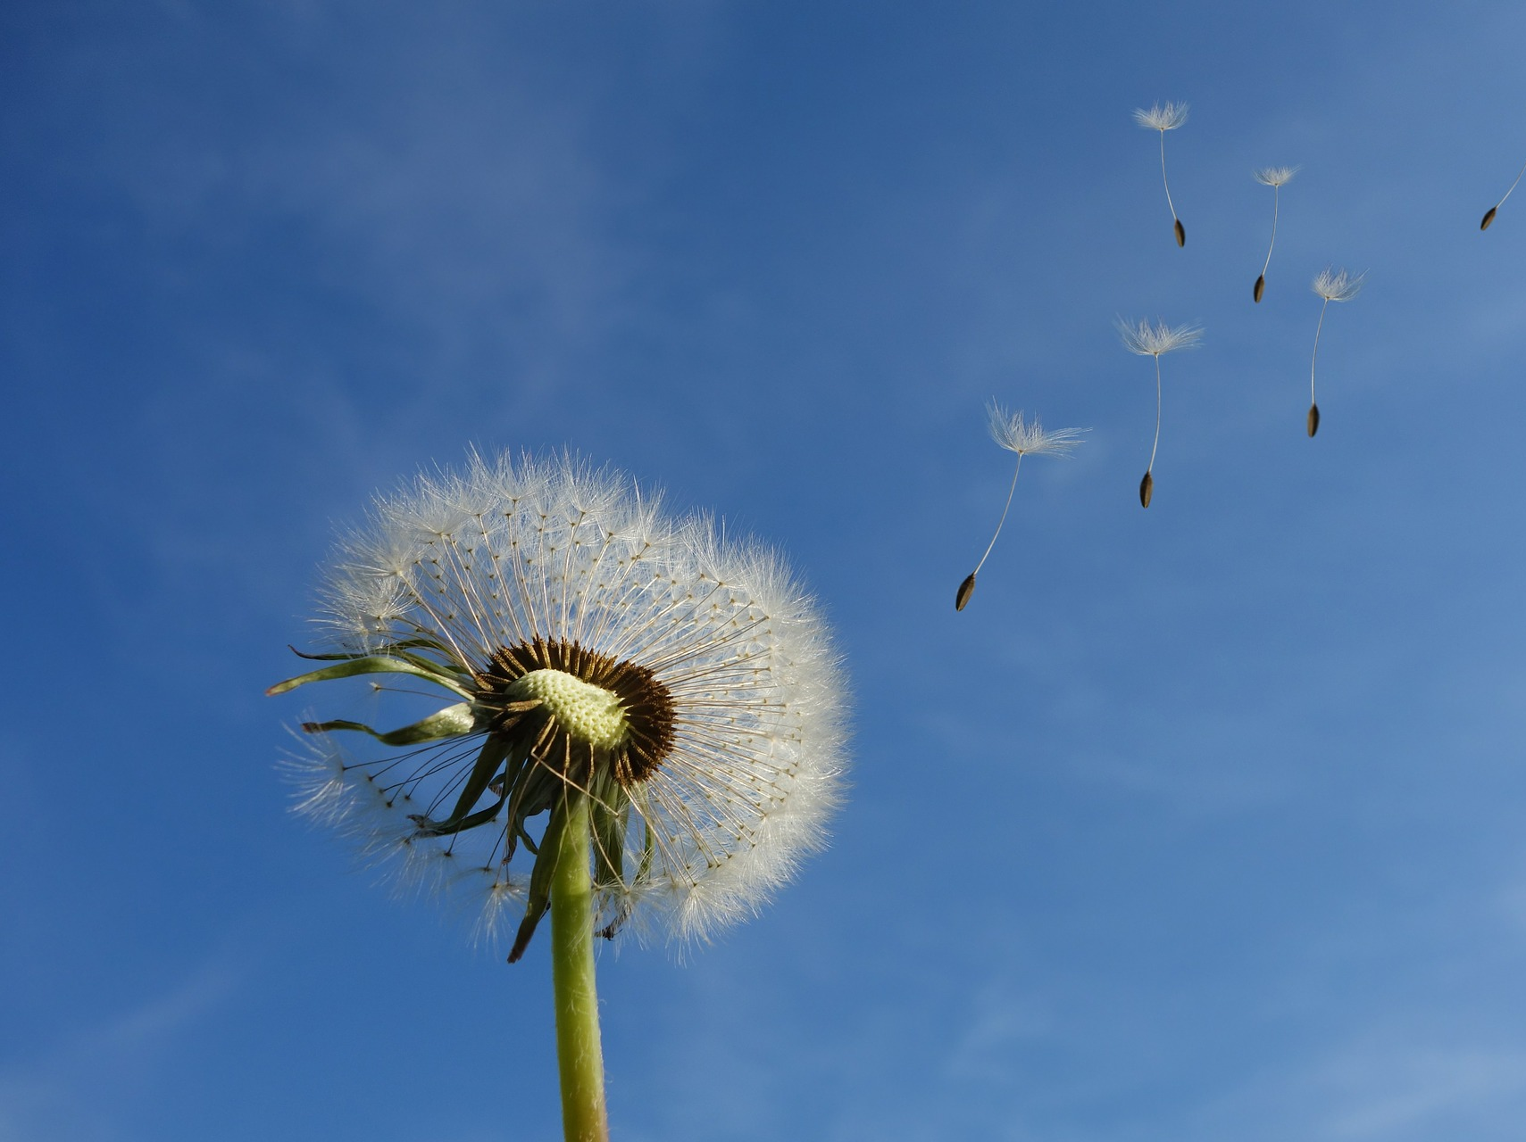
What small and simple things will grow our faith?
Image: BlackPixel
Notes:
BlackPixel. (2014, Sept. 27). Retrieved July 26, 2020, from https://pixabay.com/photos/dandelion-sky-flower-nature-seeds-463928/ Used under a Pixabay License. Free for commercial use. No attribution required.
Video: https://pixabay.com/videos/dandelion-faded-seed-formation-39163/

Slide 15
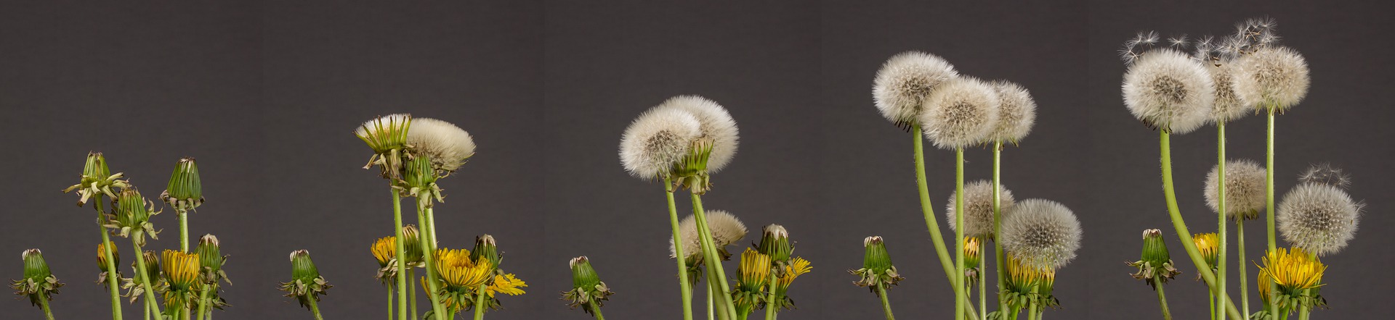
Faith is belief in action!
Pray
Search for truth in the scriptures
Listen to the Holy Ghost
Act on Spiritual Promptings
Show love to others
View this as a video: https://pixabay.com/videos/dandelion-faded-seed-formation-39163/
Image: Adege
Notes:
Adege. (2020, Apr. 20). Retrieved July 26, 2020, from https://pixabay.com/photos/dandelion-seeds-was-development-5064638/ Used under a Pixabay License. Free for commercial use. No attribution required.
Video: https://pixabay.com/videos/dandelion-faded-seed-formation-39163/

Slide 16
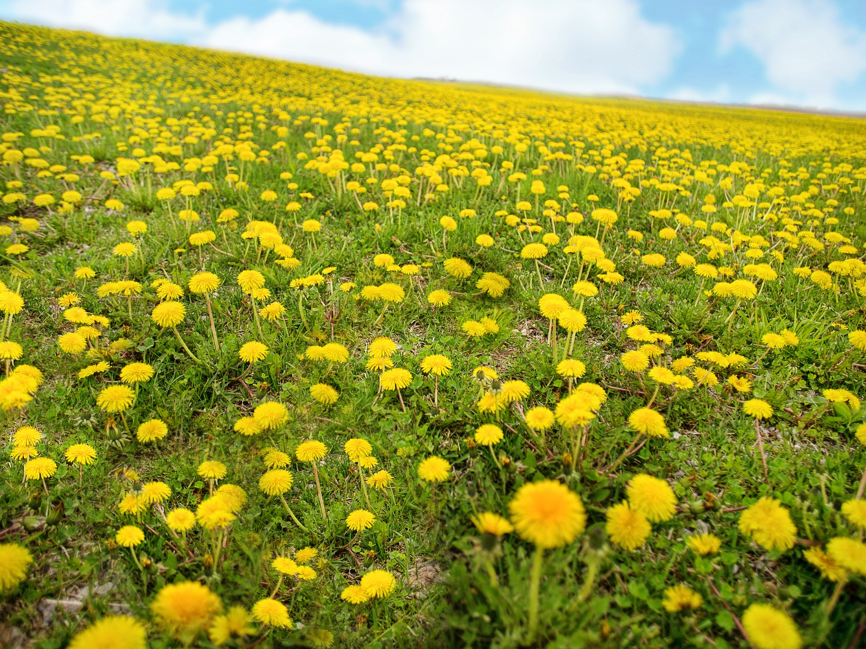
Nephi’s Courage, p. 120 (V. 3) OR Keep the Commandments, p. 146
“If ye will keep my commandments,
ye shall prosper in the land” (Alma 37:13)
Image: Jill Wellington
Notes:
Wellington, Jill. (2018, May 16). Retrieved July 26, 2020, from https://pixabay.com/photos/dandelions-spring-yellow-hill-3404750/ Used under a Pixabay License. Free for commercial use. No attribution required.
Video: https://pixabay.com/videos/dandelion-faded-seed-formation-39163/

Slide 17
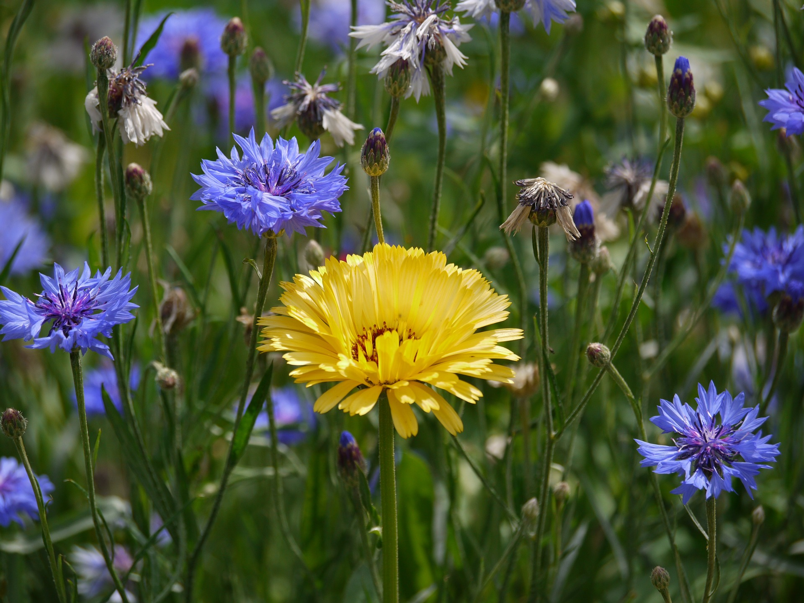
Text
How has Heavenly Father blessed you for keeping the commandments?
Image: Monika P
Notes:
MonikaP. (2016, Jul. 18). Pixabay. Retrieved July 11, 2020, from https://pixabay.com/photos/marigold-cornflowers-sunny-1522592/ Used under a Pixabay License. Free for commercial use. No attribution required.

Slide 18
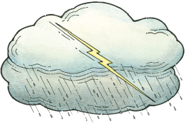
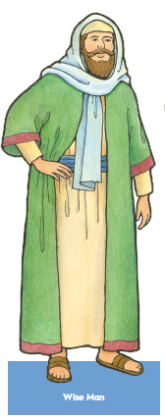
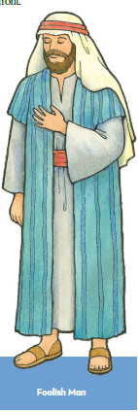

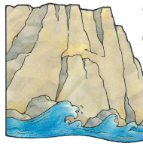
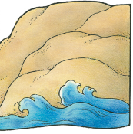
Testimonies don’t grow well in “sandy” soil!
The Wise Man & The Foolish Man, p. 281
Images: The Church of Jesus Christ
Notes:
The Church of Jesus Christ. (2015, Mar.). New Testament scripture figures: The wise man and the foolish man. The Friend. Retrieved July 26, 2020, from https://www.churchofjesuschrist.org/bc/content/shared/content/images/magazines/friend/2015/03/march-2015-friend-magazine-mormon_1410666_prt.pdf

Slide 19
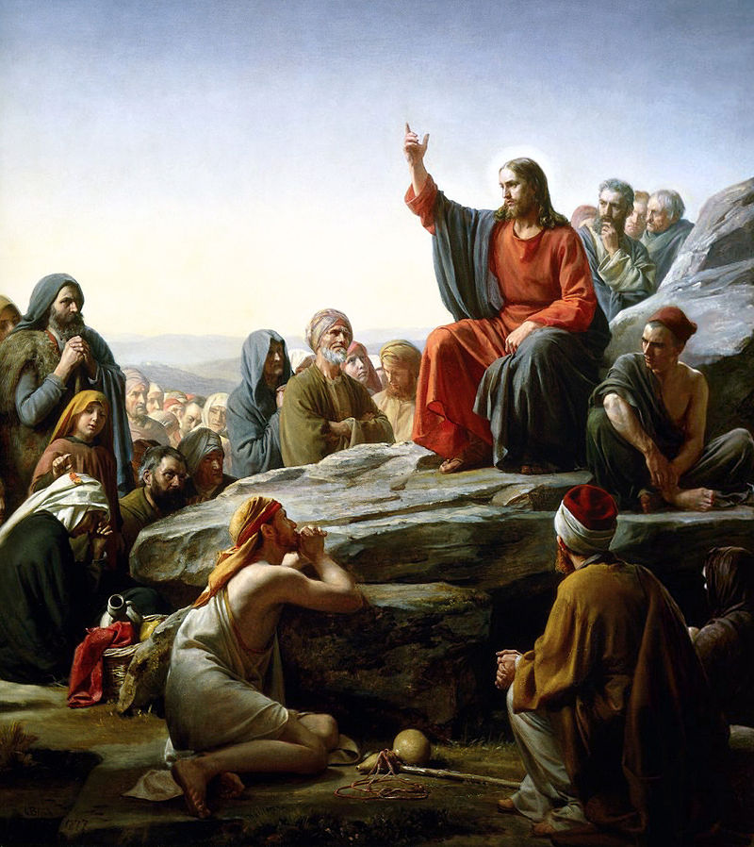
We should build our testimonies on the rock of Jesus’s teachings.
Image: Carl Bloch
Notes:
Bloch, Carl. (1877). Sermon on the mount. Wikipedia. Retrieved July 26, 2020, from https://en.wikipedia.org/wiki/Sermon_on_the_Mount#/media/File:Bloch-SermonOnTheMount.jpg Used from the Public Domain.

Slide 20

“Counsel with the Lord in all thy doings and he will direct thee for good…” (Alma 37:37).
A Child’s Prayer, p. 12
Image: The Church of Jesus Christ
Notes:
The Church of Jesus Christ.

Slide 21
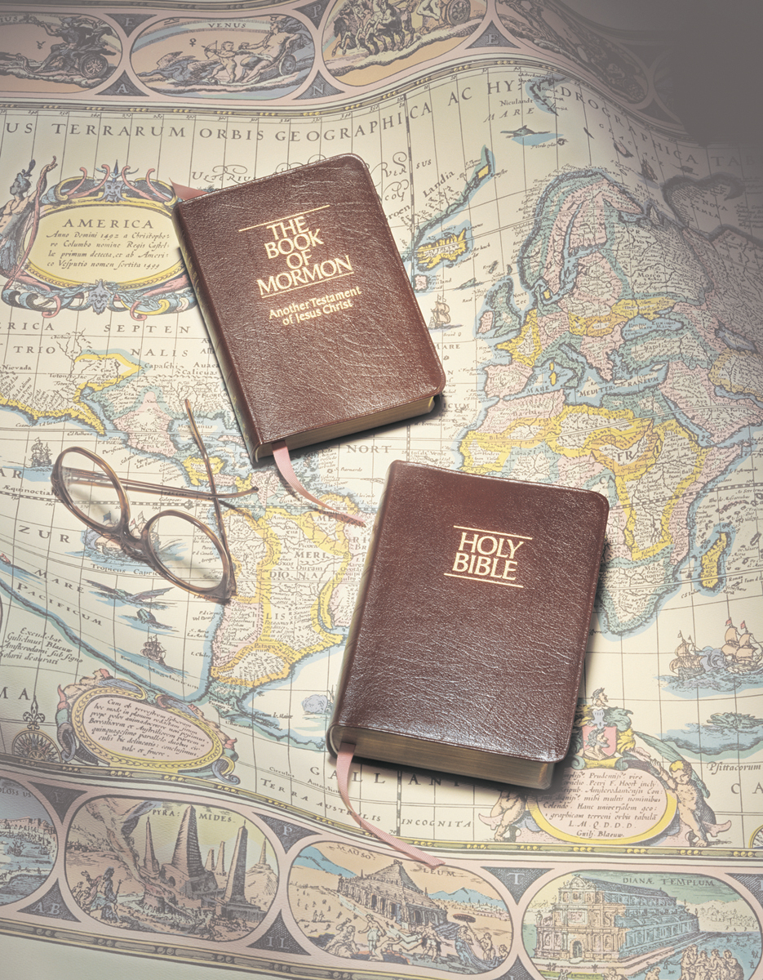
The Iron Rod, #274
Image: Grant Heaton
Notes:
Heaton, Grant. (n.d.). Scriptures, by Grant Heaton. Gospel Media Library. Retrieved March 31, 2020, from https://www.churchofjesuschrist.org/media-library/images/bible-and-book-of-mormon-261218?lang=eng

Slide 22
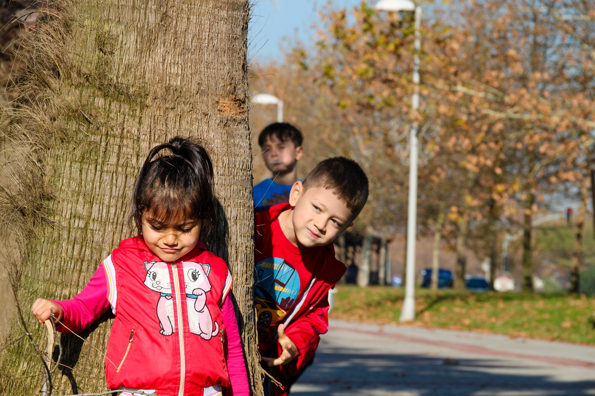
How is searching the scriptures like playing a game of Hide and Seek?
Image: Isa Karakus
Notes:
Karakus, Isa (Isakarakus) (2016, Dec. 2). Pixabay. Retrieved July 26, 2020, from https://pixabay.com/photos/children-children-playing-girl-male-1876027/ Used under a Pixabay License. Free for commercial use. No attribution required.

Slide 23

Will you find anyone if you never look?
Image: 196235
Notes:
Leoni, Luisella Planeta (Sweetlouise). (2014, Apr. 6). Pixabay. Retrieved July 26, 2020, from https://pixabay.com/photos/portrait-child-hands-hide-317041/ Used under a Pixabay License. Free for commercial use. No attribution required.

Slide 24

Look for answers in the scriptures
Doctrine & Covenants 1:37
Image: Free Photos
Notes:
Free Photos (2016, Apr. 5). Pixabay. Retrieved July 26, 2020, from https://pixabay.com/photos/hiding-boy-girl-child-young-box-1209131/ Used under a Pixabay License. Free for commercial use. No attribution required.

Slide 25
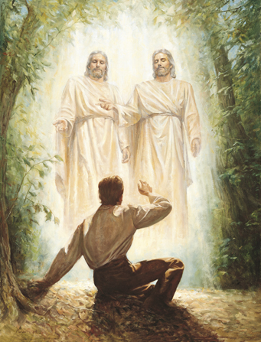
How can we hear Him (Jesus Christ)?
This is My Beloved Son, p. 76
Image: The Church of Jesus Christ
Notes:
The Church of Jesus Christ. (n.d.). The first vision. Gospel Media Library: The Church of Jesus Christ of Latter-day Saints. Retrieved July 26, 2020, from https://www.churchofjesuschrist.org/media/image/the-first-vision-fe5db8d?lang=eng

Slide 26
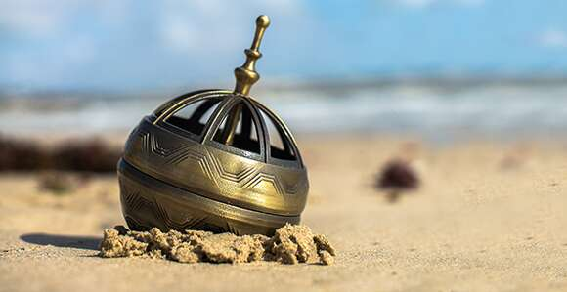
“ …the word of Christ…will point to you a straight course to eternal bliss…”
(Alma 37:44).
“…if they had faith to believe that God could cause that those spindles should point the way they should go, behold, it was done” (Alma 37:40-41).
Image: The Church of Jesus Christ
Notes:
The Church News. (2017, Mar. 12). Viewpoint: Words of Christ can be a compass for our lives. The Church News. Retrieved July 26, 2020, from https://www.churchofjesuschrist.org/church/news/viewpoint-words-of-christ-can-be-a-compass-for-our-lives?lang=eng

Slide 27
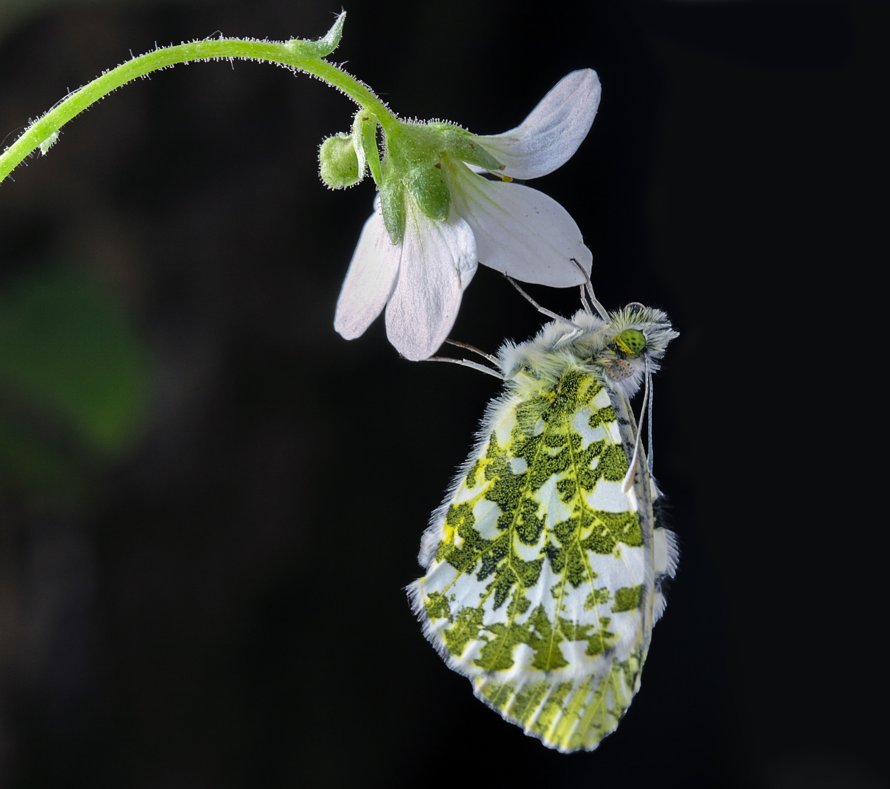
(See Doctrine & Covenants 6:23 and 8:2)
The Still Small Voice, p. 106
OR
Listen, Listen,
p. 107
Image Ian Lindsay
Notes:
Lindsay, Ian (Illuvis). (2019, Feb. 3). Pixabay. Retrieved June 1, 2020, from https://pixabay.com/photos/butterfly-orange-tip-wildlife-3972541/ Used under a Pixabay License. Free for commercial use. No attribution required.

Slide 28

Good choices add up!
Dare to Do Right, p. 158
Image: Tumisu
Notes:
Tumisu. (2020, May 22). Pixabay. Retrieved July 26, 2020, from https://pixabay.com/photos/pros-and-cons-compare-choice-5201376/ Used under a Pixabay License. Free for commercial use. No attribution required.

Slide 29

Listen to the snng Choosing
from the play My Turn on Earth
https://youtu.be/9Huggx6117s
Image: Tumisu
Notes:
Tumisu. (2017, Dec. 2). Pixabay. Retrieved July 26, 2020, from https://pixabay.com/photos/ethics-right-wrong-ethical-moral-2991600/ Used under a Pixabay License. Free for commercial use. No attribution required.

Slide 30
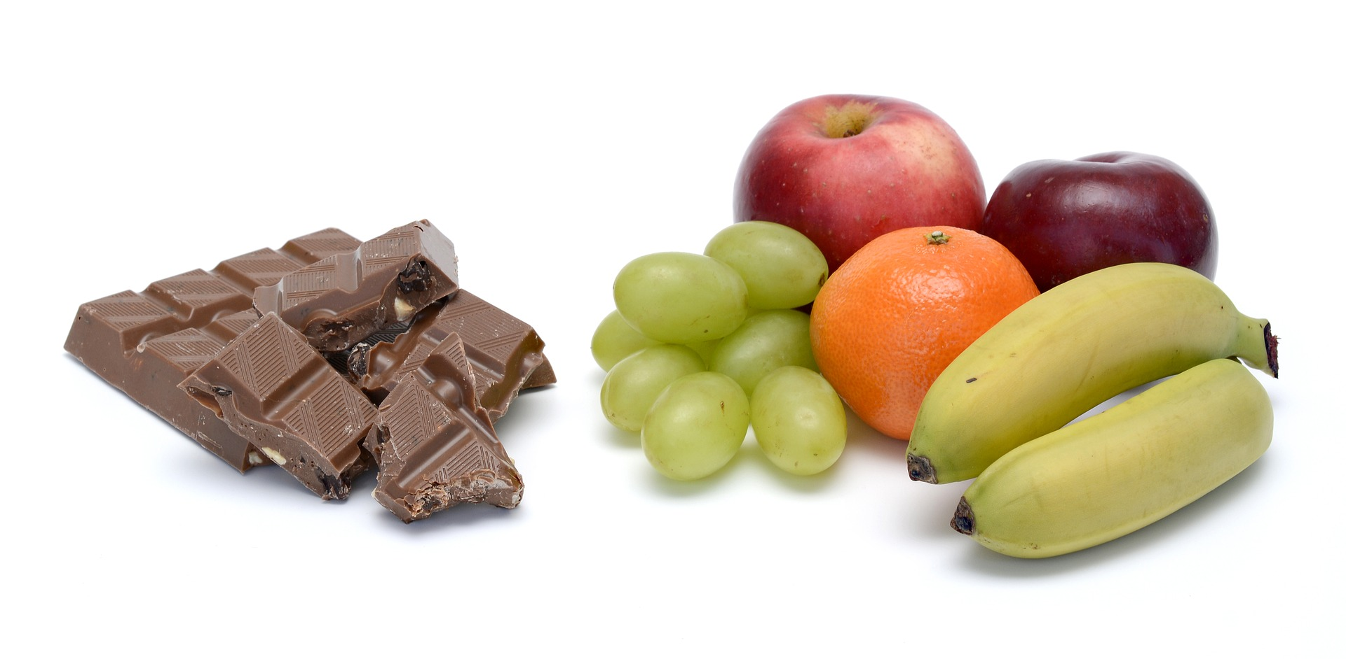
Which one is best for your body?
Image:Annca
Notes:
Annca. (2017, Dec. 22). Pixabay. Retrieved July 26, 2020, from https://pixabay.com/photos/fruit-healthy-fresh-food-vitamins-3027153/ Used under a Pixabay License. Free for commercial use. No attribution required.

Slide 31
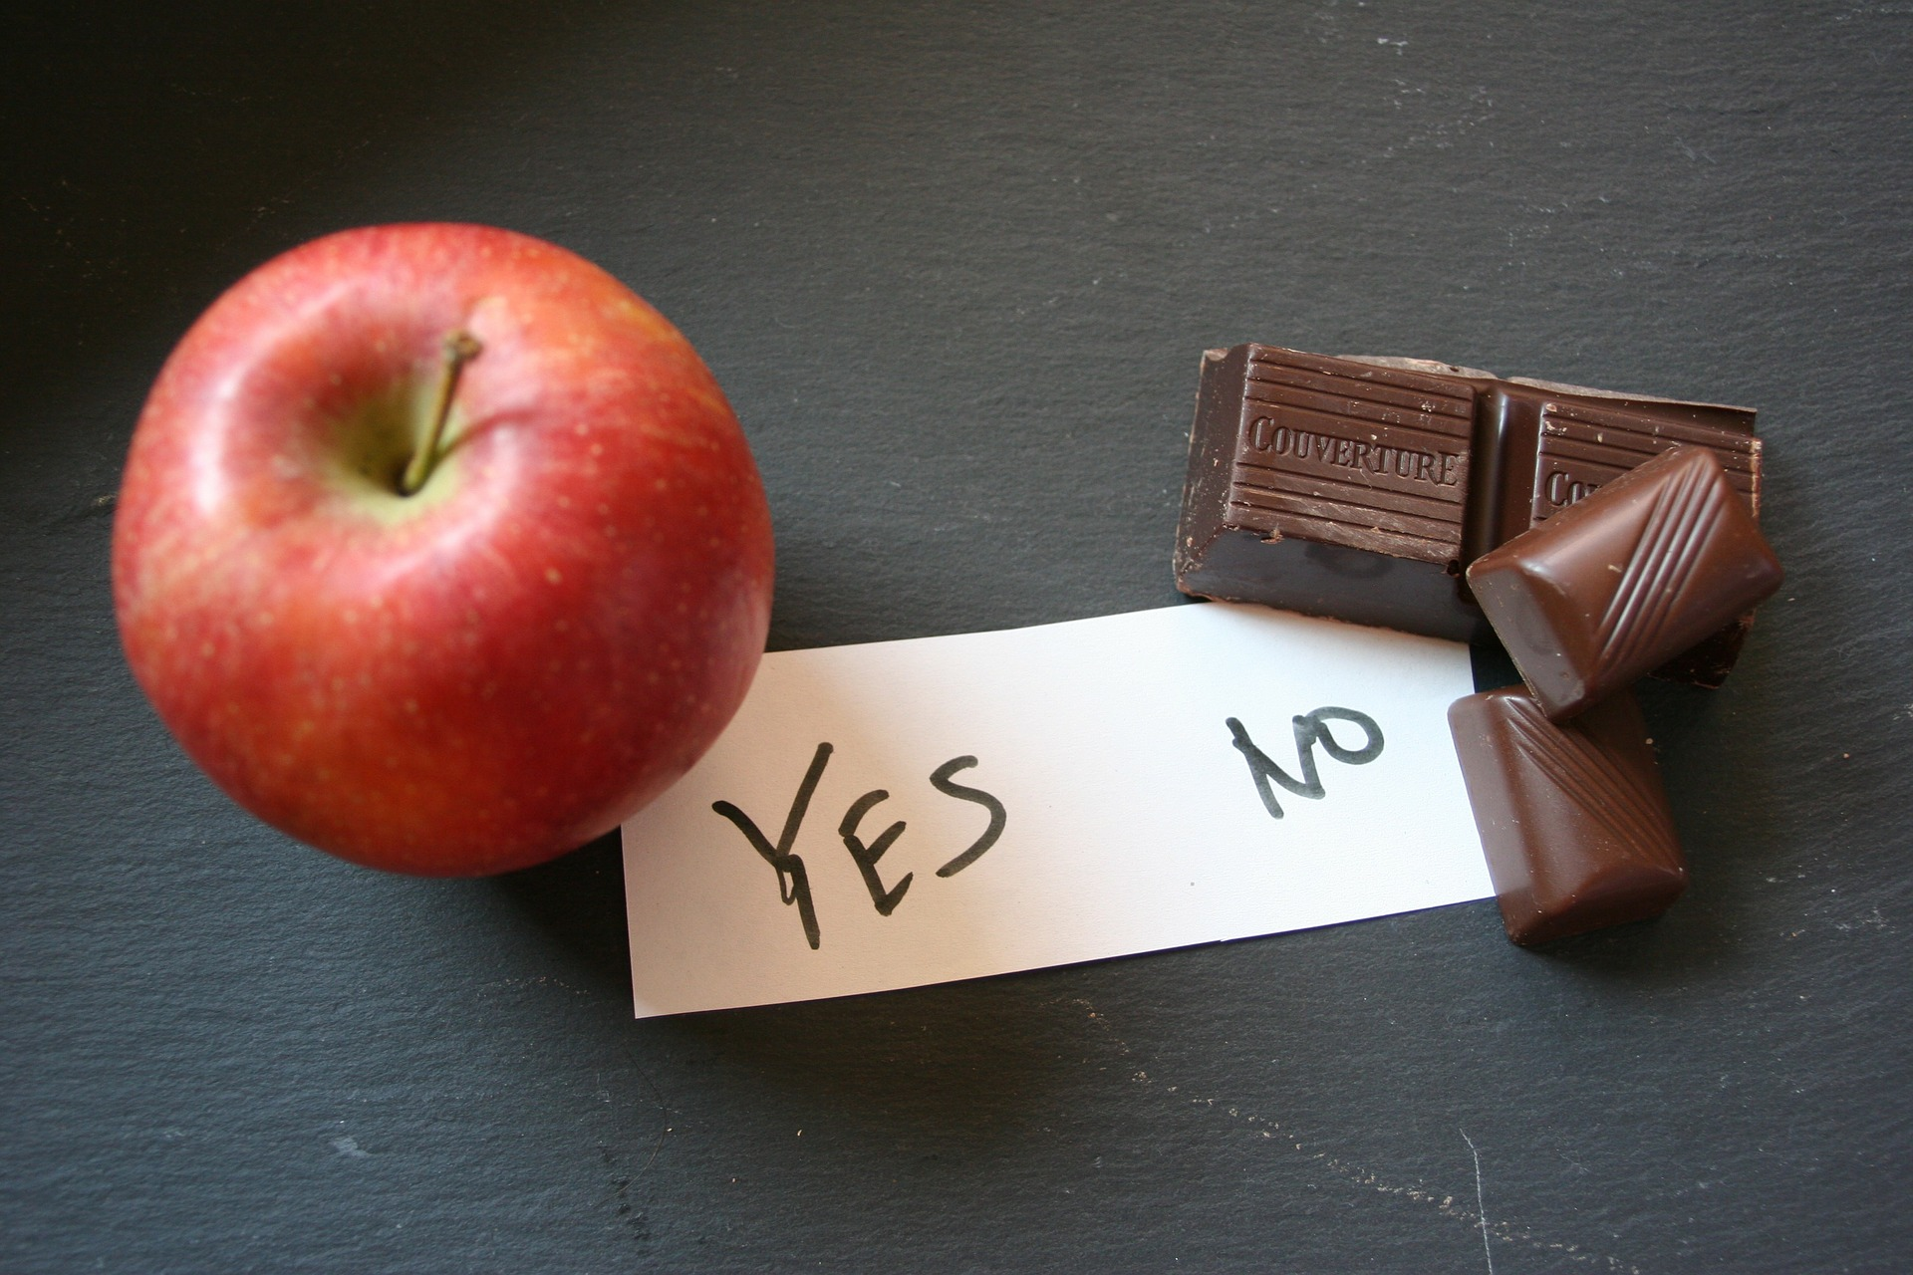
Image: Artistlike
Notes:
Artistlike. (2013, Oct. 18). Pixabay. Retrieved July 26, 2020, from https://pixabay.com/photos/apple-healthy-chocolate-unhealthy-196935/ Used under a Pixabay License. Free for commercial use. No attribution required.

Slide 32
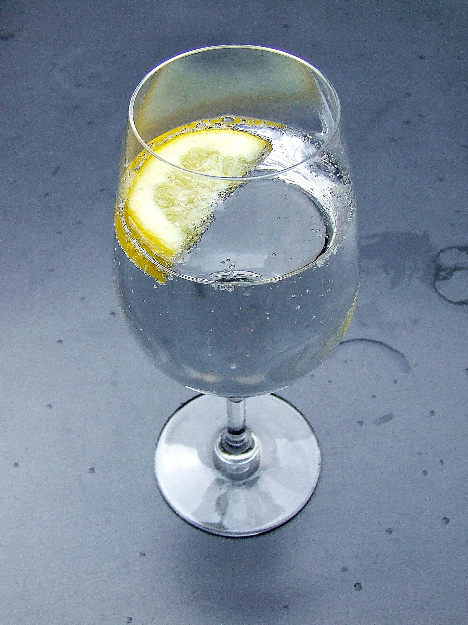

What will happen to your body if you…
drink 8 glasses of WATER every day?
drink 8 glasses of POP every day?
Images: Pete Linforth & Ranya
Notes:
Linforth, Pete (The Digital Artist). (2015, Mar. 23). Pixabay. Retrieved July 26, 2020, from https://pixabay.com/illustrations/lemonade-can-pop-fizzy-drink-soda-684991/ Used under a Pixabay License. Free for commercial use. No attribution required.
Ranya. (2015, Jan. 7). Pixabay. Retrieved July 26, 2020, from https://pixabay.com/photos/sparkling-mineral-water-spritzer-590687/ Used under a Pixabay License. Free for commercial use. No attribution required.

Slide 33
5
x
7
What will happen to my body if I walk 10,000 steps (about 5 miles) each day?
If I watch 5 hours of TV every day instead?
= 35
Image: Daniel Reche
Notes:
Reche, Daniel (Fotorech). (2017, Aug. 13). Pixabay. Retrieved July 26, 2020, from https://pixabay.com/photos/walk-path-walking-feet-trail-2635038/ Used under a Pixabay License. Free for commercial use. No attribution required.

Slide 34
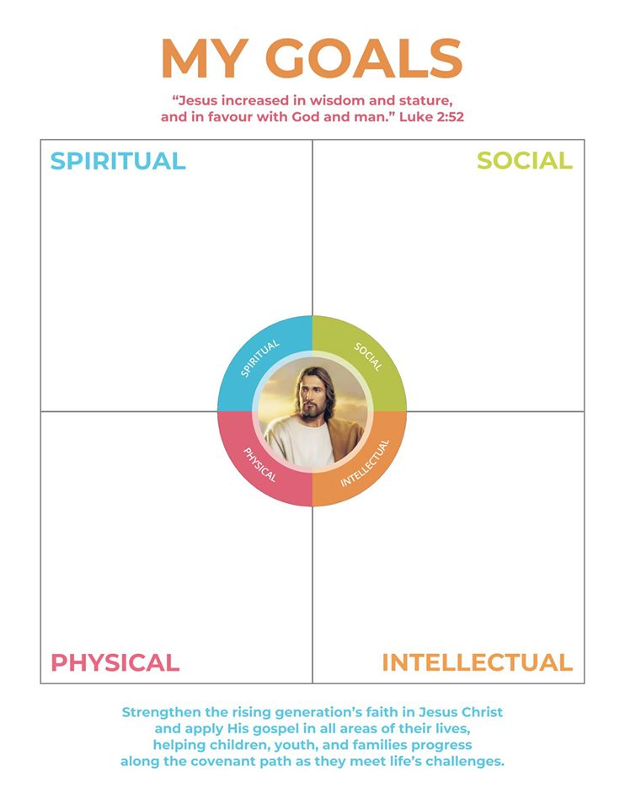
President Nelson has asked us to set one goal in each area.
(Amos 3:7)
Image: LDS Scriptures
Notes:
LDS Scriptures. (2019, Sept. 29). Facebook. Retrieved March 21, 2020, from https://www.facebook.com/LDSScriptures/posts/i-made-a-printable-for-children-youth-and-adults-for-the-new-children-and-youth-/10162215806570257/

Slide 35
Look for one connection each week between daily life & the gospel, then share it with
family or friends
Do something nice for someone else each day
Sister Montgomery’s
Small & Simple
Goals
5 fruits and veggies
8 glasses of water
8 hours of sleep
10,000 steps
Read or create something for fun every day
Image: LDS Scriptures
Notes:
LDS Scriptures. (2019, Sept. 29). Facebook. Retrieved March 21, 2020, from https://www.facebook.com/LDSScriptures/posts/i-made-a-printable-for-children-youth-and-adults-for-the-new-children-and-youth-/10162215806570257/

Slide 36
What goals will you try this week?
Image: LDS Scriptures
Notes:
LDS Scriptures. (2019, Sept. 29). Facebook. Retrieved March 21, 2020, from https://www.facebook.com/LDSScriptures/posts/i-made-a-printable-for-children-youth-and-adults-for-the-new-children-and-youth-/10162215806570257/

Slide 37
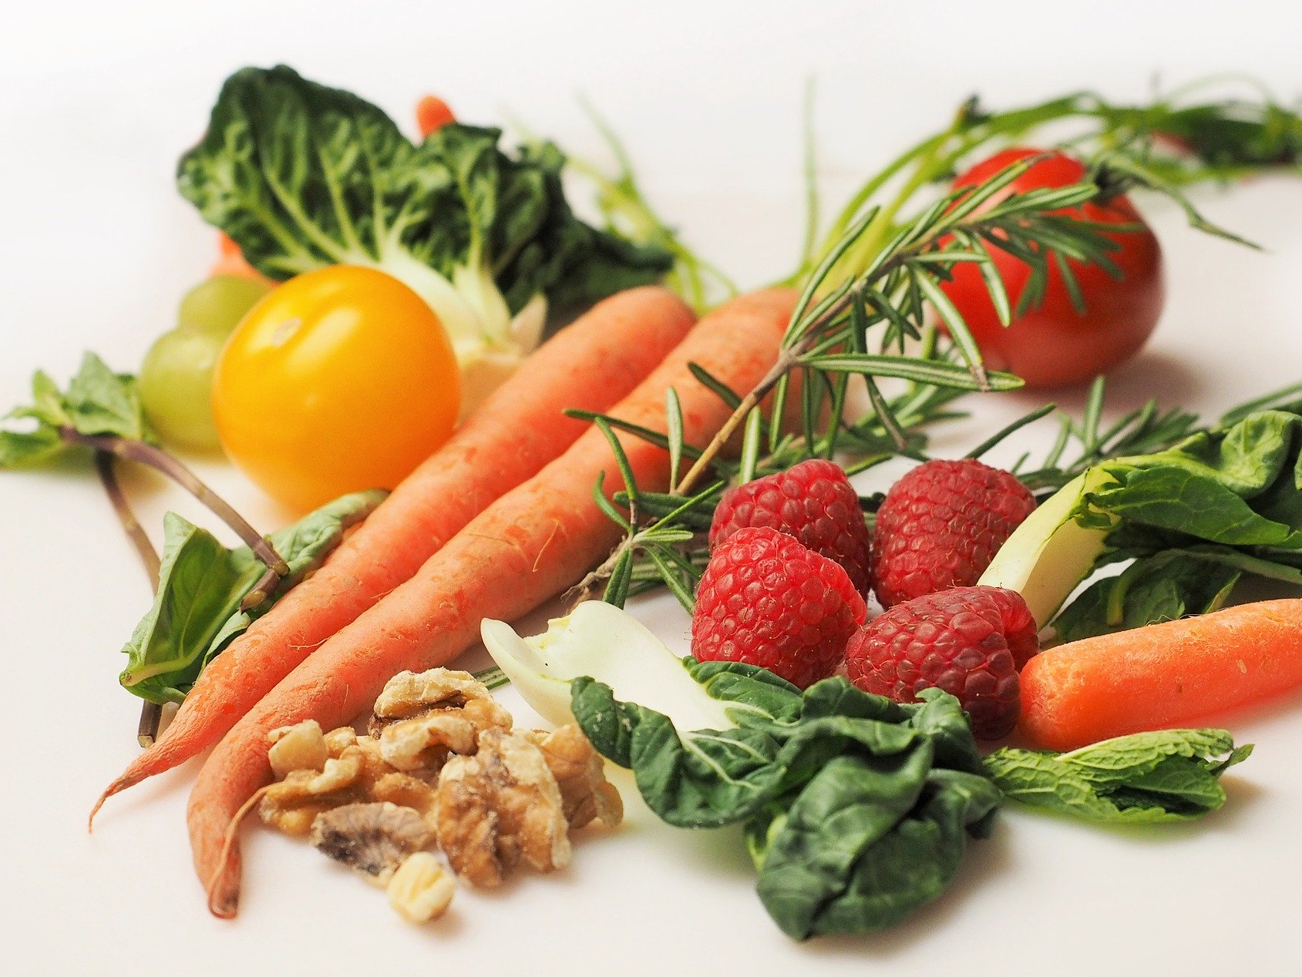
Image: Deborah Breen Whiting
Notes:
Whiting, Deborah Breen (Dbreen). (2015, Dec. 9). Pixabay. Retrieved July 26, 2020, from https://pixabay.com/photos/vegetables-carrot-food-healthy-1085063/ Used under a Pixabay License. Free for commercial use. No attribution required.

Slide 38
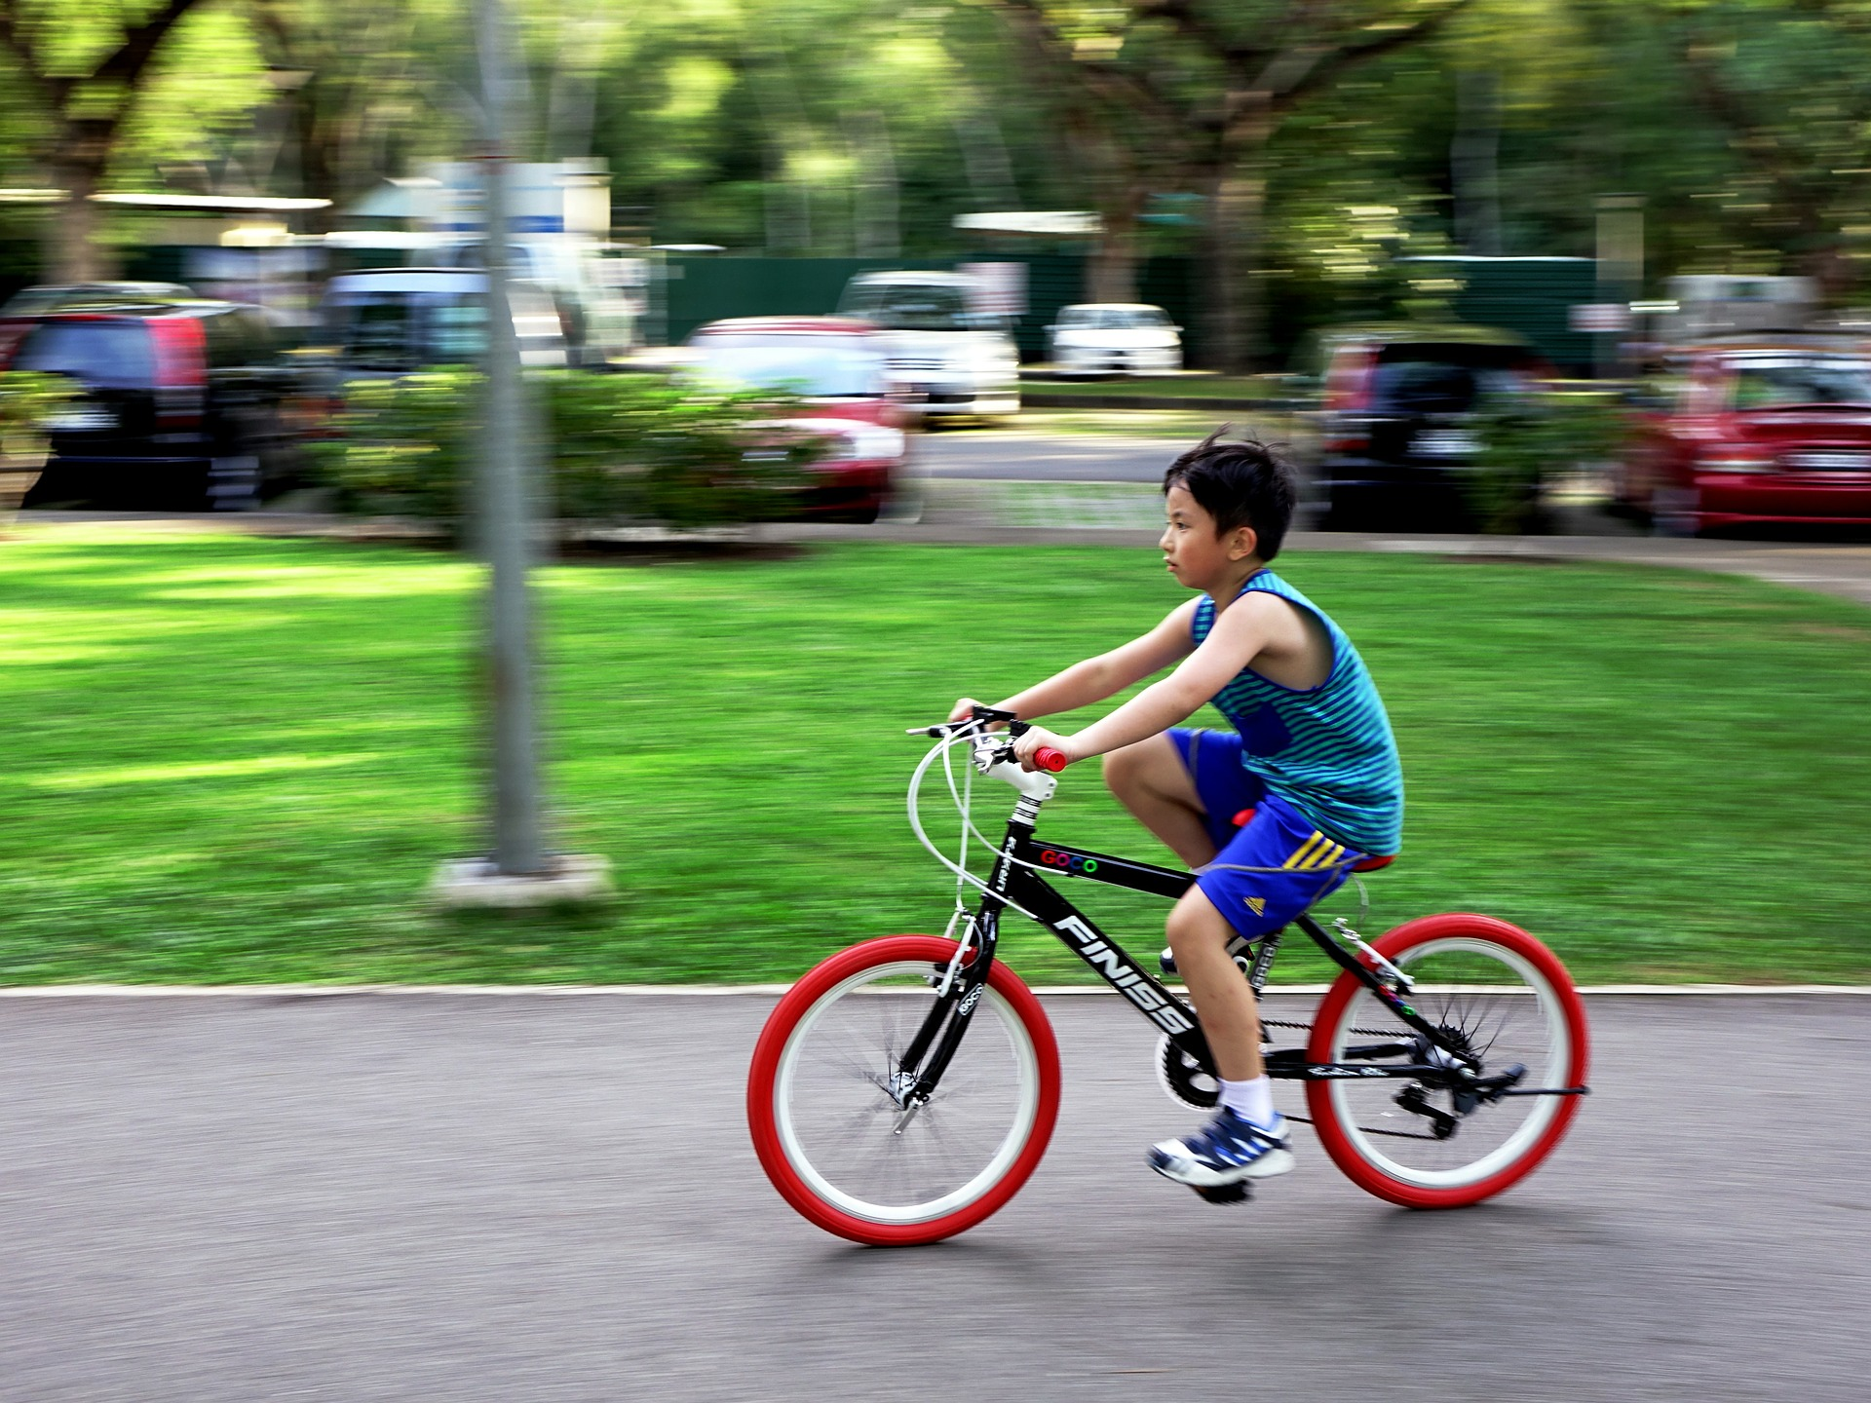
Image: Jason Goh
Notes:
Goh, Jason (Cegoh). (2014, Jul. 20). Pixabay. Retrieved July 26, 2020, from https://pixabay.com/photos/bicycle-bike-outdoor-cycling-sport-397960/ Used under a Pixabay License. Free for commercial use. No attribution required.

Slide 39
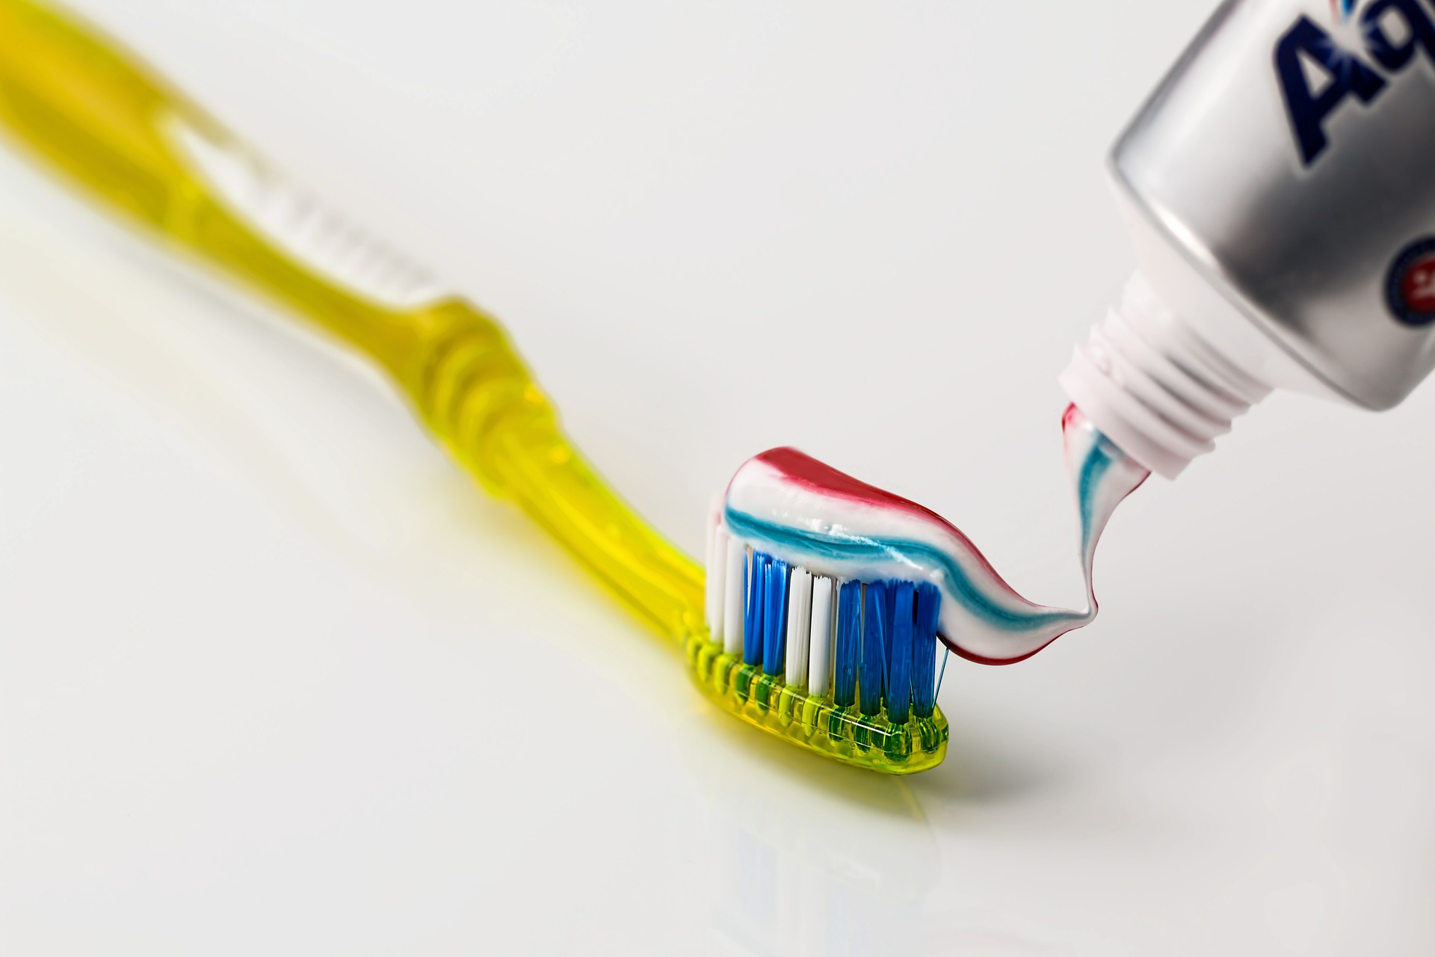
Image: Steve Buissinne
Notes:
Buissinne, Steve (Stevepb). (2014, Dec. 18). Pixabay. Retrieved July 26, 2020, from https://pixabay.com/photos/toothbrush-toothpaste-dental-care-571741/ Used under a Pixabay License. Free for commercial use. No attribution required.

Slide 40

Image: Evabalk
Notes:
Evabalk. (2020, Mar. 17). Pixabay. Retrieved July 26, 2020, from https://pixabay.com/photos/washing-hands-wash-your-hands-4940148/ Used under a Pixabay License. Free for commercial use. No attribution required.

Slide 41

Image: Gerd Altmann
Notes:
Altmann, Gerd (Geralt). (2020, March 27). Pixabay. Retrieved July 26, 2020, from https://pixabay.com/illustrations/corona-covid-19-coronavirus-wash-4972638/ Used under a Pixabay License. Free for commercial use. No attribution required.

Slide 42

Image: Alexandra Koch
Notes:
Koch, Alexandra. (2020, May 4). Pixabay. Retrieved July 26, 2020, from https://pixabay.com/photos/students-mouth-guard-viruses-corona-5121865/ Used under a Pixabay License. Free for commercial use. No attribution required.

Slide 43

Image: Martin Vorel
Notes:
Vorel, Martin. (2015, Sept. 10). Libreshot. Retrieved July 26, 2020, from https://libreshot.com/the-child-writes-homework/ Used under the Public Domain. Also available on Pixabay: https://pixabay.com/photos/child-kid-writing-homework-letters-2619902/

Slide 44

Image: Tumisu
Notes:
Tumisu. (2015, Aug. 24). Pixabay. Retrieved July 26, 2020, from https://pixabay.com/illustrations/welcome-words-greeting-language-905562/ Used under a Pixabay License. Free for commercial use. No attribution required.

Slide 45
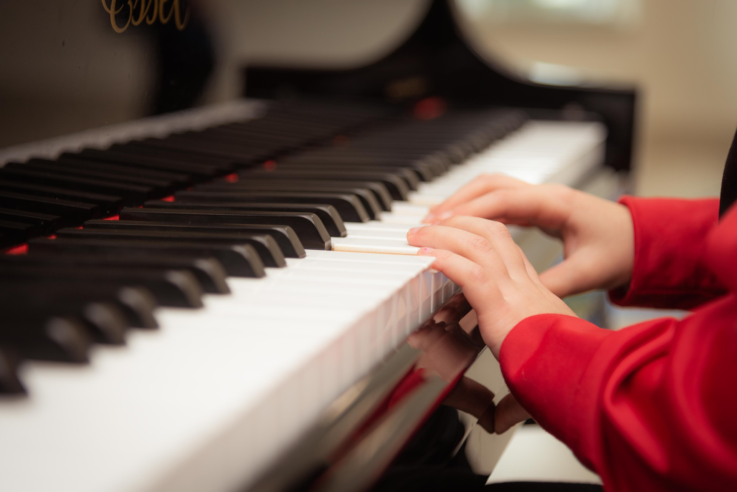
Image: Vlad Vasnetsov
Notes:
Vasnetsov, Vlad (Vladvictoria). (2019, Jan. 28). Pixabay. Retrieved July 26, 2020, from https://pixabay.com/photos/piano-playing-learning-piano-lesson-3957650/ Used under a Pixabay License. Free for commercial use. No attribution required.

Slide 46

Image: Alexandra Koch
Notes:
Koch, Alexandra. (2020, May 22). Pixabay. Retrieved July 26, 2020, from https://pixabay.com/photos/students-mouth-guard-corona-virus-5201719/ Used under a Pixabay License. Free for commercial use. No attribution required.
LDS Scriptures. (2019, Sept. 29). Facebook. Retrieved March 21, 2020, from https://www.facebook.com/LDSScriptures/posts/i-made-a-printable-for-children-youth-and-adults-for-the-new-children-and-youth-/10162215806570257/

Slide 47
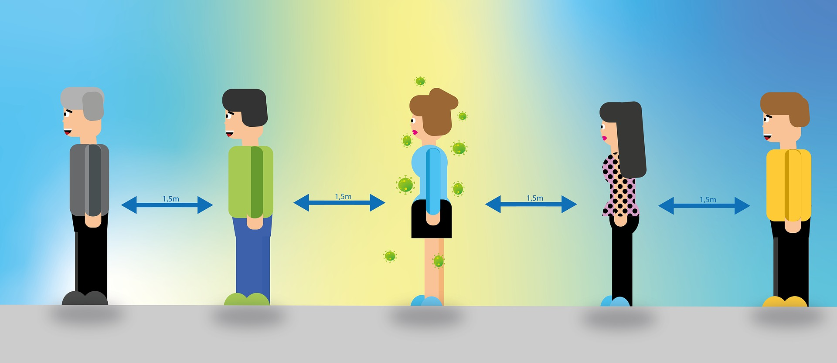
Image: Alexandra Koch
Notes:
Koch, Alexandra. (2020, Jun. 23). Pixabay. Retrieved July 26, 2020, from https://pixabay.com/illustrations/social-distancing-distance-corona-5325739/ Used under a Pixabay License. Free for commercial use. No attribution required.

Slide 48

Image: The Church of Jesus Christ
Notes:
The Church of Jesus Christ of Latter-day Saints. (2013, February). Addicted to video games. The New Era. Retrieved July 26, 2020, from https://www.churchofjesuschrist.org/study/new-era/2013/02/addicted-to-video-games?lang=eng

Slide 49
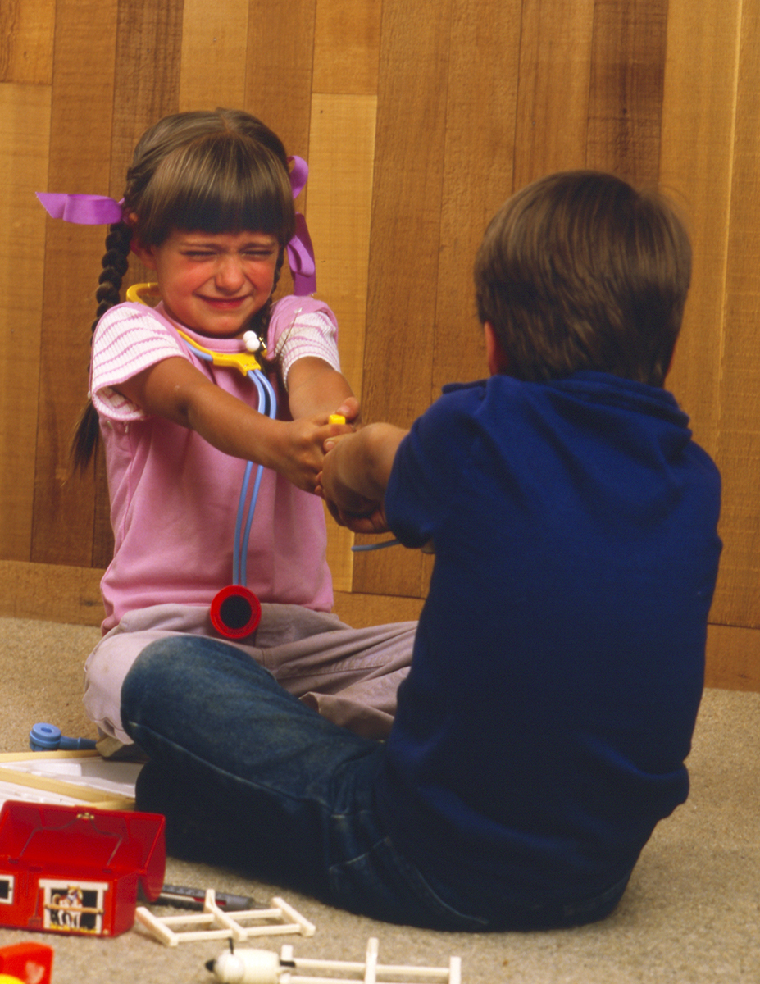
Love One Another,
p. 136
(See Alma 38:12)
Image: The Church of Jesus Christ
Notes:
The Church of Jesus Christ. (n.d.). Childhood. A little boy and a little girl fighting over a toy. Gospel Media Library: The Church of Jesus Christ of Latter-day Saints. Retrieved July 26, 2020, from https://www.churchofjesuschrist.org/media-library/images/children-childhood-fighting-toys-2054087?lang=eng

Slide 50
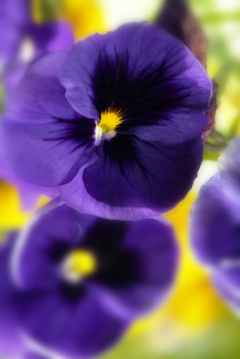
Little Purple Pansies, p. 244
Image: The Church of Jesus Christ
Notes:
The Church of Jesus Christ. (n.d.). Pansies. Gospel Media Library. Retrieved from https://www.churchofjesuschrist.org/media/image/purple-pansies-ede760d?lang=eng

Slide 51
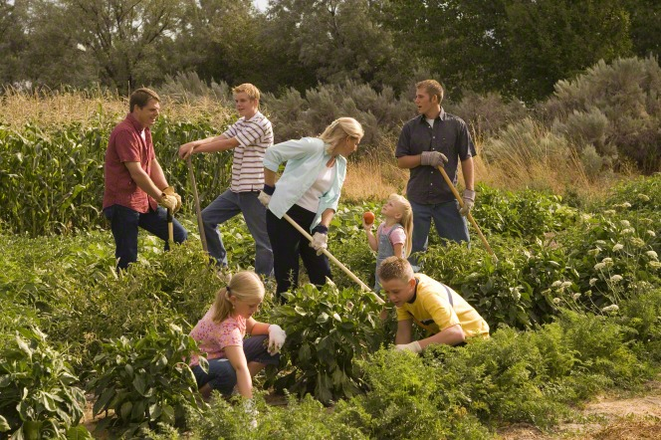
1
Image: Gospel Media Library
Notes:
Gospel Media Library. (n.d.). Working in a garden. A family of seven working in a garden. The Church of Jesus Christ of Latter-day Saints. Retrieved July 26, 2020, from https://www.churchofjesuschrist.org/media-library/images/gardening-217882?lang=eng

Slide 52
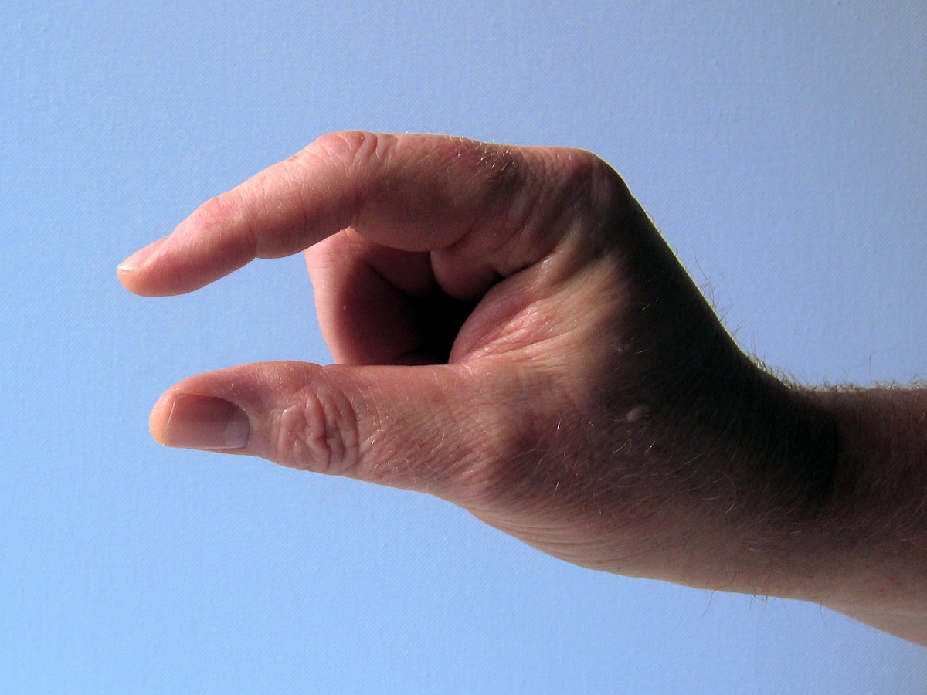
Image: Pxhere
Notes:
Pxhere. (2017, Mar. 24). Pxhere. Retrieved July 26, 2020, from https://pxhere.com/en/photo/1256274 Used under a CC0 Public Domain License. The image is released free of copyrights under Creative Commons CC0. You may download, modify, distribute, and use them royalty free for anything you like, even in commercial applications. Attribution is not required.

Slide 53
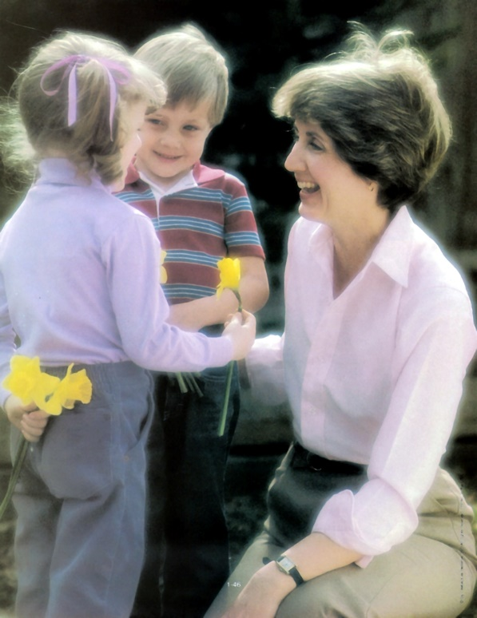
Image: The Church of Jesus Christ
Notes:
The Church of Jesus Christ. (n.d.). Mother and children. Two children give their mother a flower. Gospel Media Library. Retrieved July 26, 2020, from https://www.churchofjesuschrist.org/media-library/images/children-flowers-mother-woman-giving-479773?lang=eng

Slide 54
Image: The Church of Jesus Christ
Notes:
The Church of Jesus Christ.

Slide 55
Image: Grant Heaton
Notes:
Heaton, Grant. (n.d.). Scriptures, by Grant Heaton. Gospel Media Library. Retrieved March 31, 2020, from https://www.churchofjesuschrist.org/media-library/images/bible-and-book-of-mormon-261218?lang=eng

Slide 56

Image: The Church of Jesus Christ
Notes:
Smedley, Jelaire. (2009, Oct.). My Family Tree. The Friend: The Church of Jesus Christ of Latter-day Saints. Retrieved July 26, 2020, from https://www.churchofjesuschrist.org/study/friend/2009/10/my-family-tree?lang=eng

Slide 57
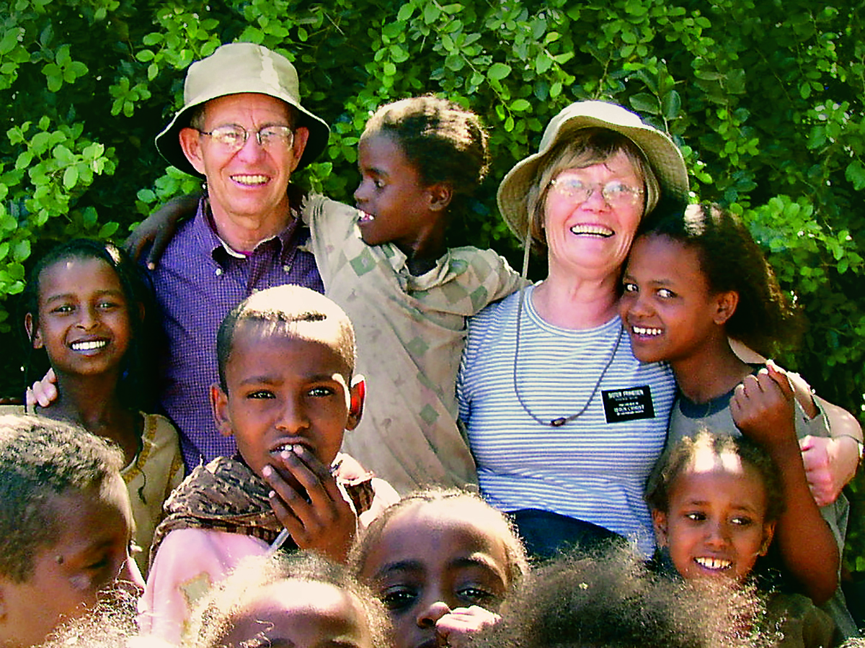
Image: The Church of Jesus Christ
Notes:
Missionaries in Ethiopia. Gospel Media Library. Retrieved March 8, 2020, from https://www.churchofjesuschrist.org/media-library/images/senior-missionaries-ethiopia-846898?lang=eng&_r=1

Slide 58

Image: H. Rudy Wherli
Notes:
Wherli, H. Rudy. (2016, Oct. 7). Shining Moment: The Blessings of Keeping a Journal. Church News. Retrieved July 26, 2020, from https://www.churchofjesuschrist.org/church/news/shining-moment-the-blessings-of-keeping-a-journal?lang=eng

Slide 59

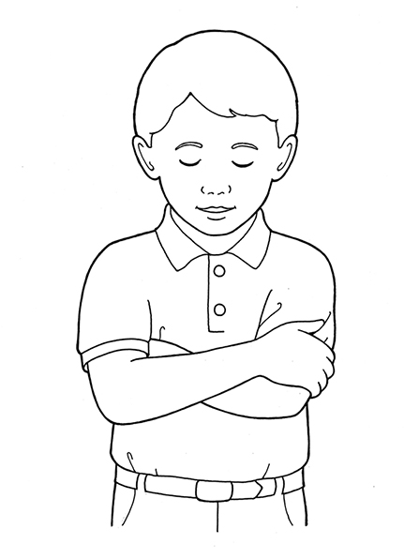
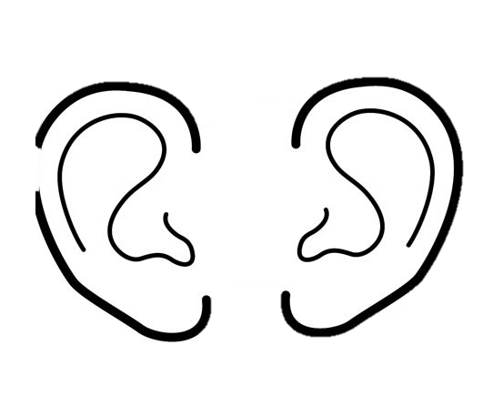



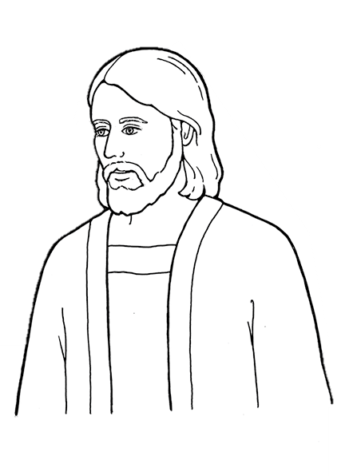


To hear Him, we must:
stop look listen learn

Slide 60
“…do not let us be slothful because of the easiness of the way…take care of these sacred things, yea, see that ye look to God and live” (Alma 37:47-48)

Slide 61

Peace in Christ
https://youtu.be/1Uy28G4U4yw
Video: Dawn S.
Notes:
LDS Scriptures. (2019, Sept. 29). Facebook. Retrieved March 21, 2020, from https://www.facebook.com/LDSScriptures/posts/i-made-a-printable-for-children-youth-and-adults-for-the-new-children-and-youth-/10162215806570257/
S., Dawn. (2018, Mar. 5). Peace in Christ- 2018 Youth Theme for the Church of Jesus Christ of Latter-Day Saints. YouTube. Retrieved July 26, 2020, from https://youtu.be/1Uy28G4U4yw

